Slide 1
PATHFINDING VISUALIZER
BY-
Rishi Dinesh (19BAI1009)
Pranav Balaji (19BAI1151)
Sruthi Srinivasan (19BAI1046)

Slide 2
ABSTRACT
The goal of this project is to build an application that helps visualize the various pathfinding algorithms as they seek to find the shortest path between two points. Through visualization, the user can cross compare the efficiency of these algorithms as they run simultaneously.
Two maze generation algorithms- Recursive division and DFS maze will be used to generate the maze. This application will implement 4 major algorithms for visualization: The A* algorithm, the Dijkstra algorithm, the BFS(breadth first search) and DFS(depth first search) algorithms.
The efficiency of the four algorithms can be compared based on metrics such as time taken, number of cells considered, cost of path and reachability.

Slide 3
ALGORITHMS
This application will implement 4 major algorithms for visualization:
A* algorithm
Dijkstra algorithm
BFS(breadth first search)
DFS(depth first search) algorithms.

Slide 4
A* SEARCH ALGORITHM
A* is a computer algorithm that is widely used in pathfinding and graph traversal. The algorithm efficiently plots a walkable path between multiple nodes, or points, on the graph.
It uses the sum of 'cost' (distance from source to the current node, defined by g(x)) as well as 'heuristic' (estimated distance from current node to destination, defined by h(x)).
The time complexity of A* depends on the heuristic. In the worst case of an unbounded search space, the number of nodes expanded is exponential in the depth of the solution (the shortest path) d: O(b^{d}), where b is the branching factor (the average number of successors per state).
The data structure typically used in the A* search algorithm is a priority queue.

Slide 5
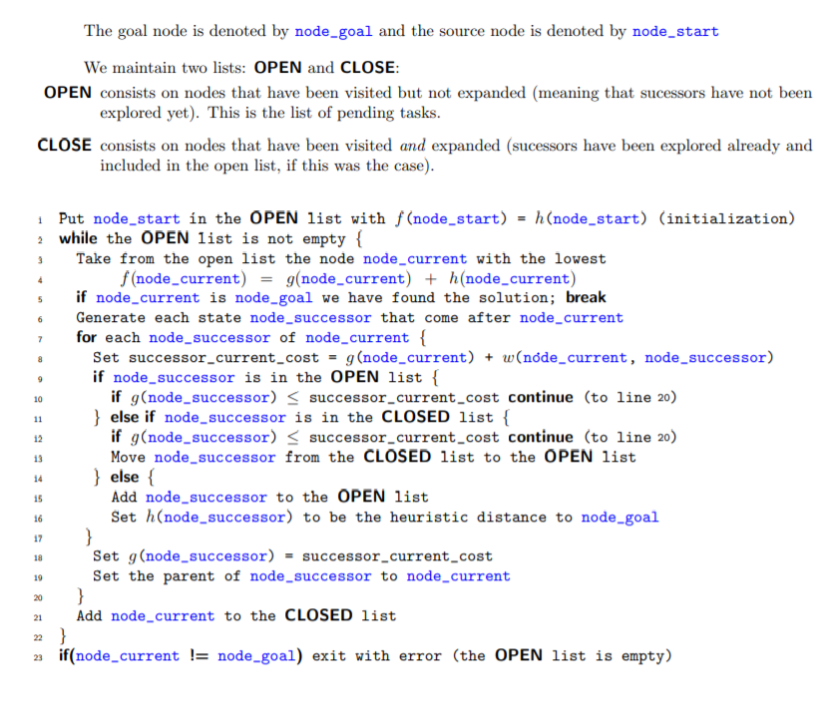
A* Search - Algorithm

Slide 6
DIJKSTRA’S ALGORITHM
Dijkstra’s Algorithm is a very widely known path-finding and graph-traversal algorithm. The algorithm has multiple variants - including source-to-destination plotting and source-to-nodes plotting (the latter creating a shortest-path tree).
It keeps track of visited and unvisited nodes, checks for the next unvisited node with the minimum distance of traversal and progressively builds on that till it reaches the target node (if it exists) or the queue becomes empty (unbounded).
Internally, it uses a Minimum-Priority Queue (combined with Heap for optimization) for figuring out the minimum heuristic traversal node.
This results in a time complexity of Θ((|V| + |E|)log(|V|)), where |V| is the number of nodes and |E| is the number of edges connecting the nodes. However, this algorithm can also be implemented in Θ(|V|²) using arrays.

Slide 7
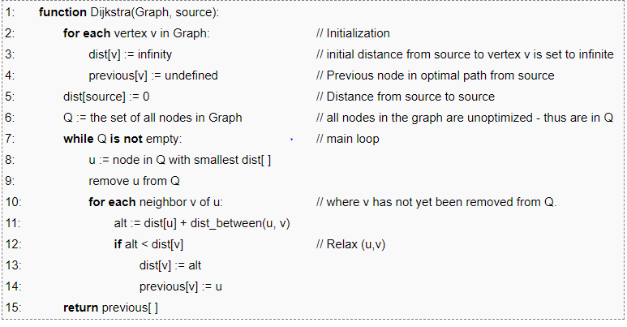
DIJKSTRA - Algorithm

Slide 8
BREADTH FIRST SEARCH
The Breadth First Search (BFS) traversal is an algorithm, which is used to visit all of the nodes of a given graph. In this traversal algorithm one node is selected and then all of the adjacent nodes are visited one by one.
After completing all of the adjacent vertices, it moves further to check another vertex and checks its adjacent vertices again.
The time complexity of BFS is O(V + E) when Adjacency List is used and O(V^2) when Adjacency Matrix is used, where V stands for vertices and E stands for edges.
The data structure used by the BFS algorithm is a queue.

Slide 9
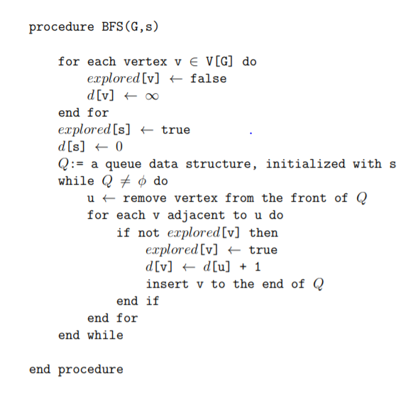
Breadth First Search – Algorithm

Slide 10
DEPTH FIRST SEARCH
Depth first search (DFS) algorithm starts with the initial node of the graph G, and then goes deeper and deeper until we find the goal node or the node which has no children.
The algorithm, then backtracks from the dead end towards the most recent node that is yet to be completely unexplored. The process is similar to the BFS algorithm.
In DFS, the edges that lead to an unvisited node are called discovery edges while the edges that lead to an already visited node are called block edges.
The time complexity of DFS is O(V + E), where V is the number of vertices and E is the number of edges in the graph.
The data structure which is being used in DFS is stack.

Slide 11
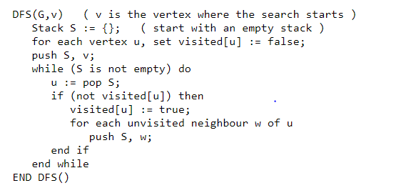
Depth First Search – Algorithm

Slide 12
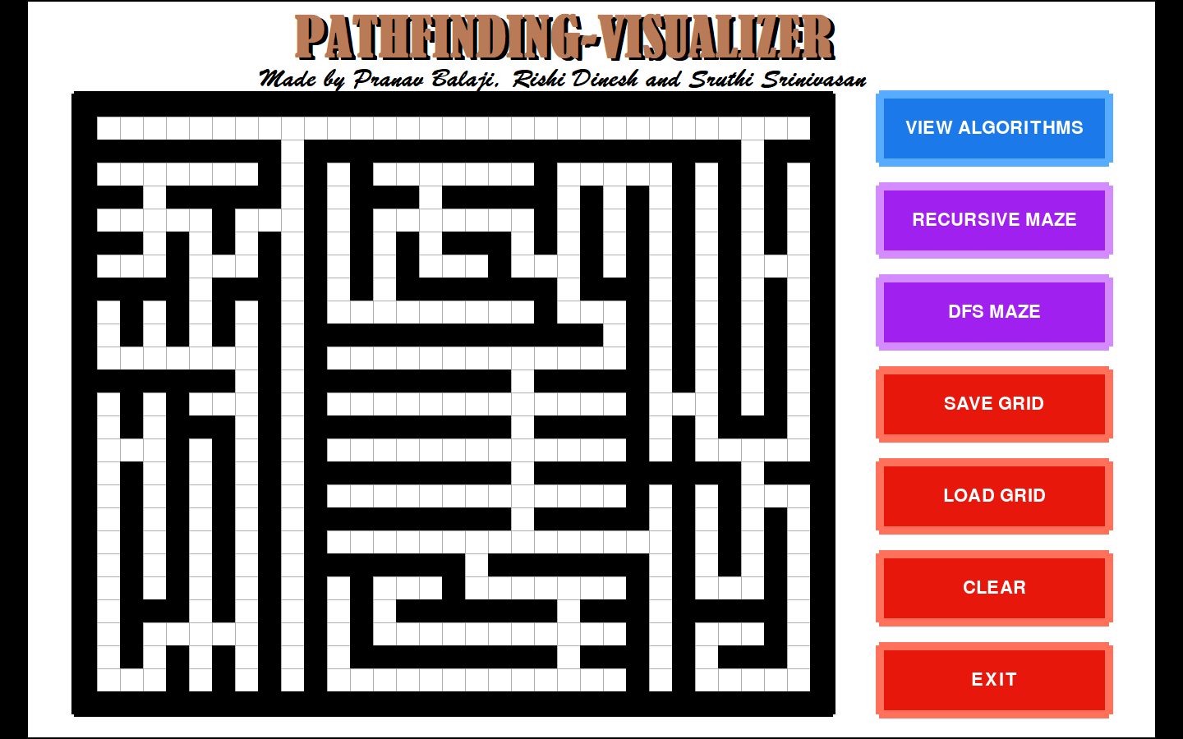
RECURSIVE DIVISION MAZE

Slide 13
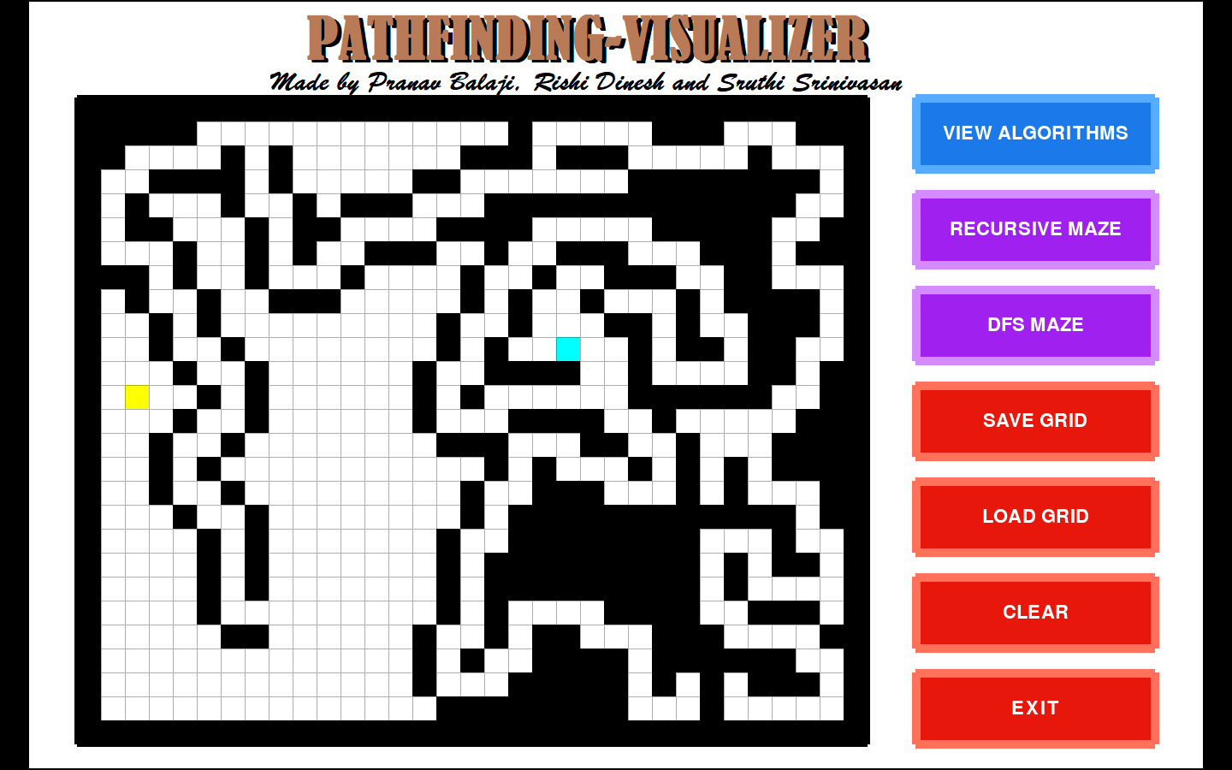
DEPTH FIRST SEARCH MAZE

Slide 14
Maze Generating Algorithms
RECURSIVE DIVISION
Step 1: Begin with an empty field.
Step 2: Bisect the field with a wall, either horizontally or vertically. Add a single passage through the wall.
Step 3: Repeat step 2 with the areas on either side of the wall.
Step 4: Continue, recursively, until the maze reaches the desired resolution.
DEPTH FIRST SEARCH
Step 1: Randomly select a node (or cell) N.
Step 2: Push the node N onto a stack S.
Step 3: Mark the cell N as visited.
Step 4: Randomly select an adjacent cell A of node N that has not been visited.
Step 5: If all the neighbours of N have been visited, continue to pop items off the stack S until a node is encountered with at least one non-visited neighbour - assign this node to N and go to step 4. Otherwise, if no nodes exist, stop.
Step 6: Break the wall between N and A.
Step 7: Assign the value A to N.
Step 8: Go to step 2.

Slide 15
INPUT AND OUTPUT
The interface is designed as a (m x n) grid. The user is expected to supply the starting position, the ending position and subsequent ‘walls’ that impede movement and generates a maze.
It uses a simple ‘click-to-place-block’ technique. In addition to the manual maze-creation, there is also an option to generate random mazes with varying difficulties. The user can then click on the ‘visualize’ button to visualize the path-solving process using different algorithms.
The visualization shows different parts of the computation processes - the current node in consideration and the next possible node candidates - all using different and appealing color schemes. Various parameters like the time taken for computation, distance covered, will be dynamically updated on the respective panes.
The four algorithms are made to run in parallel (in four sections on the same window), so that the user gets an idea of how progressive each algorithm is in comparison with others.

Slide 16
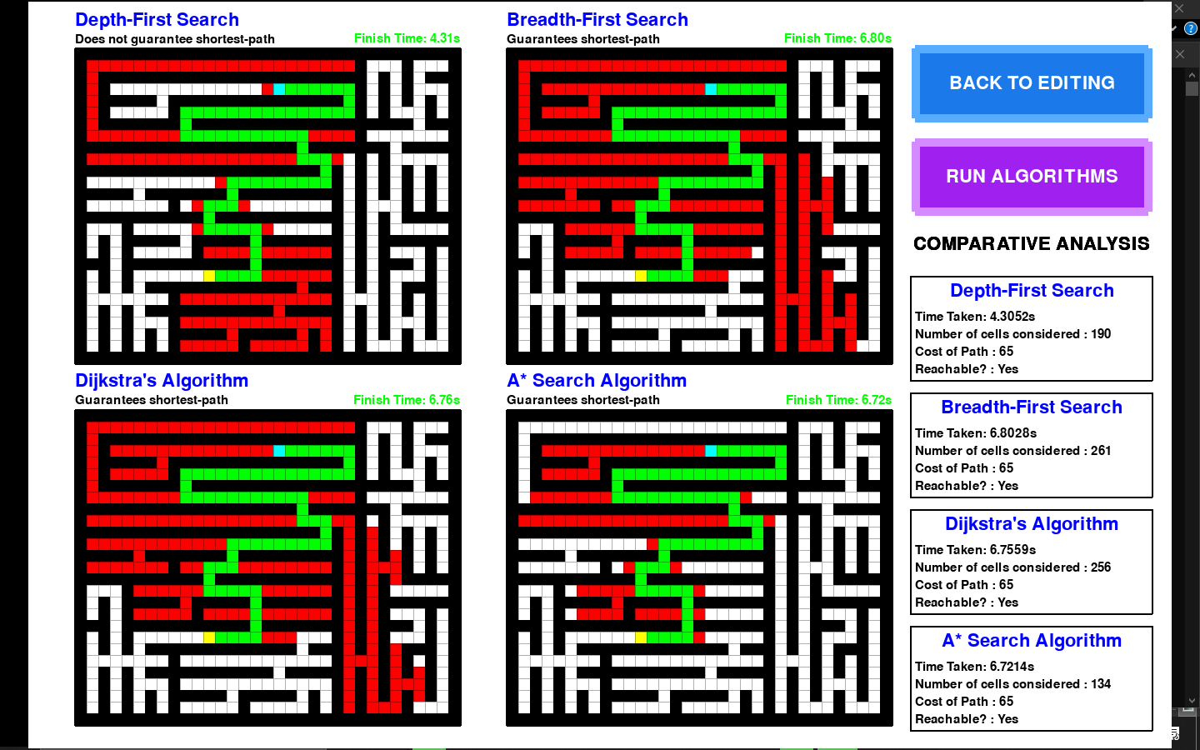
SAMPLE OUTPUT

Slide 17
SCOPE
This visualization tool is designed to be mainly used to compare the working efficiency of different pathfinding algorithms in different scenarios. All the algorithms used in this application are adapted for a 2D grid where 90 degree turns and movement from one node to another both have a “cost” of 1. Hence this application can be extended to include variable costs and visualize more algorithms both in 2D and 3D settings.

Slide 18
REVIEW COMMENTS
COMMENT 1: “How is your project different from the other projects based on pathfinding algorithms?”
Response: Our project is primarily a visualization tool that cross compares the efficiency of different pathfinding algorithms simultaneously in different user defined settings. Unlike the other projects, this project is a generic application as the maze designed by the user can represent anything from city roads to a computer network.
COMMENT 2: “Can you write a review paper on your project?”
Response: Yes, if time permits after completion of the project.

