Slide 1




Deep Explainable Relational Reinforcement Learning: A Neuro-Symbolic Approach
Rishi Hazra
Luc De Raedt
Notes:
Hi everyone, thanks for attending the presentation. I’m Rishi and I’ll be presenting our paper titled <>. It’s coauthored with my advisor Luc De Raedt.

Slide 2
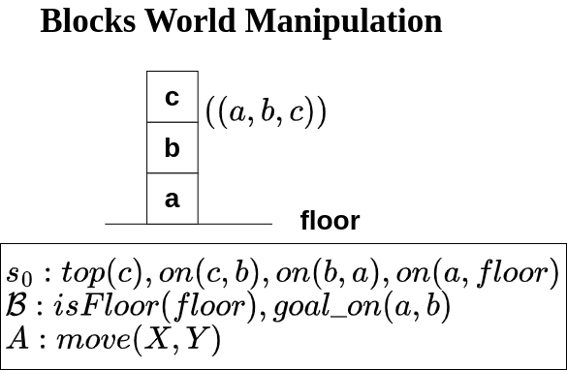
Let’s start with a simple example.
Notes:
To motivate this work, let’s looks at this simple blocksworld manipulation example. Here the blocks are placed in stacks and the goal is to put a specified block on top of another specified block. The inputs are symbolic and includes an initial state, perhaps some (predefined) background information and the action move(X,Y).

Slide 3
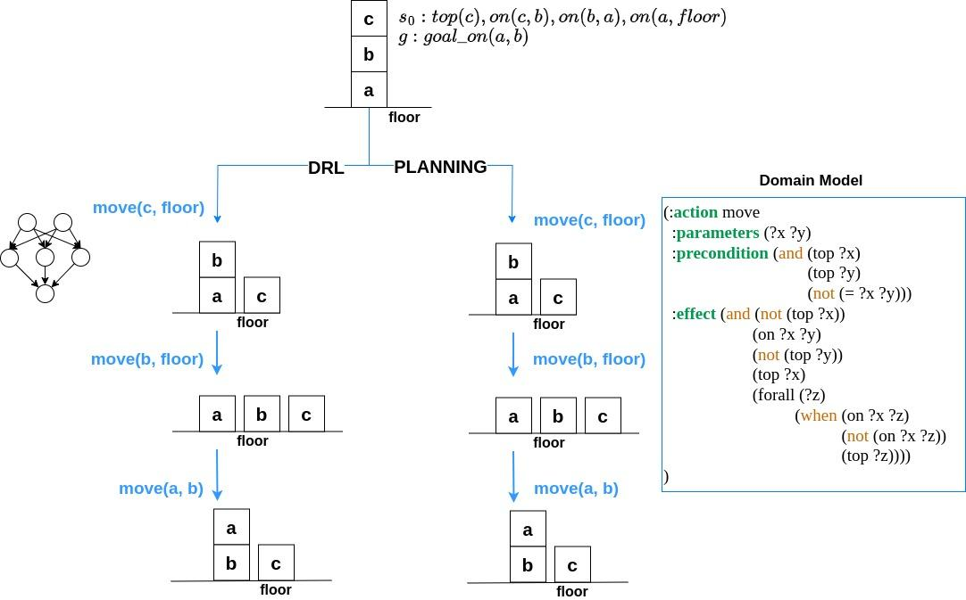
Notes:
Given a goal to place block a on top of block b …. How do we go about solving it?

Slide 4
Explainable
Generalizable
Domain model requirement
Robustness to noise
Notes:
The first way is to train a Deep Reinforcement Learning module and use the learned policy to output actions. Here you can see the actions are to
Move block c to the floor.
Then, move b to the floor
Finally, to move a on top of b which is our goal So, DRL can indeed learn to do this given sufficient data. However, there are some issues with Deep Reinforcement Learning: <Define issues>

Slide 5
Explainable
Generalizable
Domain model requirement
Robustness to noise
Explainable
Generalizable
Domain model requirement
Robustness to noise
Notes:
The other way is to use Symbolic Planning. Now, for symbolic planning, you have to predefine a domain model which includes action precondition and postconditions as shown here. Given the domain model, the planning algorithm finds an optimal sequence of actions to reach the goal. Here, the actions are explainable, ….

Slide 6
Explainable
Generalizable
Domain model requirement
Robustness to noise
Explainable
Generalizable
Domain model requirement
Robustness to noise
Can we combine the best of both into one framework?
Notes:
So, the motivation of our work is to combine the best of both neural and symbolic methods into a single framework.

Slide 7
We propose (DERRL)
Deep Explainable Relational Reinforcement Learning
Neural
Symbolic
Model Free RL
[1] Dzeroski, S., De Raedt, L., Blockeel, H.: Relational reinforcement Learning, ICML’98
Notes:
To this end, we introduce Deep Explainable Relations Reinforcement Learning. Quite a mouthful, right? So how about, we just call it DERRL? As you can see, we have the terms Deep and Relational in our title. Indeed, it’s a neuro-symbolic approach. It’s also a Reinforcement Learning method (or more precisely, an model-free RL approach that doesn’t require one to specify the domain model).

Slide 8
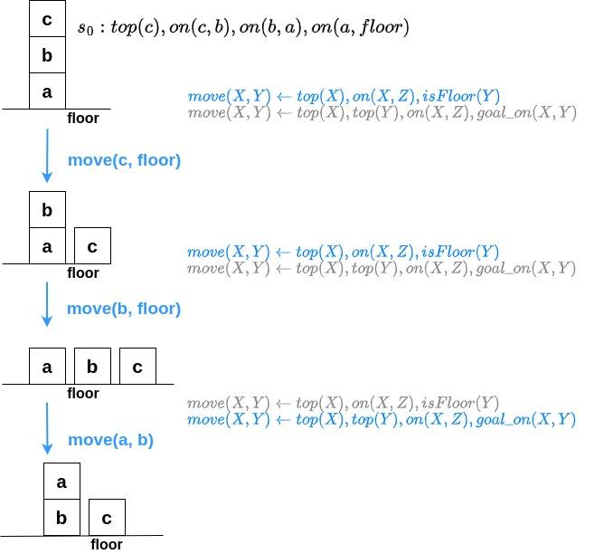
We propose (DERRL)
Deep Explainable Relational Reinforcement Learning
Action Definitions (Rules)
Head: Action
Body: Action triggering criterion
Rules are discriminative
Applicable to env modifications
[1] Dzeroski, S., De Raedt, L., Blockeel, H.: Relational reinforcement Learning, ICML’98
Notes:
This is how DERRL solves the blocksworld problem. It learns actions definitions or rules (which are discriminative). The head is the action and the body is the criterion for triggering the action. In here, there are two definitions for the same action. The first one which is <SHOW and EXPLAIN> gets triggered in the first time-step.
Note, that the same rules are applicable for a new goal (say goal_on(c, d)) or when blocks are increased to 10.

Slide 9
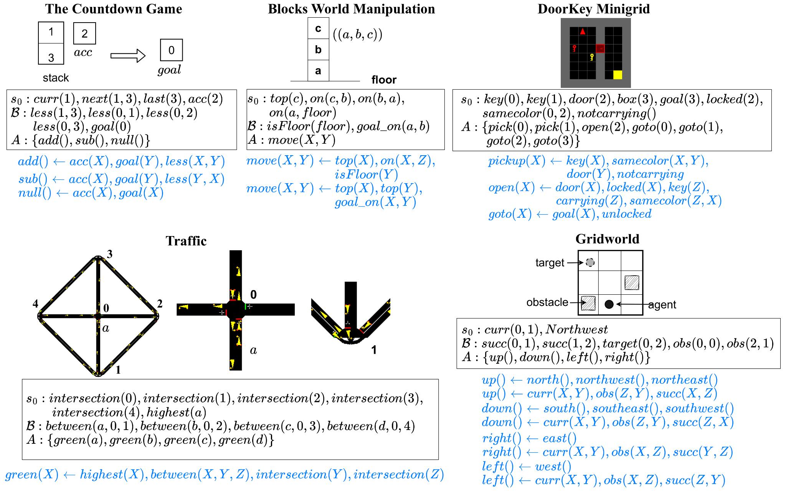
Notes:
Here’ are some other environments where we used DERRL.

Slide 10
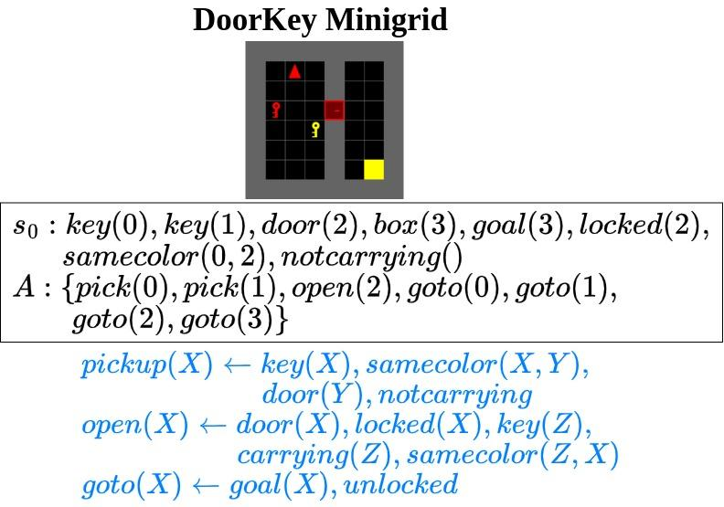
Notes:
Here’s an example from gym minigrid. Here, the agent’s task is to unlock a locked door, and reach a goal. Various colored keys are scattered throughout the room, and the agent must select the key that matches the color of the door to unlock it.
The high-level actions are defined as pickup,open and goto.
As you can see, the learned rule for pickup is <Explain the rule>.

Slide 11
DERRL: Learning Algorithm
Actions: r, s
Possible atoms
Q. What are we trying to do?
Learn membership of rule definitions
r :- p(X) p(Y) q(X,X) q(X,Y) q(Y,X) q(Y,Y)
Notes:
Now, let me provide an overview of how DERRL learns interpretable policies. Let’s say, we want to learn the action definitions for two actions r, s. The predicates are as <GIVEN AS>. This is done by a parameterized rule generation network <POINT TO IT>

Slide 12
DERRL: Learning Algorithm
Actions: r, s
Possible atoms
Q. What are we trying to do?
Learn membership of rule definitions
r :- p(X) p(Y) q(X,X) q(X,Y) q(Y,X) q(Y,Y)
r :- p(Y) q(Y,X)
Notes:
Now, let me provide an overview of how DERRL learns interpretable policies. Let’s say, we want to learn the action definitions for two actions r, s. The predicates are as <GIVEN AS>. This is done by a parameterized rule generation network <POINT TO IT>

Slide 13
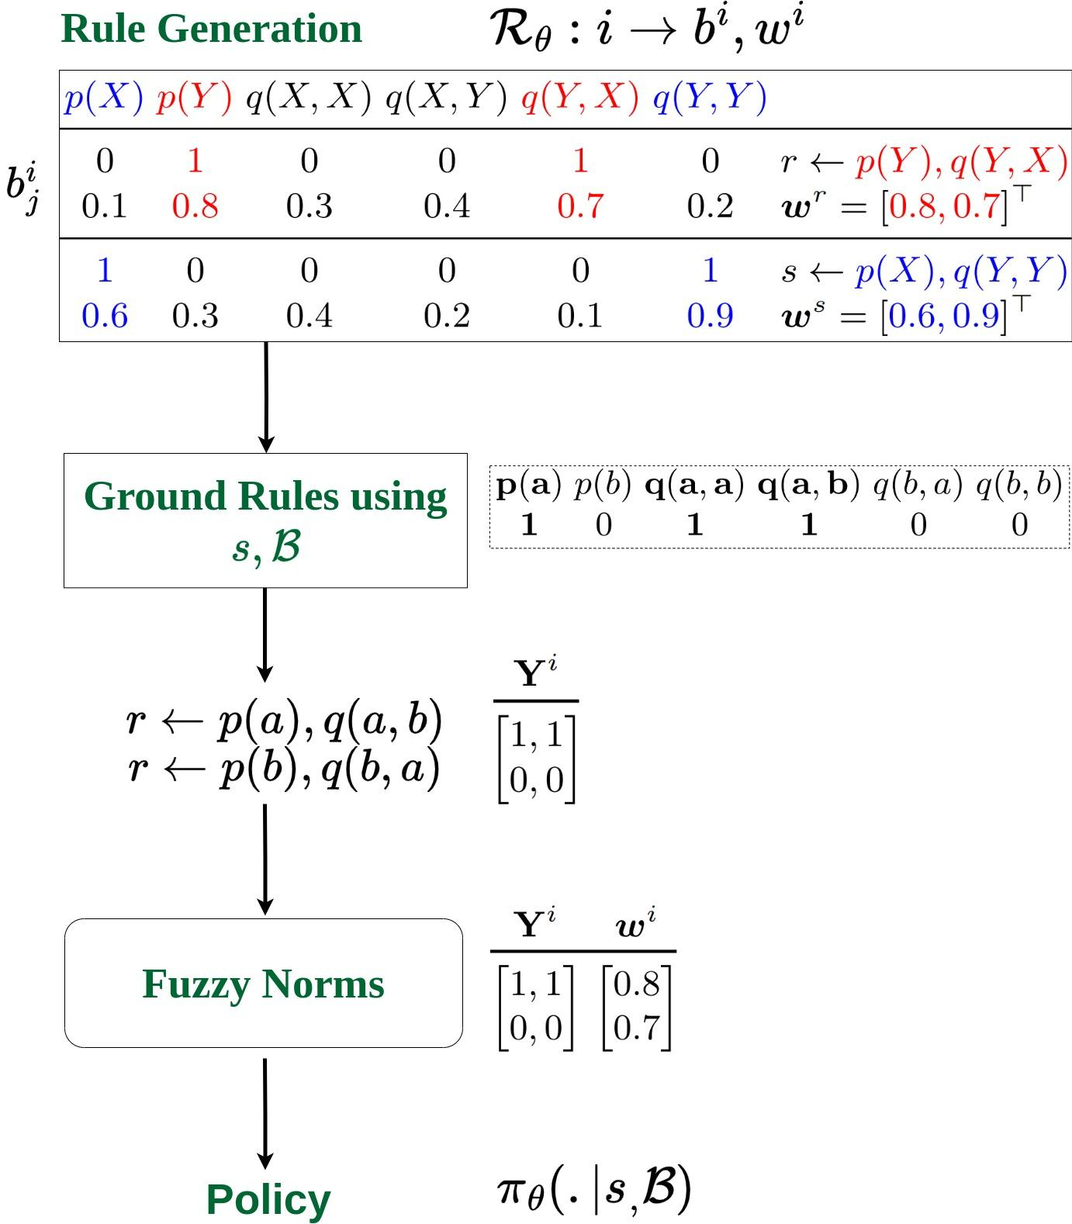
DERRL: Learning Algorithm
Actions: r, s
Possible atoms
Notes:
Here, we provide an overview of how DERRL learns interpretable policies. As stated, DERRL is end-2-end differentiable.
We start by generating a rule body for each action. This is done by a parameterized rule generation network <POINT TO IT>. This network also generates weights corresponding to each atom in the rule body <POINT TO IT> – this is akin to the probability of the atom in the rule-body.

Slide 14
DERRL: Learning Algorithm
Actions: r, s
Possible atoms
Truth values of ground atoms in s_t
Notes:
Once the rule bodies for all actions are generated, we ground them with the help of the current state and background knowledge.

Slide 15
DERRL: Learning Algorithm
Actions: r, s
Possible atoms
Truth values of ground atoms in s_t
Ground rules
Notes:
Here, the two possible groundings for the rule for action r is <POINT TO IT>.
Another way of representing this rule body is in form of a matrix wherein each row is a possible grounding and each column is a predicate in the rule body (p(a), q(aa)). The matrix entries are values of the predicate in the grounded rule body.
You can think of Y_i as the as truth values of the grounded rule. If the rule definition is not satisfied in the current state, the corresponding row vectors will have sparse entries.

Slide 16
DERRL: Learning Algorithm
Actions: r, s
Possible atoms
Truth values of ground atoms in s_t
Ground rules
r: 0.5, s: 0
Notes:
To ensure differentiability, we apply fuzzy conjunction norms to compute a probability of taking an action from the grounded rules.

Slide 17

DERRL: Semantic Loss
Possible rules ⤴ with state space.
Two types of semantic constraints:
Relations (transitive, symmetry etc.). samecolor(X,Y) :- samecolor(Y,X)
Background Facts. False :- on(X,Y), on(Y,X)
We propose a semantic loss to guide the rule search.
r :- on(X,Y), on(Y,X), …
w w
Penalize both weights
Notes:
With a larger state space, the number of possible combinations of rules increase exponentially, making it difficult for the rule generation framework to converge on the correct set of rules.
To limit the space of rules, we can use background knowledge to discard infeasible rules right from the beginning. This is done using semantic constraints. <EXPLAIN THE EXAMPLES>
For differentiable relaxation - for instance, if both on(X,Y) and on (Y,X) appear in the same rule body, we penalize the probabilities of both atoms.

Slide 18
Experimental Questions
Can DERRL learn explainable policies?
Are learned policies generalizable to environmental changes?
How efficient and scalable is DERRL compared to NLRL?
[1] Jiang, Z., Luo, S.: Neural logic reinforcement learning, ICML’19

Slide 19
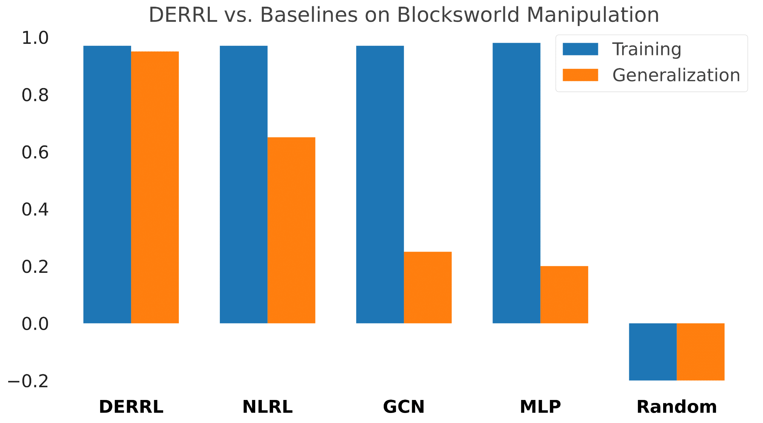
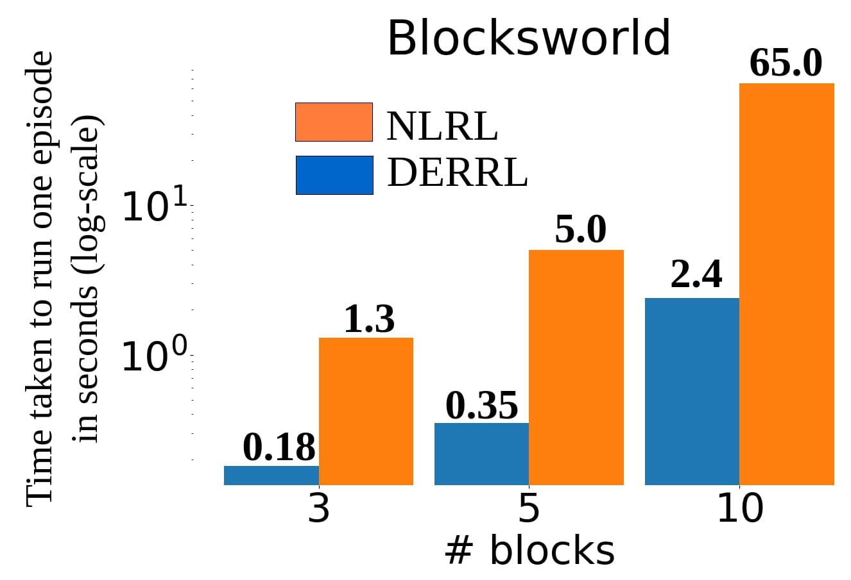
Results
 | DRL | Symbolic Planning | DERRL (Ours)
Explainable | ✗ | ✔ | ✔
Generalizable | ✗ | ✔ | ✔
Domain Model | Not required | Required | Not required
Robustness to noise | ✔ | ✗ | ✔
Notes:
We’ve already seen how DERRL learns explainable and generalizable policies.
When benchmarked against the state-of-the-art NLRL and other baselines like Graph Convolution Networks and Multi-Layered Perceptrons as shown In the first plot <Point to the 1st plot>. Here, the Y-axis represents the rewards with r=1 being the highest. We provide negative rewards for each action step to optimize the number of actions. All models exhibit strong training performance, but only DERRL maintains high adaptability in unseen scenarios. We also use a Random baseline to show the lower limit of performance.
In the second plot, we compare the time taken to run one-episode of inference (as shown in the Y-axis in seconds) for Blocksworld manipulation. As block count rises from 3 to 10, NLRL's inference time grows exponentially, highlighting DERRL's efficiency.

Slide 20
Limitations
Scaling to real-world applications.
Processing sensory data
Larger state-spaces (more variables)
Automatic learning of the required number of rules

Slide 21

Deep Explainable Relational Reinforcement Learning: A Neuro-Symbolic Approach
Thank You ! Questions.
Wanna connect? Reach out at rishi.hazra@oru.se
Look me up: rishihazra.github.io
Rishi
Luc

Slide 22
Related Works
Symbolic Planning + RL (PEORL¹, RePReL²)
High-level planner + low-level RL policies
DERRL is a model-free RL approach
Differentiable logic programming + RL (NLRL³, dNL-ILP⁴)
dNL-ILP lacks goal generalization
DERRL beats NLRL
[1] Yang et al., Peorl: Integrating symbolic planning and hierarchical reinforcement learning for robust decision-making, IJCAI’18
[2] Kokel et al., Reprel: Integrating relational planning and reinforcement learning for effective abstraction, ICAPS’21
[3] Jiang, Z., Luo, S.: Neural logic reinforcement learning, ICML’19
[4] Payani, A., Fekri, F.: Incorporating relational background knowledge into reinforcement learning via differentiable inductive logic programming

