Slide 1
NBA MVP
Creating a Predictor Model for Top MVP Candidates

Slide 2
Current MVP Voting Landscape
Media members vote for their top 5 choices and points are assigned based on rank
Factors that influence MVP voting
Individual Player Stats
Points, Assists, Rebounds, Shooting Percentages, Advanced Metrics
Team Performance
Wins, Losses, Playoffs
NBA storylines and narratives
There is always debate whether the best player statistically actually wins the MVP

Slide 3
Problem Statement
Creating an algorithm that can predict the MVP voting share and rank of NBA players based on individual statistics and team performance
Provide an analytical approach to understand who the MVP was for each season based on statistics
Understand which features correlate most highly with the MVP vote shore

Slide 4
Data
CSV files of data pulled from basketball reference
Data Used:
Per game average stats for every player going back to 1947
Advanced statistics for every player going back to 1947
Team wins/losses
MVP voting share data

Slide 5
Data Cleaning and Manipulation
Used per game stats as the base dataset
Replaced nulls with 0s for columns that were going to be used in the model
Merged in relevant advanced stats, MVP share, and team performance data
Limited data to 1980 onwards as certain stats were not tracked before then

Slide 6
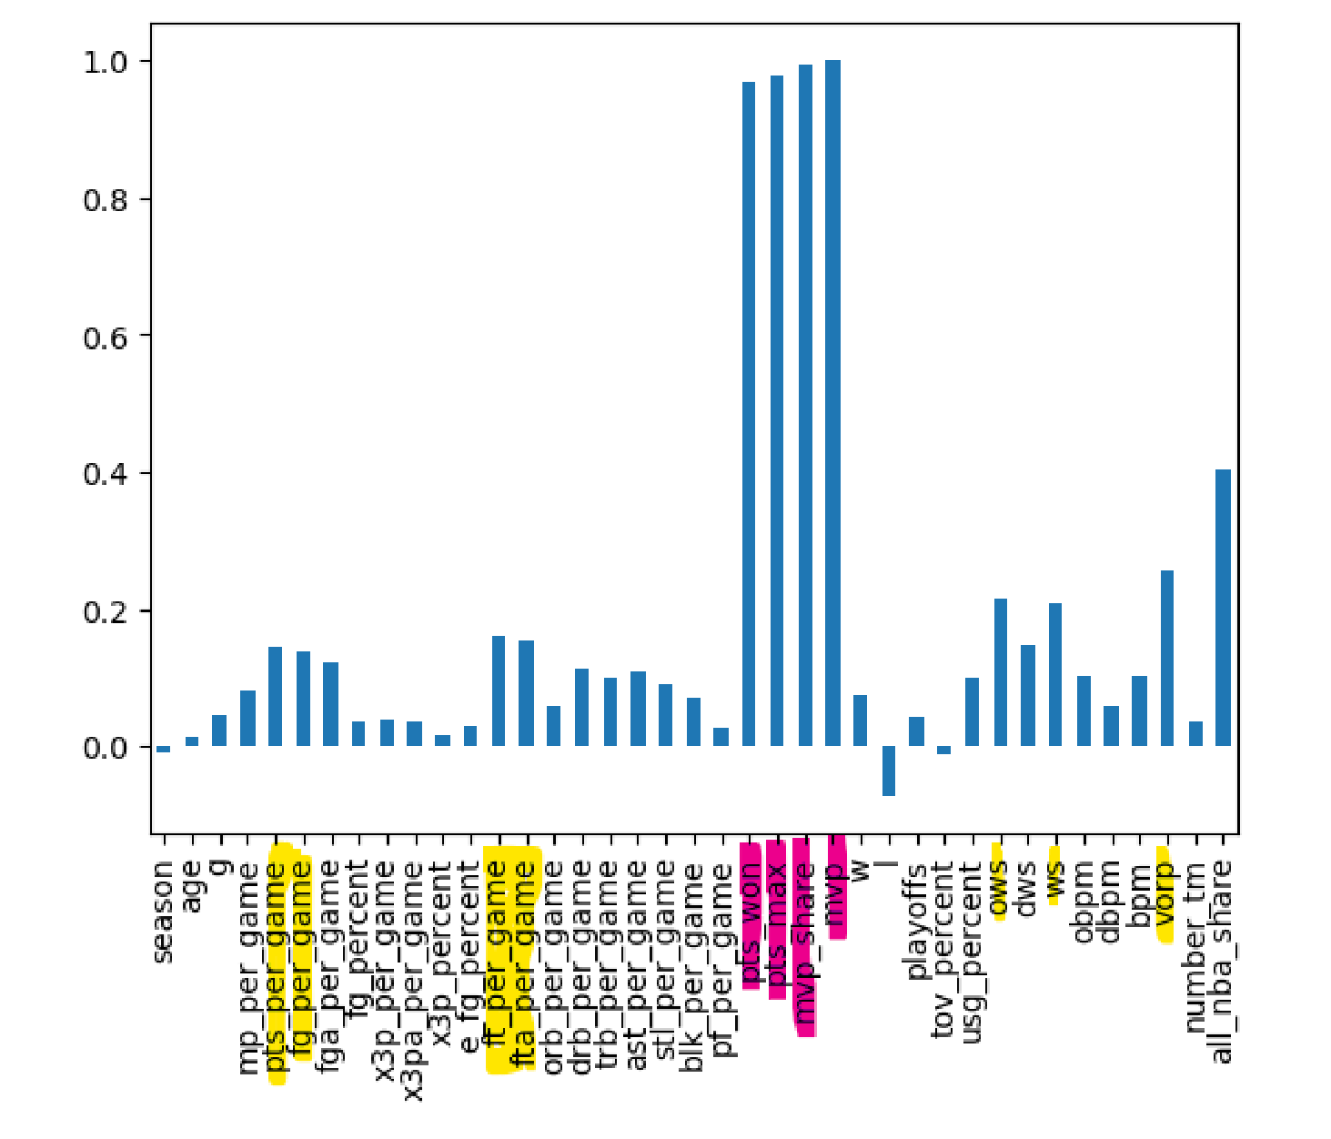
Exploratory Data Analysis
The chart shows the correlation between MVP Share and the different features we want to test
Features of Interest
Points per game
Free throws per game
Win shares
Value over replacement

Slide 7
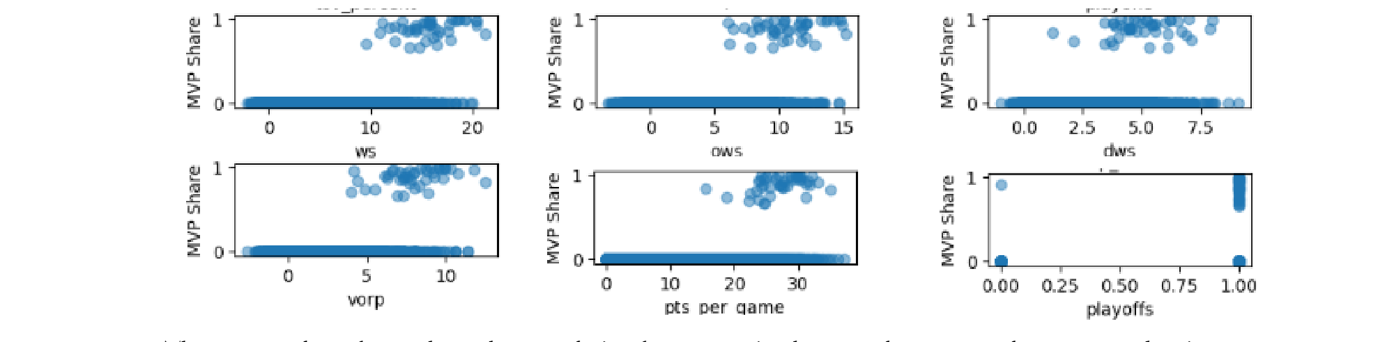
Exploratory Data Analysis
Most players who have high MVP share tend to have higher points per game averages, win shares, and VORP
Players who have a high MVP share also tend to be on teams that made the playoffs

Slide 8
Modelling
Models used for testing:
Ridge Regression
Random Forest Regressor
Created predictor variable that calculated an MVP share based on the Ridge model
Created rank variables to get actual rank and a predicted rank to compare results
Error Metrics
Check if the model got the exact rank of the player correct
Total sum of the difference between the predicted and actual rank
How many of the top 5 predicted were in the actual top 5

Slide 9
Model Results
The random forest model predicts more accurately for every metric
Neither model can predict the exact rank accurately with the current parameters
On average the model can predict the top 5 list at an accuracy of 80%
Error Metric | Ridge | Random Forest
Exact Rank | 0.88/5 (17.6%) | 1.56/5 (31.2%)
Total Difference | 9.1 | 7.2
Top 5 Correct | 75.5% | 80%

Slide 10
Conclusion
This model can be used to the understand who the most deserving MVP candidate is based on statistics and team performance
Media members who vote would be able to use this to help guide who to vote for
Fans can use this to bet on MVP finishes

