Slide 1
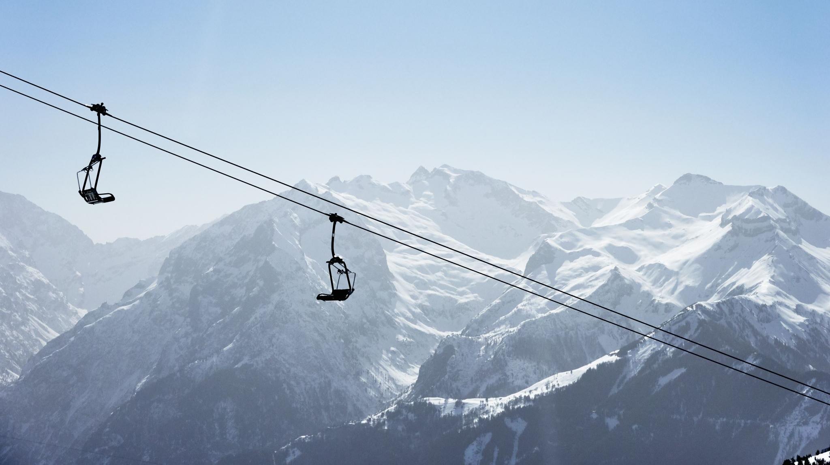
Big Mountain Ski Resort
Pricing Strategy

Slide 2
Increasing Expenses and Ticket Prices
New Chair Lift has increased costs by $1.54m
A pricing strategy needs to be determined to know how much ticket prices should be raised to cover this added expense
A comprehensive analysis must be conducted in comparison to other ski resorts across the United States to understand what mountain features most directly correlate with higher ticket prices

Slide 3
Data Analysis and Model Testing
Cleaning, scaling, and exploratory analysis of the data
Test both a linear regression and random forest model
Testing shows that the random forest model is a more accurate predictor as it is less variable and has a lower cross validation mean
Metric | Linear Regression | Random Forest
Mean Absolute Error (MAE) | 11.80 | 9.53
MAE Mean | 10.50 | 9.64
MAE STD | 1.62 | 1.35

Slide 4
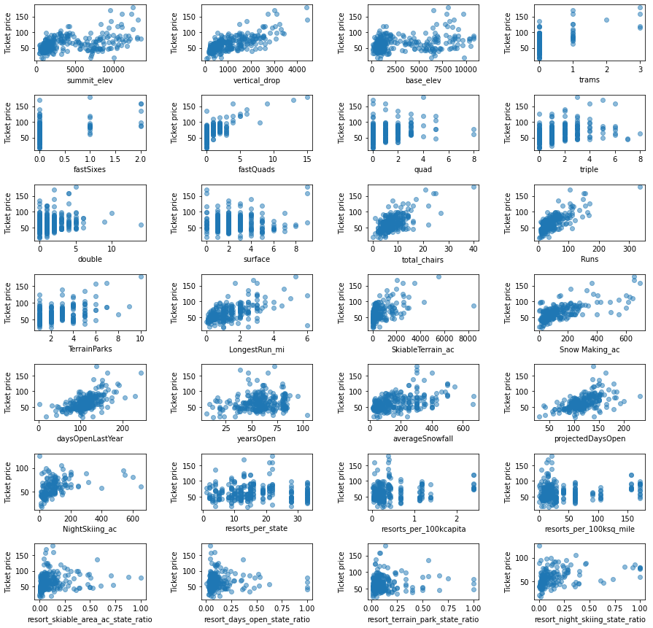
Correlation Analysis
Features of Importance
Vertical Drop
Number of Fast Quad Lifts
Total Chairs
Total Runs
Snowmaking Area

Slide 5
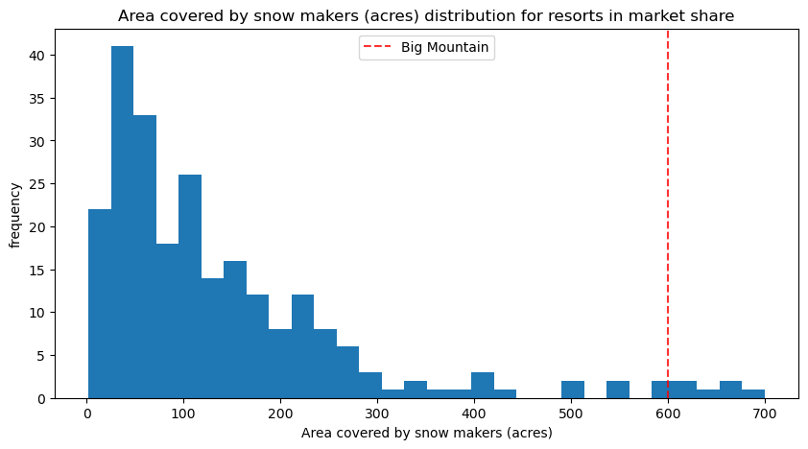
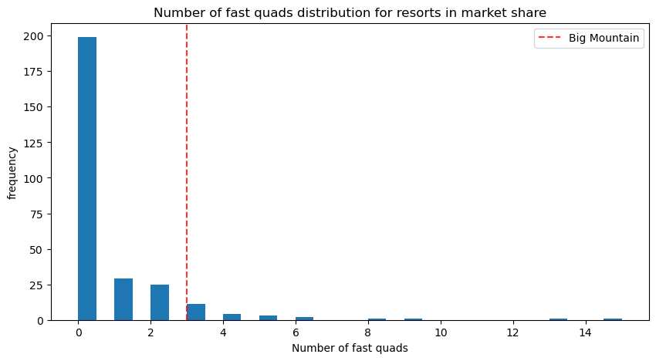
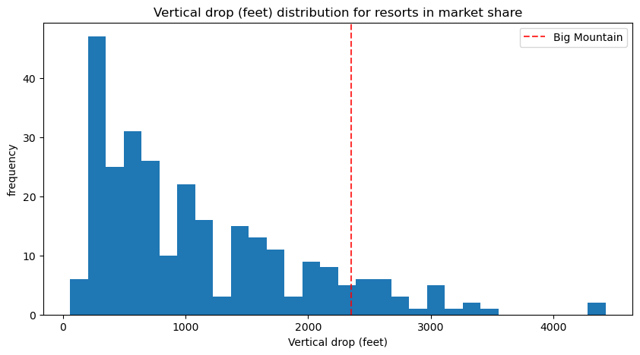
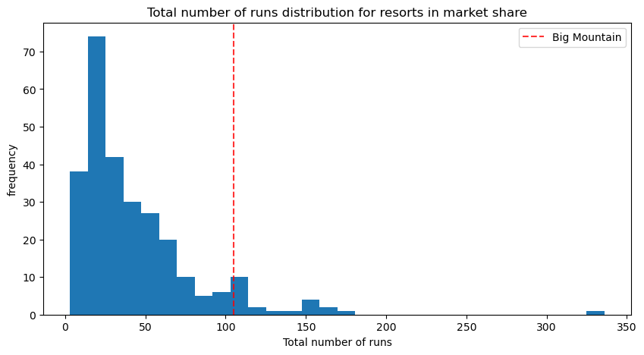
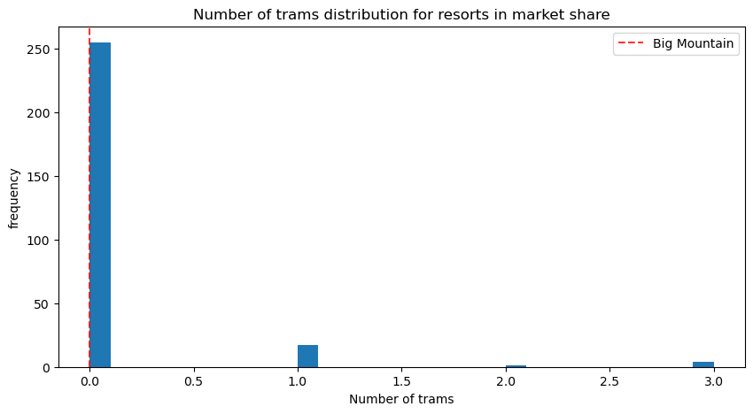
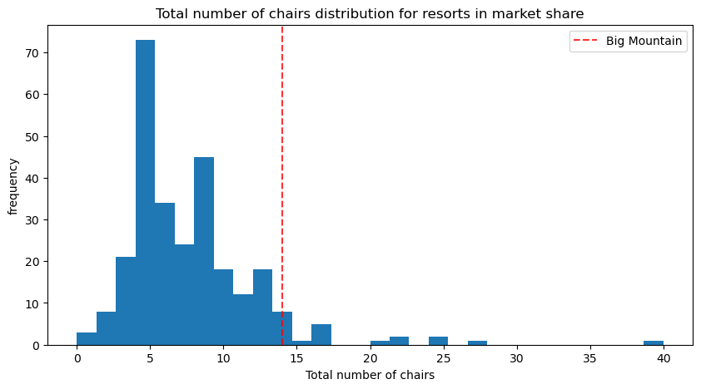
Distribution of Features of Interest
Big Mountain is on the higher end of the distribution when comparing the features of interest to other resorts in America

Slide 6
Conclusion and Scenario Testing
Permanently closing down up to 10 of the least used runs.
4-5 runs can be closed without significant impact to pricing
Increase the vertical drop by adding a run to a point 150 feet lower down but requiring the installation of an additional chair lift to bring skiers back up, without additional snow making coverage
The model suggests a $1.99 increase in ticket price
Same as number 2, but adding 2 acres of snow making cover
No impact at all
Increase the longest run by 0.2 mile to boast 3.5 miles length, requiring an additional snow making coverage of 4 acres
No impact at all

