Slide 1


Introduction to
Robotic Process Automation
AUTOMATED HOUSE FINDER
220701225
RISHI KARTHICK P
DURAIMURUGAN N
B.E CSE

Slide 2
Abstract
The "Automated House Finder" is a project designed to streamline the process of gathering real estate data using UiPath. By accepting location and email as inputs, the system extracts key property details (address, price, square footage, number of bedrooms, and bathrooms) from the Zillow website. The extracted data is structured stored in an Excel file and sent to the user via email This automation significantly reduces manual effort, enhances efficiency, and ensures timely delivery of accurate real estate information

Slide 3
Need for the Proposed System
Manual extraction of real estate data is time-consuming and prone to human errors.
A lack of automation in gathering detailed property information creates inefficiencies for businesses and individuals.
Sending the data via email ensures easy access and organization, making the process user-friendly.

Slide 4
Advantages of the Proposed System
Efficiency: Automates the repetitive task of scraping data.
Accuracy: Reduces human errors in data collection.
Convenience: Directly emails the results to the user, enhancing accessibility.
Scalability: Can easily adapt to additional data sources or user requirements.
Time-saving: Speeds up data retrieval and processing significantly.

Slide 5
Main Objective
The primary objective of the "Automated Real Estate Data Scraper" project is to create an efficient, user-friendly system that automates the collection and delivery of real estate data. By leveraging UiPath's automation capabilities, the project aims to:
  Simplify Data Acquisition: Eliminate the manual effort required to browse multiple real estate websites and extract relevant property details such as price, location, and specifications.
  Enhance Data Accuracy: Ensure reliable and error-free data extraction through automation, minimizing the risks of human oversight.
  Improve Accessibility: Provide users with property data in a structured and organized format (Excel file) delivered directly to their email inbox.
  Save Time and Effort: Significantly reduce the time spent gathering and compiling real estate information, making it particularly useful for individuals or businesses that require frequent data updates.

Slide 6
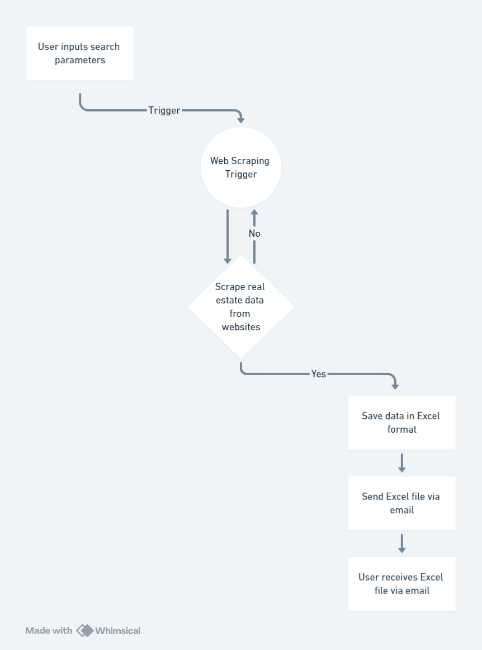
Architecture Diagram

Slide 7
System Requirements
Hardware
  Processor: Dual-core processor (2 GHz or higher).
  RAM: 4 GB or more (8 GB recommended for better performance).
  Storage: At least 10 GB of free disk space.
  Operating System: Windows 7 or higher (64-bit preferred).
  Display: 1024x768 resolution or higher.
Software
  Microsoft Excel (2016 or later) for managing input data.
  UiPath Studio (latest version recommended).

Slide 8
Functional Description
Module 1: Data Scraping Process
The scraper logs into the Zillow website navigates to the location, and extracts structured property data using UiPath's web automation features.
Module 2: Email Sending Functionality
Using UiPath's email activities, the project ensures secure and automated delivery of the property data file to the user.
Additional Functional Features:
  Scalability for Large Datasets: Handles multiple pages of property listings if the results exceed a single webpage, ensuring comprehensive data collection.

Slide 9
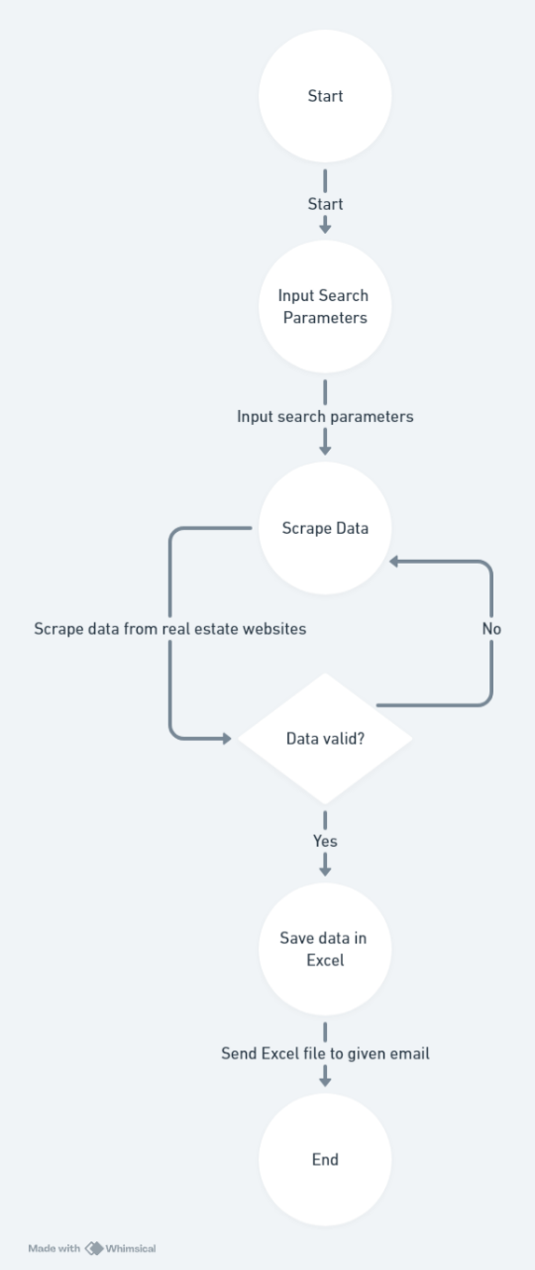
Flow Diagram

Slide 10
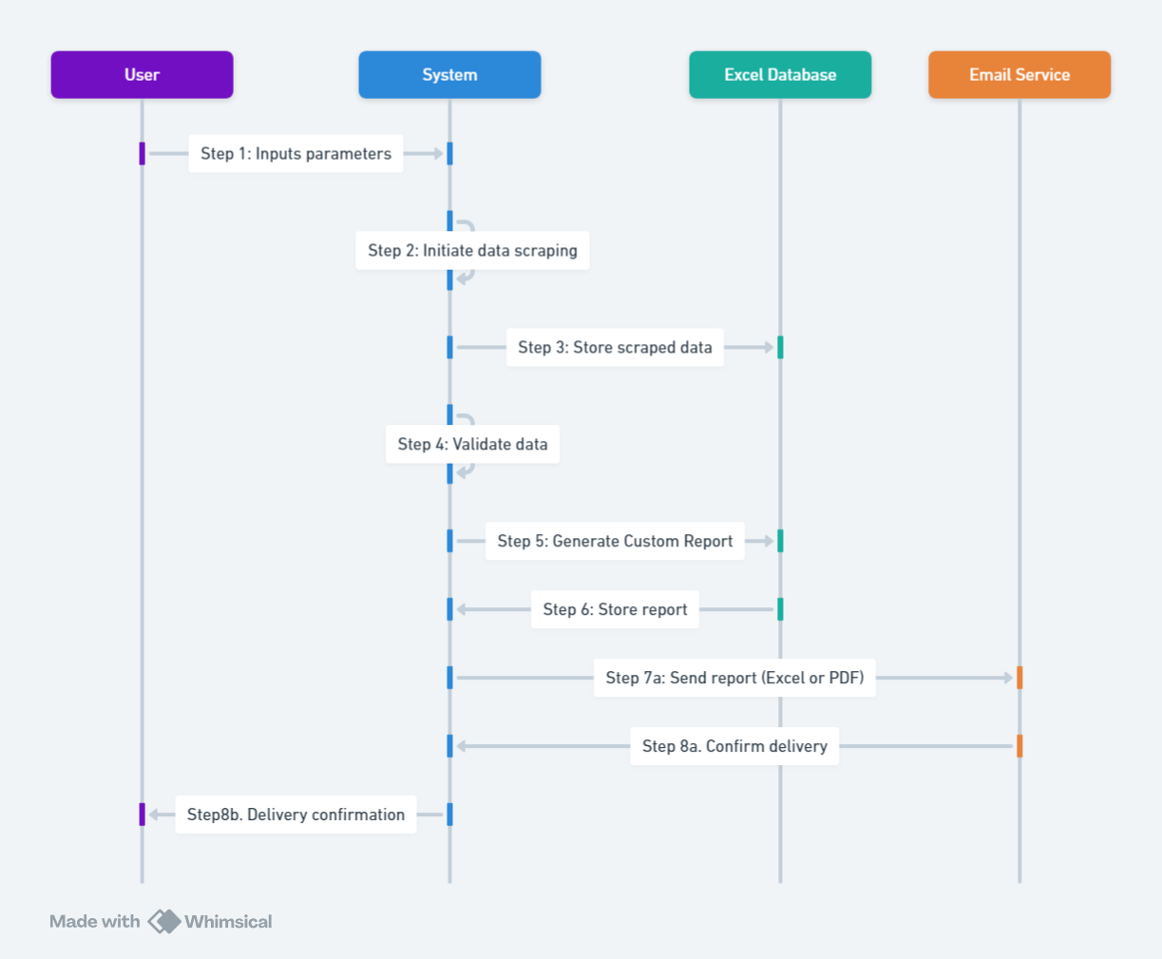
Sequence Diagram

Slide 11
Process Design
Main Process
  User Input Collection: Gather location and email from the user.
  Data Extraction: Scrape property details from Zillow.
  Data Storage: Save the data into an Excel file.
  Email Delivery: Send the Excel file to the user's email.
Sub Process
  Web Scraping:
    Access Zillow and navigate to the specified location page.
    Extract property details like address, price, square footage, and bedroom/bathroom counts.
  Data Organization:
    Format the scraped data into an Excel sheet with clear headers.
  Email Automation:
    Attach the Excel file and send it to the provided email address.

Slide 12
Implementation
The "Automated Real Estate Data Scraper" was implemented using UiPath's RPA (Robotic Process Automation) platform, leveraging its powerful automation tools for web scraping and email integration. The key steps in implementation include:
Input Collection: A user interface in UiPath captures the location and email address
Web Automation: UiPath's browser automation activities navigate the Zillow website and extract property data.
Data Storage: The extracted data is structured into an Excel file using UiPath's file handling capabilities.
Email Delivery: The system uses email automation activities to send the file to the user.

Slide 13
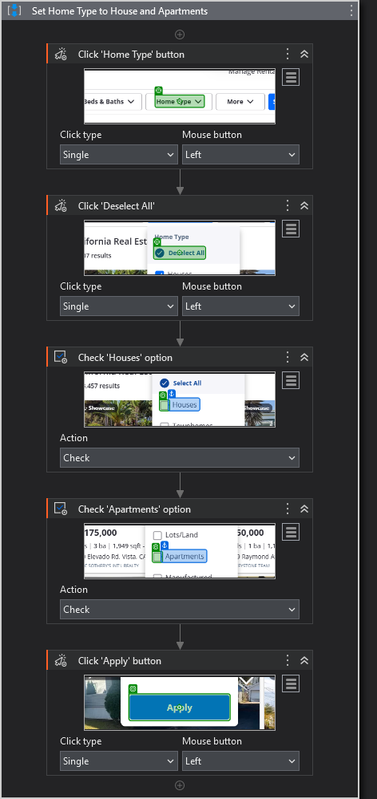
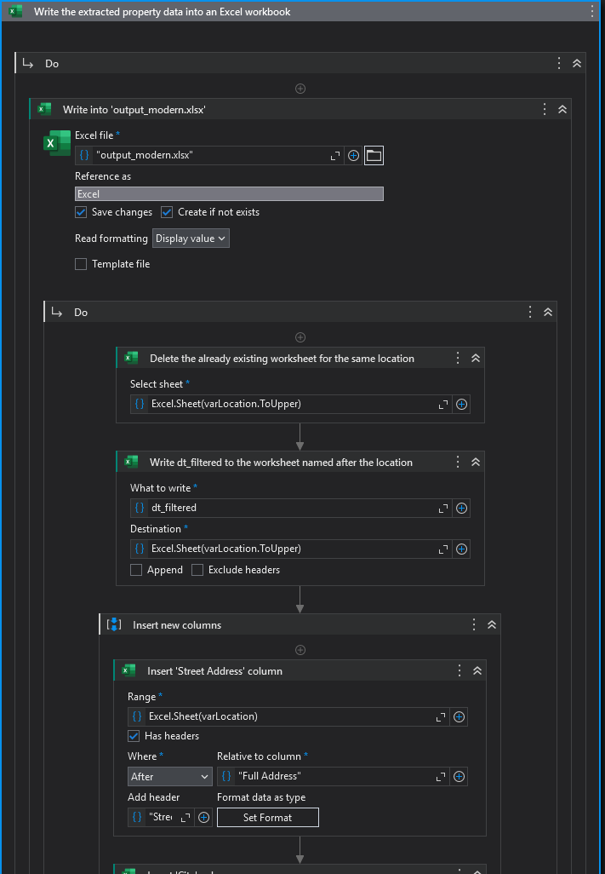
Screenshots of Workflow

Slide 14
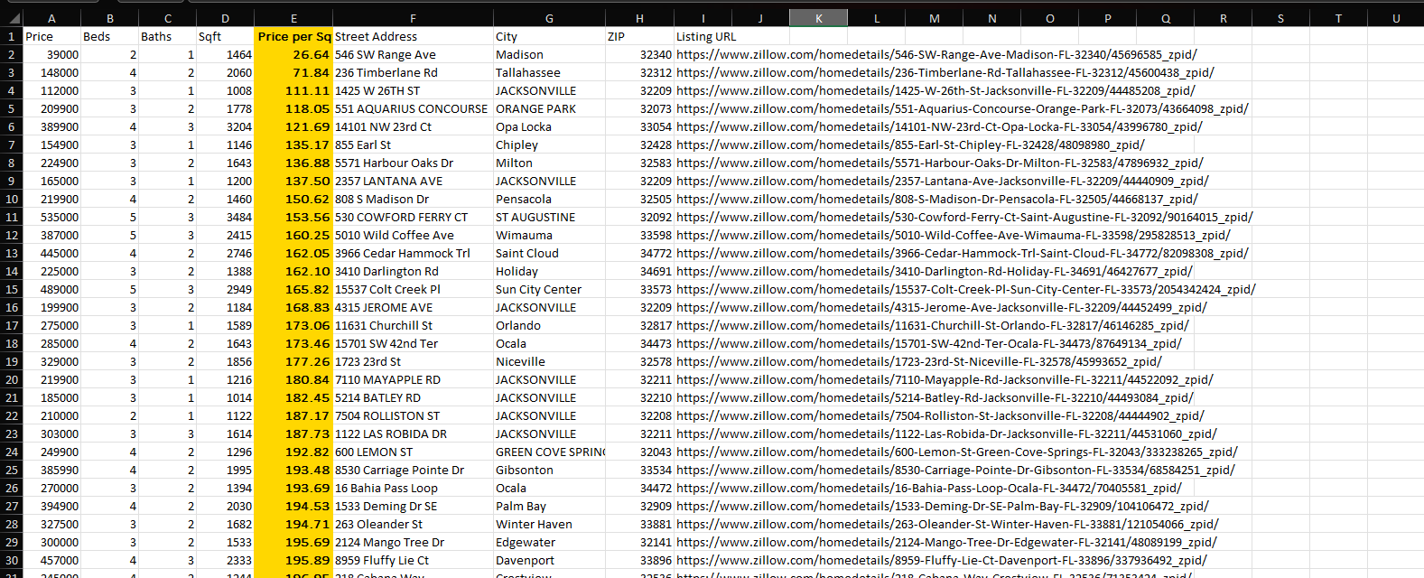
Testing
Screenshot of Excel File

Slide 15
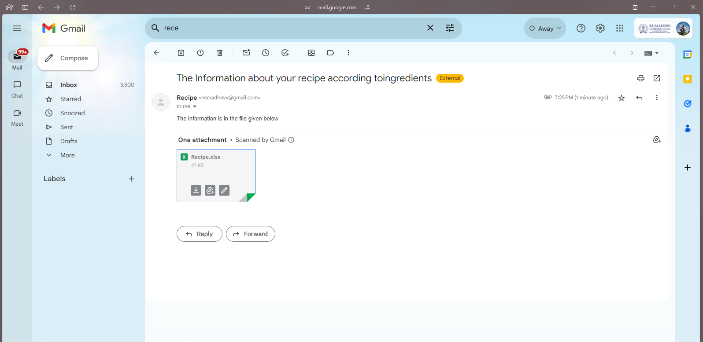
Testing
Screenshot of Mail Received

Slide 16
Conclusions
The "Automated Real Estate Data Scraper" project demonstrates the power of UiPath in automating complex tasks such as web scraping and email notifications. It significantly reduces the time and effort required to gather real estate data while improving accuracy and accessibility.

Slide 17
Future Enhancement
Integration with Multiple Real Estate Websites
  Expand the system to scrape data from multiple real estate platforms to provide users with a more comprehensive view of available properties.
  Implement a centralized database to consolidate data from different sources for easy comparison.
Advanced Data Filtering
  Add advanced filtering options, such as property type, budget range, square footage, number of bedrooms, and additional amenities, to deliver more personalized results.

Slide 18
References
Kuppusamy, Palanivel & Joseph K, Suresh. (2020). Robotic Process Automation to Smart Education. 3775.
Patil, Dr & Mane, Vinod & Patil, Dr. (2019). Social Innovation in Education System by using Robotic Process Automation (Rpa). International Journal of Innovative Technology and Exploring Engineering. 8. 3757-3760. 10.35940/ijitee.K2148.0981119.
Elkhatat, A.M., Elsaid, K. & Almeer, S. Evaluating the efficacy of AI content detection tools in differentiating between human and AI- generated text. Int J Educ Integr 19, 17 (2023). https://doi.org/10.1007/s40979-023-00140-5.
H. Alamleh, A. A. S. AlQahtani and A. ElSaid, "Distinguishing Human-Written and ChatGPT-Generated Text Using Machine Learning," 2023 Systems and Information Engineering Design Symposium (SIEDS), Charlottesville, VA, USA, 2023, pp. 154-158, doi: 10.1109/SIEDS58326.2023.10137767.
Tomáš Foltýnek, Norman Meuschke, and Bela Gipp. 2019. Academic Plagiarism Detection: A Systematic Literature Review. ACM Comput. Surv. 52, 6, Article 112 (November 2020), 42 pages. https://doi.org/10.1145/3345317
H. A. Chowdhury, D. K. Bhattacharyya, “Plagiarism: Taxonomy, Tools and Detection Techniques”, 19th National Convention on Knowledge, Library and Information Networking, 2018.

Slide 19
Queries

Slide 20
Demonstration

Slide 21
Thank You

