Slide 1
IoT Farmbeats
By Team 28

Slide 2
User Requirements
We conducted phone-call interviews…
Farmer, Age 70
1. Do current normal farmers have any kind of remote way to monitor the situation of the farm? If yes, what's that, and do you find it easy for your life? If no, what's something that you would want if possible?
We do have some remote ways to monitor the farm such as cameras, but it's only used for monitor if there's any thief or animals that may damage the plants. We would want more devices that can monitor factors in the farm such as luminosity and temperature.
2. What's the level of software operating you got?
I have a smart mobile phone but I only use it for WeChat and phone call, but my son can operate them quite well I think.
3. How do you monitor and find out the situation of growth of plants in the farm?
Basically what I used to do is to go down to the farm and see the situation by my hand and eyes.
4. How often do you monitor the situation in the farm?
At least once a day at morning.
5. What's the size of your field and how many time you would need to organize them everyday?
My land for wheat is half a MU, and there's also half a MU for corn, about quatre a MU for potato and other vegetables. (MU is a Chinese Unit of area, equal to 1/15 of a hectare or 1/6 an acre)

Slide 3
1. What is your job like? What do you do?
I am a Farm Research Scientist from the Biotechnology and Biological Sciences Research Council (BBSRC) based in Wales. I carry out experiments and fieldworks on farms to gain new insights to current farm processes and devise ways to optimise and improve them. We want to increase the yield as much as possible to ensure food sustainability. Within my company, different research scientists focus on different sectors such as soils, plants, animals, and farm produce. My focus is on soils.
1. Do you perform experiments/collect data on bigger test samples - actual farms? If not, would you be interested in being able to do so?
- I collect some data on samples but not as much as we want. I would like to streamline the process (make more efficient).
- The specific type of data includes rainfall with rain meter - to give information about possible causes of soil erosion - and soil pH with pH meter. I intend to investigate the pollution level of the soil in order to help reduce its negative impact on plant growth from the soil.
2. How do you collect the data? Do you have to travel directly to the farm to collect the data yourself?
- yes, I manually collect data, which can be a bit inconvenient since travelling from office to farm takes about an hour commute every day. I physically place down the meters in the soil and take readings whilst I am at the farm to log data in my excel spreadsheet.
3. Would you be interested in having access to data collected on the farm such as soil humidity, soil ph, luminosity, air humidity and others remotely?
I would love to have the opportunity to have an improved infrastructure on data collection method.
4. In what form would you want data to be presented to help with your job?
- a range of different visualizations from which I can choose would be useful, for example pie charts and line graphs. e.g. see how rainfall and pH varies throughout the year and see relationships between factors that may affect the state of the soil over time.
5. What other features would you like to have in such a remote system?
- Some pre-analysis of the data by trained models would help to predict costs, weather patterns, etc.
- A model that can predict characteristics of soils such as nutrient and water level based off data already collected would be very useful. By predicting the possible state of the soil in the future we can provide suggestions to farmers on how to manage their land to provide a healthier environment for their crops.
Oscer hao = Agricultural Research Scientist
Graduated from Royal Agricultural University, UK
works in Wales

Slide 4
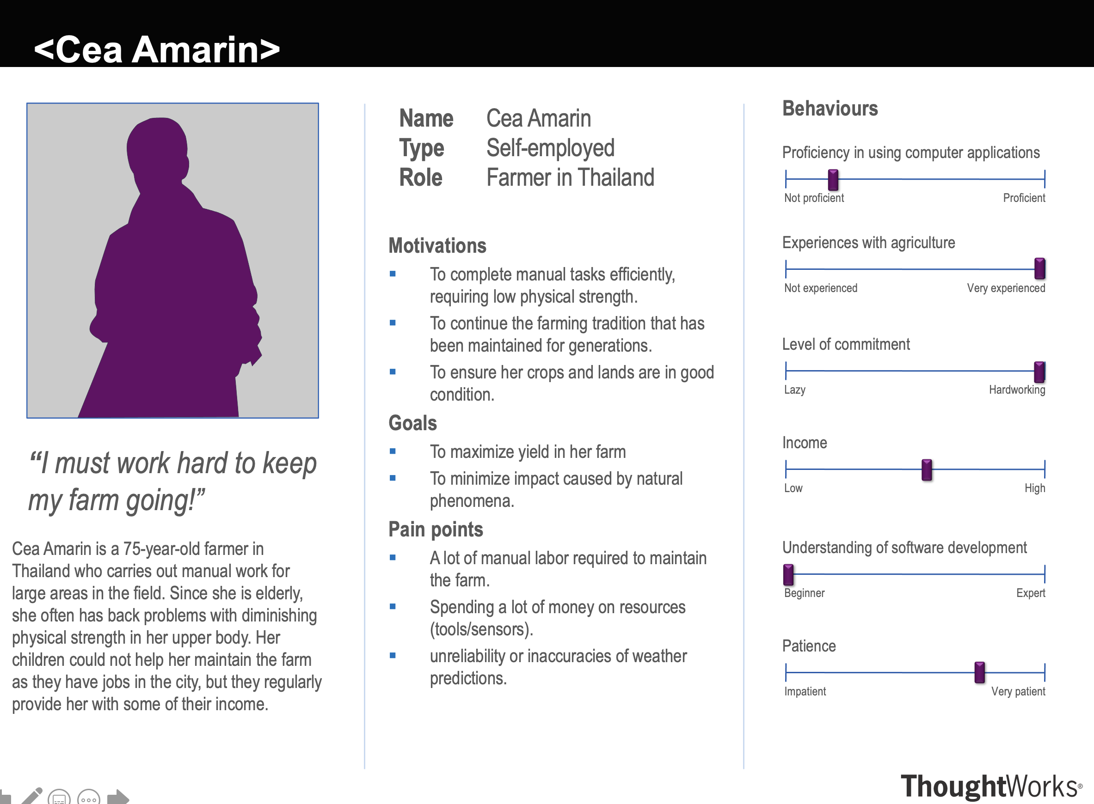
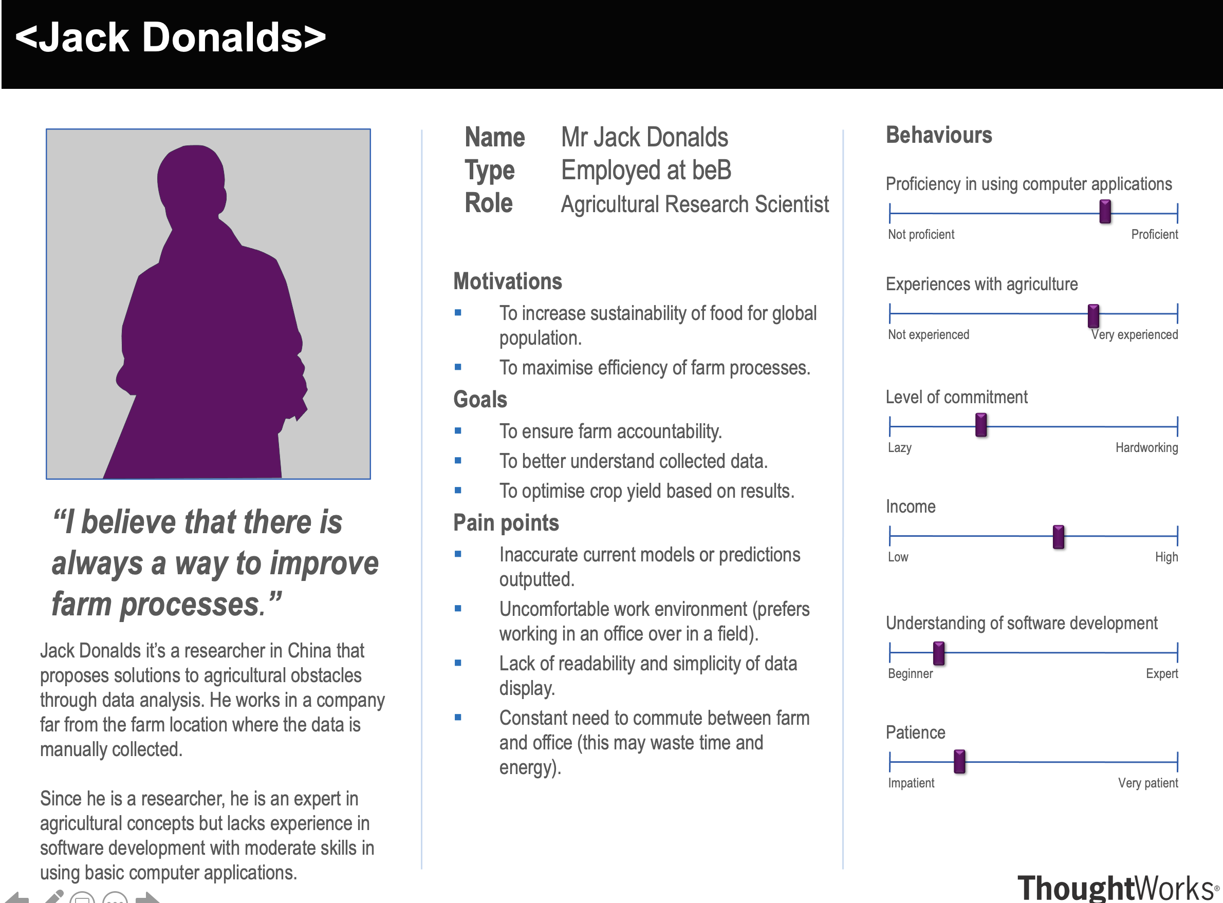
Personas

Slide 5
Refernces
https://www.environmentalscience.org/career/soil-and-plant-scientist
https://careerswales.gov.wales/job-information/agricultural-research-scientist/job-role

