Slide 1
License Plate Recognition and Text Extraction
Supervisor:
Prof. Narinder Singh Sahni
Associate Professor
SCIS, JNU - New Delhi
Presented by:
Rishi kumar Soni
PGD in Big Data Analytics
SCIS, JNU - New Delhi

Slide 2
Presentation Outline
Objective
Tools and Technology Used
Flow Chart of the Proposed Approach
Stepwise Explanation
Results
Application
Future Scope
References

Slide 3
Objective
To detect vehicle license plate and extract the plate text using openCV and EasyOCR on image based data.
Workflow:
The problem has three major steps:
Image Preprocessing: Taking an image input and removing noise using filtering techniques.
Number Plate Detection: Edge and contour detection to extract the number plate image.
Text Extraction: Application of EasyOCR library to read the number plate text.

Slide 4
Tools and Technologies Used
Two key libraries used in this project:
OpenCV: Developed by Intel, OpenCV is a cross-platform free to use library of programming functions mainly aimed at real-time computer vision.
EasyOCR: It is a ready-to-use optical character recognition(OCR) library with more than 80 supported languages and popular writing scripts including: Latin, Chinese, Arabic, Devanagari, Cyrillic, etc. It uses pytorch based deep learning network for character recognition.
Other Tools: Matplotlib, imutils and numpy are some other libraries that are used for visualizations, contour manipulation and image masking and cropping purposes respectively.

Slide 5
Flow Chart of the Proposed Approach
1
2
3
4
Taking image
input
Converting it
to grayscale
Removing noise using bilateral filter
Detecting edges
using Canny alg
Finding contours using openCV
5
Showing the result on the screen
Using EasyOCR to read the text
Applying mask on number plate
Collect contours using imutils
9
8
7
6

Slide 6
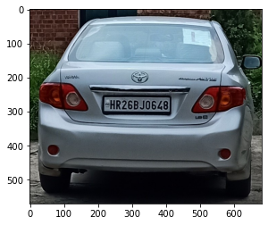
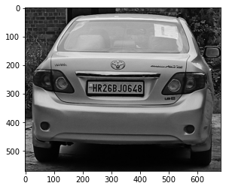

Step 1: Reading and Preprocessing Image
Read an input image
Convert into grayscale image
Remove noise using bilateral filter

Slide 7
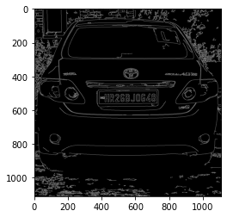
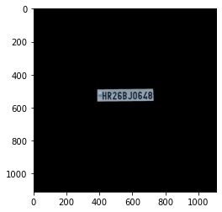
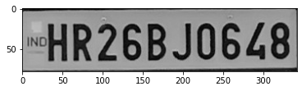
Step 2: Plate Detection and Masking
Use Canny alg for edge detection
Detect plate contour using findContours
Apply mask and crop the plate area using numpy

Slide 8
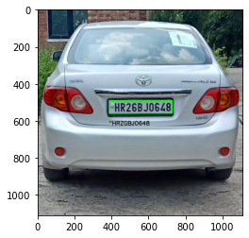
Output and Rendering
Read the number plate using EasyOCR’s readertext
Render the result on the input image

Slide 9
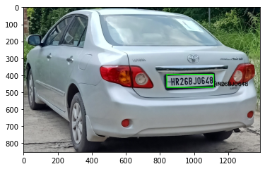
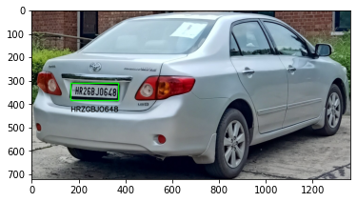
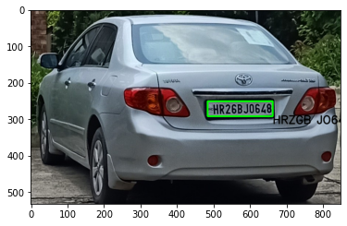
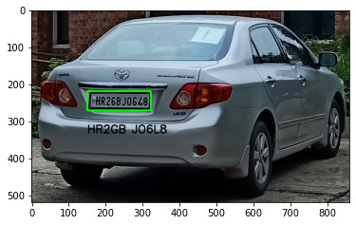
Result
The following images are taken at a particular sunny day around 1pm in different angles.
'HR26BJO648'
'HRZGBJO648'
'HRZGB JO648'
'HR2GB JO6L8'

Slide 10
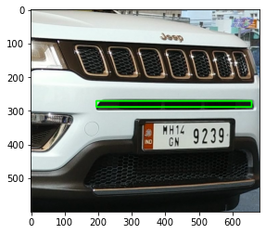
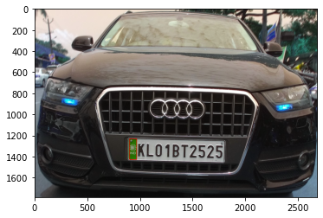
Results
Mistake in plate contour detection

Slide 11
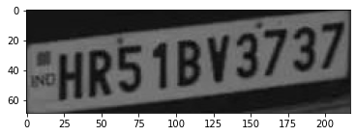
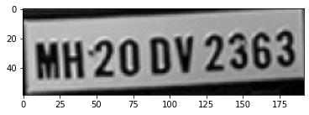
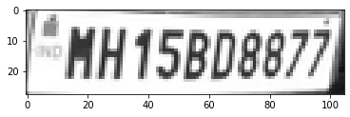
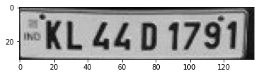
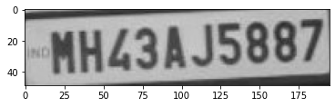
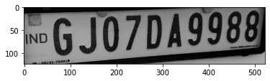
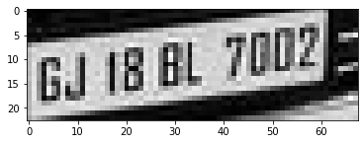
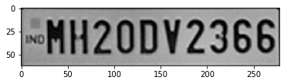
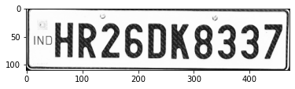
Results
HRS1BY3737
MH20 DV2363
HH15BD8877
KL LLD 1791
MHL3AJ5887
6J07049988
GJ IB BL 700Z
GJ IB BL 700Z
HRZGDK8337

Slide 12
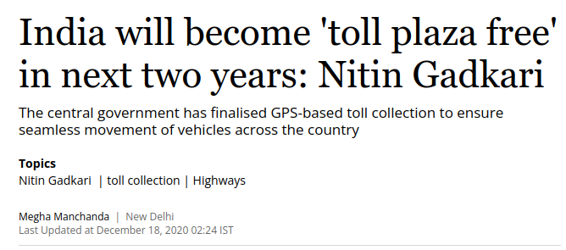
Application
This model can be used in the below fields:
To automate token system at JNU entrance
Toll plaza free highway system
Traffic analysis during peak hours
To enhance the vehicle theft protection
Security monitoring at borders and checkpoints
Automation at airport and harbour logistics
Smart car parking
Vehicle surveillance - Prevention of non-payment at gas stations, drive-in restaurant

Slide 13
Discussion & Future Scope
There are multiple things in this model which can be improved. Some of these points are pointed below:
Use ML for better number plate localization
OCR Accuracy Improvement using Neural Network
Model improvement at different angles and light conditions
Ability to integrate RFID technology

Slide 14
References
Kaur, S. and Kaur, S. “An Efficient Approach for Number Plate Extraction from Vehicles Image under Image Processing”, International Journal of Computer Science and Information Technologies, 2014
https://muthu.co/algorithm-for-detecting-and-extracting-number-plates-from-images-of-cars/
https://medium.com/data-science-in-your-pocket/vehicle-number-plate-detection-and-ocr-tcs-humain-2019-a253019e52a1
https://blog.devcenter.co/developing-a-license-plate-recognition-system-with-machine-learning-in-python-787833569ccd

Slide 15
Thank You!

