Slide 1

AMRITA SCHOOL OF ARTIFICIAL INTELLIGENCE, BENGALURU
B. Tech in Artificial Intelligence and Data Science (AID)
Second Semester, Section F, Academic Year: 2023-24
INTRODUCTION TO MATERIALS INFORMATICS(23CHY115)
END-TERM PROJECT REPORT
on
PREDICTING CONCRETE COMPRESSIVE STRENGTRH USING
MACHINE LEARNING
Presented by Group No. 01
Aileni Chanakya Reddy (BL.EN.U4AID23001)
Elluru Sai Rohith (BL.EN.U4AID23015)
Muddana Manikanta (BL.EN.U4AID23031)
Maddi Rishi Dhaneswar (BL.EN.U4AID23032)
Palla Chinvitha (BL.EN.U4AID23041)

Slide 2


Predicting Concrete Compressive Strength: A Comparative Analysis of Regression Methods
Concrete compressive strength is a crucial metric in the construction industry, directly impacting the structural integrity and safety of buildings and infrastructure. Accurately predicting this strength is essential for optimizing construction processes, reducing risks, and ensuring the reliability of concrete structures. In this comprehensive study, we explore and evaluate five state-of-the-art regression methods to determine the most effective approach for predicting concrete compressive strength.

Slide 3
Objective
The primary objective of this study is to compare and evaluate the performance of five regression methods for the prediction of concrete compressive strength. The regression methods to be analyzed are Principal Component Analysis (PCA) coupled with Linear Regression, Decision Tree Regression, Random Forest Regression, Support Vector Regression (SVR), and Gradient Boosting Regression. By thoroughly examining the strengths and limitations of these techniques, we aim to identify the most accurate and reliable approach for predicting this critical construction parameter.

Slide 4
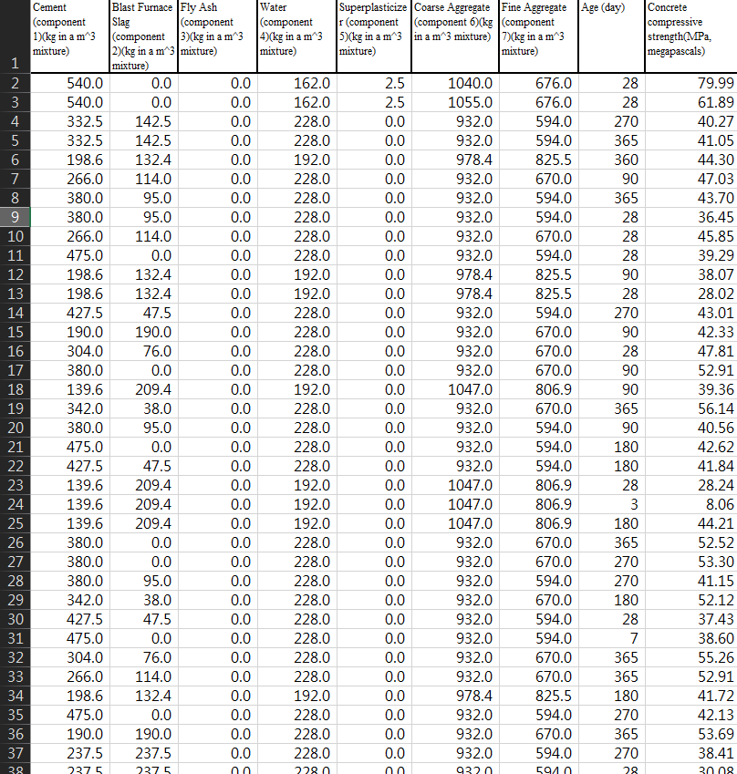
Data Detail
The dataset used in this study comprises a comprehensive collection of concrete samples, with each sample characterized by various physical and chemical properties. The dataset includes a total of 1,030 samples, each with 8 input features, such as cement content, water content, and age of the concrete. The target variable of interest is the Concrete Compressive Strength (CC_Strength), which represents the maximum load-bearing capacity of the concrete. Prior to the analysis, the data was preprocessed, including standardization of the features to ensure equal consideration and feature selection to identify the most relevant predictors.

Slide 5
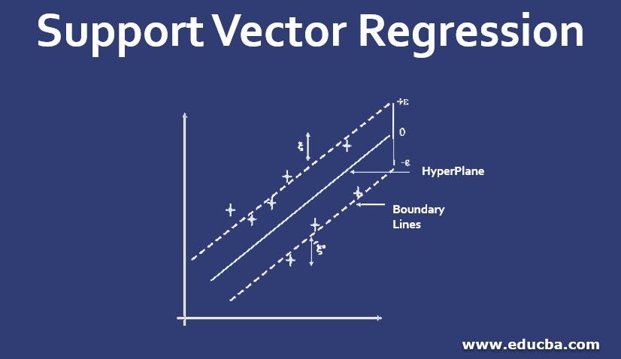
Support Vector Regression (SVR):
Method Overview
Implementation Details
- Support Vector Regression (SVR) is a supervised learning algorithm that uses support vector machines (SVMs) to perform regression tasks.
- It finds the hyperplane that maximizes the margin between the data points and fits as many instances as possible within the margin while limiting margin violations.
- The implementation involves training an SVR model using the `SVR` class from the `sklearn.svm` module.
- Features are standardized using the `StandardScaler` to ensure that each feature contributes equally to the model.
- SVR uses kernel functions to transform the input space into a higher-dimensional space where the data may be linearly separable.
Key Features
- SVR can capture complex non-linear relationships between features and the target variable.
- It is effective in high-dimensional spaces and robust to outliers.
- However, SVR requires careful tuning of hyperparameters, such as the choice of kernel function and regularization parameter.

Slide 6
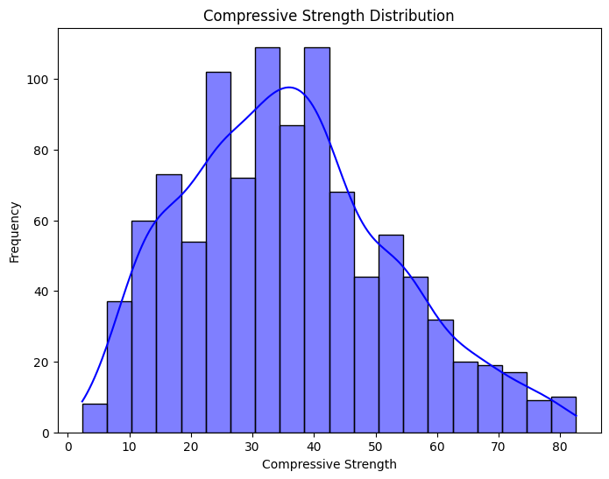
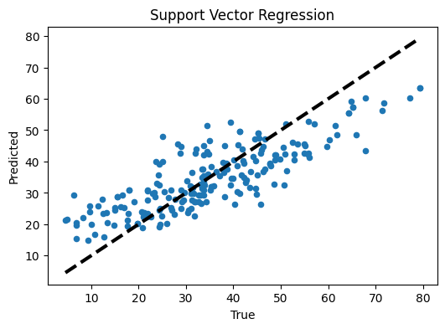
Results and Plots
Support Vector Regression (SVR) Results:
RMSE: 9.134058380031528
MSE: 83.43102248982416
MAE: 7.437601436199734
R2 Score: 0.660874253855722

Slide 7
Implementation of Support Vector Regression (SVR)
# Standardize the data
sc = StandardScaler()
x_train = sc.fit_transform(x_train)
x_test = sc.transform(x_test)
# Support Vector Regression (SVR)
svr = SVR()
svr.fit(x_train, y_train)
# Predictions
y_pred_svr = svr.predict(x_test)

Slide 8
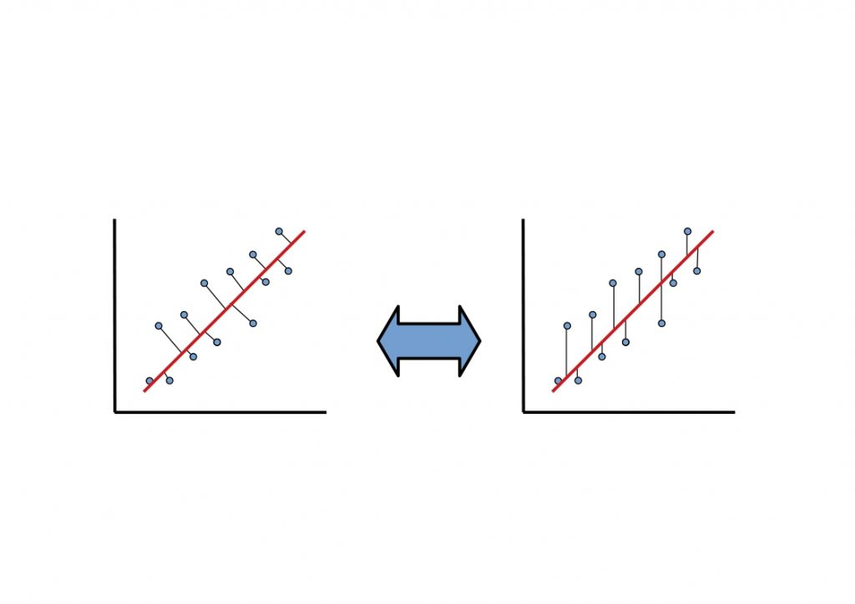
PCA + Linear Regression:
Method Overview
Implementation Details
- PCA (Principal Component Analysis) is a dimensionality reduction technique used to transform high-dimensional data into a lower-dimensional space while retaining most of the variance in the data.
- Linear Regression is a statistical method used for modeling the relationship between a dependent variable and one or more independent variables.
- The implementation involves first applying PCA to the feature matrix to reduce the dimensionality of the data.
- Then, the reduced feature matrix is used to train a linear regression model using the `LinearRegression` class from the `sklearn.linear_model` module.
- Features are standardized using the `StandardScaler` to ensure that each feature contributes equally to the model.
Key Features
- PCA reduces the dimensionality of the feature space, allowing for simpler models and potentially improved generalization performance.
- Linear Regression provides insights into the linear relationships between features and the target variable.
- However, PCA assumes linear relationships between variables, which may not hold true for all datasets, and linear regression may not capture complex non-linear relationships in the data.

Slide 9
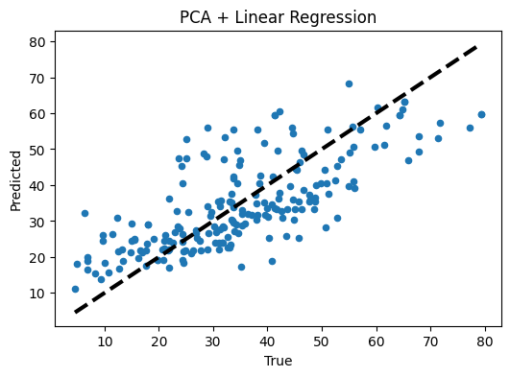
Results and Plots
PCA + Linear Regression:
RMSE: 10.609595633977868
MSE: 112.56351951652223
MAE: 8.518805227221984
R2 Score: 0.5424581120371326

Slide 10
Implementation of PCA + Linear Regression:
# Standardize the data
sc = StandardScaler()
x_train = sc.fit_transform(x_train)
x_test = sc.transform(x_test)
# Model training and evaluation with PCA
pca = PCA(n_components=7)
x_train_pca = pca.fit_transform(x_train)
x_test_pca = pca.transform(x_test)
lr_pca = LinearRegression()
lr_pca.fit(x_train_pca, y_train)
y_pred_lr_pca = lr_pca.predict(x_test_pca)

Slide 11
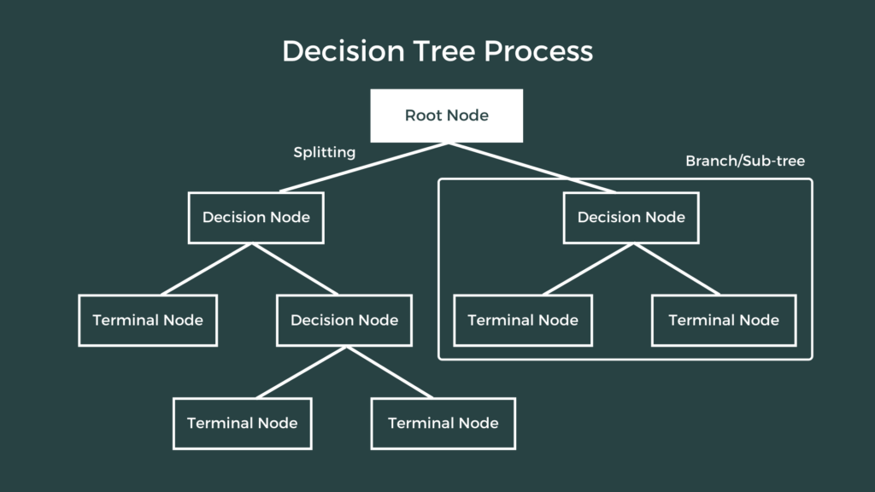
Decision Tree Regression:
Method Overview
Implementation Details
- Decision Tree Regression is a non-parametric supervised learning method used for regression tasks.
- It partitions the feature space into a hierarchy of binary decisions based on feature values to predict the target variable.
- The model predicts the target variable by traversing the tree from the root to a leaf node corresponding to the predicted value.
- The implementation involves training a decision tree regression model using the `DecisionTreeRegressor` class from the `sklearn.tree` module.
- No feature scaling is required for decision tree models.
- The tree is built recursively by splitting the data based on the feature that maximizes the reduction in variance or mean squared error.
Key Features
- Decision Tree Regression can capture complex non-linear relationships in the data.
- It provides interpretable results in the form of a tree structure.
- However, decision trees are prone to overfitting, especially with deep trees and noisy data.

Slide 12
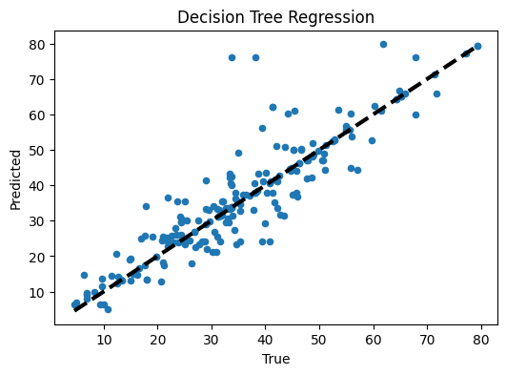
Results and Plots
Decision Tree Regression Results:
RMSE: 7.205654958248253
MSE: 51.92146337732763
MAE: 4.392515007736343
R2 Score: 0.7889525444700546

Slide 13

Implementation of Decision Tree Regression
# Standardize the data
sc = StandardScaler()
x_train = sc.fit_transform(x_train)
x_test = sc.transform(x_test)
# Decision Tree Regression
dt_reg = DecisionTreeRegressor(random_state=2)
dt_reg.fit(x_train, y_train)
# Predictions
y_pred_dt = dt_reg.predict(x_test)

Slide 14
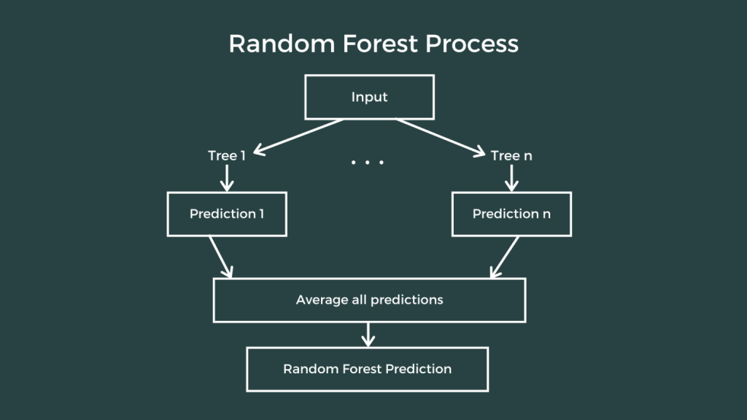
Random Forest Regression:
Method Overview
Implementation Details
- The implementation involves training a random forest regression model using the `RandomForestRegressor` class from the `sklearn.ensemble` module.
- Multiple decision trees are trained on random subsets of the training data (bootstrap samples) and random subsets of the features.
- The final prediction is the average of the predictions from all trees.
- Random Forest Regression is an ensemble learning method that constructs multiple decision trees during training and outputs the average prediction of the individual trees.
- It reduces overfitting and improves the predictive performance compared to a single decision tree.
Key Features
- Random Forest Regression is robust to overfitting and noisy data.
- It can handle a large number of features and maintain good predictive accuracy.
- However, random forests may lack interpretability compared to single decision trees.

Slide 15
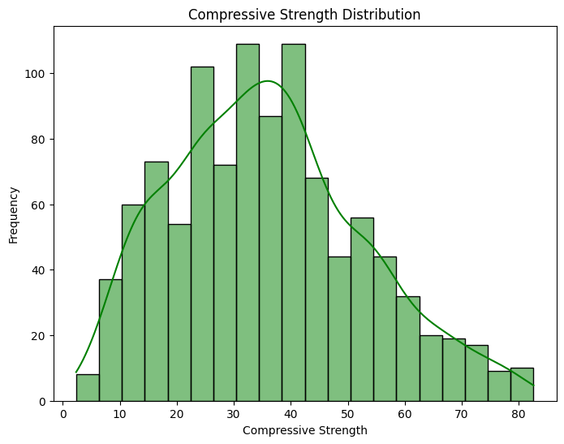
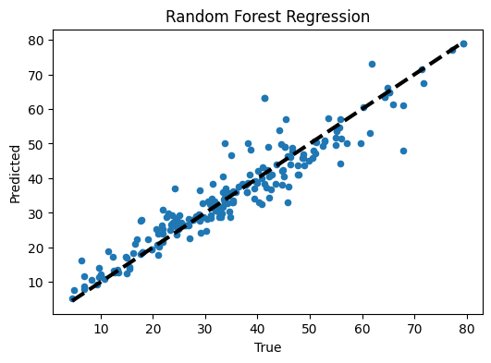
Results and Plots
Random Forest Regression Results:
RMSE: 5.110578778304108
MSE: 26.118015449252304
MAE: 3.472546327419586
R2 Score: 0.8938369540165259

Slide 16
Implementation of Random Forest Regression
# Standardize the data
sc = StandardScaler()
x_train = sc.fit_transform(x_train)
x_test = sc.transform(x_test)
# Random Forest Regression
rf_reg = RandomForestRegressor(n_estimators=100, random_state=2)
rf_reg.fit(x_train, y_train)
# Predictions
y_pred_rf = rf_reg.predict(x_test)

Slide 17
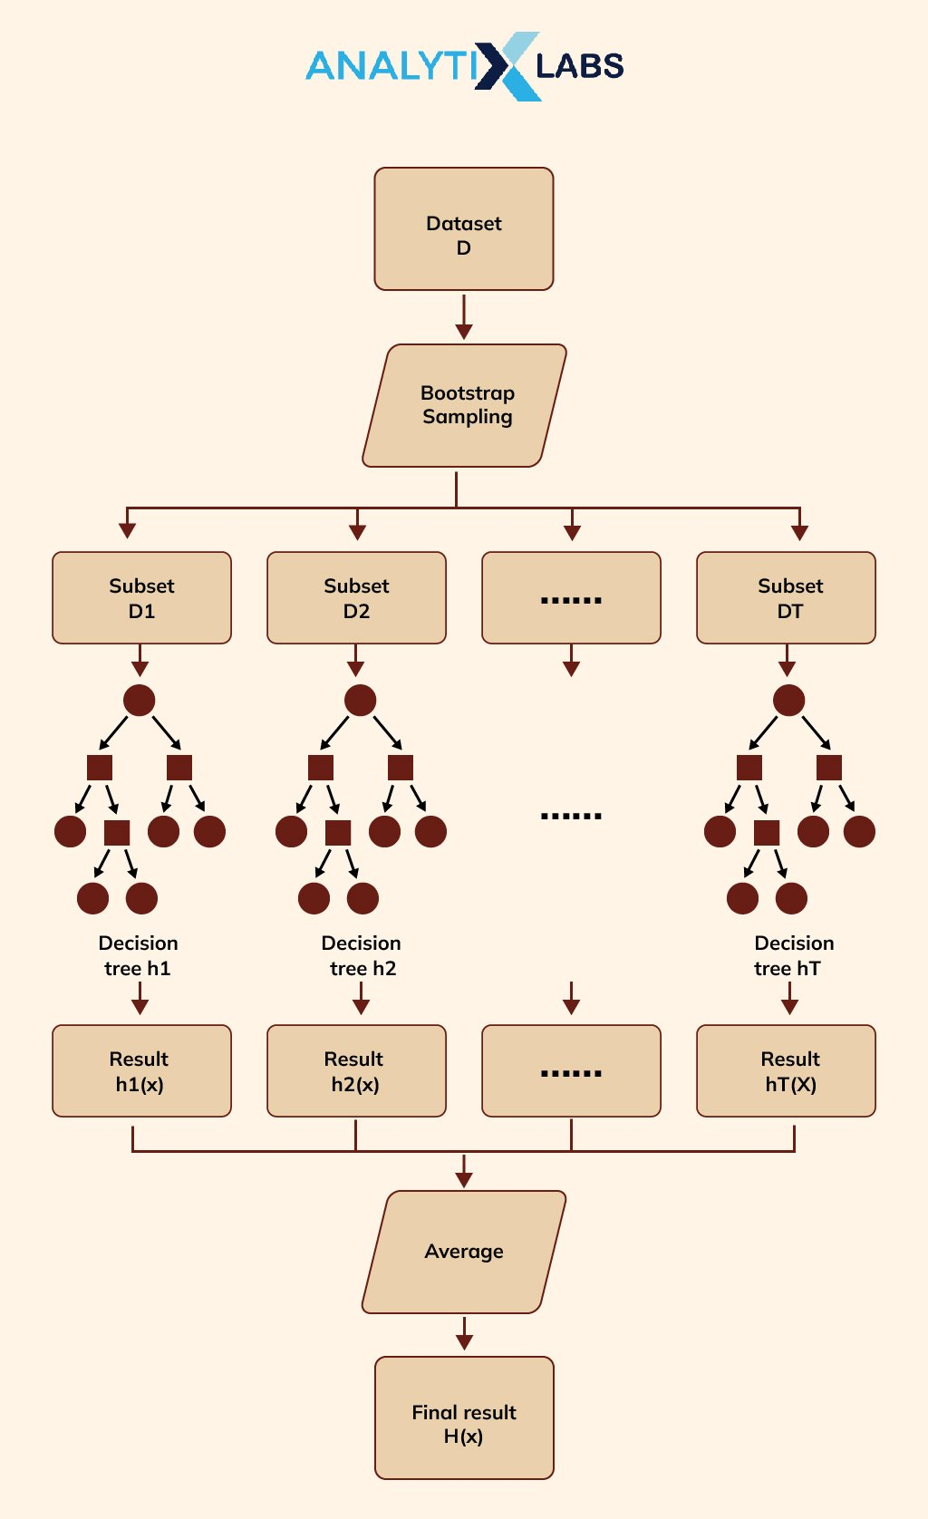
Gradient Boosting Regression:
Method Overview
Implementation Details
- Gradient Boosting Regression is an ensemble learning method that builds a series of weak learners (typically decision trees) sequentially, with each new learner correcting the errors of the previous one.
- It combines multiple weak learners to create a strong learner, with each weak learner focusing on the residuals (errors) of the previous one.
- The implementation involves using the `GradientBoostingRegressor` class from the `sklearn.ensemble` module.
- Hyperparameters such as the number of estimators (weak learners), learning rate, and maximum depth of the trees are crucial for controlling the behavior of the gradient boosting model.
- Features may or may not be standardized depending on the specific implementation.
Key Features
- Gradient Boosting Regression is a powerful technique that can capture complex relationships in the data and handle both linear and non-linear patterns.
- It typically provides high predictive accuracy and is less prone to overfitting compared to individual decision trees.
- However, gradient boosting models can be computationally expensive and may require careful tuning of hyperparameters to achieve optimal performance.

Slide 18
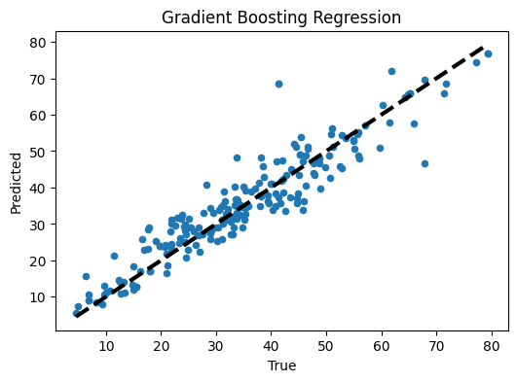
Results and Plots
Gradient Boosting Regression (GBR) Results:
RMSE: 5.587195501165179
MSE: 31.21675356824042
MAE: 3.9946833118350114
R2 Score: 0.8731118889580578

Slide 19
Implementation of Gradient Boosting Regression
# Train-test split
X = data.iloc[:, :-1]
y = data.iloc[:, -1]
x_train, x_test, y_train, y_test = train_test_split(X, y, test_size=0.2, random_state=2)
# Standardize the data
sc = StandardScaler()
x_train = sc.fit_transform(x_train)
x_test = sc.transform(x_test)
# Gradient Boosting Regression
gbr = GradientBoostingRegressor()
gbr.fit(x_train, y_train)

Slide 20
Predictive Performance:
- Random Forest Regression achieved the lowest RMSE of 5.11, indicating superior predictive accuracy compared to other methods. It also demonstrated the lowest MAE of 3.47, suggesting better performance in capturing the average magnitude of errors.
- Gradient Boosting Regression closely followed Random Forest Regression with an RMSE of 5.59 and an MAE of 3.99, showcasing competitive predictive accuracy.
- **Decision Tree Regression** and **Support Vector Regression (SVR)** exhibited higher RMSE and MAE values, indicating comparatively lower predictive accuracy.
Interpretability vs. Complexity:
- While Decision Tree Regression provided interpretability, Random Forest Regression and Gradient Boosting Regression introduced higher computational complexity due to ensemble learning.
- Support Vector Regression (SVR) showed lower interpretability but required longer training times and higher computational resources.

Slide 21
Performance Metrics:
- Random Forest Regression*outperformed other methods with the lowest RMSE, MSE, and MAE values, indicating superior predictive accuracy.
- Gradient Boosting Regression*demonstrated competitive performance, closely following Random Forest Regression in terms of RMSE and MAE.
- Decision Tree Regression*and Support Vector Regression (SVR) exhibited higher RMSE and MAE values, indicating comparatively lower predictive accuracy.
Computational Complexity:
- Random Forest Regression and Gradient Boosting Regression*required more computational resources due to ensemble learning but provided better predictive accuracy.
- Decision Tree Regression*and **Support Vector Regression (SVR) offered faster training times and lower computational complexity but showed limited predictive accuracy on complex datasets.

Slide 22
Thank You for Exploring Concrete Compressive Strength Prediction with Us!
Your curiosity and dedication have made this exploration possible.
Let's continue our quest for better understanding and prediction of concrete compressive strength.
Stay tuned for further advancements and breakthroughs in this fascinating field!

