Slide 1
Major Project-1 Presentation
Project No: 42
Project Title: Object recognition and identification
Rangoli Jaiswal-191B199
Rishi Neelkanth-191B201
Sejal jain-191B223
Under The Guidance Of
Dr. Neelesh Ku. Jain

Slide 2
Table of Contents
1. Introduction
2. Technologies Used
3. Feature Extraction
4. Image Classification
5. ImageNet
6. Image Detection
7. COCO Dataset
8. Segmentation
9. SSD
10. Results
11. Future Work

Slide 3
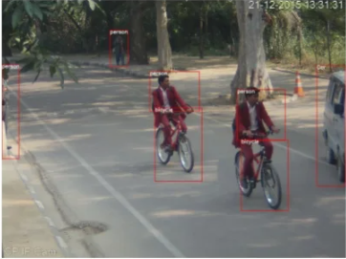
Introduction
Aim
Detection and identification of objects in surveillance video into various categories.
Categories- Car, Person, Motorcycle, Bicycle, Rickshaw, Autorickshaw
Figure-01: Detection and Identification of objects
Motivation- Recognition, Tracking, Security, etc.

Slide 4
Technologies Used
Tools : Anaconda , Jupyter Notebook
Languages: Python
Concepts: SSD mobilenetV3 (Single Shot Detection)
Libraries: TensorFlow, Open CV, Matplotlib.pyplot

Slide 5
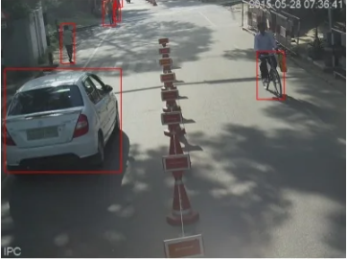
Feature Extraction- Dataset
To obtain the image dataset required for classification, we extracted frames from the provided video data.
Frames were taken after every 20 frames of each videos.
The images in the dataset correspond to the labelled bounding boxes from these frames.
Figure-02: Red Boxes Images used as dataset

Slide 6
Image Identification
Image identification is where a computer can analyze an image and identify the class the image falls under.
A class is essentially a label, for instance, 'car', 'animal', 'building' and so on.
Famous Dataset like ImageNet can be used having around 1000 classes.

Slide 7
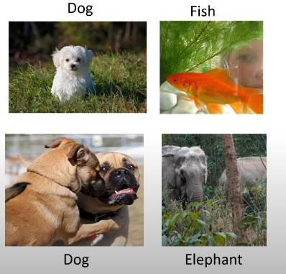
ImageNet
ImageNet is an image database organized according to the WordNet hierarchy, in which each node of the hierarchy is depicted by hundreds and thousands of images. The project has been instrumental in advancing computer vision and deep learning research. The data is available for free to researchers for non-commercial use.
Figure-03: Image Identification

Slide 8
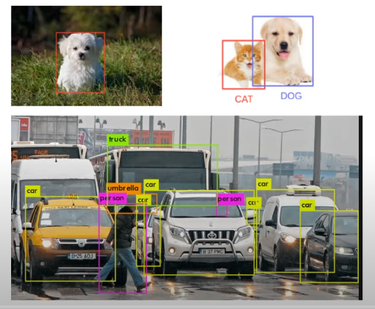
Image Detection
Based on salient features, object detection specifies the location of multiple objects in the image , i.e localization of object in the image.
Famous algorithms includes SSD-MobileNetv2, SSD-MobileNetv3, YOLO v1,YOLO v2.
Famous Dataset like COCO can be used having around 80 classes
Figure-04: Image Detection

Slide 9
COCO Dataset
COCO stands for Common Object in Context, this dataset contains around 330K labelled images. COCO is a large scale object detection, segmentation, and captioning database.
Features
Object segmentation
Recognition in context
330K images (>200K labelled)
1.5 million object instances
Since the model is pre trained, there is no need for Data Preprocessing.

Slide 10
Segmentation
IMAGE SEGMENTATION
Image segmentation is a commonly used technique in digital image processing and analysis to partition an image into multiple parts or regions, often based on the characteristics of the pixels in the image.
SEMANTIC SEGMENTATION
Semantic segmentation describes the process of associating each pixel of an image with a class label

Slide 11
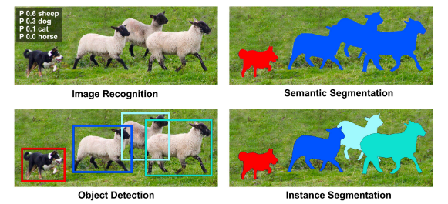
Figure-05: Image Recognition, Detection, Instance Segmentation, Semantic Segmentation

Slide 12
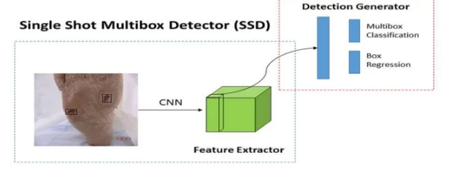
SSD
SSD(Single Shot Detector) is a designed for object detection in real time.
Figure-03 Single Shot Detector

Slide 13
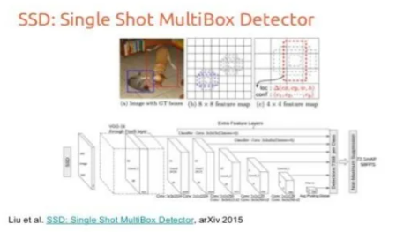
Object detection using SSD algo
It is a three steps process:
Region Proposal
Feature Generation
Classification
Figure04— Object detection using SSD

Slide 14
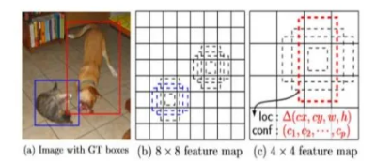
SSD Framework
Multi-scale feature maps for detection.
Convolutional predictors for detection.
Default boxes and aspect ratios.
Figure05— SSD Framework

Slide 15
Experiment Results
The project will be able to detect all the objects and classify it .
It will classify the object along with the suitable label.
It will work for static picture , any mp4 video as well as web camera.
Project will work in real time and will be fast .

Slide 16
THANK YOU

