Slide 1
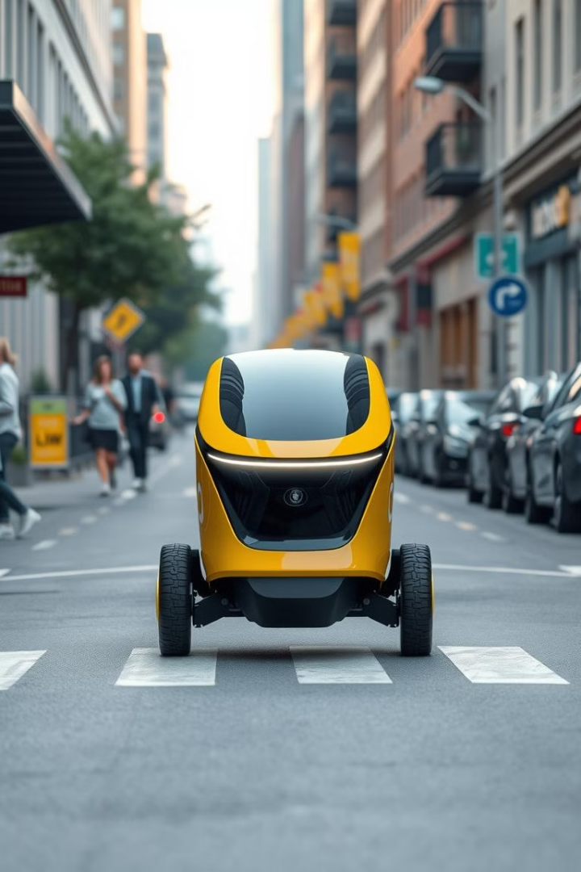
Autonomous Delivery Robot with Optimised Path Planning
Team Number:
D10
Team Members: Kalyan Rohit – CB.SC.U4AIE23318
P Tejadeep – CB.SC.U4AIE23328
Rishi Raajha A – CB.SC.U4AIE23335
S Gangadhar – CB.SC.U4AIE23337

Slide 2
Introduction
Autonomous delivery robots enhance hospital logistics by efficiently transporting medicines between rooms.
Optimized path planning algorithms, like the Alternating Direction Method of Multipliers (ADMM), improve navigation in complex hospital layouts.
Integrating AI and robotics ensures robust obstacle detection and real-time decision-making for safe route optimization.
Validating robot performance in dynamic hospital settings allows comparison with traditional path planning methods.
Combining robotics, artificial intelligence, and applied mathematics leads to reliable, scalable healthcare logistics solutions.

Slide 3
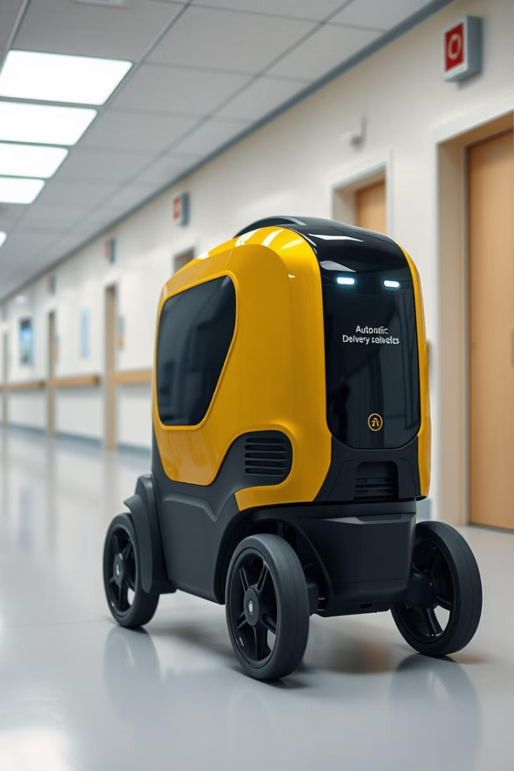
Objectives
Develop a fully autonomous delivery robot for transporting medicines within a hospital setting.
Implement an optimised path planning algorithm using the Alternating Direction Method of Multipliers (ADMM) to enhance operational efficiency and reduce the workload of hospital staff.
Improve patient care by ensuring timely and accurate medication delivery.

Slide 4
Literature Review
S.No
Name of the Paper (Year)
Methodology
Drawbacks and Challenges
1
Path Planning and Obstacle Avoidance for Autonomous Mobile Robots: A Review (2023)
Review of various path planning and obstacle avoidance techniques for mobile robots.
Limited adaptability in highly dynamic settings; high computational cost with complex layouts.
2
Path Planning for Autonomous Mobile Robots: A Review (2021)
Global classification of path planning algorithms, focusing on autonomous ground vehicles.
Challenges in real-time implementation; difficulty in handling dynamic obstacles.
3
Local Path Planning for Autonomous Mobile Robots by Integrating Modified Dynamic-Window Approach and Improved Follow-the-Gap Method (2024)
Integration of modified dynamic-window approach and improved follow-the-gap method for local path planning.
Potential issues with obstacle detection accuracy; computational complexity in dynamic environments.
4
MPPTM: A Bio-Inspired Approach for Online Path Planning and High-Accuracy Tracking of Multi-Robot Systems (2021)
Bio-inspired multi-robot path planning and tracking model for online applications.
Complexity in coordination among multiple robots; sensitivity to dynamic obstacles.

Slide 5
Literature Review
S.No
Name of the Paper (Year)
Methodology
Drawbacks and Challenges
5
Distributed Multi-Robot Task Assignment via Consensus ADMM (2021)
Distributed algorithms for multi-robot task assignment using Consensus ADMM.
Communication overhead among robots; convergence issues in large-scale systems.
6
Path Planning of a Mobile Delivery Robot Operating in a Multi-Story Building (2023)
Utilization of a manually created weighted navigation system combined with Dijkstra’s algorithm.
Manual creation of navigation systems can be labor-intensive; scalability issues in larger environments.
7
Multi-Robot Task Allocation and Path Planning with Maximum Range Constraints (2024)
Auction-based approach integrating path planning while considering robots' range limits.
NP-hard nature of task allocation; additional complexity due to obstacle avoidance requirements.

Slide 6
Literature Review
S.No
Name of the Paper (Year)
Methodology
Drawbacks and Challenges
8
Task Assignment and Path Planning for Autonomous Mobile Robots in a Warehouse Environment (2020)
Addressing task assignment and path planning in warehouse settings.
Challenges in dynamic and cluttered environments; computational demands for real-time processing.
9
Model Predictive Path Planning of AGVs: Mixed Logical Dynamical Formulation and Distributed Coordination (2023)
Model predictive control for path planning of Automated Guided Vehicles (AGVs).
High computational requirements; complexity in distributed coordination among multiple AGVs.
10
Multi-Modal Multi-Agent Optimization for LIMMS, A Modular Robotics Approach to Delivery Automation (2022)
Motion planner for a modular multi-agent, multi-modal package delivery platform using ADMM.
Complexity in coordinating multiple modular units; computational challenges in solving the optimization problem.

Slide 7
Research Gap
While existing literature addresses various aspects of autonomous delivery robots, there is a notable gap in comprehensive studies focusing on optimised path planning specifically tailored for indoor hospital environments using Alternating Direction Method of Multipliers (ADMM) algorithms.
Current research often emphasizes general path planning techniques without adequately considering the unique challenges posed by hospital settings, such as dynamic obstacles, varying layouts, and the need for real-time responsiveness.
Moreover, many studies do not sufficiently explore the integration of global path optimization with real-time obstacle avoidance, which is crucial for ensuring both efficiency and safety in critical healthcare environments.
By addressing these limitations, our project will pave the way for more effective autonomous solutions that can adapt to the complexities of indoor hospital navigation.

Slide 8
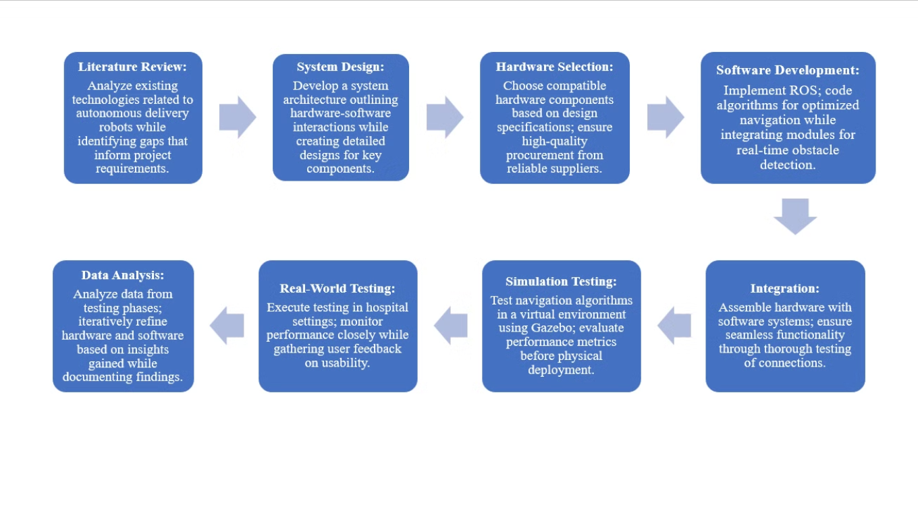
Proposed Methodology

Slide 9
Hardware Requirements
Component
Description
Robot Chassis
A011 2WD Indoor Robotics Chassis for stable navigation
Payload Compartment
Customizable compartment for transporting medicines
LIDAR Sensor
2D LIDAR sensor for mapping and obstacle detection
Inertial Measurement Unit (IMU)
MPU-6050 for orientation and acceleration data
Motor Driver
L298N Motor Driver for controlling DC motors
DC Motors
High-torque DC motors for driving the robot
Wheels
Designed for smooth movement on hospital floors
Power Supply
Lithium-ion batteries with sufficient capacity

Slide 10
Software Requirements
Component
Description
Operating System
Robot Operating System (ROS)
Programming Languages
Python/C++ for algorithm implementation
Simulation Software
Gazebo for testing and RViz for visualization

Slide 11
Timeline
1
Research and Planning
Conduct literature review
Identify hardware and software needs
2
Design architecture
Design system architecture
Create detailed designs for robot chassis and payload compartment
Develop software architecture
3
Developement of robot
Build the robot prototype (hardware assembly)
Implement software algorithms (ADMM for path planning, obstacle avoidance)
Integrate hardware and software components
4
Testing
Test the robot in simulation environment using Gazebo
Conduct real-world testing in controlled hospital settings
Analyze performance data and identify areas for improvement
5
Deployment and Evaluation
Refine design based on testing feedback
Prepare for deployment in actual hospital environment
Deploy the autonomous delivery robot
Monitor performance and gather user feedback for future iterations

Slide 12
Conclusion
By automating routine deliveries, healthcare staff can dedicate more time to direct patient care, improving overall service quality.​
Robots can operate in areas with biohazardous materials, reducing the risk of exposure for healthcare workers.​
Autonomous robots handle time-consuming tasks, alleviating the burden on healthcare professionals and allowing them to focus on critical responsibilities.​
Implementing autonomous delivery systems streamlines hospital logistics, leading to faster and more reliable transportation of medical supplies.

Slide 13


