Slide 1
Autonomous Delivery Robot with Optimized Path Planning
Team Number:
D10
Team Members:
Kalyan Rohit – CB.SC.U4AIE23318
P Tejadeep – CB.SC.U4AIE23328
Rishi Raajha A – CB.SC.U4AIE23335
S Gangadhar – CB.SC.U4AIE23337

Slide 2
Introduction
Autonomous delivery robots enhance hospital logistics by efficiently transporting medicines between rooms.
Optimized path planning algorithms, like the Alternating Direction Method of Multipliers (ADMM), improve navigation in complex hospital layouts.
Integrating AI and robotics ensures robust obstacle detection and real-time decision-making for safe route optimization.
Validating robot performance in dynamic hospital settings allows comparison with traditional path planning methods.
Combining robotics, artificial intelligence, and applied mathematics leads to reliable, scalable healthcare logistics solutions.

Slide 3
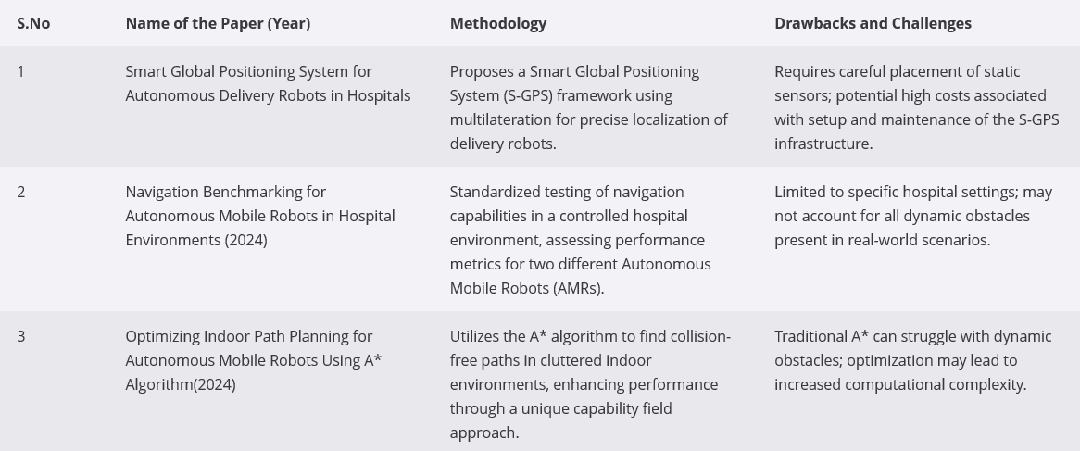
Literature Review

Slide 4
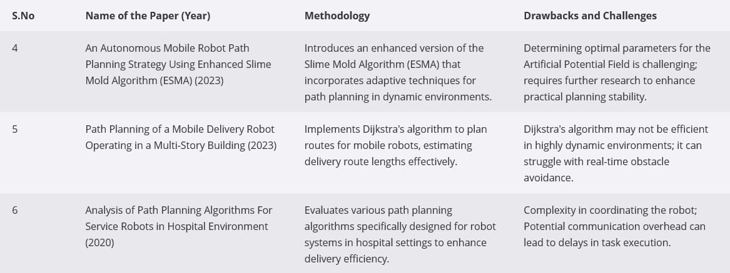
Literature Review

Slide 5
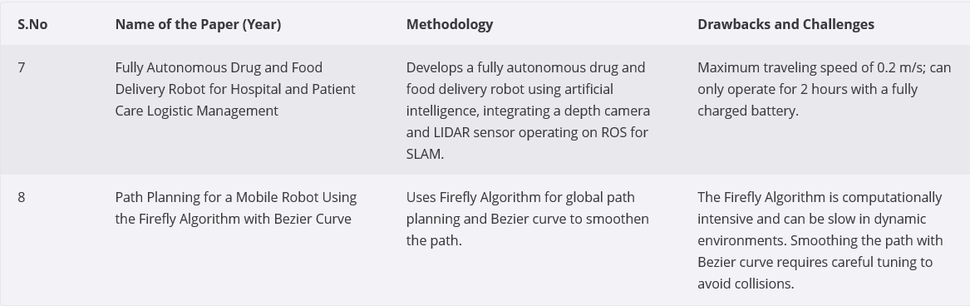
Literature Review

Slide 6
Objectives
Design and develop an autonomous delivery robot equipped with efficient navigation and delivery capabilities.
Implement the Alternating Direction Method of Multipliers (ADMM) for optimized path planning and real-time decision-making.
Integrate hardware components like sensors, motors, and controllers with software modules for seamless system performance.
Develop robust algorithms for localization and obstacle avoidance using GPS, LiDAR, and computer vision techniques.
Ensure system reliability and efficiency through extensive testing, performance evaluation, and validation in real-world environments.

Slide 7
Challenges Faced
Hardware-Software Synchronization: Ensuring seamless integration between microcontrollers, sensors, motors, and software for real-time decision-making and control.
ADMM Implementation Complexity: Adapting the Alternating Direction Method of Multipliers (ADMM) for real-time path optimization while managing computational efficiency and convergence issues.
Reliable Localization in Dynamic Environments: Overcoming GPS inaccuracies, sensor drift, and environmental interference to achieve precise real-time navigation.
Obstacle Detection and Adaptive Path Planning: Handling unexpected obstacles dynamically and ensuring collision-free navigation using LiDAR, computer vision, and sensor fusion.
Power Management and Battery Efficiency: Optimizing power consumption to ensure prolonged operational time without frequent recharging or performance degradation.

Slide 8
Proposed System
Input Layer
  Sensors
    LIDAR – Light Detection And Ranging
    IMU – Inertial Measurement Unit
  User Commands
    Delivery requests, destination input via mobile or web interface.

Slide 9
Proposed System
Processing Layer:
  Microcontroller (like Arduino/Raspberry Pi): Central control unit for hardware communication.
  ADMM Algorithm: Processes sensor data and computes optimized path planning in real time.
  Navigation System: Uses GPS, IMU, and computer vision for real-time localization and route adjustments.

Slide 10
Proposed System
Decision Layer:
  Obstacle Detection and Avoidance: Sensor fusion to identify obstacles and reroute dynamically.
  Path Optimization: Selects the most efficient route based on ADMM calculations and live environment data.
Actuation Layer:
  Motor Drivers: Control wheel speed and direction for movement.
  Servo Motors: Handle package loading and unloading mechanisms.
  Payload Compartment: Secure storage space for delivering items safely.

Slide 11
Proposed System
Output Layer:
  Real-Time Monitoring: Mobile/Web Interface providing live tracking and system status updates.
  Delivery Completion: Confirmation messages and status updates once delivery is successfully completed.

Slide 12
Implementation
Our autonomous delivery robot system is implemented through four key modules:
  ADMM Path Planning Module
  Odometry Publisher Module
  Keyboard Input Publisher Module
  Motor Control Subscriber Module

Slide 13
ADMM Path Planning Module
This module implements the Alternating Direction Method of Multipliers (ADMM) for optimized real-time path planning of the autonomous delivery robot.
  Path Initialization: A global path consisting of a series of waypoints is initialized for the robot’s movement.
  Variable Setup: The algorithm maintains local paths, dual variables, and primal variables to balance local and global optimization objectives.
  ADMM Iteration: During each iteration, the local path is adjusted incrementally, and the primal and dual variables are updated to minimize deviation from the global path.
  Odometry Integration: The robot’s current position is obtained from real-time odometry data and used for refining path predictions.
  Command Generation: Based on the updated local path, linear and angular velocities are calculated and converted into movement commands, which are published to control the robot’s motors.

Slide 14
Odometry Publisher Module
This module is responsible for publishing the robot’s position and orientation in real-time by calculating odometry from motor RPM (Revolutions Per Minute) data.
  Motor RPM Subscription: The module subscribes to left and right motor RPM data and converts it into linear and angular velocities.
  Position Estimation: Using the calculated velocities and time intervals, the robot’s x and y coordinates and heading (theta) are updated.
  Quaternion Orientation: The heading is converted into a quaternion representation for compatibility with ROS2’s odometry message format.
  Odometry Publishing: Updated position, orientation, and velocity data are published at regular intervals to the 'odom' topic for use by other modules.

Slide 15
Keyboard Input Publisher Module
This module provides a manual control interface for the robot via keyboard commands, allowing developers to intervene when needed.
  Non-Blocking Input: It captures single keypresses without requiring the Enter key, making control more responsive.
  Command Mapping: Arrow keys and specific characters ('w', 's', 'a', 'd', 'k', etc.) are mapped to movement commands like forward, reverse, left, right, and stop.
  Speed Control: Linear and angular speeds are adjusted incrementally based on keypresses, with defined speed limits for safety.
  ROS2 Messaging: Formatted movement commands are published to the 'keyboard_input' topic for use by the motor control system.
  Emergency Stop: The robot can be stopped immediately by sending a “stop” command or using keyboard shortcuts like Ctrl+C.

Slide 16
Motor Control Subscriber Module
This module translates movement commands into physical motor actions by directly interfacing with the robot’s BLDC motors through Jetson GPIO pins.
  GPIO Setup: Input and output pins are configured for motor speed, direction, emergency stop, and alarm control.
  PWM Control: Pulse Width Modulation (PWM) is used to adjust motor speeds smoothly.
  Directional Control: Based on received movement commands, the robot moves forward, backward, left, or right by setting the appropriate motor directions.
  Emergency and Alarm Handling: The module reads emergency switch and alarm states, stopping the robot when safety conditions are triggered.
  Braking and Stopping: Motors are gradually slowed and braking pins engaged to prevent sudden halts that could destabilize the robot.

Slide 17
Works to be done
Configure ROS with Existing Code: Ensure smooth execution of all modules by setting up proper ROS2 topics, nodes, and message communication.
Integrate Hardware and Software Seamlessly: Establish efficient interaction between sensors, motors, and control algorithms for real-time performance.
Achieve Complete Autonomy and Integrate ADMM: Fully automate the robot’s navigation and decision-making by implementing ADMM-based optimized path planning.

Slide 18
Completed Objectives
Tasks | Feb 11-Feb 16 | Feb16 – Feb 21 | Feb 21 – Feb 26 | Feb 26 – Mar 3 | Mar 3 – Mar 9
Development of Core System Modules
Real-Time Odometry and Localization
Path Planning with ADMM
Manual Control via Keyboard Interface
Motor Control and Actuation

