Slide 1
IoT Integrated Facial Recognition System for Real Time Attendance Management Using Machine Learning
Team Number:
D10
Team Members:
Kalyan Rohit – CB.SC.U4AIE23318
P Tejadeep – CB.SC.U4AIE23328
Rishi Raajha A – CB.SC.U4AIE23335
S Gangadhar – CB.SC.U4AIE23337

Slide 2
Introduction
The Smart Attendance System is designed to modernize traditional attendance tracking by integrating IoT and ML technologies.
It provides a contactless, efficient, and automated method for attendance marking, reducing manual work and preventing fraudulent entries.
The system enhances security and accuracy by using facial recognition to authenticate students, ensuring only those physically present in the classroom can mark attendance.
By leveraging deep learning models and smart IoT-based connectivity, it creates a seamless and real-time attendance management solution.
The system is designed to be scalable and adaptable, allowing for future enhancements such as voice recognition or multi-factor authentication.

Slide 3
Literature Review
S. No | Title | Authors | Year | Outcomes | Limitations
1 | IoT-Based Smart Attendance System | Patil, P. S., Sherekar, S. S., & Dorle, S. S. | 2023 | Developed an IoT-based system integrating RFID and sensors for attendance tracking. | Lacks biometric authentication; possible proxy attendance via RFID card sharing.
2 | Face Recognition-Based Attendance System Using Deep Learning | Chandaka, S., & Thandra, A. R. | 2024 | Implemented a CNN-based model for accurate face recognition in attendance systems. | Accuracy drops in low lighting and with partial occlusion of faces.
3 | Automated Attendance System Using Facial Recognition | Rao, T. C., Sharma, N. S., Shadik, M. M., Sree, P. U., Harsha, P. S., & Suryavardhan, K. | 2024 | Created a real-time system using OpenCV and Haar cascade for face detection and recognition. | Requires stable internet and consistent camera quality; sensitive to pose variations.

Slide 4
Literature Review
S. No | Title | Authors | Year | Outcomes | Limitations
4 | Automating Attendance Management in Human Resources | Nguyen-Tat, B.-T., Bui, M.-Q., & Ngo, V. M. | 2024 | Proposed a Design Science Research approach using deep learning for HR attendance tracking. | Focused more on HR process integration than technical scalability or edge deployment.
5 | An Embedded Intelligent System for Attendance Monitoring | Abderraouf, T., Wassim, A. A., & Larabi, S. | 2024 | Introduced an embedded system using Raspberry Pi and facial recognition for portable monitoring. | Hardware limitations restrict high-resolution processing; limited database scalability.
6 | Smart Attendance System Using CNN | Arya, S., Mesariya, H., & Parekh, V. | 2020 | Utilized CNN for smart attendance with automatic face recognition from a live video stream. | Struggles with real-time performance on low-end hardware; needs optimized models.

Slide 5
Literature Review
S. No | Title | Authors | Year | Outcomes | Limitations
7 | AttenFace: A Real-Time Attendance System Using Face Recognition | Rao, A. | 2022 | Designed a practical attendance solution with real-time detection and easy UI integration. | Challenges in large-scale deployment due to increased processing time with larger datasets.
8 | Face Recognition Attendance | Pooja, J. C. G., Rajalakshmi, R., & Jasna, R. | 2024 | Developed a face-based attendance system using machine learning algorithms for recognition. | May misidentify in crowded environments or under varying illumination conditions.

Slide 6
Research Gap
Environmental Robustness: Existing solutions often lack resilience under real-world conditions such as varying lighting, facial occlusions (e.g., masks, headwear), and background complexity, leading to inconsistent accuracy.
Resource-Constrained Deployment: Most systems are developed and tested on high-performance machines, with limited optimization for real-time performance on low-power edge devices like Raspberry Pi or Jetson Nano.
Scalability and Database Management: Many approaches do not adequately address scalability challenges—accuracy and response time tend to degrade with increasing numbers of enrolled individuals and facial images.
Data Privacy and Ethical Compliance: There is insufficient consideration for privacy-preserving mechanisms, user consent, and adherence to legal frameworks (such as GDPR), especially when handling sensitive biometric data.

Slide 7
Objectives
To develop an automated, real-time face recognition attendance system to enhance security and efficiency.
To use deep learning models for accurate face recognition and authentication.
To implement a smart Wi-Fi camera to capture images and process attendance remotely.
To develop a frontend web portal for both admin and student users, integrating management and attendance marking functionalities.
To ensure real-time synchronization between the web application and the database.
To provide an easy-to-use interface for students and faculty.

Slide 8
Problem Statement
Manual and biometric attendance systems often suffer from issues such as proxy attendance, time inefficiencies, and limited scalability, especially in academic and corporate environments.
While face recognition-based solutions offer automation, many existing models struggle with environmental variability, lighting conditions, and user privacy concerns.
Additionally, there is a lack of integration between intelligent edge devices and secure cloud platforms to enable real-time, tamper-proof attendance monitoring.
This highlights the need for a reliable, accurate, and scalable attendance management system powered by advanced deep learning techniques and IoT-based automation.

Slide 9
Relevance to Machine Learning
Deep Learning Models Used
MTCNN (Multi-Task Cascaded Convolutional Networks)
InceptionResNetV1
Face Recognition Approach
MTCNN is used for face detection and landmark alignment, ensuring that only well-positioned faces are processed.
InceptionResNetV1 extracts unique facial embeddings and compares them with stored templates in the database.
A similarity threshold is applied to determine if a student is correctly identified.

Slide 10
Relevance to Communication and IoT
IoT Components
Smart Wi-Fi Camera captures real-time images and sends data to the backend for processing.
Django-based Web Portal processes and logs attendance data securely.
Data Flow
The camera continuously streams data to the ML-based backend.
The database stores attendance records and allows real-time updates.
The web portal retrieves attendance logs dynamically for admin and student access.

Slide 11
Message Queuing Telemetry Transport(MQTT)
MQTT (Message Queuing Telemetry Transport) is a lightweight messaging protocol designed for real-time communication between devices.
It works on a publish-subscribe model, which makes it perfect for IoT applications where multiple devices need to exchange data efficiently.
MQTT is designed for low-bandwidth, high-latency environments, making it perfect for IoT applications where devices need to communicate in real time.
MQTT supports different levels of message delivery assurance — from “fire and forget” (QoS 0) to guaranteed delivery (QoS 2), ensuring reliable communication even in unstable networks.

Slide 12
Working of MQTT
Broker Acts as Middleman
The MQTT broker (like Mosquitto) is the central hub that manages all message traffic.
It receives messages from publishers and delivers them to subscribers.
Publish-Subscribe Model
Publisher: A device or application (Django backend) sends messages to specific topics.
Subscriber: Devices (Web interface) subscribe to topics to receive real-time updates.

Slide 13
Working of MQTT
Topic-Based Communication
Messages are categorized by topics.
Subscribers only receive messages from the topics they’re subscribed to — keeping communication efficient.
Real-Time Message Flow
IoT camera captures a face → Backend processes and recognizes it → Backend publishes attendance update to face/recognized.
Web interface immediately receives and displays the update.

Slide 14
Working of MQTT
Quality of Service (QoS):
MQTT ensures message reliability even with network issues through different QoS levels:
QoS 0: “At most once” — Fast, no guarantee of delivery.
QoS 1: “At least once” — Ensures the message is delivered at least once.
QoS 2: “Exactly once” — Guarantees the message is delivered only once.

Slide 15
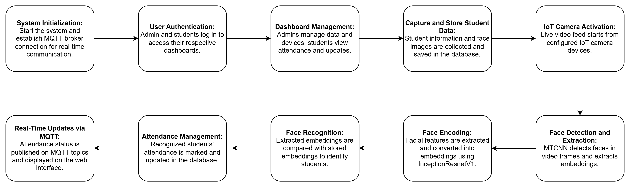
Methodology

Slide 16
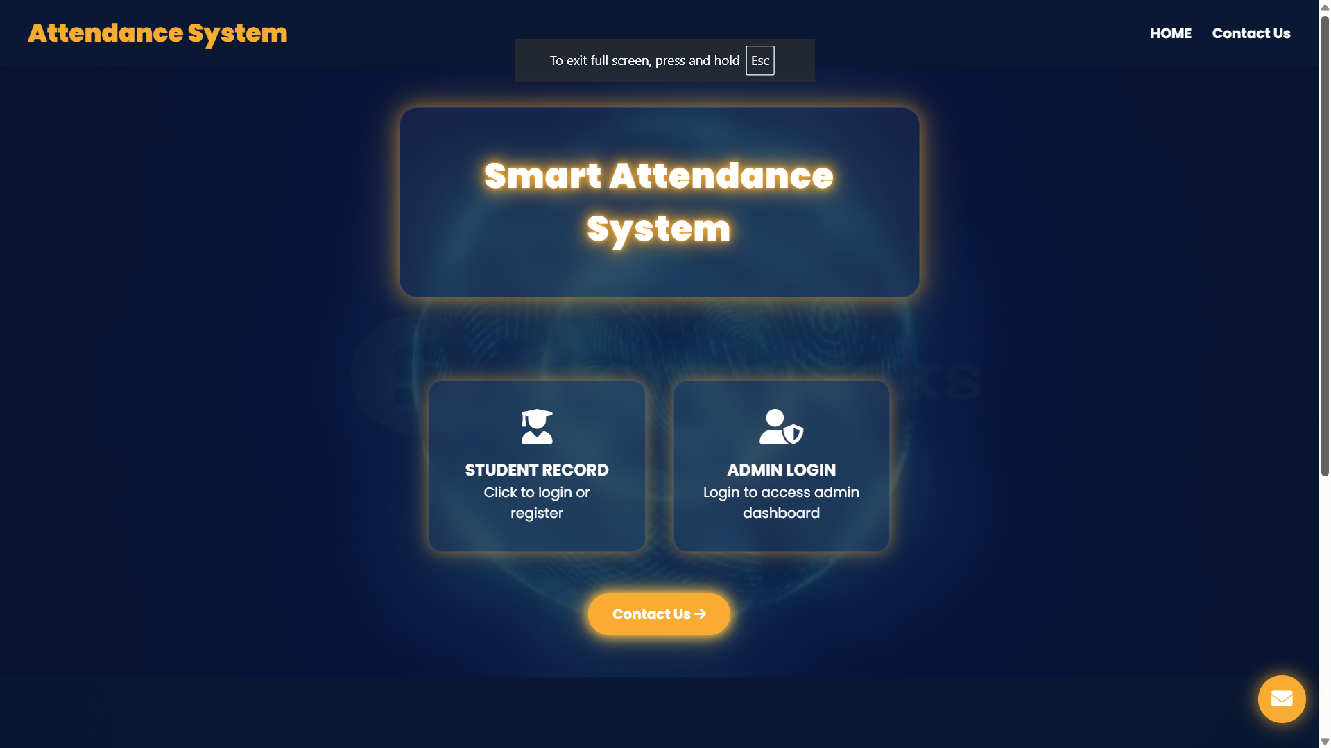
Results

Slide 17
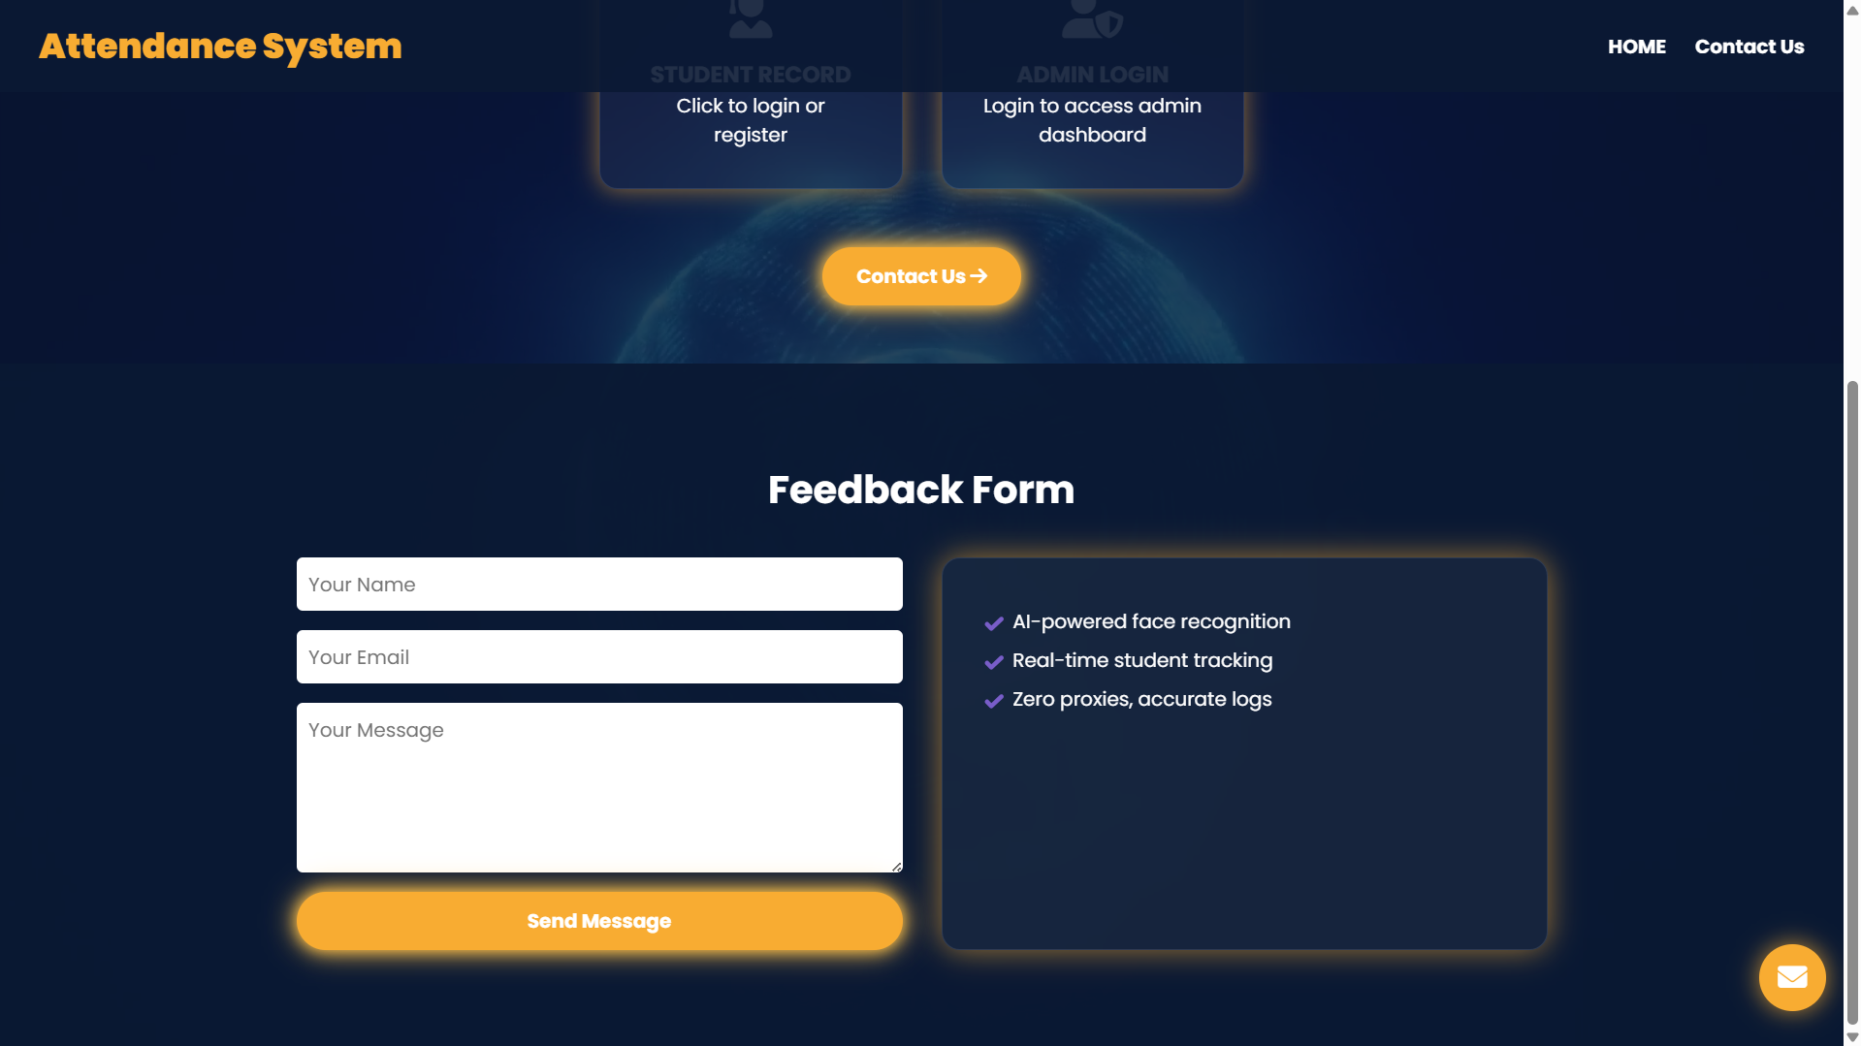
Results

Slide 18
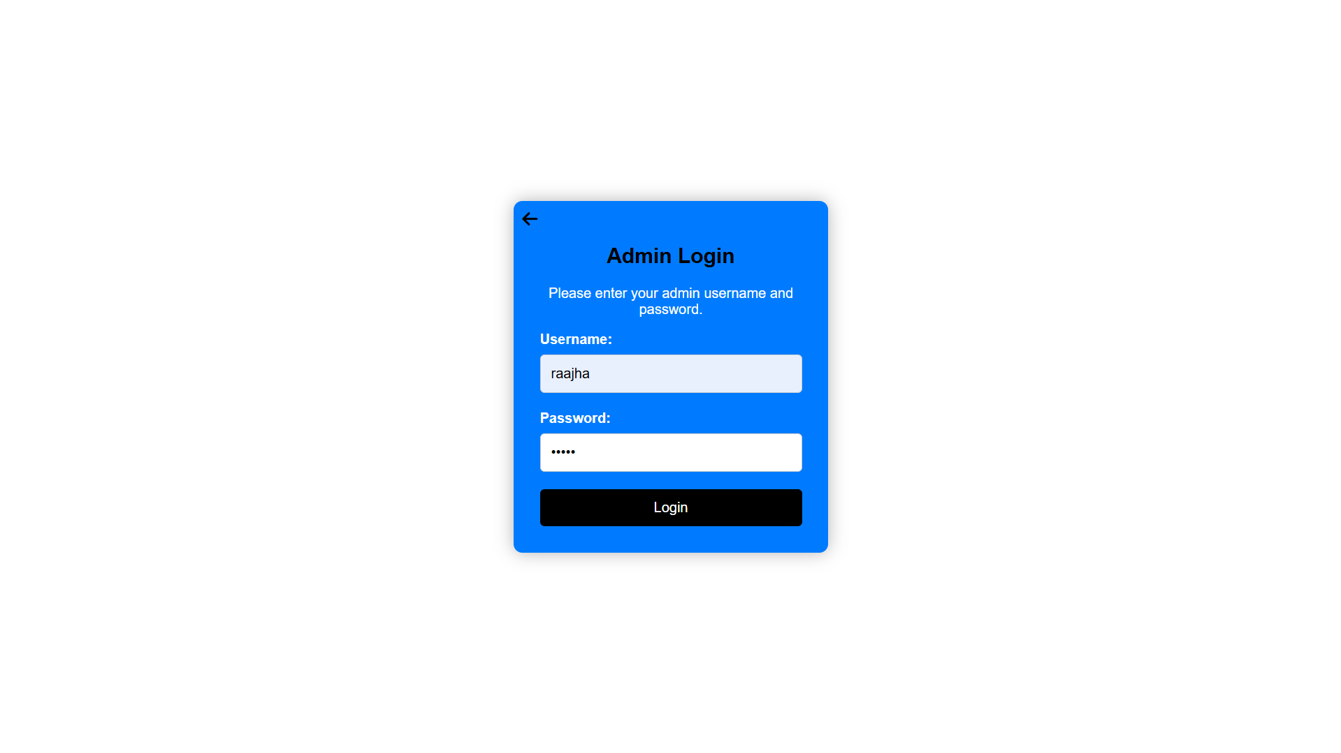
Results

Slide 19
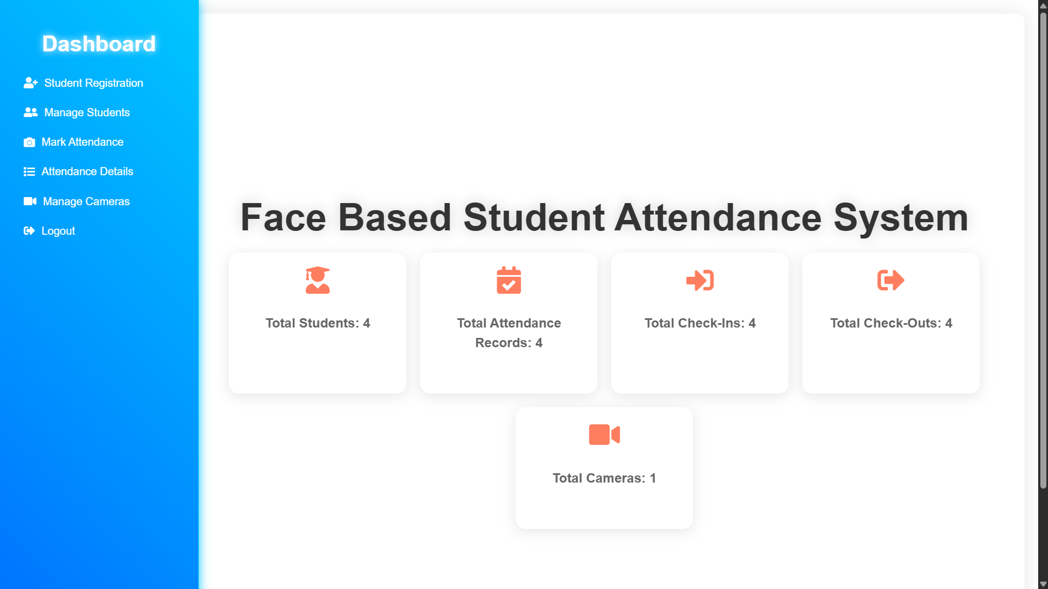
Results

Slide 20
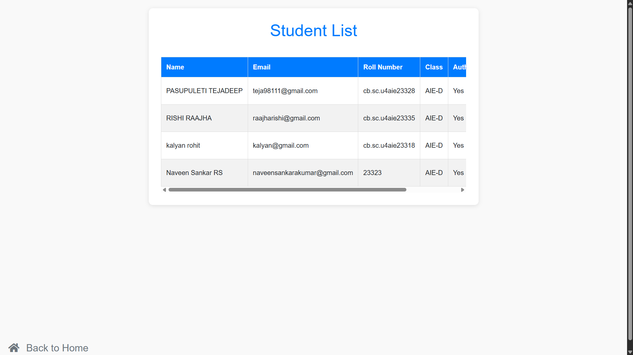
Results

Slide 21
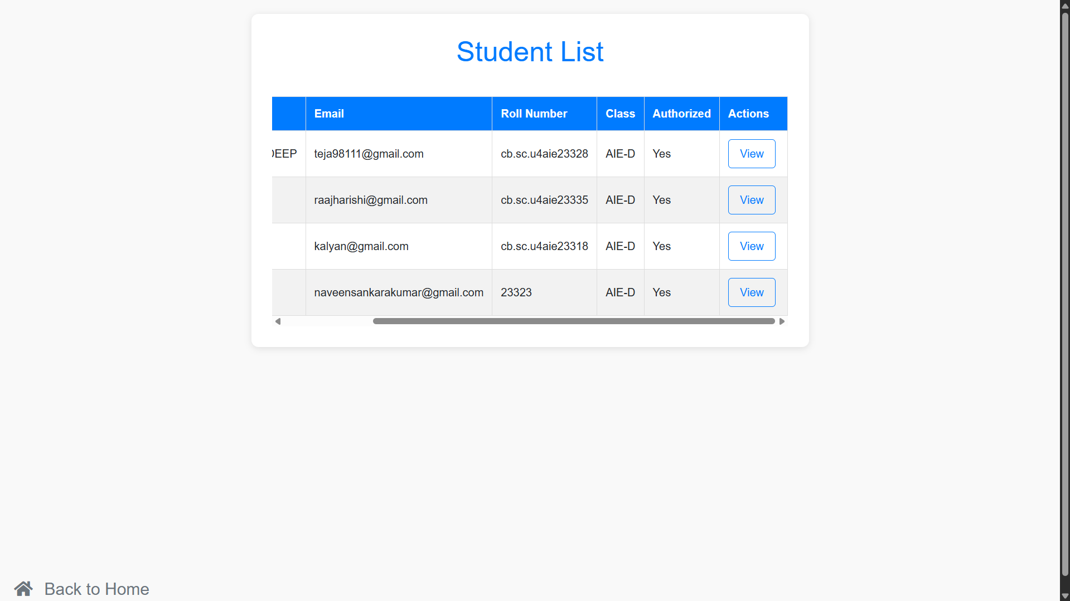
Results

Slide 22
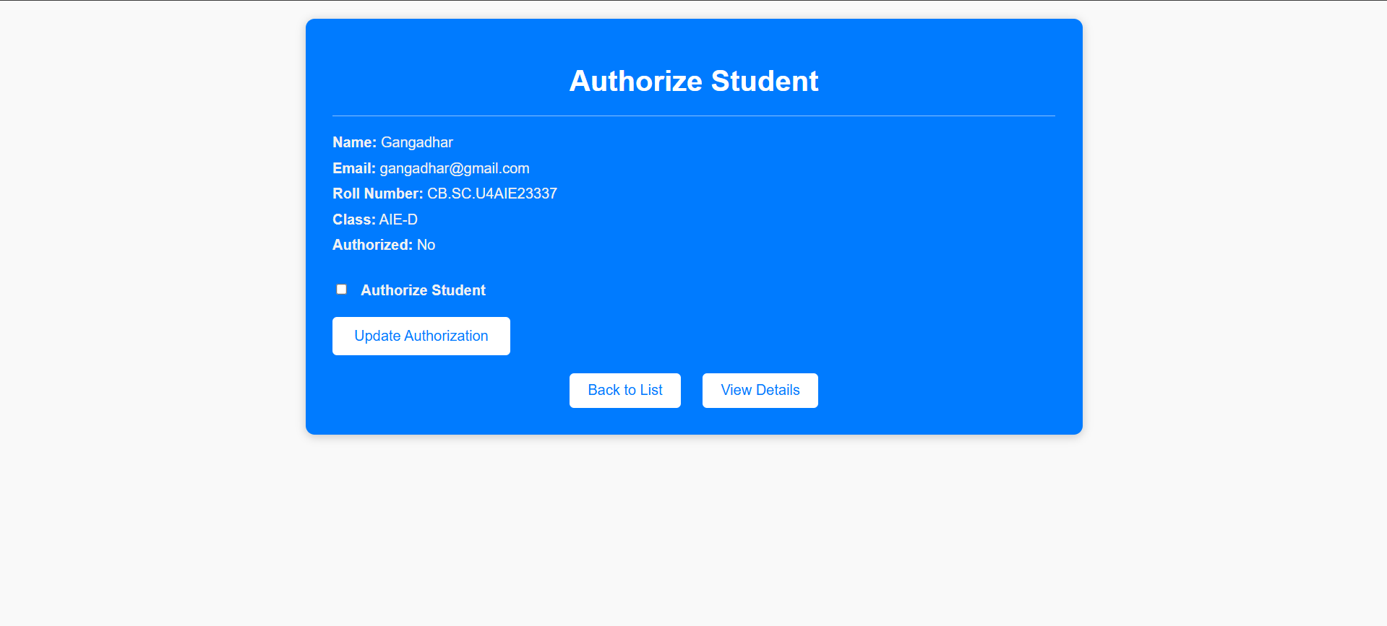
Preliminary Results

Slide 23
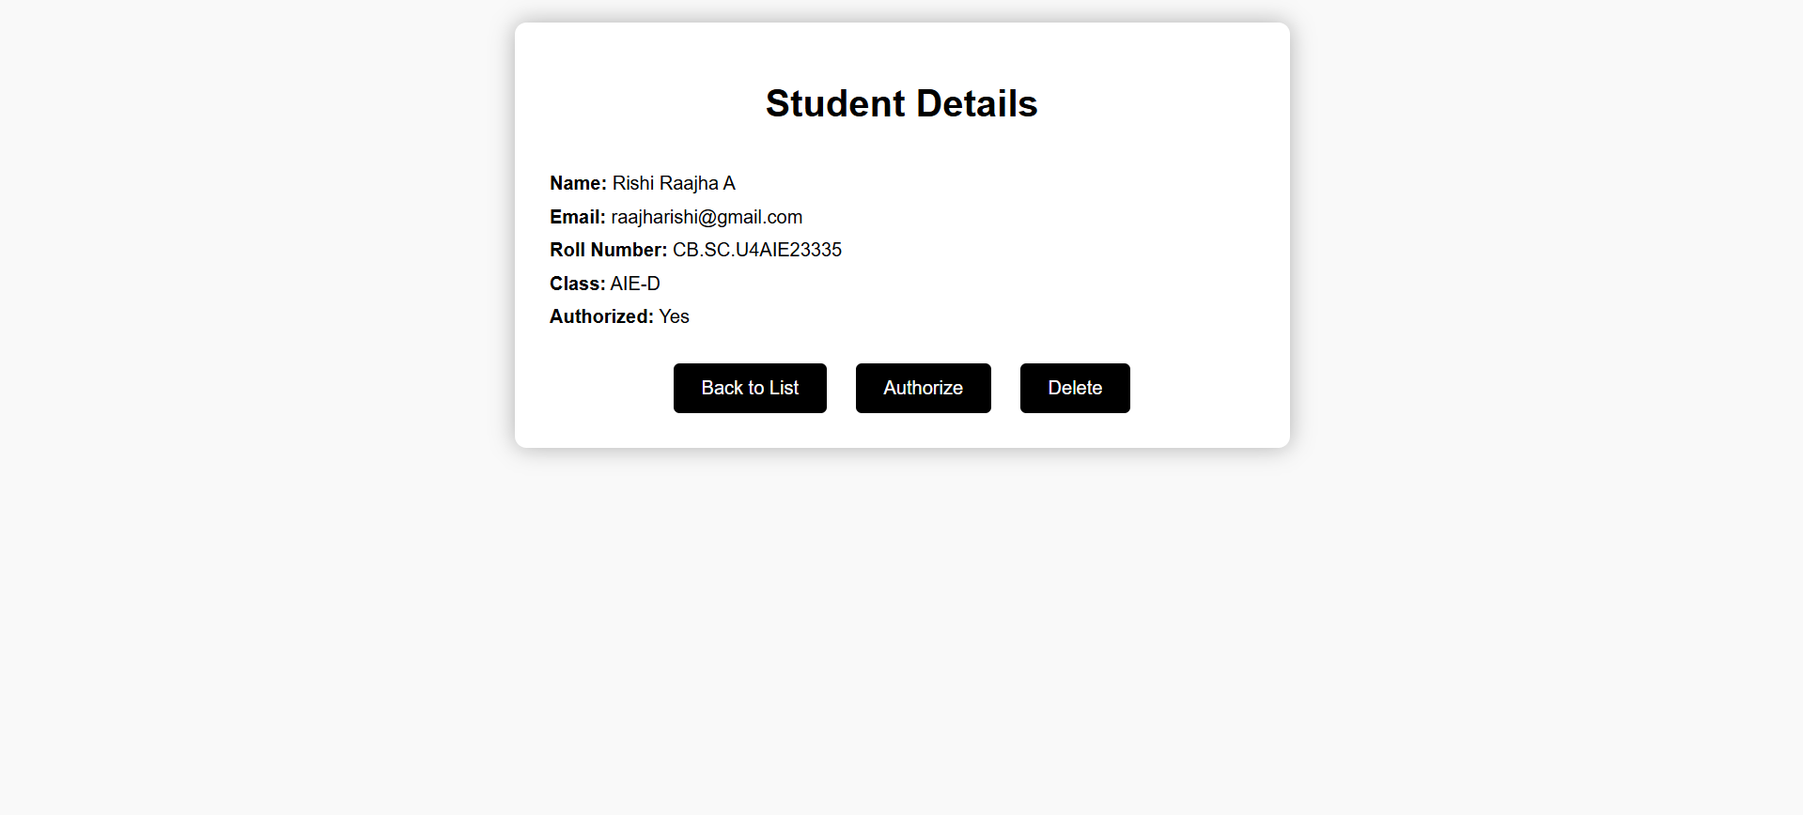
Preliminary Results

Slide 24
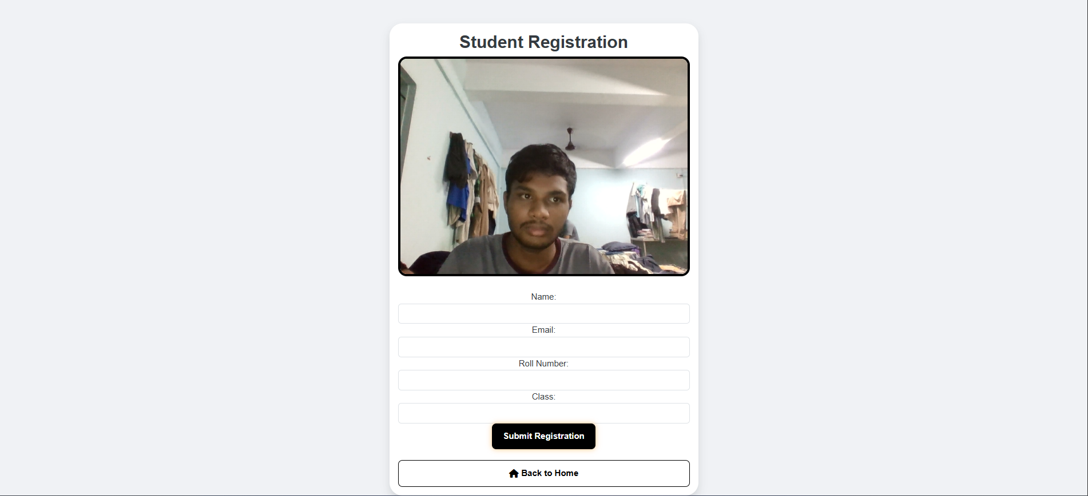
Preliminary Results

Slide 25
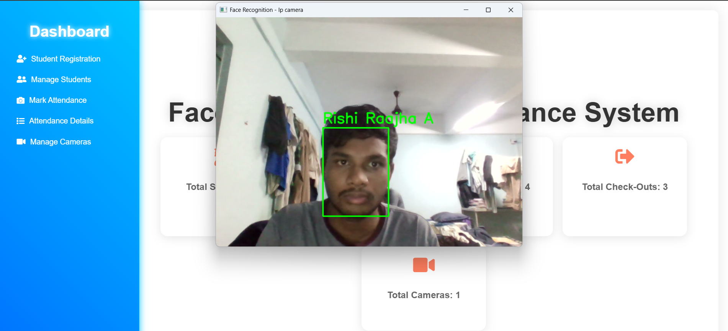
Preliminary Results

Slide 26
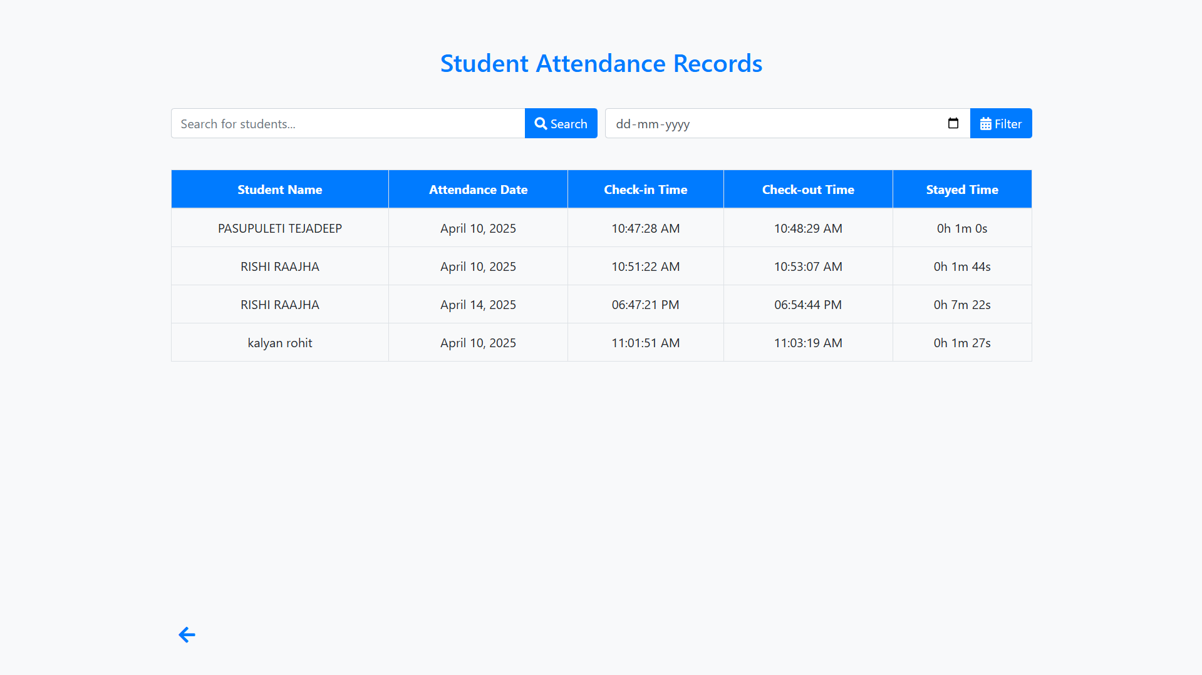
Results

Slide 27
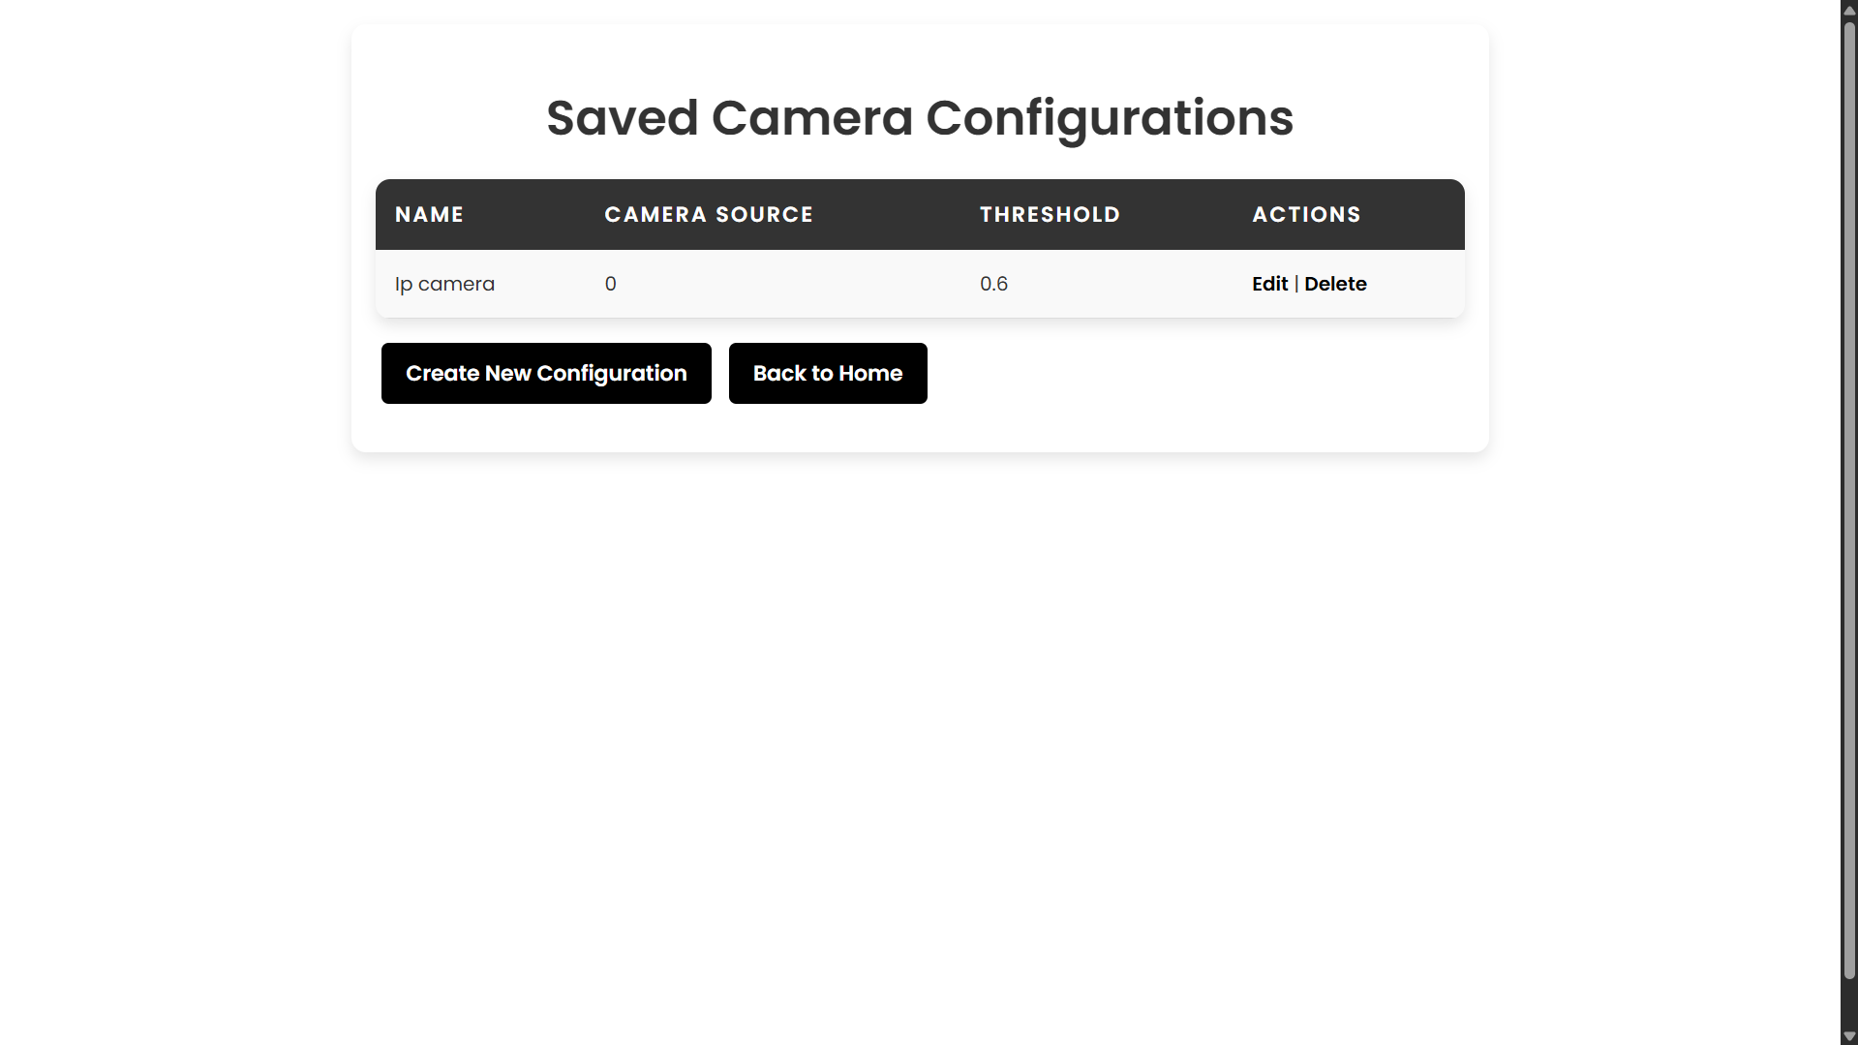
Results

Slide 28
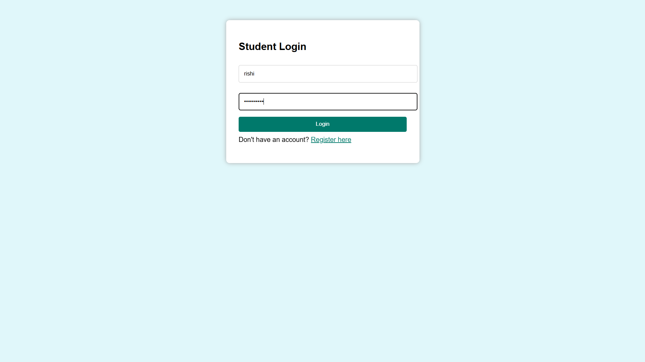
Results

Slide 29
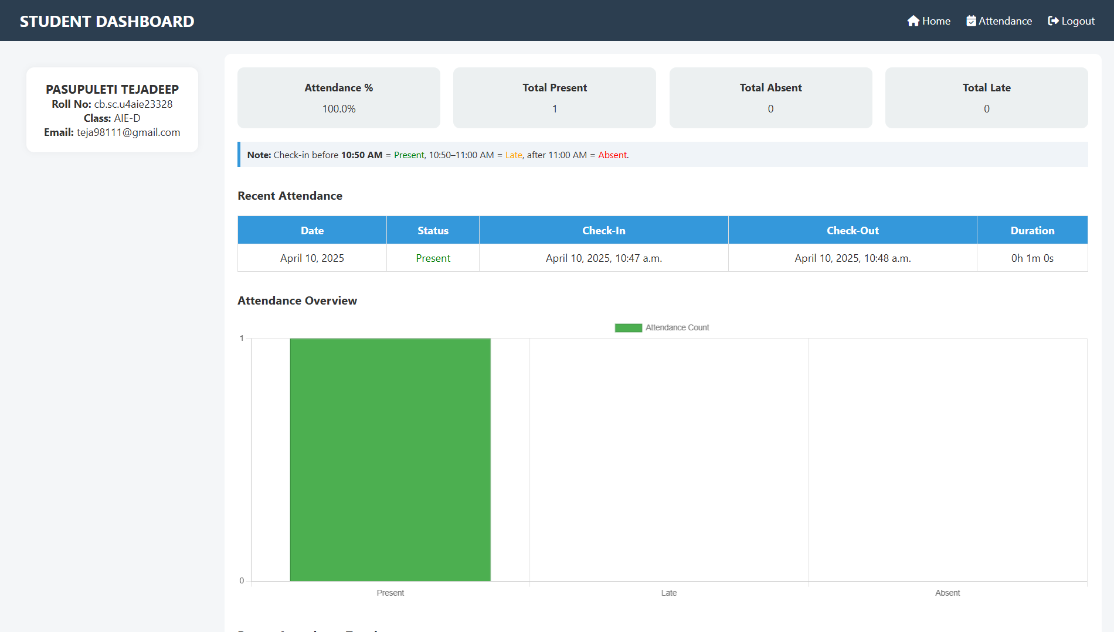
Results

Slide 30
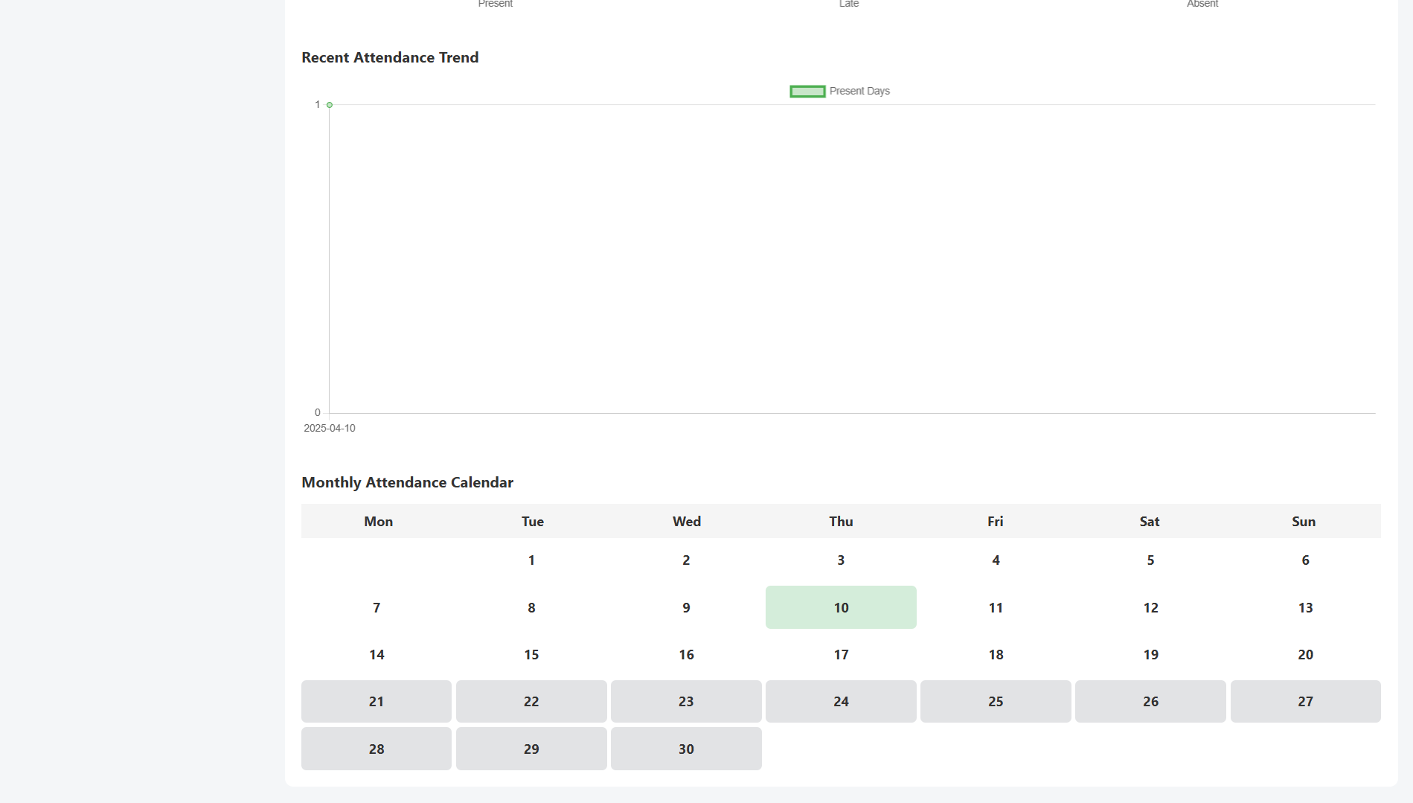
Results

Slide 31
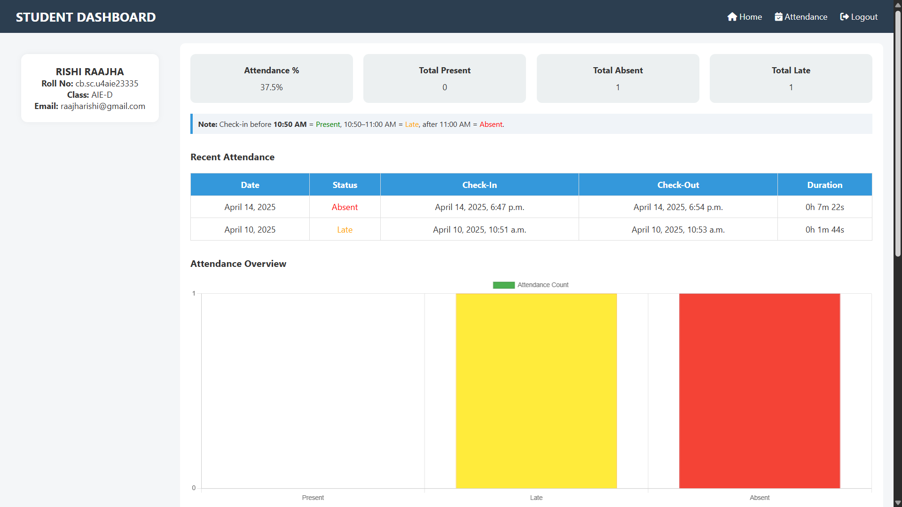
Results

Slide 32
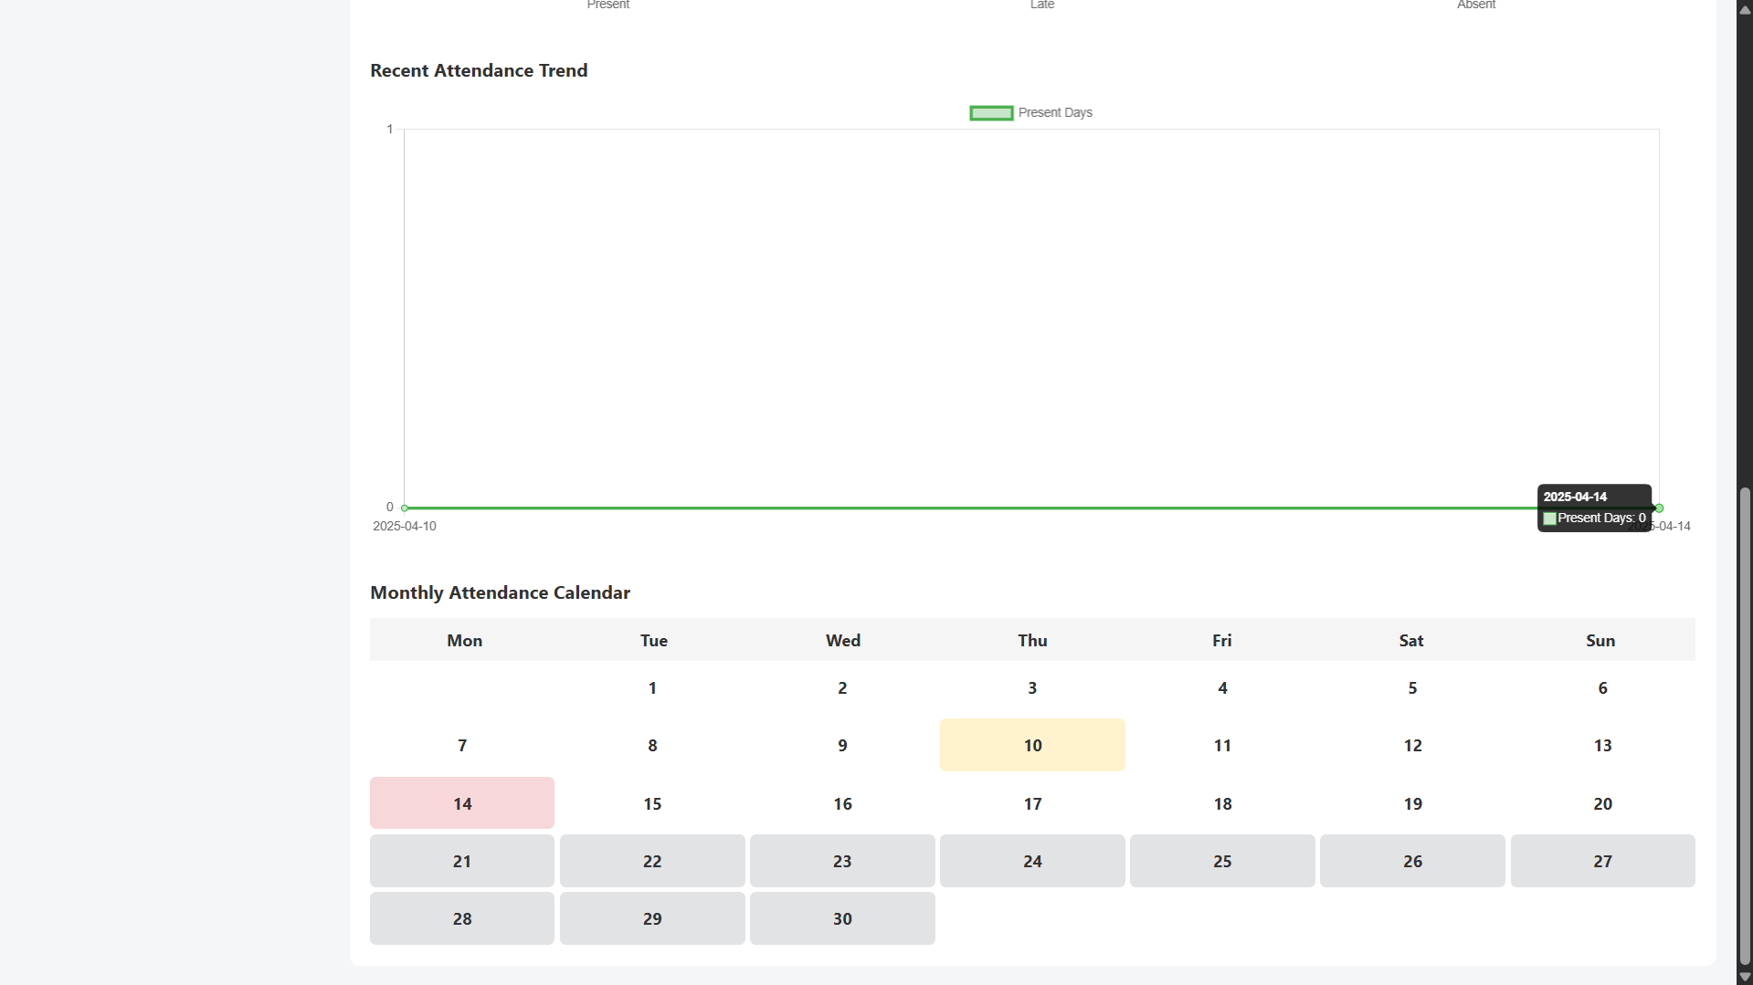
Results

Slide 33
Limitations and Future scope
Limitations:
Camera feed stability is inconsistent, affecting real-time detection.
Low FPS (Frames Per Second) impacts smooth processing and recognition.
System may lag under high load or multiple simultaneous camera streams.
Future Scope:
Optimize camera feed handling to improve FPS and reduce latency.
Deploy model on edge devices like Jetson Nano for faster local inference.
Enable multi-factor authentication (e.g., voice or ID card) for added security.
Integrate cross-campus cloud syncing for large-scale attendance monitoring.

Slide 34
Conclusion
The Smart Attendance System successfully integrates IoT and deep learning to automate attendance tracking, offering a reliable and contactless alternative to traditional methods.
The use of MTCNN for face detection and InceptionResNetV1 for feature extraction ensures high accuracy and robustness in real-time facial recognition.
MQTT-based communication facilitates low-latency data transmission between hardware components and the server, enabling efficient real-time updates.
Overall, the system enhances operational efficiency, minimizes human intervention, and demonstrates strong potential for deployment in educational and institutional environments.

Slide 35
References
Patil, P. S., Sherekar, S. S., & Dorle, S. S. (2023). IoT-Based Smart Attendance System. 2023 International Conference on Smart Technologies and Systems for Next Generation Computing (ICSTSN).
Chandaka, S., & Thandra, A. R. (2024). Face Recognition-Based Attendance System Using Deep Learning. Artificial Intelligence in Engineering. Elsevier.
Rao, T. C., Sharma, N. S., Shadik, M. M., Sree, P. U., Harsha, P. S., & Suryavardhan, K. (2024). Automated Attendance System Using Facial Recognition. International Journal of Scientific Research in Science and Technology, 11(2), 67-74.
Nguyen-Tat, B.-T., Bui, M.-Q., & Ngo, V. M. (2024). Automating Attendance Management in Human Resources: A Design Science Approach Using Computer Vision and Facial Recognition. arXiv preprint arXiv:2405.12633.
Abderraouf, T., Wassim, A. A., & Larabi, S. (2024). An Embedded Intelligent System for Attendance Monitoring. arXiv preprint arXiv:2406.13694.
Arya, S., Mesariya, H., & Parekh, V. (2020). Smart Attendance System Using CNN. arXiv preprint arXiv:2004.14289.
Rao, A. (2022). AttenFace: A Real-Time Attendance System Using Face Recognition. arXiv preprint arXiv:2211.07582.
Pooja, J. C. G., Rajalakshmi, R., & Jasna, R. (2024). Face Recognition Attendance. International Journal of Novel Research and Development, 9(4), 601-611.

