Slide 1
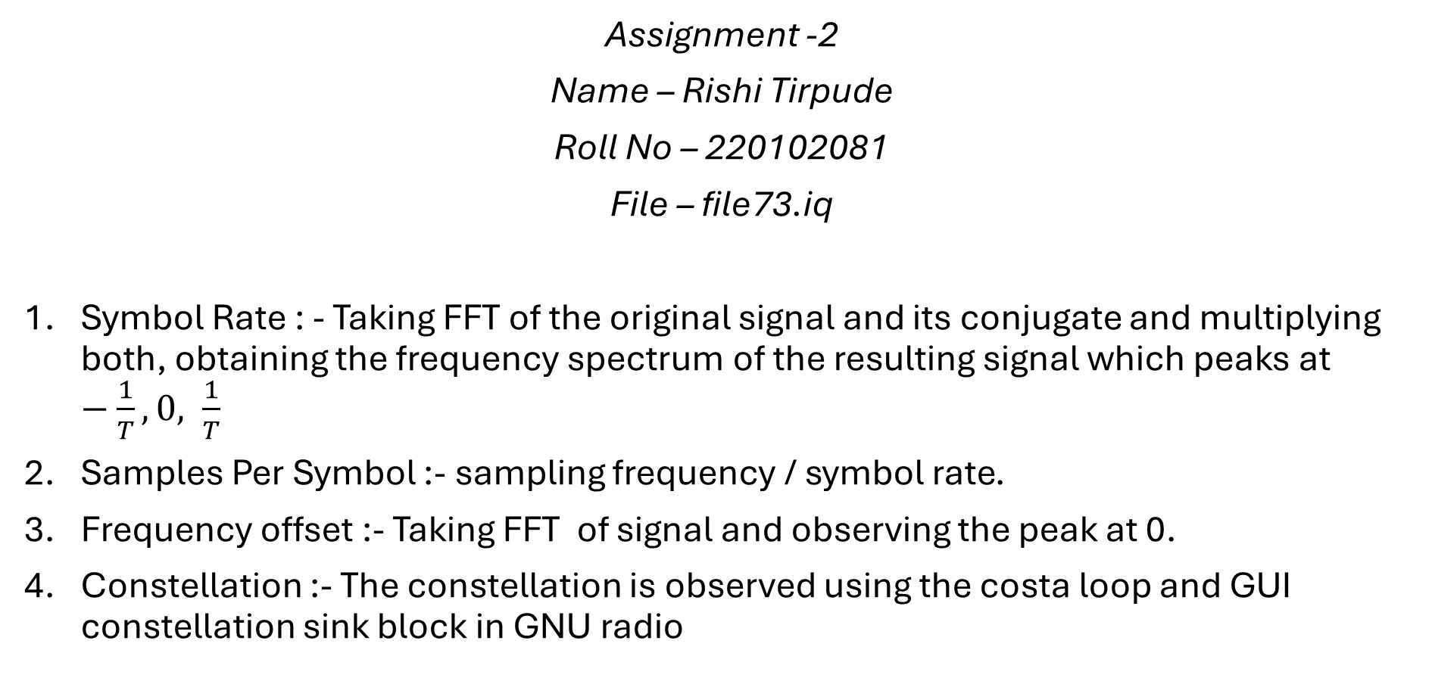
EE332 Digital Communication
Assignment -2
Name – Rishi Tirpude
Roll No – 220102081
File – file73.iq
Symbol Rate : - Taking FFT of the original signal and its conjugate and multiplying both, obtaining the frequency spectrum of the resulting signal which peaks at $−\frac{1}{T},0, \frac{1}{T}$
Samples Per Symbol :- sampling frequency / symbol rate.
Frequency offset :- Taking FFT of signal and observing the peak at 0.
Constellation :- The constellation is observed using the costa loop and GUI constellation sink block in GNU radio

Slide 2
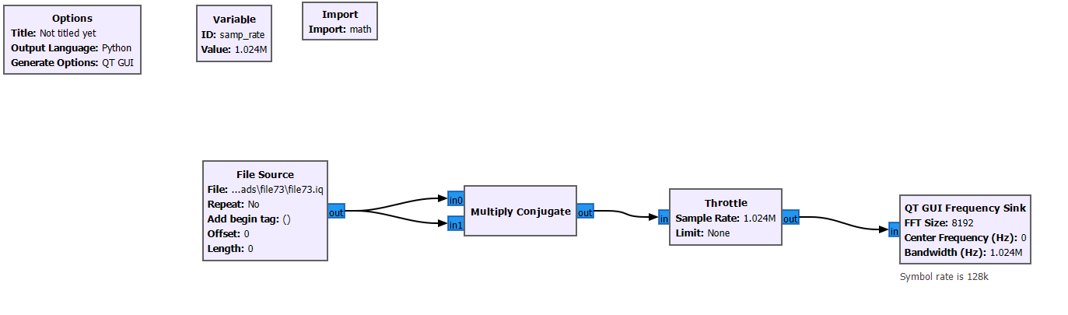
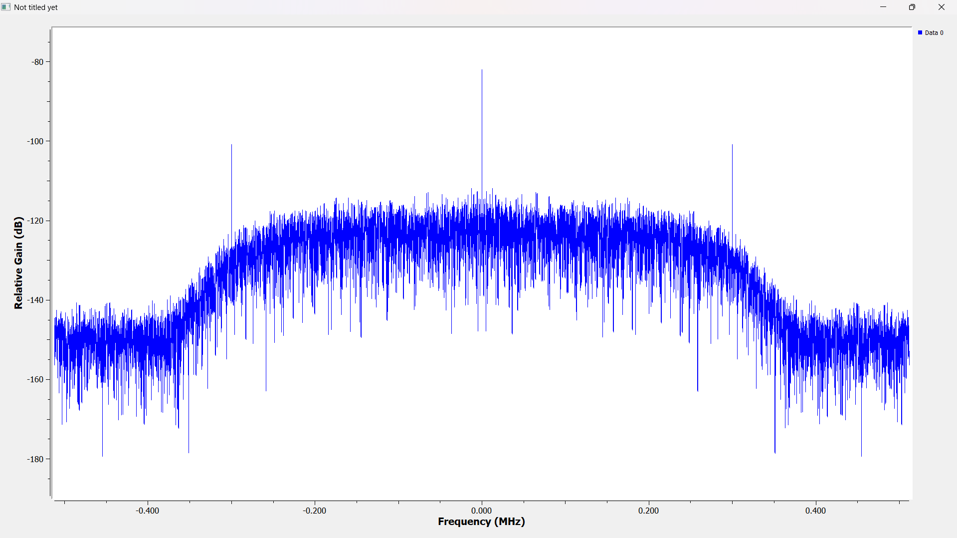
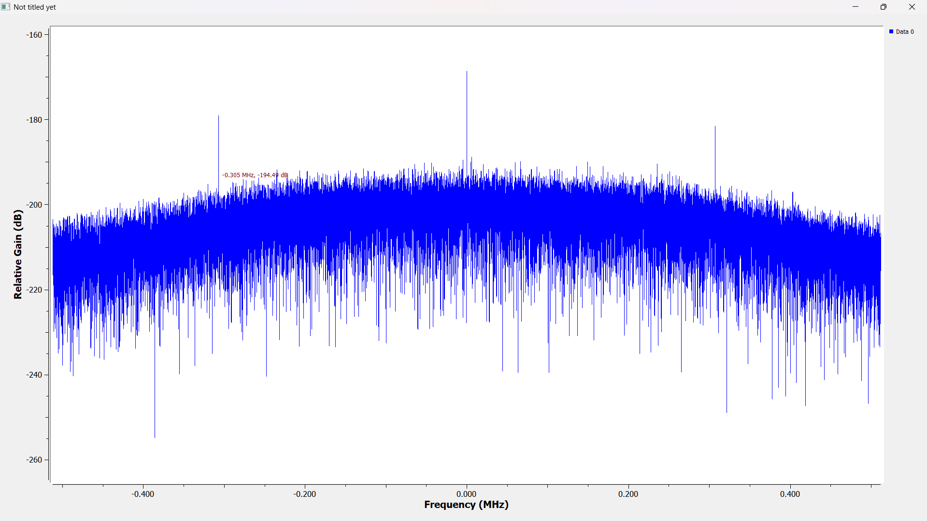
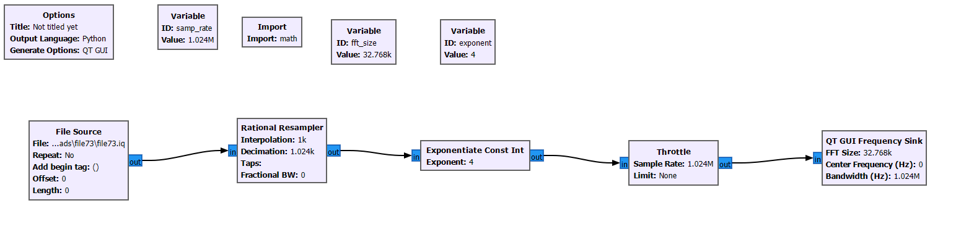
Symbol Rate: Output :-
We get symbol rate of 300kHz.
2. Samples per Symbol:- Output :-
On closely observing we find the peak at 0Hz to be exactly at the same place as before hence the offset observed is zero.

Slide 3
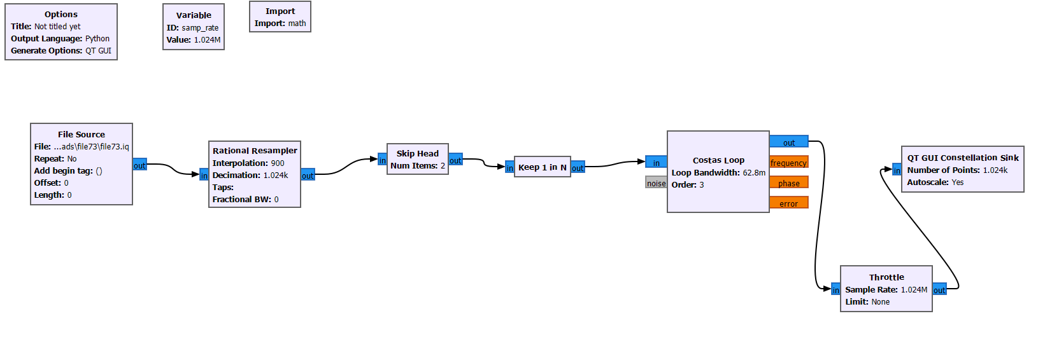
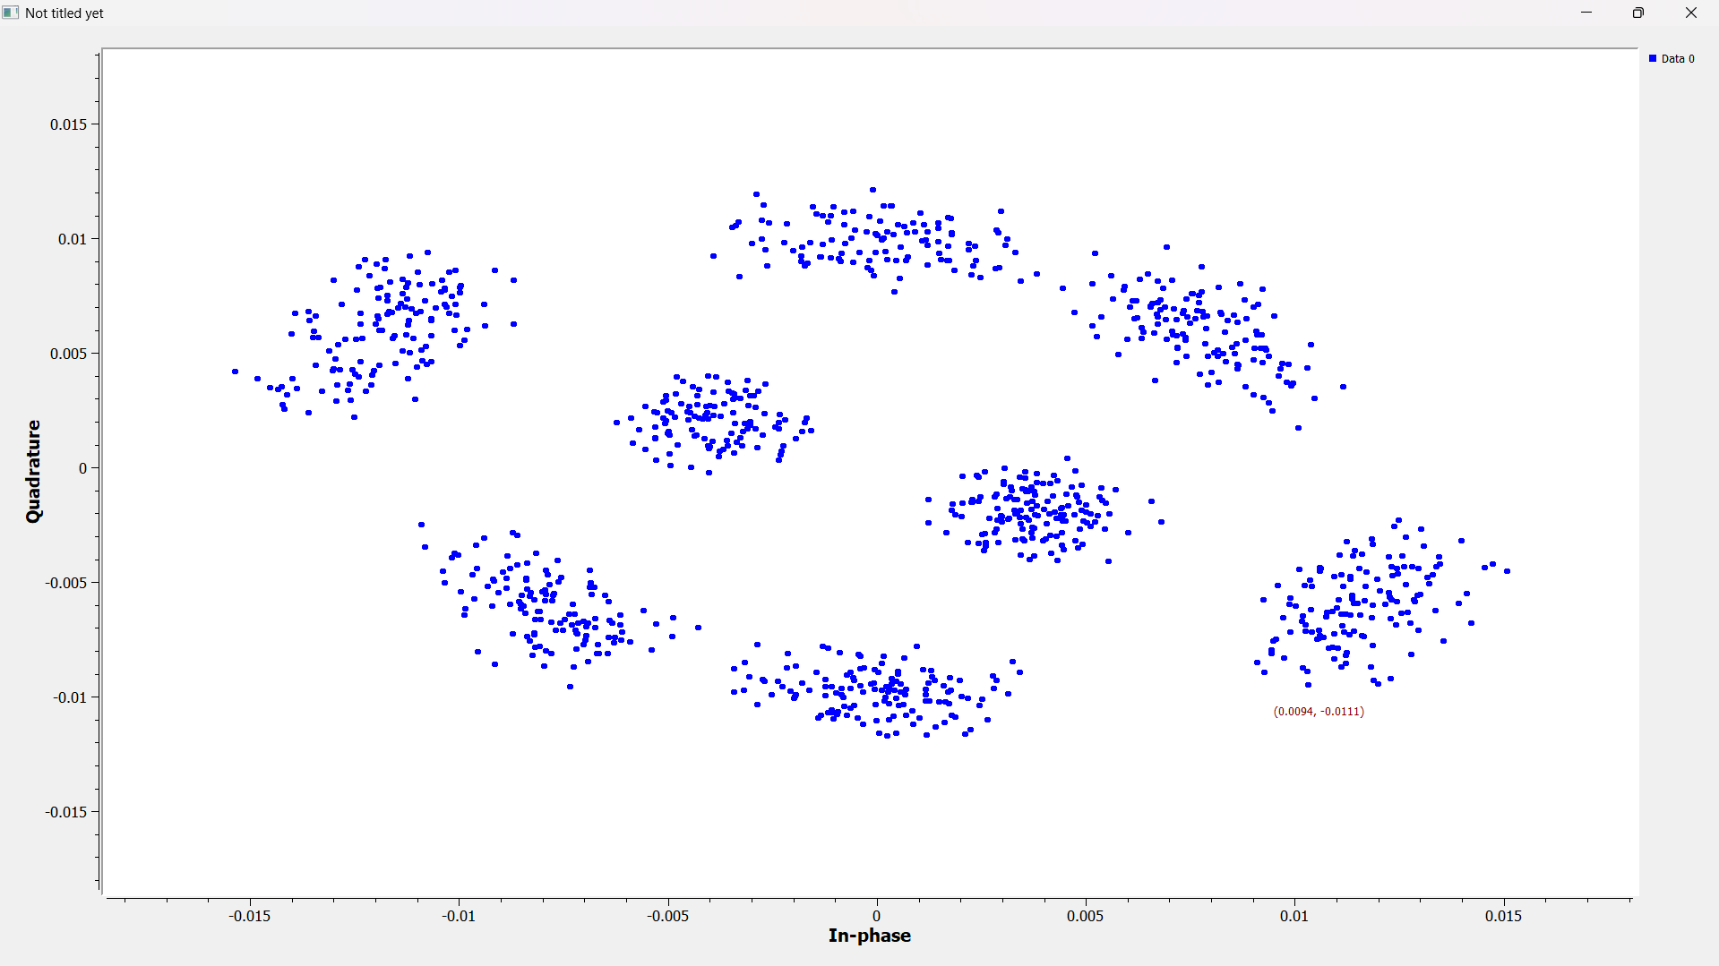
3. Constellation diagram :- Output :-
Observed Constellation – 8 QAM constellation.
Result:-
Symbol rate – 300kHz.
Samples Per Symbol – approx 3.
Offset – Zero.
4. Constellation – 8QAM

