Slide 1

Hybrid IoT-Based Swarm Intelligence and Digital Twin System for Traffic Optimization
INTERNAL GUIDE
Mrs. T.Adarana
(Assistant Professor)
Presented by
V Krishna Teja (23P61A66H6)
V Manasa (23P61A66H9)
S Sri Ram (23P61A66F4)

Slide 2
Content
ABSTRACT
LITERATURE SURVEY
EXISTING SYSTEM
PROPOSED SYSTEM
OBJECTIVES
UML DIAGRAMS
TECHNOLOGIES

Slide 3
ABSTRACT
Urban transportation systems face increasing traffic congestion, accidents, delayed emergency response, and inefficient traffic management, while existing systems are mostly reactive and provide limited real-time coordination between vehicles. A Cooperative AI Traffic Intelligence Network enables Vehicle-to-Vehicle (V2V) communication, Digital Twin-based traffic prediction, Swarm Robotics coordination, ambulance priority routing, and Blockchain-secured communication. The system creates a Digital Twin of the road network and uses Swarm Robotics principles so vehicles can cooperate and make better routing decisions. It also gives priority to ambulances by creating a clear traffic corridor. The system detects accidents, road hazards, wrong parking, and congestion in real time while remaining compatible with existing vehicles and future smart-city transportation infrastructure.
KEYWORDS:
Artificial Intelligence (AI), Internet of Things (IoT), Vehicle-to-Vehicle Communication (V2V), Digital Twin, Swarm Robotics, Blockchain, Smart Traffic Management, Emergency Vehicle Routing.

Slide 4
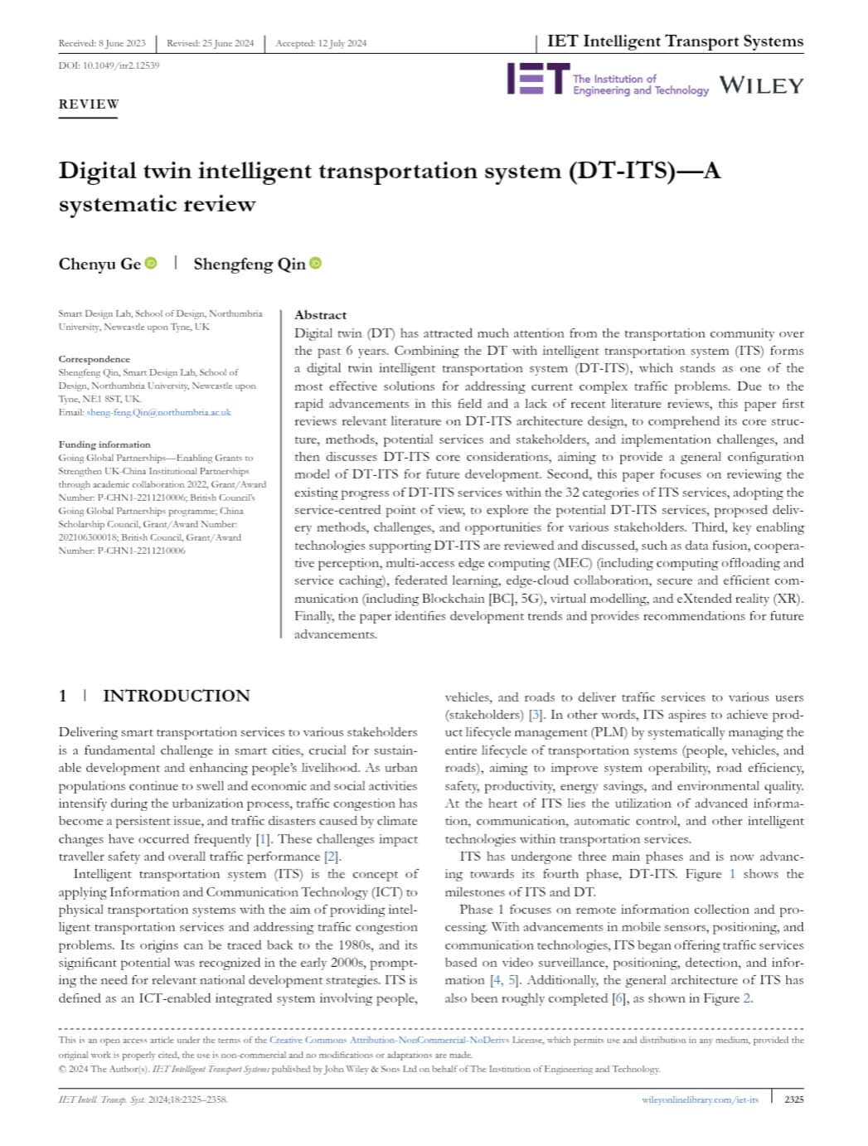
LITERATURE SURVEY
Existing System (in the paper)
Uses Digital Twin technology for transportation systems.
Creates a virtual model of roads and traffic.
Collects real-time traffic data from vehicles and sensors.
Monitors traffic conditions continuously.
Supports traffic analysis and route planning.
Research Gap
Focuses mainly on traffic monitoring and prediction.
Does not provide direct Vehicle-to-Vehicle (V2V) communication.
Limited cooperative decision-making among vehicles.
Does not include swarm intelligence-based traffic coordination.
Lacks secure blockchain-based communication for connected vehicles.

Slide 5
EXISTING SYSTEM
Existing Indoor Delivery Robots:
GPS-based navigation and traffic monitoring
Route guidance through map applications
Historical and real-time traffic estimation
Independent vehicle operation
Centralized traffic management approach
Limitations:
Traffic detected only after congestion forms
No direct Vehicle-to-Vehicle communication
Limited prediction of future traffic conditions
No automatic ambulance prioritization
Centralized systems have security and data-integrity risks

Slide 6
PROPOSED SYSTEM
AI-enabled device installed in every vehicle
Real-time Vehicle-to-Vehicle (V2V) communication
Uses Digital Twin for predictive traffic analysis
Applies Swarm Robotics for cooperative vehicle coordination
Provides ambulance priority routing through dynamic traffic corridors
Compatible with existing vehicles and future smart-city transportation systems
Secures communication using Blockchain technology
Advanced AI Dashboard that displays alerts, congestion levels, nearby hazards, and recommended actions from connected vehicles

Slide 7
OBJECTIVES
Establish Vehicle-to-Vehicle (V2V) communication for real-time cooperative driving
Provide priority routing for ambulances and emergency vehicles through dynamic traffic corridors
Detect accidents, wrong parking, road hazards, and congestion in real time
Secure communications using Blockchain technology for privacy and data integrity
Build a scalable smart-city transportation platform for future connected and autonomous vehicles

Slide 8
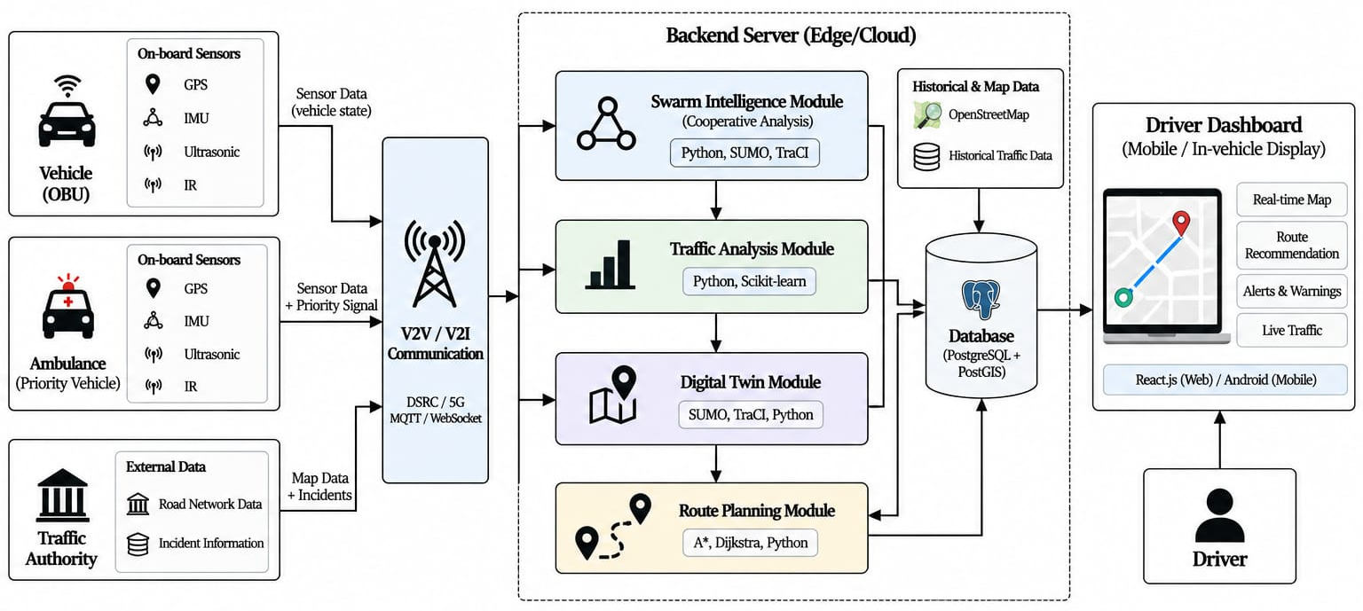
SYSTEM ARCHITECTURE

Slide 9
UML DIAGRAMS
CLASS DIAGRAM
USECASE DIAGRAM
SEQUENCE DIAGRAM

Slide 10
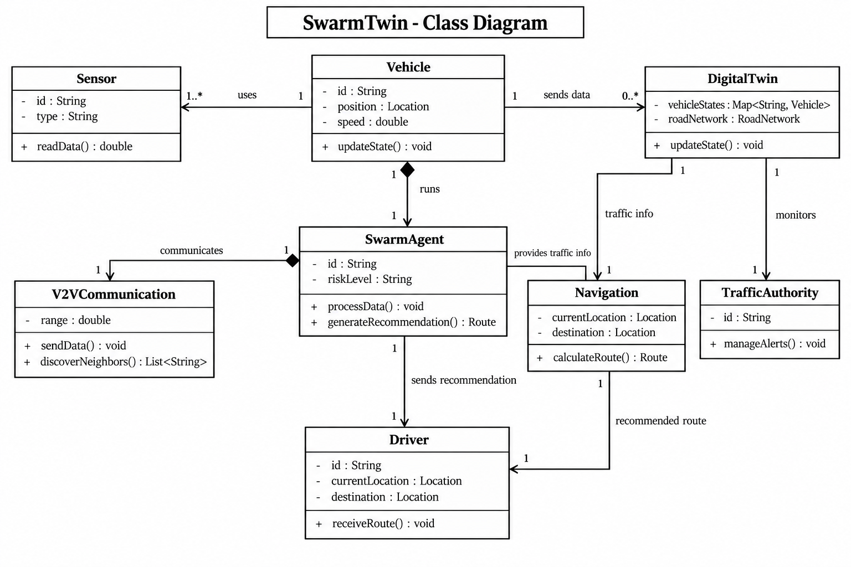
CLASS DIAGRAM

Slide 11
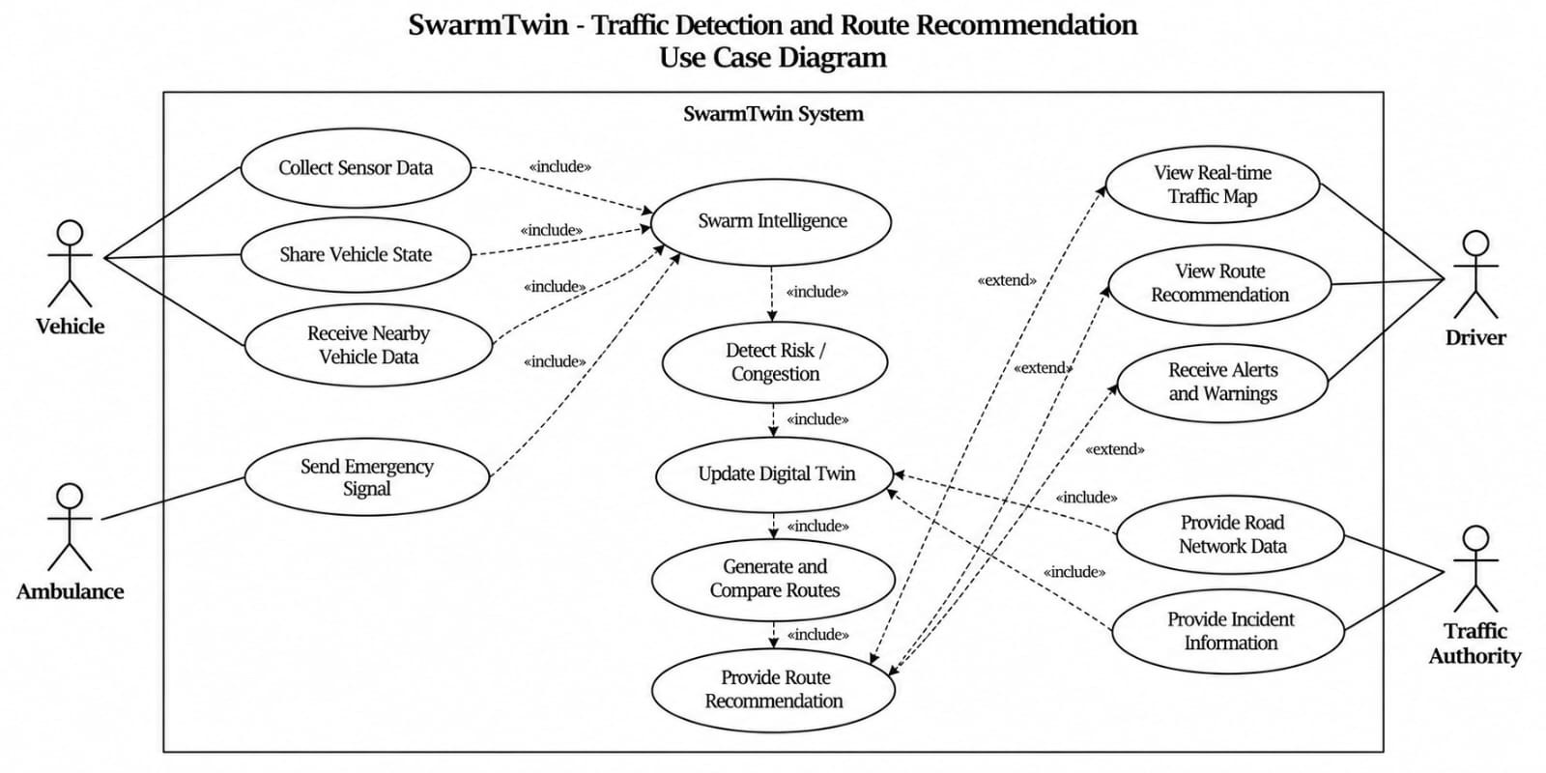
USECASE DIAGRAM

Slide 12
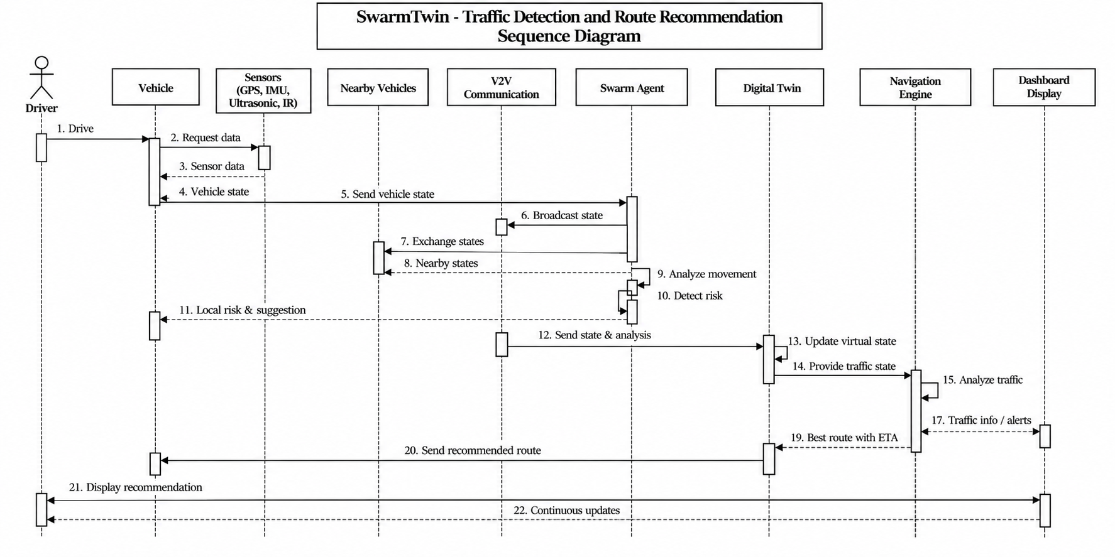
SEQUENCE DIAGRAM

Slide 13
TECHNOLOGIES
Programming languages : C++, Python, JavaScript
Frontend : HTML5, CSS3, JavaScript, React.js
Backend : Python, FastAPI, Websockets
Database : PostgreSQL
Hardware : ESP32, MPU6050, HC-SR04
Artificial intelligence : GRU, DBSCAN
Algorithms : Swarm Intelligence(PSO), A*(DT), Kalmal Filter
Libraries : Adafruit MPU6050, PubSubClient(MQTT), TraCI, scikit-learn
Simulation : Wokwi, SUMO, OpenStreetMap

Slide 14
THANK YOU

