Slide 1

Team Name : AICloud for Bharat
Team Leader Name : Rishi Yogi L.N
Problem Statement : Build an AI-powered multilingual solution that helps rural Indian citizens discover government schemes they are eligible for.

Slide 2
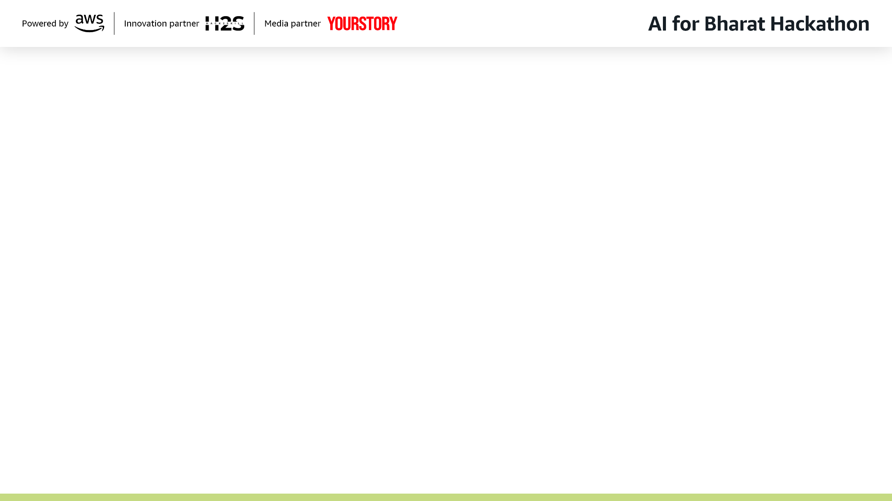
Brief about the Idea:
Project Summary – AICloud for Bharat
AICloud for Bharat is a multilingual AI assistant designed to help rural citizens discover government schemes they are eligible for.
The solution leverages AWS services such as Lambda, Bedrock (Nova 2, Titan), S3, EC2, API Gateway, CloudFront, CloudWatch and, VectorDB to deliver a scalable, cloud‑native platform.
Using Retrieval‑Augmented Generation (RAG), the system interprets complex eligibility conditions from official documents and transforms them into simplified, actionable next step guidance in Local regional languages.
By combining AI with AWS infrastructure, the platform ensures accessibility, accuracy and trust.
Citizens receive clear next steps, reducing misinformation and preventing exploitation.
This empowers individuals to claim welfare benefits effectively, promoting inclusive and sustainable socio‑economic growth across Bharat.

Slide 3
Why AI is required in your solution ? The normal architecture used is called Rule‑based architecture, in which a system makes decisions using predefined “IF – THEN” rules. Its main drawback is rigidity: it cannot adapt to New or unforeseen data, requires constant manual updates, and scales poorly compared to modern AI approaches.
Why Rule-Based Systems Fail and AI is Required regarding this Project ?
Scheme eligibility criteria are not simple yes/no conditions.
Government scheme eligibility involves Complex and Contextual Eligibility Rules.
Dynamic and Evolving Schemes: Government schemes are frequently updated, merged, or replaced.
New schemes are launched regularly.
Drawbacks in Rule-based
Rule-based systems require manual updates to decision trees and filters for every change, making them impossible to maintain at scale across hundreds of schemes and multiple languages.
This is why AI is much needed, not just beneficial but necessary for making government schemes accessible to rural India at scale.

Slide 4
How AWS services are used within your architecture?
The architecture is a hybrid serverless design:
AWS Lambda
Implements serverless logic for ingestion, RAG orchestration, and PDF generation.
Scales automatically with user demand.
Amazon EC2 (with ChromaDB)
Hosts the vector database service for embeddings.
Provides fast retrieval of relevant government scheme documents.
Amazon Bedrock (Nova 2, Titan)
Supplies the AI foundation models for natural language understanding.
Powers multilingual query interpretation and simplified scheme explanations.
Amazon CloudWatch
Monitors Lambda executions, API Gateway calls, and EC2 performance.
Provides logs, metrics, and alarms for observability.
Amazon S3
Hosts the multilingual frontend (HTML, CSS, JS).
Stores generated PDFs and other static assets.
Amazon CloudFront
Distributes the frontend globally with low latency.
Provides secure, cached access to the S3‑hosted UI.
Amazon API Gateway
Acts as the entry point for all user requests.
Routes queries from the frontend to backend Lambda functions.

Slide 5
What value the AI layer adds to the user experience?
Language Diversity & Semantic Understanding
India has 22 official languages and hundreds of dialects. Rural citizens often express their needs in local languages with varied vocabulary. Traditional keyword search or static translation fails to capture true intent.
The AI layer, powered by Retrieval‑Augmented Generation (RAG) and AWS Bedrock, understands semantic meaning across languages, interprets complex eligibility rules, and delivers simplified, actionable guidance in regional languages.
User Experience Benefits
• Citizens can ask questions naturally in their own language.
• AI interprets eligibility conditions and explains them clearly.
• Provides transparency with citations and confidence scores.
• Ensures trust by monitoring bias and logging decisions.
• Scales seamlessly through AWS serverless architecture.

Slide 6
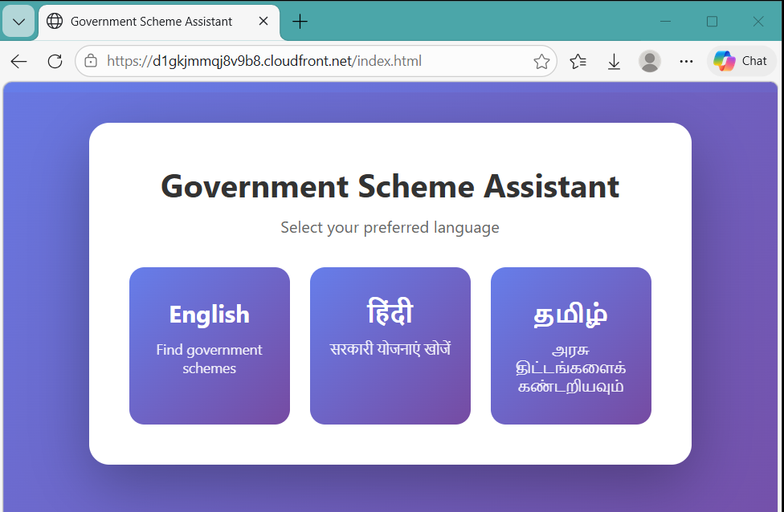
List of features offered by the solution
Multilingual support (currently designed for 3 languages).
Semantic eligibility matching for accurate scheme discovery.
Source citation for transparency and trust.
Confidence score indicator to show reliability of answers.
Bias monitoring and audit logging for fairness.
Secure cloud‑native deployment leveraging AWS services.
Scalable API architecture to handle growing demand.

Slide 7
Process flow diagram:
User
Input Collection
API Layer
RAG Engine
Vector DB
LLM
Response & Citation

Slide 8
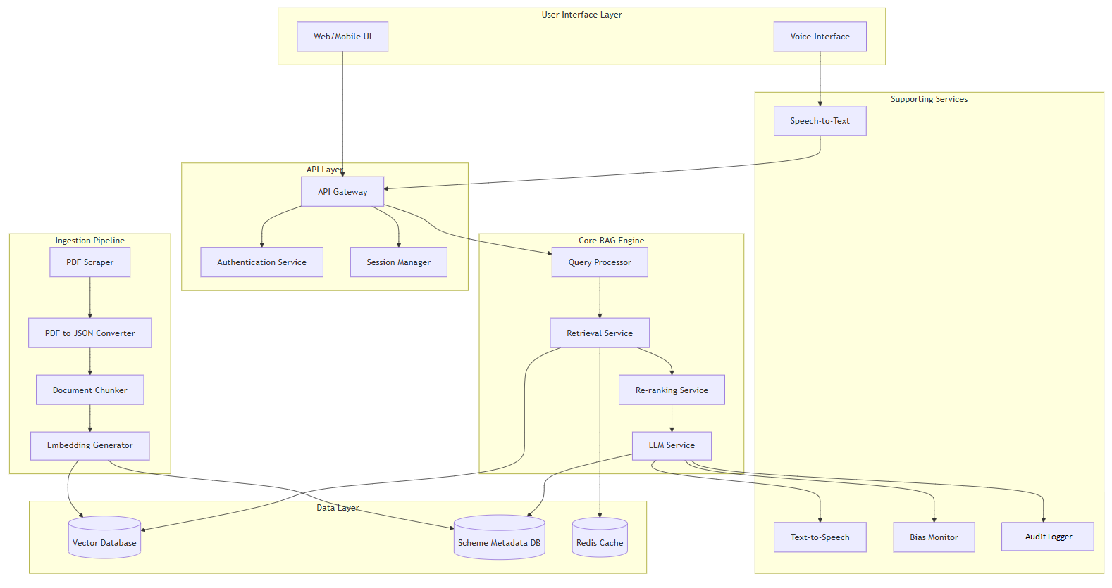
Architecture diagram of the proposed solution:

Slide 9
Technologies utilized in the solution:
Amazon S3 → Hosts the multilingual frontend and stores generated PDFs/static assets.
Amazon CloudFront → Provides secure, low‑latency content delivery for the frontend.
Amazon API Gateway → Entry point for user queries, routing requests to backend logic.
AWS Lambda → Serverless functions for ingestion, RAG orchestration, and PDF generation.
Amazon EC2 + ChromaDB → Vector database service for embeddings and semantic retrieval.
Amazon CloudWatch → Monitoring, logs, metrics, and alarms for observability.
Frontend (HTML/JS) → Simple, accessible user interface hosted on S3.
Retrieval‑Augmented Generation (RAG) → AI technique combining ChromaDB retrieval with Bedrock LLM generation. Amazon Bedrock → AI foundation models for multilingual query understanding and RAG responses.
Embedding Model: amazon.titan-embed-text-v2:0 (1024 dimensions)
This is used in the Ingestion Lambda. It converts text into embeddings (vectors) so they can be stored and later retrieved efficiently during query time.
LLM Model: global.amazon.nova-2-lite-v1:0 (Nova 2 Lite)
This is the Query Lambda model. It’s the large language model used to process and answer user queries

Slide 10
Estimated implementation cost (optional):
Cost Estimation
Prototype (Current Setup) Competitive and Architecture-heavy, hybrid-Serverless
(CloudFront+ Lambda + S3+ API Gateway + EC2+ Bedrock+ CloudWatch+ ChromaDB)
1 Week:
EC2 t3.micro: $0 (free tier - 750 hrs/month)
EBS 8GB: $0 (free tier)
Lambda: $0 (free tier - 1M requests)
API Gateway: $0 (free tier)
S3: $0 (free tier)
CloudFront: $0 (free tier)
Bedrock only: ~$2-5 (depends on usage)
Total: $2-5/week
1 Month:
EC2 t3.micro: $0 (free tier - 750 hrs/month)
EBS 8GB: $0 (free tier)
Lambda: $0 (free tier - 1M requests)
API Gateway: $0 (free tier)
S3: $0 (free tier)
CloudFront: $0 (free tier)
Bedrock only: ~$2-5 (depends on usage)
Bedrock: ~$5-10 (light testing)
Total: $5-10/month

Slide 11


