Slide 1
Book1vc
File created on: 01-06-2023 18:30:45

Slide 2
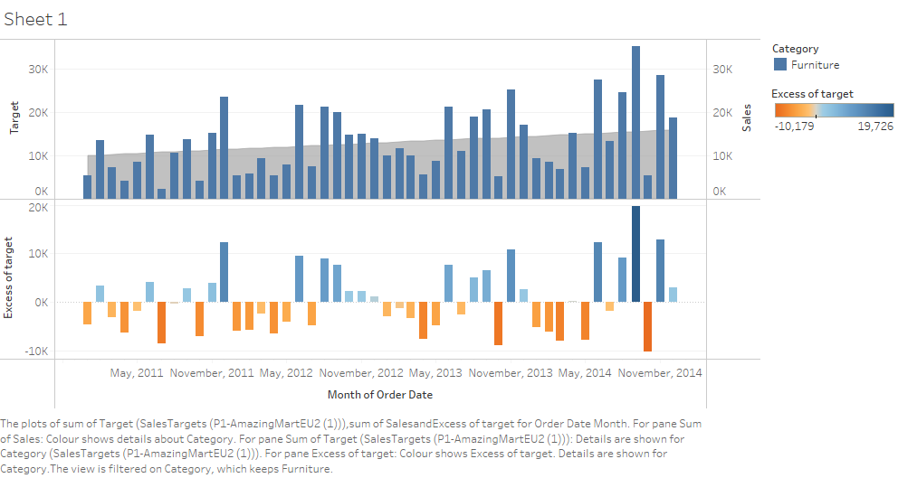

Slide 3


