Slide 1
Regional Training Institute
Jaipur
SQL Series
Manipulating Data

Slide 2
Objectives
After completing this session, you should be able to do the following:
  Describe Data Manipulation Language (DML) statements
  Insert rows into a table
  Update rows in a table
  Delete rows from a table
  Control transactions

Slide 3
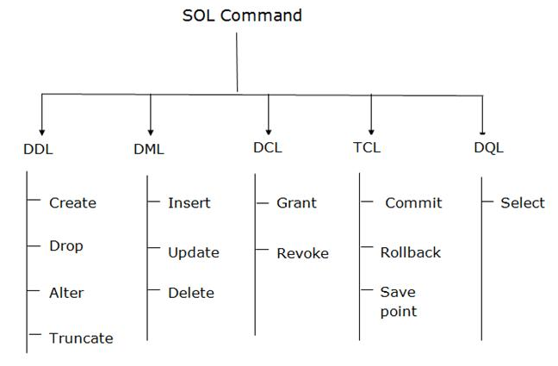
Types of SQL Commands
There are five types of SQL commands: DDL, DML, DCL, TCL, and DQL.

Slide 4
Data Definition Language (DDL)- TRUNCATE
TRUNCATE: It is used to delete all the rows from the table and free the space containing the table.
Syntax:
TRUNCATE TABLE table_name;
Example:
TRUNCATE TABLE EMPLOYEE;

Slide 5
Data Manipulation Language
A DML statement is executed when you:
  Add new rows to a table
  Modify existing rows in a table
  Remove existing rows from a table
A transaction consists of a collection of DML statements that form a logical unit of work
  For example, a bank customer transfers money from a savings account to a current account
  Here, the transaction might consist of three separate operations: decrease the savings account, increase the current account, and record the transaction in the transaction journal

Slide 6
Inserting New Rows
You can add new rows to a table by issuing the INSERT statement
  INSERT INTO DEPT
  VALUES (50, ‘DEVELOPMENT’, ‘DETROIT’);
This statement with the VALUES clause adds only one row at a time to a table
If you insert a row that contains values for each column, the column list is not required in the INSERT clause. However, the values must be listed according to the default order of the columns in the table
Character and date values must be enclosed within single quotation marks; but numeric values must not

Slide 7
Inserting a partially filled new row
A partially filled new row can be inserted by specifying the column list in the INSERT statement
INSERT INTO DEPT
(DEPTNO, DNAME)
VALUES (60, ‘PERSONNEL’);

Slide 8
Inserting Rows with Null Values
Implicit method:
Omitting the column from the column list
  INSERT INTO DEPT
  (DEPTNO, DNAME)
  VALUES (70, ‘MIS’);
Explicit method:
Specifying the NULL keyword in the VALUES list
  INSERT INTO DEPT
  VALUES (80, ‘FINANCE’, NULL);

Slide 9
Inserting Special Values
INSERT INTO emp
(empno, ename, job, mgr, hiredate, sal, comm, deptno)
VALUES (7196, ‘GREEN’, ‘SALESMAN’, 7782, SYSDATE, 2000, NULL, 10);
  Stores current date in the Hiredate column

Slide 10
Inserting Specific Date Values
The DD-MON-YY format is usually used to insert a date value
With this format, the century defaults to the current century with midnight (00.00.00) as default time
If a date is required to be entered in another century, the TO_DATE function can be used as shown below:
  INSERT INTO emp
  VALUES (2296, ‘AROMANO’, ‘SALESMAN’, 7782,
  TO_DATE(‘FEB 3, 1997, ‘MON DD, YYYY’),
  1300, NULL, 10);

Slide 11
Inserting Values by Using Substitution Variables
You can produce an INSERT statement that allows the user to add values interactively by using SQL*Plus substitution variables
INSERT INTO dept (deptno, dname, loc)
VALUES (&department_id, ‘&department_name’, ‘&location’);
Enter value for department_id: 90
Enter value for department_name: EDUCATION
Enter value for location: ATLANTA

Slide 12
Copying Rows from Another Table
You can use the INSERT statement to add rows to a table where the values are derived from existing tables
To do so, you use a subquery in place of the VALUES clause
  INSERT INTO managers
  (id, name, salary, hiredate)
  SELECT empno, ename, sal, hiredate
  FROM emp
  WHERE job = ‘MANAGER’;
  The number of columns and datatypes in the INSERT clause must match the number of columns and datatypes in the subquery

Slide 13
Changing Data in a Table
You can modify the existing rows by using the UPDATE statement
UPDATE emp
SET deptno = 20
WHERE empno = 7782;
  Specific row or rows are modified when you specify the WHERE clause
UPDATE emp
SET deptno = 20;
  All rows in the table are modified if you omit the WHERE clause

Slide 14
Updating with Multiple-Column Subquery
Updating employee 7698’s job and deptno to match that of employee 7499
UPDATE emp
SET (job, deptno) =
(SELECT job, deptno
FROM emp
WHERE empno = 7499)
WHERE empno = 7698;

Slide 15
Updating Rows Based on Another Table
UPDATE employee
SET deptno =
(SELECT deptno FROM emp
WHERE empno = 7788)
WHERE job =
(SELECT job FROM emp
WHERE empno = 7788);

Slide 16
Updating Rows: Integrity Constraint Error
If you attempt to update a record with a value that is tied to an integrity constraint, you will experience an error
UPDATE emp
SET deptno = 55
WHERE deptno = 10;
  Because, deptno 55 does not exist in the parent table (DEPT), you will get the “parent key not found” error message
Integrity constraints assure that the data adheres to a predefined set of rules

Slide 17
Removing a Row from a Table
You can remove existing rows from a table by using the DELETE statement
Specific row or rows are deleted when you specify the WHERE clause
  DELETE FROM department
  WHERE dname = ‘DEVELOPMENT’;
All rows in the table are deleted if you omit the WHERE clause
  DELETE FROM department;

Slide 18
Deleting Rows Based on Another Table
Use subqueries in DELETE statements to remove rows from a table based on values from another table.
SQL> DELETE FROM employee
WHERE deptno =

Slide 19
Data Control Language
DCL commands are used to GRANT and TAKE BACK authority from any database user.
Here are some commands that come under DCL:
Grant
Revoke

Slide 20
Data Control Language - Grant
GRANT: It is used to give user access privileges to a database.
Example:
GRANT SELECT, UPDATE ON MY_TABLE TO SOME_USER, ANOTHER_USER;
REVOKE: It is used to take back permissions from the user.
Example:
REVOKE SELECT, UPDATE ON MY_TABLE FROM USER1, USER2;

Slide 21
Transaction Control Language
TCL commands can only use with DML commands like INSERT, DELETE and UPDATE only.
These operations are automatically committed in the database that's why they cannot be used while creating tables or dropping them.
Here are some commands that come under TCL:
COMMIT
ROLLBACK
SAVEPOINT

Slide 22
Transaction Control Language - COMMIT
Commit: Commit command is used to save all the transactions to the database.
Syntex:
COMMIT;
Example:
DELETE FROM CUSTOMERS WHERE AGE = 25; COMMIT;

Slide 23
Transaction Control Language - Rollback
Rollback: Rollback command is used to undo transactions that have not already been saved to the database.
Syntex:
ROLLBACK;
Example:
DELETE FROM CUSTOMERS WHERE AGE = 25; ROLLBACK;
SAVEPOINT: It is used to roll the transaction back to a certain point without rolling back the entire transaction.
Syntex:
SAVEPOINT SAVEPOINT_NA ME;

