Slide 1



Slide 2


📊Project Title :Blinkit Sales Data Analysis
Name: Rishij Manna
College Name: Narula Institute of Technology
Department: Information Technology
📞 Contact Us
📱 Phone: 8981838547
🌐 Website: https://classroomtech.in
🔗 LinkedIn: https://www.linkedin.com/company/classroom-tech/
Duration: 3 months 1st April 2025 to 30th June 2025

Slide 3
Table of Contents
1
Objective
Goal of the project and key analytical questions
6
Key Findings
3–5 headline insights distilled from the analysis
2
Dataset Overview
Data source, size, and key fields used in analysis
Conclusion
Lessons learned and how the insights support
decision‑making
7
3
Tools Used
Power BI, GitHub
8
GitHub Link
URL to code, Power BI file, and datasets
Methodology
Data‑cleaning steps and the rationale behind chosen visualizations
4
9
Thank You
5
Visualizations & Insights
Individual charts with purpose and key takeaways

Slide 4
Objective / Problem Statement
Goal: To analyze Blink IT's customer, delivery, inventory, and marketing data using Power BI, and generate actionable insights that can improve customer experience, delivery performance, inventory management, and campaign effectiveness.
Key Objectives:
Identify loyal customers and analyze order patterns
Measure delivery delays and performance
Track product demand and stock levels
Evaluate marketing campaigns based on ROAS
Understand customer feedback and satisfaction
Forecast future inventory needs

Slide 5
Dataset Overview
Dataset Name: Blinkit Sales Dataset
Source: Kaggle : https://www.kaggle.com/datasets/akxiit/blinkit-sales-dataset
5. blinkit_inventoryNew.csv
Shape: 1,500 rows × 5 columns
Key Columns:
product_id
damaged_percentage
Used for: Analyzing damaged stock rates
6. blinkit_marketing_performance.csv
Shape: 300 rows × 6 columns
Key Columns:
campaign_id, campaign_name
spend, revenue_generated, ROAS
Used for: Evaluating campaign effectiveness
7. blinkit_order_items.csv
Shape: 50,000 rows × 4 columns
Key Columns:
order_id, product_id
quantity, price
Used for: Product-level sales analysis
8. blinkit_orders.csv
Shape: 20,000 rows × 5 columns
Key Columns:
order_id, customer_id
order_date, store_id, delivery_status
Used for: Order volume and trends
1. blinkit_customer_feedback.csv
Shape: 5,000 rows × 3 columns
Key Columns:
Customer_id
feedback_category
feedback_text
Used for: Analyzing customer complaints & satisfaction
2. blinkit_customers.csv
Shape: 10,000 rows × 5 columns
Key Columns:
customer_id
customer_name
address, phone, email
Used for: Customer segmentation, location-based trends
3. blinkit_delivery_performance.csv
Shape: 15,000 rows × 4 columns
Key Columns:
order_id
delivery_time_minutes
delivery_delay_minutes
delivery_status
Used for: Measuring delivery efficiency and delay.
4. blinkit_inventory.csv
Shape: 1,500 rows × 4 columns
Key Columns:
product_id
stock_received
month, year
Used for: Stock movement over time
9. blinkit_products.csv
Shape: 1,000 rows × 5 columns
Key Columns:
product_id, product_name
category, price, discount_percentage
Used for: Product and pricing analytics
10. Category_Icons.xlsx
Shape: ~20 rows × 2 columns
Key Columns:
category, icon_url
Used for: Dashboard visuals and category mapping

Slide 6
Tools Used
Methodology
Power BI – For data visualization, dashboard creation, and insights extraction
GitHub – For storing the project files, datasets,and report
Data Preprocessing:
The dataset from Kaggle was already well-structured and cleaned. No major missing values or outliers were found during initial inspection. Basic validation was done to ensure consistency across files (e.g., matching product_id, order_id, and customer_id across tables).
Visualization Process:
Power BI was used to create interactive dashboards and visualizations including:
Bar Charts for order counts, product sales, and feedback distribution
Line Charts and Time Series for monthly trends and stock forecasts
Donut Charts for customer segments and feedback categories
KPI Cards to highlight revenue, customer retention, and order value
Funnel Charts and Decomposition Trees to track campaign performance and segment insights

Slide 7
Slide 7: Key Findings
Top insights gathered from the Power BI analysis of BlinkIT’s datasets:
Peak Order Months Identified Highest order volumes were recorded in August 2023 and May 2023, indicating seasonal demand spikes.
Delivery Performance is Strong but Needs Improvement Over 70% of deliveries are on time, but around 30% experience delays, mostly slight — suggesting opportunities in route or slot optimization.
High-Damage Products Detected Products like Toilet Cleaner and Detergent have damage rates over 20%, indicating issues in packaging or transport.
Marketing Campaign ROI is Uneven Campaigns like Referral Programs and Festival Offers show high ROAS (~3.9+), while others perform poorly — suggesting a need for budget reallocation.
High-Value Customers Identified Some customers, like Aadhya Cherian, have CLV above ₹28,000, highlighting potential for premium segmentation and retention strategies.

Slide 8
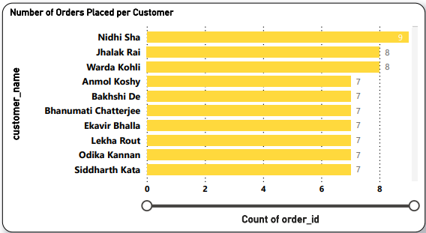
1️⃣ Number of Orders Placed per Customer
Purpose: To display which customers have placed the highest number of orders.
Visual: Horizontal bar chart (X-axis: order count, Y-axis: customer names)
Insights:
Nidhi Sha has the highest orders (9).
Multiple customers have 7–8 orders, showing repeat buying behavior.
Useful to target loyal customers with offers and retention campaigns.

Slide 9
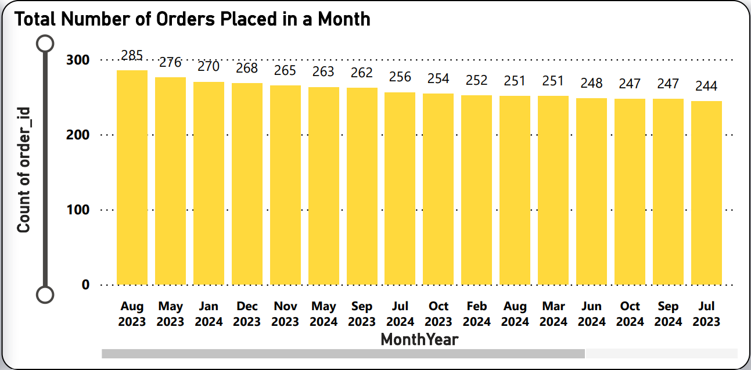
2️⃣ Total Number of Orders Placed in a Month
Purpose: To track order volume trends by month.
Visual: Vertical bar chart (X-axis: Month-Year, Y-axis: total orders)
Insights:
Peak orders in August 2023 (285) and May 2023 (276).
Order volume stays consistent month to month.
Helps plan campaigns, manpower, and stock for busy periods.

Slide 10
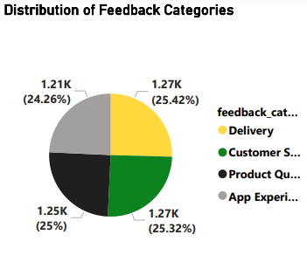
3️⃣ Distribution of Feedback Categories
Purpose: To understand which areas customers give the most feedback about.
Visual: Pie chart with slices for Delivery, Customer Service, Product Quality, App Experience.
Insights:
Feedback is evenly spread across all 4 categories (~24–25% each).
No single area dominates, so multiple teams need to improve together.
Confirms the need for holistic service improvement.

Slide 11
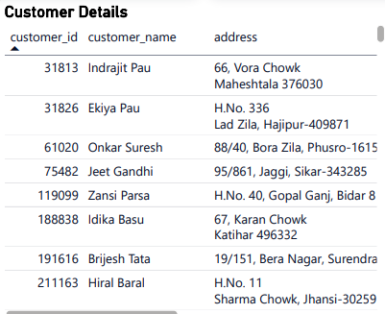
4️⃣ Customer Details
Purpose: To view basic details about individual customers.
Visual: Table with customer ID, name, and address.
Insights:
Supports address validation for deliveries.
Useful for store or zone-level order tracking.
Can be used for personalized service and communication.

Slide 12
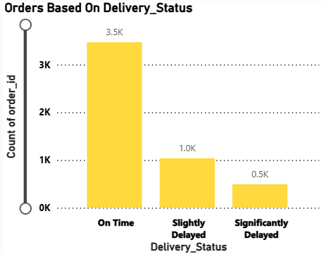
5️⃣ Orders Based on Delivery Status
Purpose: To show how many orders were on time, slightly delayed, or significantly delayed.
Visual: Vertical bar chart (X-axis: Delivery Status, Y-axis: order count)
Insights:
3.5K orders delivered on time, 1K slightly delayed, 0.5K significantly delayed.
Over 70% orders meet delivery promises.
Highlights where process improvements can cut delays further.

Slide 13
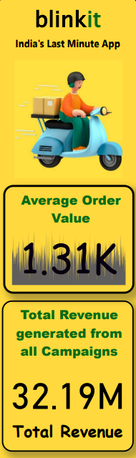
6️⃣ Average Order Value (AOV)
Purpose: To show the average value of each customer’s order across all transactions.
Visual: KPI Card displaying 1.31K (currency implied)
Insights:
Indicates that each order brings in about 1,310 units of currency.
Helpful for tracking customer spending behavior.
Can be used to plan upselling or bundled offers to increase basket size.
7️⃣ Total Revenue from Campaigns
Purpose: To display the total revenue generated from all marketing campaigns combined.
Visual: KPI Card showing 32.19M total revenue.
Insights:
Highlights the overall contribution of advertising to sales.
Shows the effectiveness of the App Push Notification strategy.
Helps marketing managers justify ad spend and ROI.

Slide 14
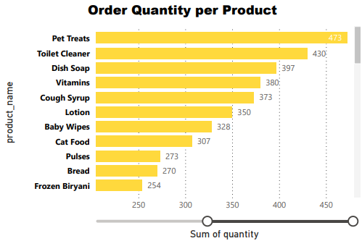
8️⃣Order Quantity per Product
Purpose: To see which products sell the most by volume.
Visual: Horizontal bar chart by product and quantity.
Insights:
Pet Treats, Dish Soap lead in quantity sold.
Guides restocking priorities.
Shows top revenue drivers.

Slide 15
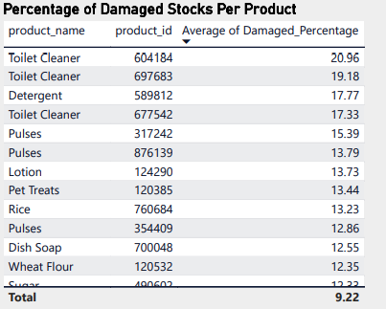
9️⃣Percentage of Damaged Stocks Per Product
Purpose: To detect which products have high damage rates.
Visual: Table with product name, ID, and damage percentage.
Insights:
Toilet Cleaner, Detergent are high risk.
Fix packaging to reduce waste.
Protects profit margins.

Slide 16
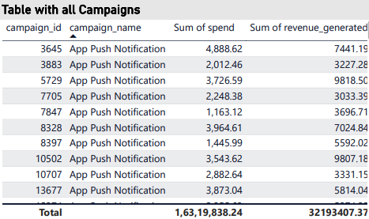
🔟 Campaign Table
Purpose: To list and compare individual marketing campaigns by spend and revenue.
Visual: Table with columns: campaign_id, campaign_name, Sum of spend, Sum of revenue_generated
Insights:
Shows spend ranges from ~1K to ~5K per campaign.
Revenue generated is higher than spend for most campaigns.
Provides a clear ROI view for each campaign, enabling better budget allocation.

Slide 17
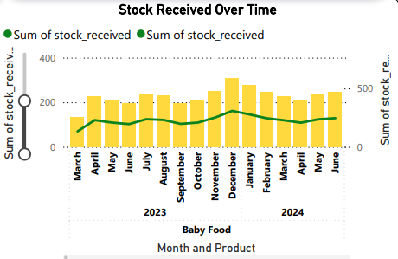
1️⃣1️⃣ Stock Received Over Time
Purpose: To track how much stock is received each month.
Visual: Line and column chart by month and product.
Insights:
Stock peaks in Oct–Dec.
Helps with demand forecasting.
Ensures stock levels match sales needs.

Slide 18
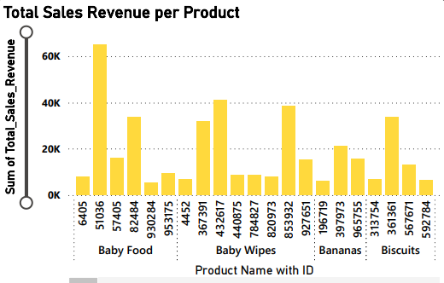
1️⃣2️⃣ Total Sales Revenue per Product
Purpose: To display which products generate the highest total revenue.
Visual: Vertical bar chart (X-axis: Product with ID, Y-axis: Total Sales Revenue)
Insights:
Baby Food and Baby Wipes are top revenue drivers.
Bananas and Biscuits also contribute significant sales.
Helps managers focus promotions and stock planning on profitable items.

Slide 19
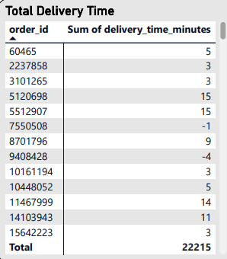
1️⃣3️⃣ Total Delivery Time
Purpose: To show the delivery time (in minutes) for each order.
Visual: Table with columns: order_id and Sum of delivery_time_minutes.
Insights:
Most deliveries fall within 3–15 minutes.
Some negative or zero values indicate data entry errors.
Useful for monitoring delivery speed and cleaning bad data.

Slide 20
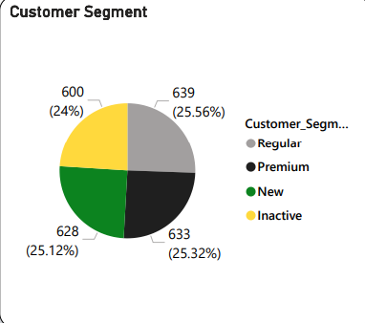
1️⃣4️⃣ Customer Segment
Purpose: To show the proportion of customers in each segment.
Visual: Pie chart with segments: Regular, Premium, New, Inactive.
Insights:
Segments are evenly spread (24–25% each).
Indicates a balanced mix of loyal, new, and inactive customers.
Helps tailor offers to re-engage inactive users.

Slide 21
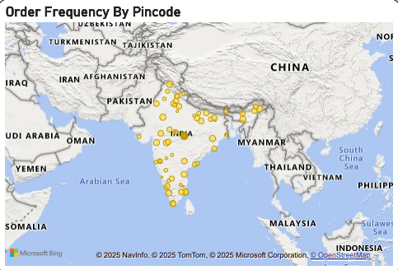
1️⃣5️⃣ Order Frequency by Pincode
Purpose: To visualize where orders are coming from geographically.
Visual: Map with pin markers for order locations by pincode.
Insights:
Clusters show dense order activity in key states.
Helps optimize delivery hubs and expansion plans.
Useful for region-wise marketing.

Slide 22
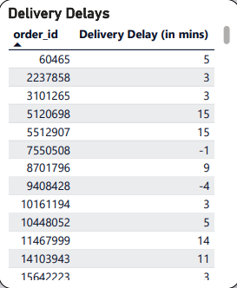
1️⃣6️⃣ Delivery Delays
Purpose: To display delivery delays for each order.
Visual: Table with order_id and Delivery Delay (mins).
Insights:
Most delays are under 15 mins.
Some negative values highlight possible data corrections needed.
Supports logistics performance tracking.

Slide 23
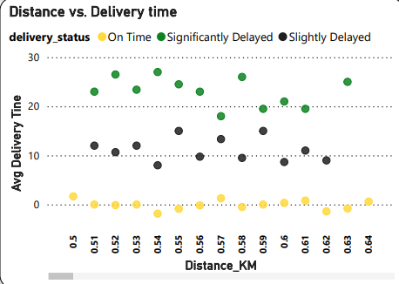
1️⃣7️⃣ Distance vs Delivery Time
Purpose: To show how delivery time changes with distance.
Visual: Scatter plot (X-axis: Distance KM, Y-axis: Average Delivery Time) with color by delivery status.
Insights:
Slight upward trend — longer distance means longer time.
On Time, Slightly Delayed, and Significantly Delayed are clearly distinguished.
Helps optimize routes for faster delivery.

Slide 24
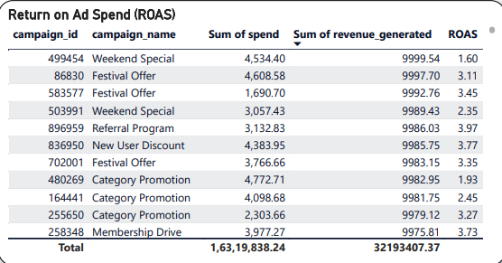
1️⃣8️⃣ Return on Ad Spend (ROAS)
Purpose: To measure the effectiveness of each marketing campaign based on return on ad spend.
Visual: Table showing campaign_id, campaign_name, spend, revenue generated, and ROAS.
Insights:
Highest ROAS: New User Discount (3.77), Festival Offer (3.45), Referral Program (3.19).
Most campaigns generate more than they cost.
Critical for reallocating marketing budget toward high-performing campaigns.

Slide 25
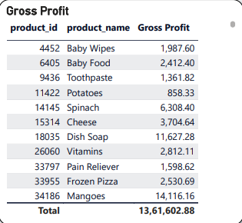
1️⃣9️⃣ Gross Profit by Product
Purpose: To show which products generate the highest gross profit.
Visual: Table with product_id, product_name, and gross profit amount.
Insights:
Top product: Mangoes (₹14,116), followed by Dish Soap, Spinach, and Cheese.
Baby Wipes and Baby Food are also profitable.
Helps focus on stocking and marketing high-profit items.

Slide 26
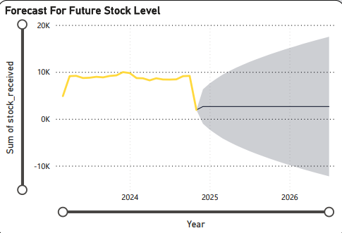
2️⃣0️⃣ Forecast for Future Stock Level
Purpose: To predict future stock levels using past trends.
Visual: Line chart with shaded area for forecasted values (2023–2026).
Insights:
Stock is projected to drop sharply after 2024.
May lead to stockouts if no procurement plan is in place.
Calls for proactive inventory planning for 2025–2026.

Slide 27
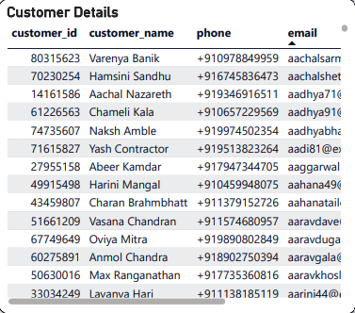
2️⃣1️⃣ Customer Details
Purpose: To provide customer-specific information such as ID, name, phone number, and email for operational or marketing reference.
Visual: Detailed table with columns: customer_id, customer_name, phone, email.
Insights:
Supports personalized communication and marketing campaigns.
Useful for customer service tracking, re-engagement, and segment-based targeting.
Can be used to identify frequent or VIP customers for loyalty programs.

Slide 28
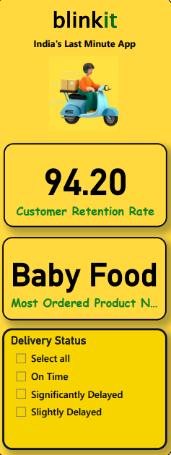
2️⃣2️⃣Customer Retention Rate
Purpose: To show how many customers return for repeat purchases.
Visual: KPI card showing “94.20” as the retention percentage.
Insights:
High retention rate (94.2%) indicates strong customer satisfaction.
Reflects effective engagement and loyalty management.
2️⃣3️⃣ Most Ordered Product
Purpose: To highlight the product with the highest number of total orders.
Visual: Highlight card labeled “Baby Food – Most Ordered Product”.
Insights:
Baby Food is the most frequently purchased item.
Suggests high demand and essential inventory priority.
2️⃣4️⃣ Delivery Status Filter
Purpose: To filter order-level delivery records based on timeliness.
Visual: Slicer box with four options: On Time, Slightly Delayed, Significantly Delayed, Select All.
Insights:
Enables focused analysis of delays for operational efficiency.
Helpful in reviewing logistics team performance and root-cause analysis.
Allows dynamic visual filtering across the entire dashboard.

Slide 29
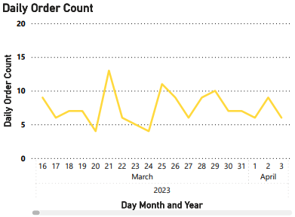
2️⃣5️⃣ Daily Order Count
Purpose: To track the number of orders placed each day.
Visual: Line chart (X-axis: Day, Month, Year; Y-axis: Order Count)
Insights:
Order volume fluctuates daily but stays within a stable range.
Peaks help plan daily staffing and delivery slots.
Identifies any sudden drop-offs needing action.

Slide 30
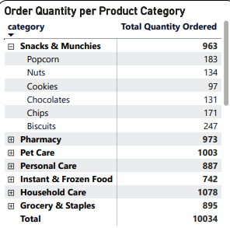
2️⃣6️⃣ Order Quantity per Product Category
Purpose: To show which product categories have the highest total orders.
Visual: Table with categories and total quantity ordered.
Insights:
Household Care, Pet Care, and Pharmacy lead in quantity.
Snacks & Munchies show good demand too.
Helps plan category promotions and restocking priorities.

Slide 31
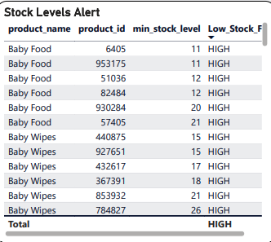
2️⃣7️⃣ Stock Levels Alert
Purpose: To identify products that have hit low stock levels.
Visual: Table listing product names, IDs, and low stock flags.
Insights:
All listed items are flagged HIGH for low stock.
Mostly Baby Food and Baby Wipes — high turnover products.
Supports timely reordering to avoid stockouts.

Slide 32
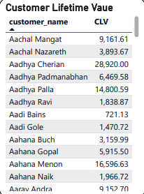
2️⃣8️⃣ Customer Lifetime Value (CLV)
Purpose: To display the total lifetime value of each customer.
Visual: Table with customer names and CLV.
Insights:
Customers like Aadhya Cherian and Aadhya Palla have very high CLV.
Shows who contributes the most to revenue long-term.
Useful for loyalty programs and retention marketing.

Slide 33
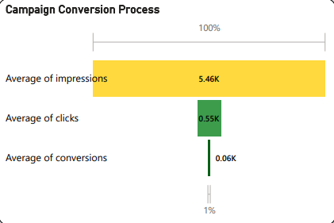
2️⃣9️⃣ Campaign Conversion Process
Purpose: To show how impressions convert to clicks and then to conversions.
Visual: Funnel or bar chart with average impressions, clicks, and conversions.
Insights:
Starts at 5.46K impressions, drops to 0.55K clicks, then 0.06K conversions.
Reveals a ~1% conversion rate.
Helps refine targeting and ad creative.

Slide 34
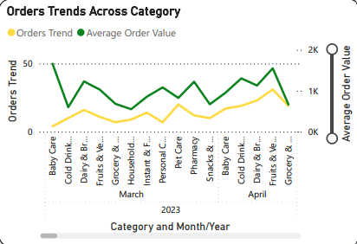
3️⃣0️⃣ Orders Trends Across Category
Purpose: To compare order trends and average order value by category.
Visual: Dual line chart — one for orders trend, one for average order value.
Insights:
Baby Care, Snacks, and Cold Drinks see steady demand.
Average order value varies across categories.
Supports tailored promotions for different product lines.

Slide 35
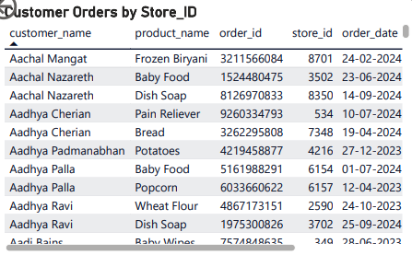
3️⃣1️⃣ Customer Orders by Store ID
Purpose: To see which customer bought which product, from which store, and when.
Visual: Table with customer_name, product_name, order_id, store_id, and order_date.
Insights:
Helps map order activity to specific stores.
Tracks which products are popular at different locations.
Supports store-level inventory and service planning.

Slide 36
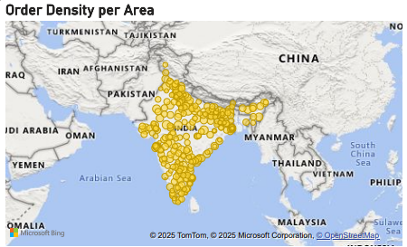
3️⃣2️⃣ Order Density per Area
Purpose: To visualize where most orders are placed geographically.
Visual: Map with pins showing order concentration.
Insights:
High density in major cities and states.
Useful for optimizing delivery zones.
Helps plan regional marketing or new hub locations.

Slide 37
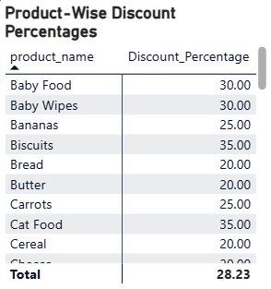
3️⃣3️⃣ Product-Wise Discount Percentages
Purpose: To display how much discount is applied to each product.
Visual: Table with product_name and Discount_Percentage.
Insights:
Highest discounts on Cat Food, Biscuits, and Baby Food (~30–35%).
Average discount ~28%.
Supports pricing strategy and promotion planning.

Slide 38
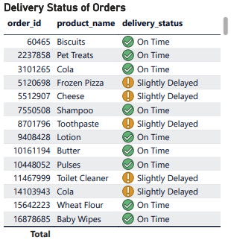
3️⃣4️⃣ Delivery Status of Orders
Purpose: To show the status of delivery for each product and order.
Visual: Table with order_id, product_name, and delivery_status.
Insights:
Most items marked On Time.
Frozen Pizza, Cheese, and Toilet Cleaner show slight delays.
Monitors delivery performance by product.

Slide 39
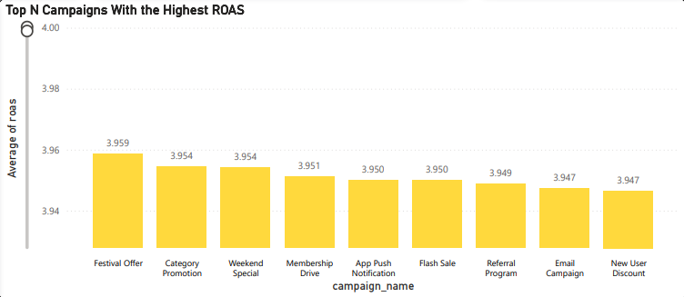
3️⃣5️⃣ Top N Campaigns with Highest ROAS
Purpose: To highlight marketing campaigns that deliver the best return on ad spend.
Visual: Column chart showing campaign names and average ROAS.
Insights:
Festival Offer and Category Promotion lead with ROAS ~3.95–3.96.
Referral and Email Campaigns perform well too.
Supports decisions on which campaigns to scale or repeat.

Slide 40
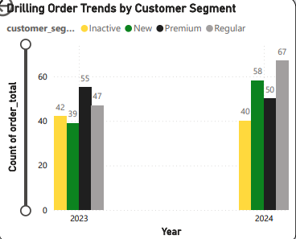
3️⃣6️⃣ Drilling Order Trends by Customer Segment
Purpose: To show how order counts change for each customer segment over years.
Visual: Clustered column chart by year and segment (Inactive, New, Premium, Regular).
Insights:
Regular and New segments show growth from 2023 to 2024.
Inactive customers reduced slightly — sign of good retention.
Supports targeting segments with tailored campaigns.

Slide 41
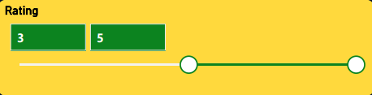
3️⃣7️⃣ Rating
Purpose: To display selected rating value for filters or scenario checks.
Visual: Numeric scale or card showing rating value (3 to 5).
Insights:
Shows customer feedback or rating scale for current filter.
Used for simulating impact of high vs low ratings.
Useful for service quality tracking.

Slide 42
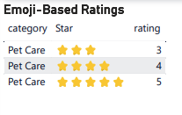
3️⃣8️⃣ Emoji-Based Ratings
Purpose: To show customer product/service ratings using emoji stars.
Visual: Table with category, Star, and rating.
Insights:
Pet Care category shows average ratings of 3–5 stars.
Indicates high satisfaction for Pet Care items.
Supports maintaining product/service standards.

Slide 43
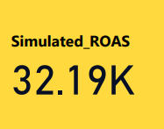
3️⃣9️⃣ Simulated ROAS
Purpose: To test possible Return on Ad Spend with hypothetical scenarios.
Visual: KPI card displaying 32.19K simulated ROAS.
Insights:
Shows what ROI could look like under adjusted budgets.
Helps managers decide on budget changes.
Useful for financial planning and forecasting.

Slide 44
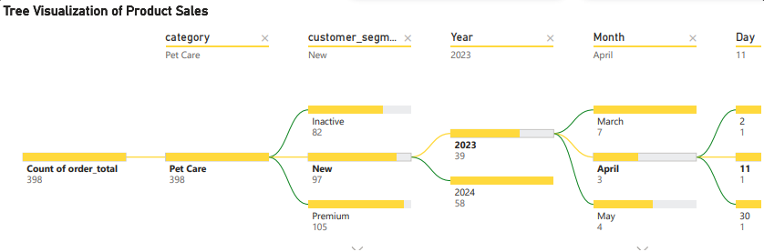
4️⃣0️⃣ Tree Visualization of Product Sales
Purpose: To break down product sales by category, customer segment, year, month, and day.
Visual: Tree or Sankey diagram with multiple levels.
Insights:
Pet Care shows 398 total orders, split by segments and dates.
New segment contributes the most.
Gives a clear drill-down path for deep analysis.

Slide 45
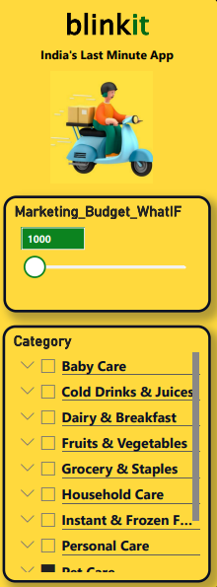
4️⃣1️⃣Marketing Budget What-If
Purpose: To simulate budget changes and see impact on metrics.
Visual: Slider bar or input field for budget with adjustable value (e.g. 1,000).
Insights:
Enables testing how spending more or less affects ROAS.
Supports better allocation of ad spend.
Aids scenario-based planning.
4️⃣2️⃣ Category Filter Panel
Purpose: To let users filter visuals by product categories.
Visual: Category checklist with options for Baby Care, Snacks, Pet Care, etc.
Insights:
Enables focused analysis on selected product lines.
Useful for customized dashboard views.
Helps compare performance category-wise.

Slide 46
Key Findings
Peak Order Months Identified Highest order volumes were recorded in August 2023 and May 2023, indicating seasonal demand spikes.
Delivery Performance is Strong but Needs Improvement Over 70% of deliveries are on time, but around 30% experience delays, mostly slight — suggesting opportunities in route or slot optimization.
High-Damage Products Detected Products like Toilet Cleaner and Detergent have damage rates over 20%, indicating issues in packaging or transport.
Marketing Campaign ROI is Uneven Campaigns like Referral Programs and Festival Offers show high ROAS (~3.9+), while others perform poorly — suggesting a need for budget reallocation.
High-Value Customers Identified Some customers, like Aadhya Cherian, have CLV above ₹28,000, highlighting potential for premium segmentation and retention strategies.

Slide 47
Conclusion
Through this analysis, I gained deep insights into customer behavior, delivery operations, marketing efficiency, and inventory health. Power BI enabled the consolidation of multiple datasets into a clear, actionable dashboard.
How This Helps in Decision-Making:
Operations: Identify and fix delivery bottlenecks
Marketing: Focus spending on high- ROAS campaigns
Inventory: Reduce product damage and stockouts
Customer Management: Reward loyal customers and improve satisfaction
Strategic Planning: Base decisions on data, not assumptions
GITHUB Link → https://github.com/RishijManna/PowerBi_BlinkIt_DataAnalysis

Slide 48


Thank You!

