Slide 1
A Leakage-Aware Multi-View Machine Learning Framework for Detecting Fraudulent Online Job Postings
EMSCAD – Employment Scam Aegean Dataset
Team Members
Under the Guidance of
Nimma Lokesh Reddy – 2520030366
Ramagiri Rishik Rao – 2520030333
Manne Yashwanth Manoj – 2520030369
Jyothsna Datti
Assistant Professor, CSE
Academic Year
2026–2027

Slide 2
The Problem
Online recruitment is convenient — but fraudulent job postings can:
Mislead Applicants
Request Money
Harvest Personal Data
False promises about roles, salaries, and companies
Upfront fees disguised as registration or training costs
Collect sensitive identity and financial information
"Manual verification does not scale."
GOAL — Automatically classify job postings as GENUINE or FRAUDULENT

Slide 3
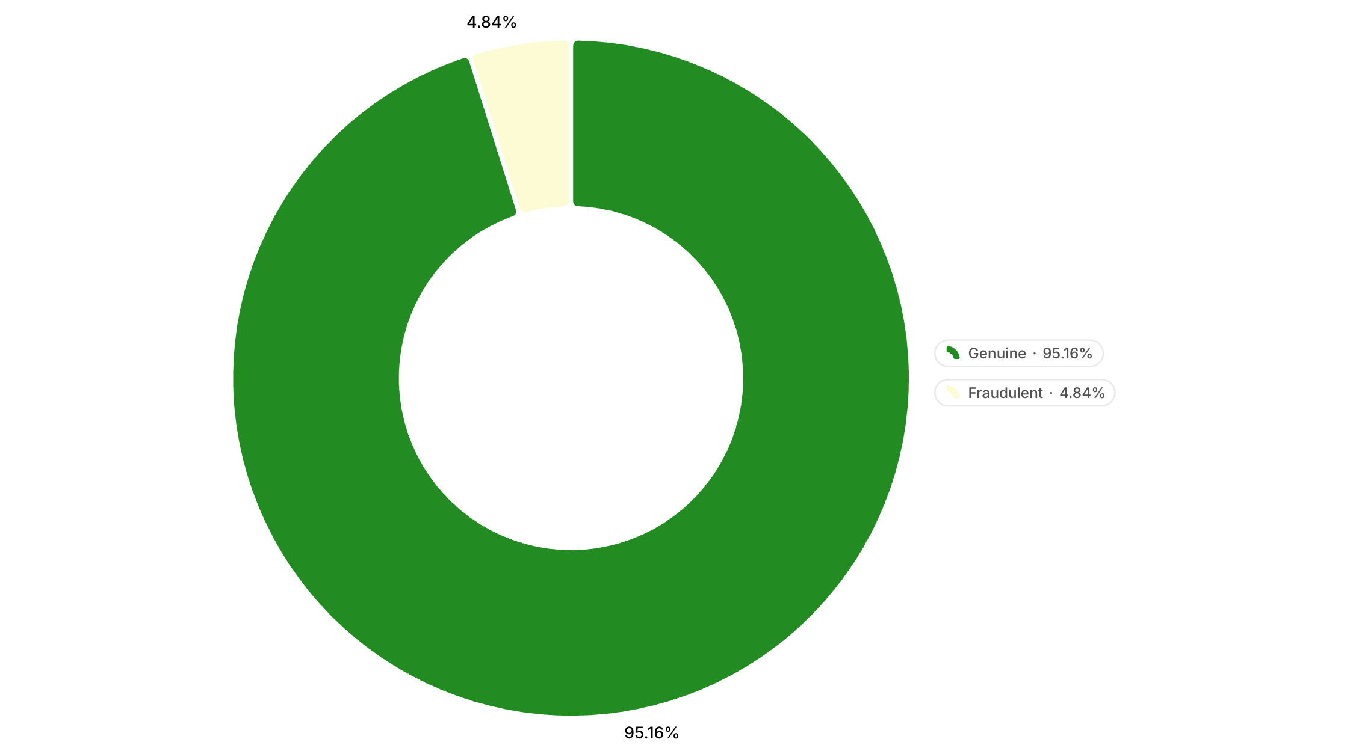
EMSCAD at a Glance
17,880
17,014
Total Job Postings
Genuine Postings
866
4.84%
Fraudulent Postings
Fraud Rate
Severe class imbalance makes accuracy alone misleading.

Slide 4


The Hidden Problem: Data Leakage
246
527
281
Repeated-Content Groups
Rows in Repeated Groups
Additional Duplicate Copies
Identical template copies
Same job campaign duplicated
Data Leakage from Split Campaigns
Train/Validation/Test overlap
Random row-level split
Copies appear in all sets
Campaigns split across sets
"Random row-level splitting can expose the same campaign to both training and testing."
OUR SOLUTION: Keep each campaign / template group inside ONE partition only.

Slide 5

Proposed Multi-View Framework
Classification
Text View (TF-IDF)
Predict fraud probability
Token-level lexical signals
Feature Fusion
Multi-View Fraud Detection
Metadata View
Combine multi-view features
Structured job attributes
Campaign View
Semantic View
Group and behavior signals
Embedding-based meaning

Slide 6



Machine Learning & Evaluation
Models
Evaluation Metrics
Logistic Regression
Precision & Recall
Interpretable baseline
F1 Score
Linear SVM
PR-AUC & MCC
Strong for sparse text
Primary Focus: Fraud Recall · Fraud F1 · PR-AUC
Tree-Based Model
Captures structured interactions
Group Split
Train
Validate
Test

Slide 7
Conclusion
Fraud detection is a highly imbalanced classification problem.
Multiple weak signals must be combined across views.
Repeated templates create serious data leakage risk.
Group-isolated evaluation gives a more realistic test.
Future Directions
Thank You
Real-world deployment & testing
Explainability & model transparency
Real-time screening integration
Questions & Discussion

