Slide 1
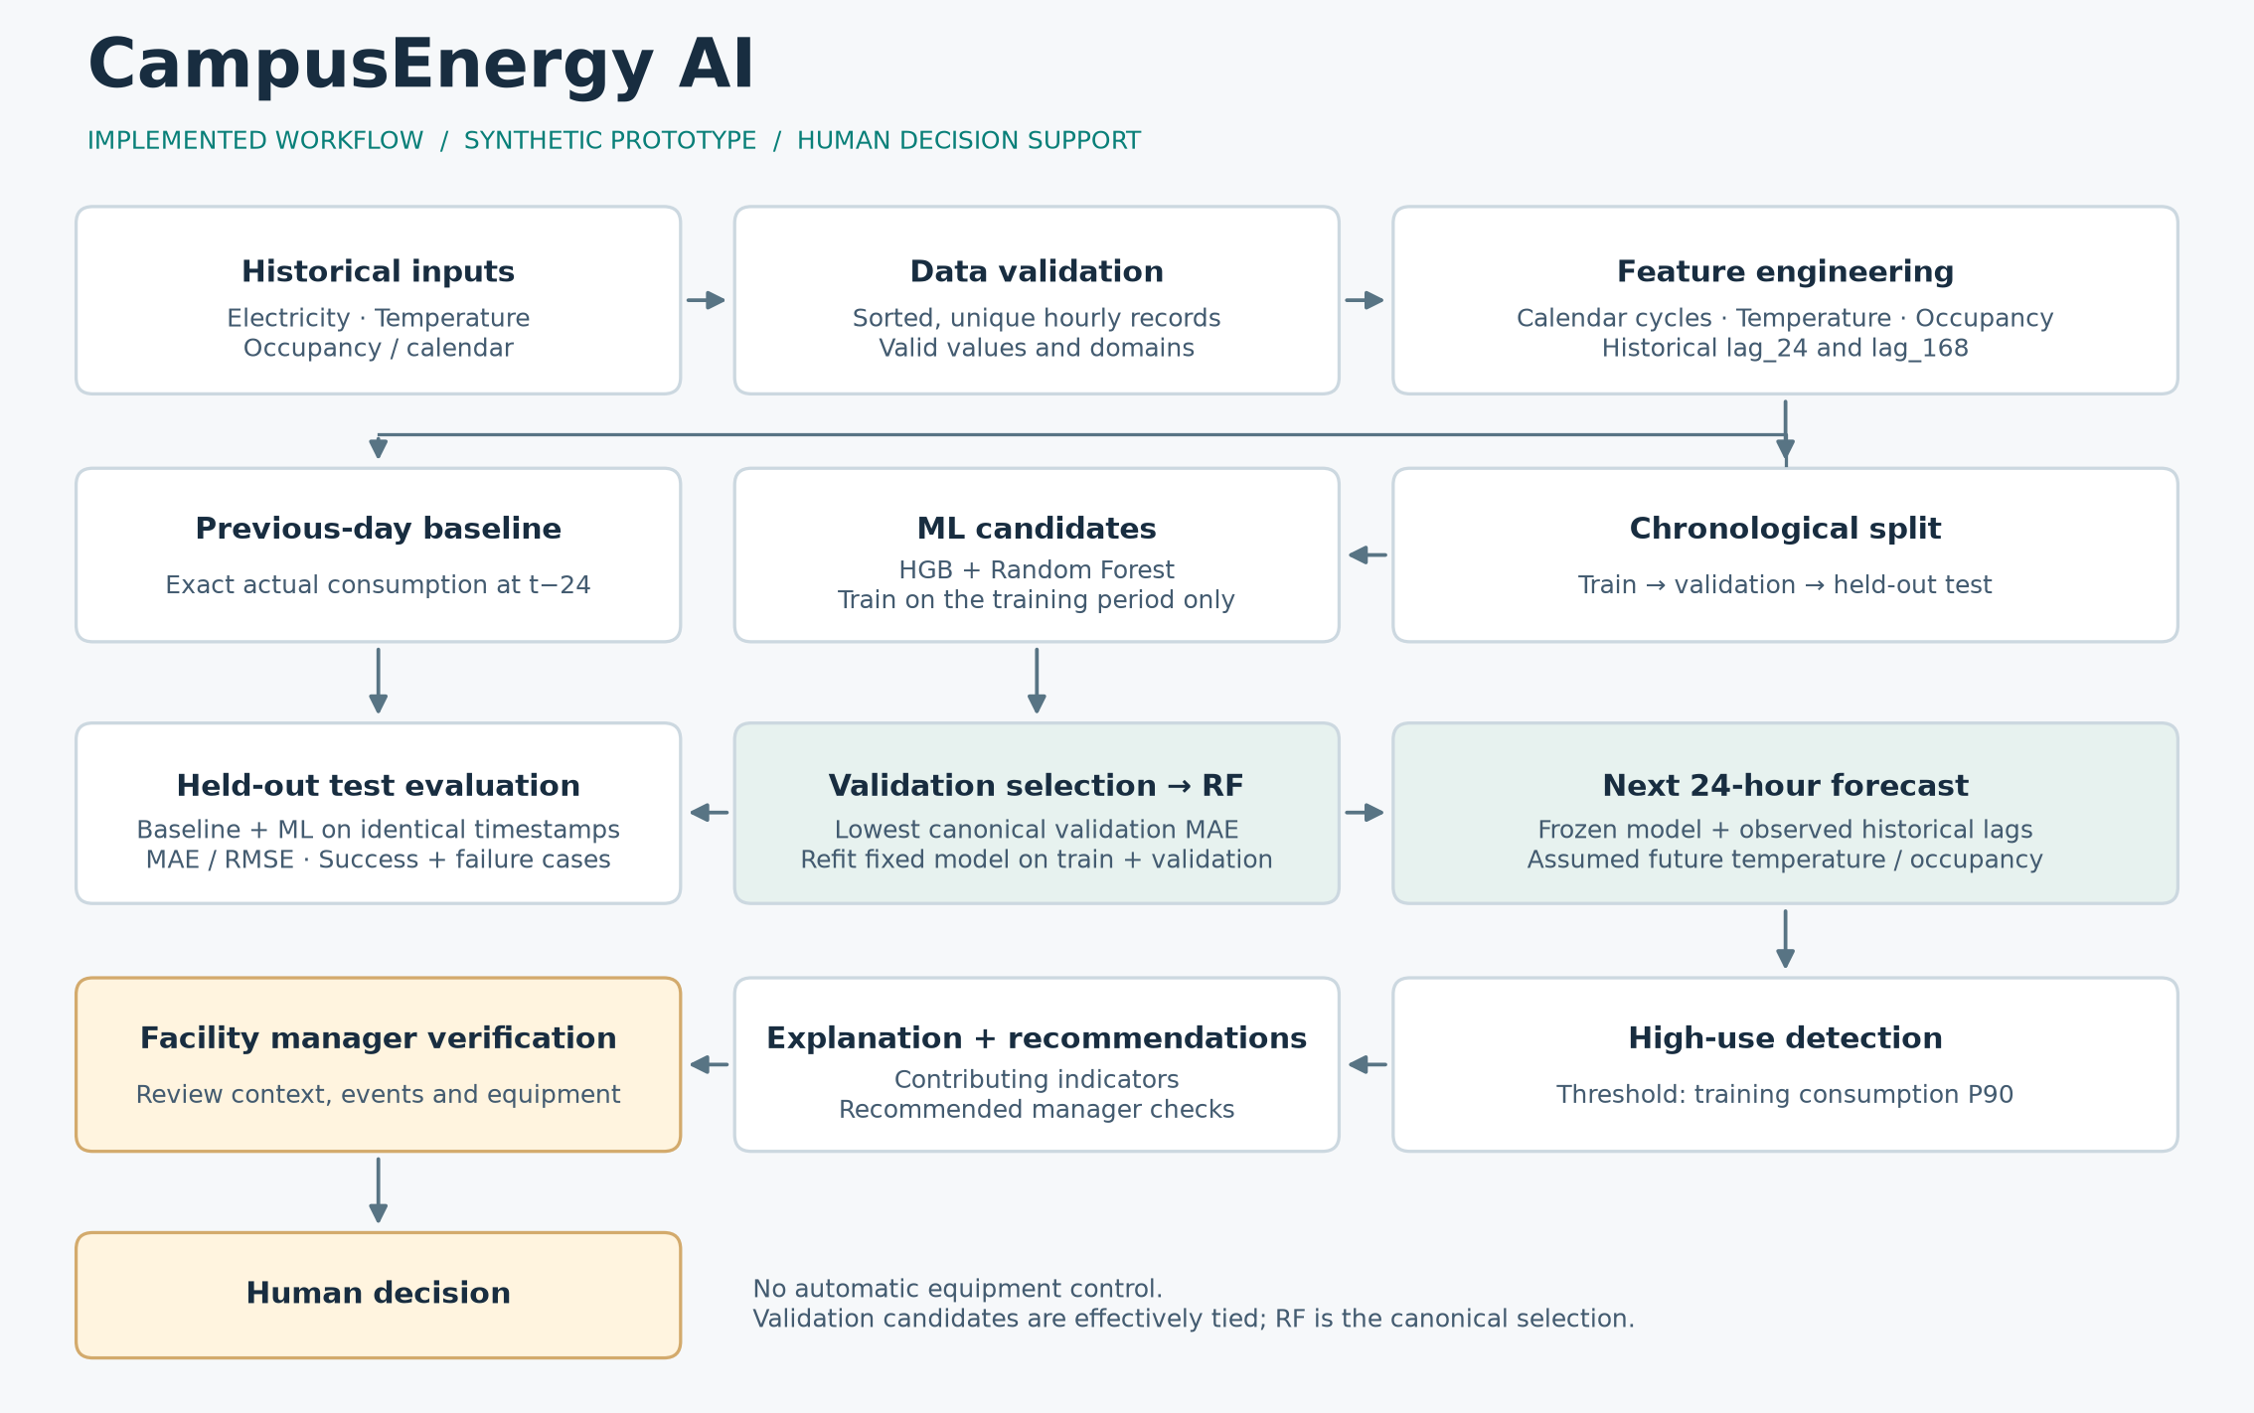
CAMPUS ENERGY · DECISION SUPPORT
CampusEnergy AI
24-Hour Campus Energy
Forecasting & Decision Support
Forecast demand. Detect peaks. Support smarter energy decisions.
WORKING PROTOTYPE
HUMAN IN THE LOOP
Hackathon project · Synthetic / simulated prototype campus energy data

Slide 2
THE PROBLEM
02
Peaks are often visible only after they happen
Reactive reporting
PEAK
THE OPPORTUNITY
A high-demand period appears in a daily or monthly report after the opportunity to investigate has passed.
›
126.25
See tomorrow
before tomorrow
kWh observed
Advance warning makes verification and scheduling possible.
The prototype predicts demand and surfaces likely high-use hours. It does not control equipment.
Synthetic / simulated prototype data · Decision support only

Slide 3
INTENDED USER
03
Designed for the facility energy manager
01
Predict
FACILITY
MANAGER
Next 24 hourly demand values
02
Detect
Likely high-use periods
Reviews forecasts, verifies context, and decides what action is safe and useful.
03
Support
Specific checks before a human decision
Synthetic / simulated prototype data · Decision support only

Slide 4
INTEGRATED SOLUTION
04
More than an ML notebook
01
02
03
04
05
FORECAST
›
DETECT
›
EXPLAIN
›
RECOMMEND
›
DECIDE
24 hourly values
Training-based peaks
Context and importance
Transparent checks
Human verification
The innovation is the verified forecast-to-decision workflow, not a claim of a new algorithm.
Synthetic / simulated prototype data · Decision support only

Slide 5
SYSTEM ARCHITECTURE
05
Verified end-to-end architecture
Observed history and assumed future context feed a human-reviewed recommendation, never automatic control.
Synthetic / simulated prototype data · Decision support only

Slide 6
SYNTHETIC DATASET
06
A reproducible prototype dataset
4,320
4,152
42
39
hourly observations
leakage-safe feature rows
fixed random seed
event-like rows
ENERGY
WEATHER
SCHEDULE
CALENDAR
consumption_kwh
temperature_c
occupied
hour and weekday
Clear disclosure
Synthetic / simulated prototype campus energy data. Not real VIT data and not evidence of real-campus accuracy.
Synthetic / simulated prototype data · Decision support only

Slide 7
TIME-SERIES METHODOLOGY
07
Time order is part of the model contract
TRAIN
VALIDATION
FINAL TEST
›
›
2,906 rows
622 rows
624 rows
08 Jan to 09 May
09 May to 03 Jun
04 Jun to 29 Jun
lag_24
NO RANDOM SHUFFLING
actual consumption 24 hours earlier
The model learns from the past before predicting later timestamps.
lag_168
actual consumption one week earlier
Synthetic / simulated prototype data · Decision support only

Slide 8
BASELINE VS AI
08
The baseline asks a hard, useful question
BASELINE
VALIDATION MODEL CHOICE
Same hour
yesterday
HistGradientBoosting
MAE 2.6283 kWh
›
Random Forest
MAE 2.6187 kWh
prediction(t) = actual(t - 24 h)
EFFECTIVELY TIED
Evaluated on the same 624 final-test timestamps as ML.
Random Forest was selected only because canonical validation MAE was marginally lower.
Synthetic / simulated prototype data · Decision support only

Slide 9
ACTUAL EVALUATION
09
ML reduced final-test MAE by 68.61%
68.61%
lower MAE than baseline
Baseline MAE 9.2585 kWh
ML MAE 2.9061 kWh
Result boundary
Specific to the synthetic prototype dataset. Not guaranteed on real campus data.
Synthetic / simulated prototype data · Decision support only

Slide 10
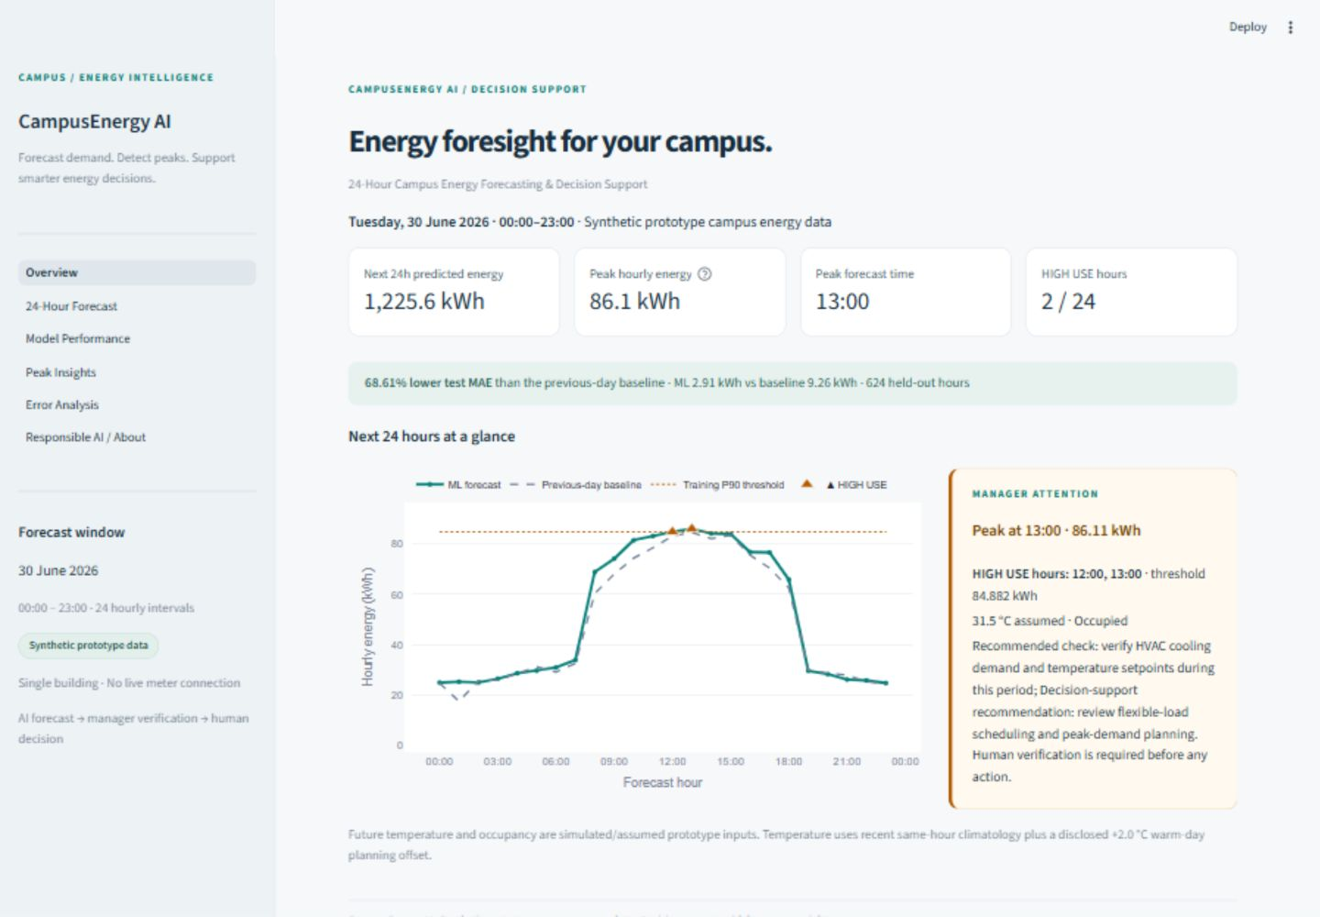
STREAMLIT DASHBOARD
10
A working product, not a static mockup
6
routed pages
01 Overview
02 24-Hour Forecast
03 Model Performance
04 Peak Insights
05 Error Analysis
06 Responsible AI / About
Real Phase 2 browser capture · Synthetic / simulated prototype data

Slide 11
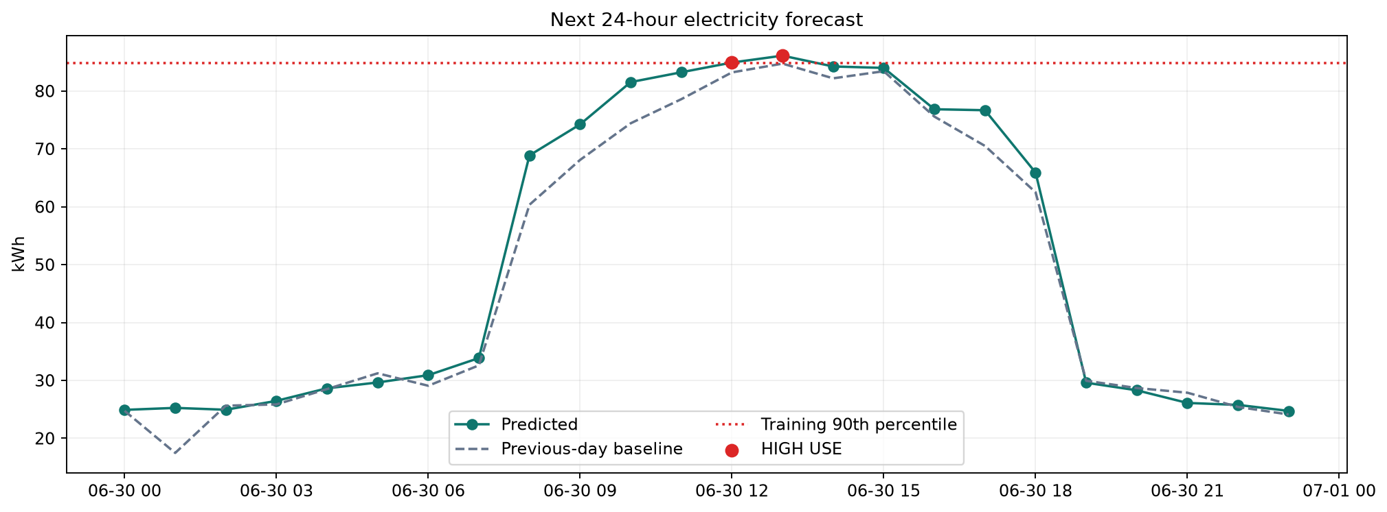
NEXT 24 HOURS + PEAKS
11
Two forecast hours cross the training threshold
12:00
84.916 kWh
HIGH USE
13:00
86.109 kWh
HIGH USE
Training 90th percentile 84.882 kWh
Temperature and occupancy are explicit assumptions. Lags use observed history only.
Synthetic / simulated prototype data · Decision support only

Slide 12
FROM PREDICTION TO ACTION
12
Turn a peak into a defensible manager check
PEAK FORECAST
1
13:00 · 86.109 kWh
BOUNDARY
CONTEXT
No automatic
equipment
control
2
Warm · occupied · high lag
RECOMMEND
3
Verify HVAC and scheduled equipment
Facility procedures, comfort, and safety stay in human hands.
HUMAN DECISION
4
Approve, defer, or investigate
Synthetic / simulated prototype data · Decision support only

Slide 13
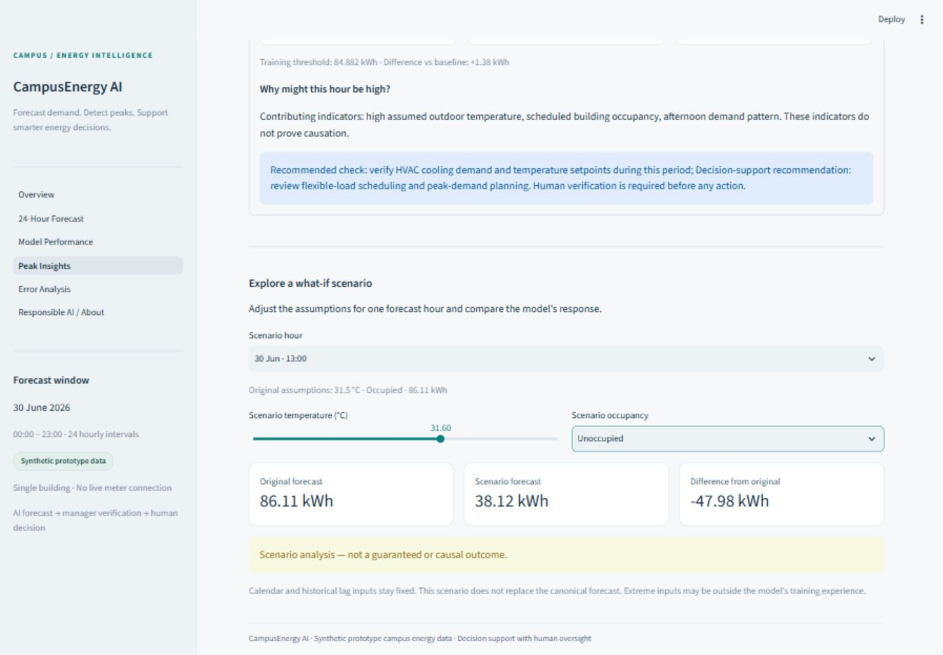
WHAT-IF + EXPLAINABILITY
13
Explore sensitivity without claiming causation
VALIDATION PERMUTATION IMPORTANCE
occupied
16.35
temperature
3.69
lag_24
0.80
lag_168
0.61
Scenario analysis is not a causal guarantee.
Synthetic / simulated prototype data · Decision support only

Slide 14
TESTING + FAILURE ANALYSIS
14
Strong averages still contain difficult hours
44 / 44
HTTP 200
20 / 20
0
pytest checks passed
real Streamlit startup
canonical files hash-identical
future targets used
GENUINE DIFFICULT CASE
17 Jun · 12:00
Actual 126.25 kWh
Prediction 83.67 kWh
42.58 kWh error
Retrospective context: a simulated laboratory-load event was intentionally unavailable to the model.
Why show it?
Honest error analysis reveals omitted context and guides safer deployment.
Synthetic / simulated prototype data · Decision support only

Slide 15
RESPONSIBLE AI + SDGS
15
Useful only when its boundaries stay visible
HUMAN OVERSIGHT
Primary alignment
SDG 7
Affordable and Clean Energy
AI FORECAST
Advance demand visibility can support efficient operations.
RECOMMENDATION
Supporting relevance
MANAGER VERIFICATION
SDG 11
Sustainable communities
HUMAN DECISION
SDG 12
Responsible consumption
SDG 13
Climate action
Aggregate occupancy · visible warnings · access controls in production
No measured carbon reduction is claimed.
Synthetic / simulated prototype data · Decision support only

Slide 16
IMPLEMENTED · FUTURE · CONCLUSION
16
A verified prototype with a clear production path
IMPLEMENTED NOW
PRODUCTION ROADMAP
✓
Leakage-safe chronological pipeline
01
Approved smart-meter data
✓
Baseline and two ML candidates
02
Live weather and occupancy
✓
24-hour forecast with peak flags
03
Multiple buildings and drift monitoring
✓
Explainability, scenarios, errors
04
Longer horizons and uncertainty
✓
Six-page human-reviewed dashboard
05
Human-approved BMS integration
Forecast demand. Detect peaks. Support smarter energy decisions.
CampusEnergy AI keeps the final decision with the facility manager.

