Slide 1

CLAIMPILOT
Agentic AI for health-insurance cashless pre-authorisation
CA-3 · Agentic AI Proof of Concept · Domain: Healthcare / Health Insurance
Rishik Sinha · 24070126154
Rishik Gupta · 24070126153
1
Planner
2
Intake
3
Research
4
Executor
5
Critic
6
Decision
Notes:
(~10 s) Member 1: We built PreAuth Agent, a six-agent system that handles cashless pre-authorisation requests for health insurance.
1

Slide 2

Cashless pre-auth today: slow, manual, hard to audit
Problem statement
1 hour
When an insured patient is admitted, the hospital sends a cashless request. A TPA executive must read the doctor's notes, check the policy, work out deductions and reply — by hand, under time pressure. Decisions are slow, inconsistent and hard to explain.
IRDAI target for an insurer to decide a cashless request
Why we chose this problem
3 hours
Rule-heavy: waiting periods, exclusions, sub-limits, co-pay, room-rent caps
Multi-step: read → look up → calculate → verify → decide → write
IRDAI target for final authorisation at discharge
Time-bound: patient is waiting at the hospital desk
Must be explainable: every rupee deducted needs a policy clause
ClaimPilot · CA-3 Agentic AI PoC
2
Notes:
(~35 s) Member 1: Problem — cashless pre-auth is done manually by TPA desks. Since IRDAI's May 2024 master circular, insurers must decide cashless requests within one hour and discharge authorisation within three hours. The work is rule-heavy, multi-step and must be explainable, which is exactly what an agentic workflow with tools is good at.
2

Slide 3
Existing process vs proposed agentic workflow
Today: manual TPA desk
With ClaimPilot
Executive reads free-text doctor notes
Intake agent extracts procedure, conditions, flags
Searches the policy PDF for clauses
Research agent retrieves clauses + tariff
Works out deductions in a spreadsheet
Executor tools compute an exact, itemised amount
Errors and non-disclosure found only at audit
Critic re-checks every case; revises or escalates
Types letter; queries go back and forth
Letter drafted with reasons and clause numbers
ClaimPilot · CA-3 Agentic AI PoC
3
Notes:
(~35 s) Member 1: On the left is how a TPA desk works today; on the right, what each agent takes over. The key difference is the bottom two rows: every case is independently verified before a decision, and every deduction is explained with a clause number.
3

Slide 4
Six agents, each with one job
1 Planner
2 Document Intake
3 Policy Research
Profiles the request, sets priority and required documents, builds the task plan
Checks documents; extracts procedure, chronic conditions and cosmetic/accident flags from notes
Fetches the policy schedule, retrieves relevant clauses, looks up the tariff benchmark
claim profiler
LLM or negation-aware rules
policy_lookup · clause_search · tariff_lookup
4 Coverage Executor
5 Critic
6 Decision & Letter
Runs eligibility checks, then computes the payable amount step by step
Re-computes independently; re-runs eligibility on the rule-based facts; checks tariff, ICD-10, PED
Picks Approve / Partial / Query / Deny / Escalate; writes reasons and letter
date & money tools (pure Python)
can REVISE or HOLD
decision policy · LLM or template
ClaimPilot · CA-3 Agentic AI PoC
4
Notes:
(~35 s) Member 1: Six agents. Planner decides what needs to be done for this specific claim. Intake reads the notes. Research gathers the policy and tariff. Member 2 takes over: the Executor does the rule checks and money with deterministic tools, the Critic independently verifies and can send work back, and the Decision agent writes the outcome and letter.
4

Slide 5
Orchestration: one shared state, three decision points
1
Planner writes the task plan into shared state
◆ 1 Eligible?
If any eligibility check fails, the calculation is skipped and the case goes straight to the Critic and Decision agent.
2
Intake adds extracted facts and missing documents
e.g. PA-0109: policy expired → Deny
3
Research adds policy, clauses and tariff benchmark
◆ 2 Critic verdict
4
Executor runs eligibility checks
PASS → decide. REVISE → Executor recalculates with the Critic's instruction (max 2). HOLD → query or human review.
5
Executor calculates the payable amount
e.g. PA-0108: estimate 73% above tariff → capped
6
Critic validates — may loop back to step 5
◆ 3 Decision policy
Deny (on grounds both extractors support) > Escalate > Query > Partial > Approve. Risky cases go to a medical officer.
7
Decision agent decides and drafts the letter
e.g. PA-0107: undisclosed hypertension → Escalate
Agents never call each other directly: the orchestrator passes one shared state (blackboard) and records every step in an audit trace.
ClaimPilot · CA-3 Agentic AI PoC
5
Notes:
(~30 s) Member 2: The orchestrator runs the Planner's task list over a shared state. There are three decision points: the eligibility gate that skips calculation, the Critic's verdict which can send work back to the Executor, and the final decision policy where risky cases always go to a human.
5

Slide 6
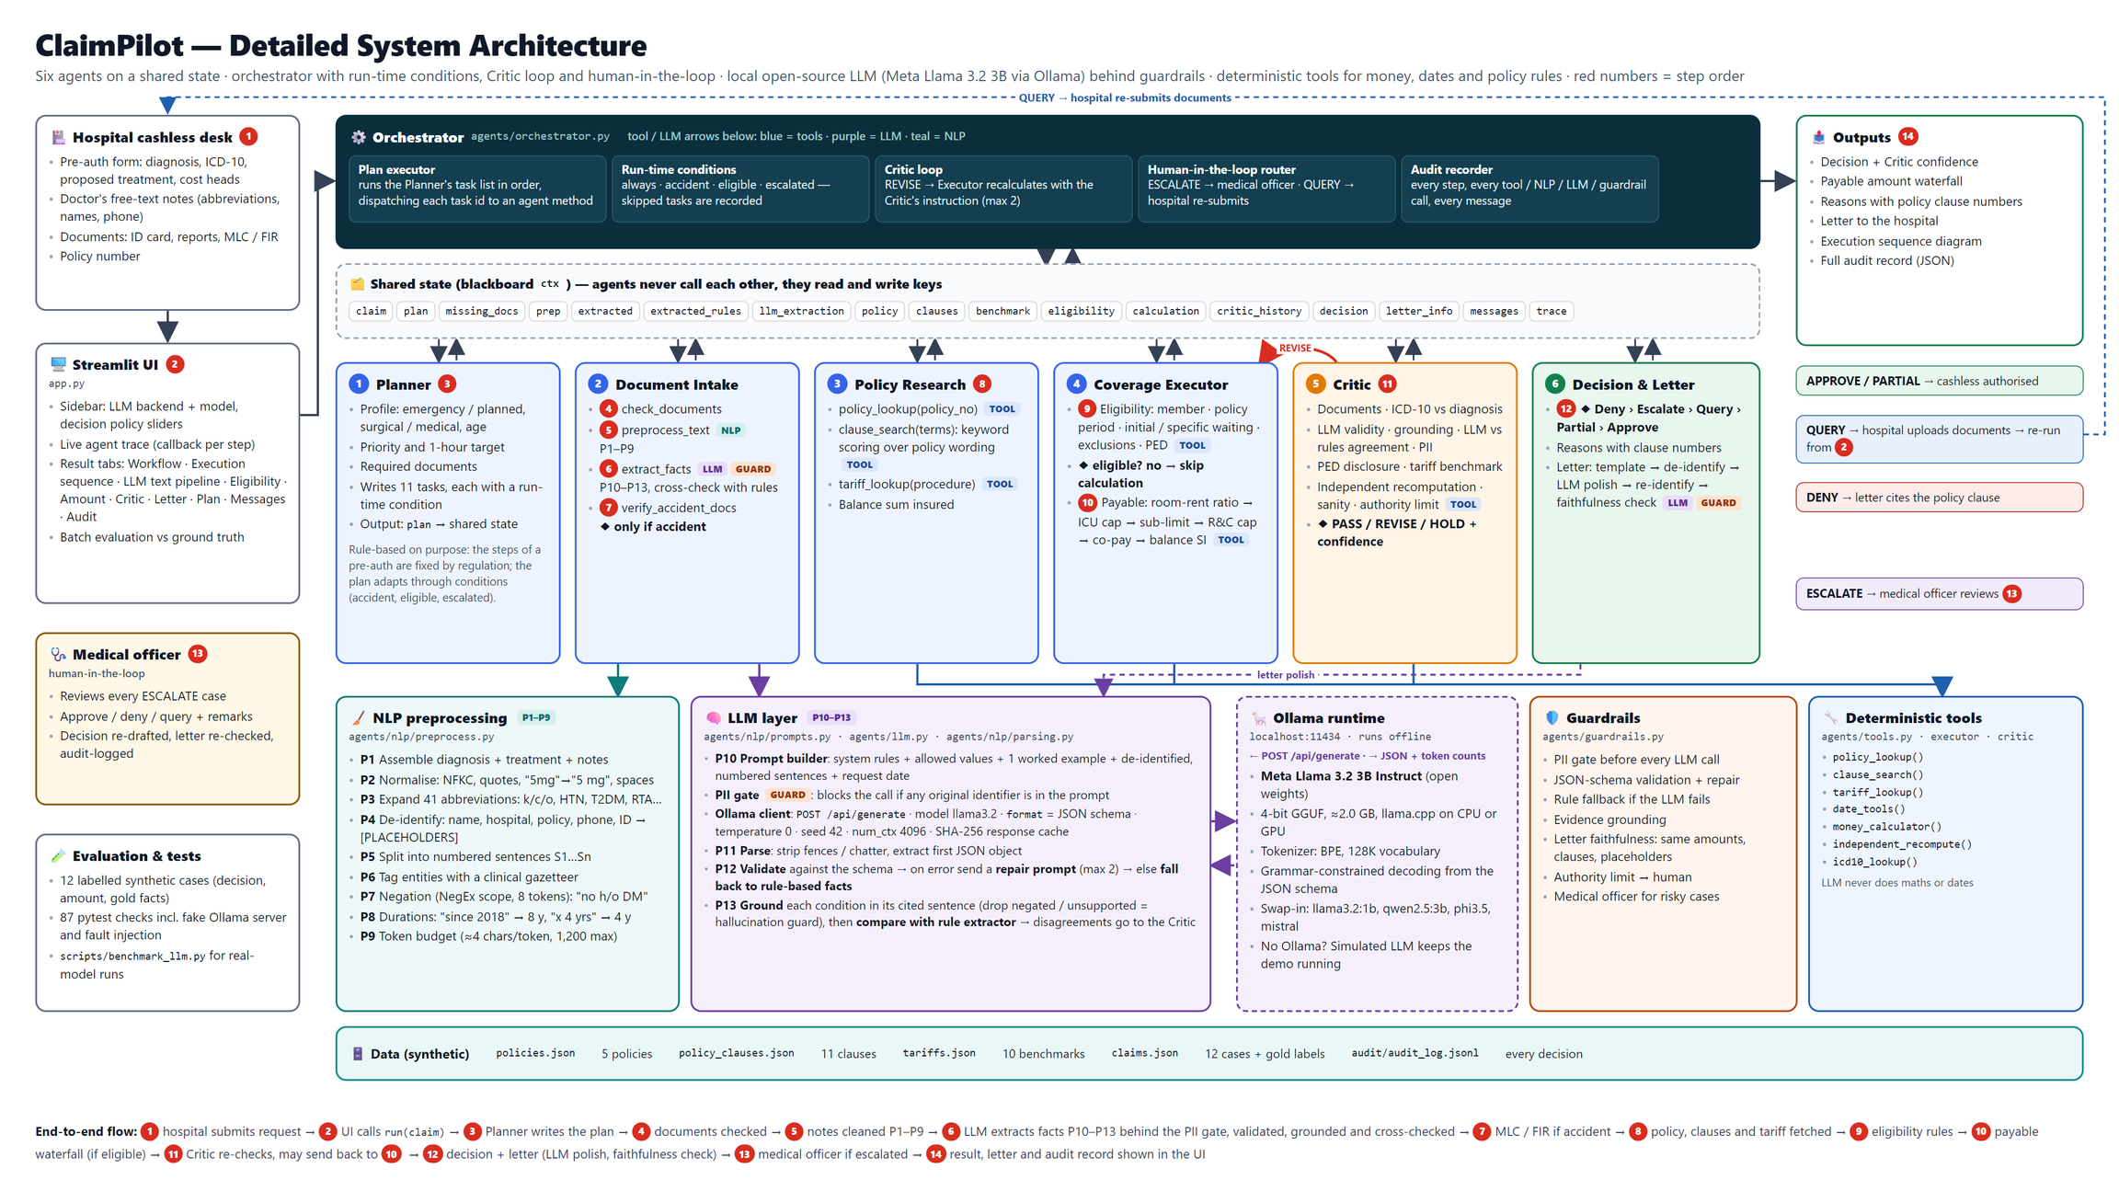
System architecture
ClaimPilot · CA-3 Agentic AI PoC
6
Notes:
(~25 s) Member 2: Architecture. The Streamlit UI drives the orchestrator; agents call deterministic tools for policy lookup, clause retrieval, dates and money. The LLM — a local Ollama model, with a mock fallback — is only used to read notes and polish letters, never to do maths. All data is synthetic JSON.
6

Slide 7
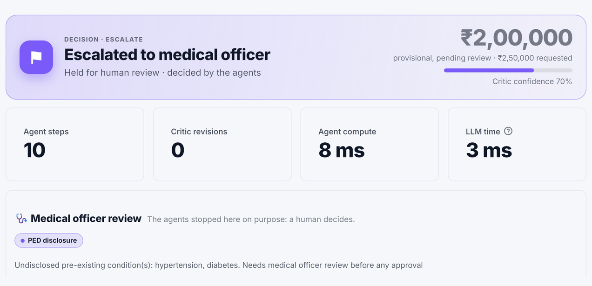
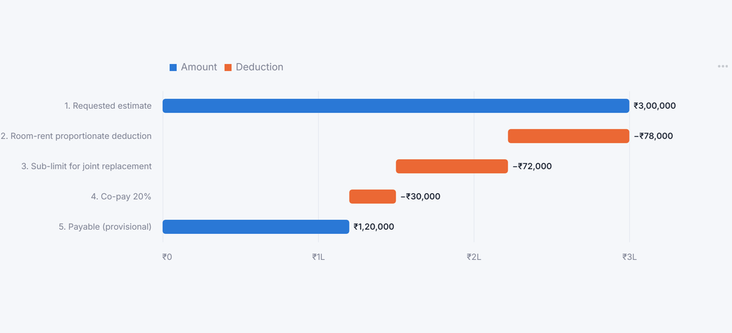
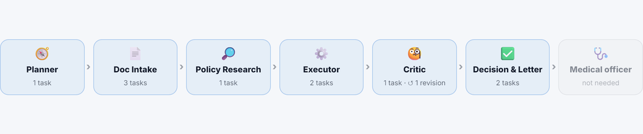
Working PoC: ClaimPilot dashboard
Escalation to the medical officer (PA-0107)
Amount waterfall (PA-0103)
Agent flow after a Critic revision (PA-0108)
Demo script
PA-0103 knee replacement: room-rent ratio → sub-limit → 20% co-pay
PA-0108 gallbladder: Critic finds 73% overbilling, sends back, amount capped
PA-0107 angioplasty: undisclosed hypertension → escalated to a human
Batch tab: 12/12 decisions, 0 wrong decisions sent
ClaimPilot · CA-3 Agentic AI PoC
7
Notes:
(~80 s, switch to the live app) Member 2 drives, Member 1 narrates. Show 0103 and open the Amount tab. Run 0108 and open Workflow path to point at the red REVISE edge, then Critic findings → earlier round. Run 0107 and show the escalation. Finish on Batch validation.
7

Slide 8
Output validation: how we know it is right
Labelled ground truth
12/12
decisions match expected
12 synthetic cases, each hand-labelled with the expected decision; 6 with a hand-calculated amount
Independent re-calculation
Critic recomputes every payable amount with a separately written function
6/6
amounts exact to the rupee
Automated tests
87 pytest checks: decisions, amounts, loops, PII masking, guardrails and every injected fault
87/87
automated tests pass
Human in the loop
Undisclosed PED, mismatched extraction or amounts above the authority limit go to a medical officer
Test set covers all five outcomes: 3 Approve · 3 Partial · 4 Deny · 1 Query · 1 Escalate
ClaimPilot · CA-3 Agentic AI PoC
8
Notes:
(~25 s) Member 1: Validation works at three levels: labelled ground truth, the Critic re-verifying every run, and 19 automated tests. All 10 cases reach the expected decision and all 6 amounts match our hand calculations.
8

Slide 9
Real open-source LLM: Qwen 2.5 7B on a laptop CPU
Same 12 labelled cases
12/12
decisions correct with the real LLM
Qwen 2.5 7B Instruct (open weights) via Ollama, CPU only; about 16 s per case for both LLM calls
What it got right
Procedure, conditions, cosmetic and accident flags 100% correct; schema-valid JSON on every first try
0
wrong decisions sent
What it got wrong
functional_need: 25% → 67% after a prompt fix. The Critic showed none of these errors changed a decision
12/12
LLM letters passed the stricter faithfulness check
What it taught us
It echoed prompt markers and reworded letter reasons: both now caught by the letter guardrail
Full table: results/benchmark_qwen2.5_7b.md. The default Llama 3.2 3B is not benchmarked yet.
ClaimPilot · CA-3 Agentic AI PoC
9
Notes:
(~25 s) Member 1: Validation works at three levels: labelled ground truth, the Critic re-verifying every run, and 19 automated tests. All 10 cases reach the expected decision and all 6 amounts match our hand calculations.
9

Slide 10
Fault injection: breaking the LLM on purpose
Before: 115 corrupted runs
After hardening
A wrong duration hid an undisclosed disease
The duration written in the notes always wins
A flipped flag paid for cosmetic surgery
Critic re-runs the rules on the rule-based facts and escalates
Disputed facts denied payable claims
Deny only on grounds both extractors support
Letters could drop a reason or flip the wording
Every reason verbatim; opposite-decision wording blocked
14 wrong decisions and 17 bad letters got out
0 wrong decisions and 0 bad letters get out
ClaimPilot · CA-3 Agentic AI PoC
10
Notes:
(~35 s) Member 1: On the left is how a TPA desk works today; on the right, what each agent takes over. The key difference is the bottom two rows: every case is independently verified before a decision, and every deduction is explained with a clause number.
10

Slide 11
Results: faster, consistent and explainable decisions
Requested vs authorised (₹), payable cases
₹3.15 lakh
Requested
Authorised
PA-0101
130,000
non-payable amount identified across 3 partial approvals, each with a clause
130,000
PA-0102
65,000
40,000
~5 ms
PA-0103
300,000
120,000
median agent compute per request (simulated LLM), vs ~45 min manual (our assumption)
PA-0108
260,000
150,000
PA-0110
175,000
175,000
100%
PA-0111
98,000
98,000
of decisions carry reasons, clause numbers and a full audit trace
ClaimPilot · CA-3 Agentic AI PoC
11
Notes:
(~20 s) Member 2: On the payable cases, the agents caught ₹3.15 lakh that the policy does not cover, and every deduction is explained. Processing takes milliseconds in mock mode; with a local LLM it is a few seconds, still far inside IRDAI's one-hour window. The 45-minute manual figure is our assumption, not a measurement.
11

Slide 12
Limitations and future scope
Limitations
Future scope
Synthetic data and a simplified policy wording (11 clauses)
Vector RAG over full policy wordings
Keyword clause retrieval, not semantic search
OCR + LLM extraction for scanned PDFs and reports
The rule cross-check cannot catch a mistake both extractors make
LangGraph + MCP tools to connect hospital systems and NHCX
No OCR of scanned reports; no real hospital or insurer integration
Fraud-pattern agent that looks across many claims
Decides on the estimate only; final bill settlement is out of scope
Learn from medical-officer overrides; status updates to patients
ClaimPilot · CA-3 Agentic AI PoC
12
Notes:
(~15 s) Member 1: Limitations are mainly data realism and retrieval depth. Next steps are semantic retrieval over real policy wordings, OCR for scanned documents, and connecting to hospital systems and the National Health Claims Exchange through LangGraph and MCP tools.
12

Slide 13
Thank you
Questions welcome. ClaimPilot: plan, read, research, execute, verify, decide.
github.com/RishikSinha06/ClaimPilot-Agentic-PreAuth
Run the PoC
Who built what
  pip install -r requirements.txt
  streamlit run app.py
  python -m pytest -q
Rishik Sinha: system architecture, orchestrator, LLM pipeline, Critic and guardrails, Decision agent, fault injection, LLM benchmark, dashboard
Rishik Gupta: Planner, Research & Executor agents, synthetic dataset, core tests
Notes:
(~10 s) Both: Thank you. Both of us can answer questions on any agent; the split shows who led each part.
13

