Slide 1
RISHIKA M
Final Project
3/21/2024 Annual Review

Slide 2
BUILDING A SMARTER AI POWERED SPAM CLASSIFIER

Slide 3

AGENDA
Problem Statement
Project Overview
End Users
Solution and Value Proposition
Specific Enhancement
Modelling
Result

Slide 4
PROBLEM STATEMENT
The exponential growth of digital communication has led to a surge in unwanted, unsolicited messages commonly known as spam. These messages not only clutter inboxes but also pose serious threats such as phishing attacks, malware dissemination, and financial fraud. As a result, there's an urgent need for robust spam filtering systems to ensure users' safety and streamline communication channels.
The challenge lies in developing an AI model capable of accurately identifying and filtering out spam messages across various platforms, including email, social media and message applications.

Slide 5

PROJECT OVERVIEW
The primary objective of this project is to develop an message classifier system that distinguish the spam and ham message based on the MLP classifier and multinomialNB algorithm of neural network.
By accurately identifying spam, we aim to enhance email security, improve user experience, and reduce the risk of falling victim to phishing attacks or malicious content.
The data is trained with three classifier model and the choice of algorithm is based on its accuracy during its testing.

Slide 6

END USERS
The end users of a spam classifier model built using AI could be individuals, businesses, or organizations that rely on message communication and want to filter out unwanted or potentially harmful messages.
Individual Users
Businesses
Email Service Providers (ESP)
Internet Service Providers (ISPs)
Government Agencies and Regulatory Bodies
Security Companies
E-commerce Platforms

Slide 7
SOLUTION AND ITS VALUE PROPOSITION
ALGORITHM WORKING
The user provide the message subjected as the input to the system, Multinomial NB computes the probability of it being spam or non-spam using Bayes' theorem.
It calculates the likelihood of observing the words in the document given each class (spam or non-spam).
It combines the likelihood with the prior probabilities to compute the posterior probability of each class.
The class with the highest posterior probability is assigned as the predicted class for the document.
SYSTEM OUTPUT
The system is provided with the input message and the system finally classifies it as ham or spam message.

Slide 8
WOW IN YOUR SOLUTION
It Streamlines Inboxes
With less garbage coming into your inbox, you can actually go through your emails more effectively and stay in touch with those who matter.
2. Protect Against Malware
Malware, viruses, and other forms of malicious attacks are heading to people’s email inboxes every day. Some of these can be easily weeded out by your internet provider’s own spam filters, but spam gets smarter every day.
3. Keeps You Compliant
Spam filtering is a major part of any cybersecurity plan, and it helps you stay compliant with the wishes and demands of companies and agencies that are concerned about their information.
4. It Saves You Money
Spam filtering is also incredibly affordable, making it a cheap but extremely effective way to keep yourself safe.
8

Slide 9
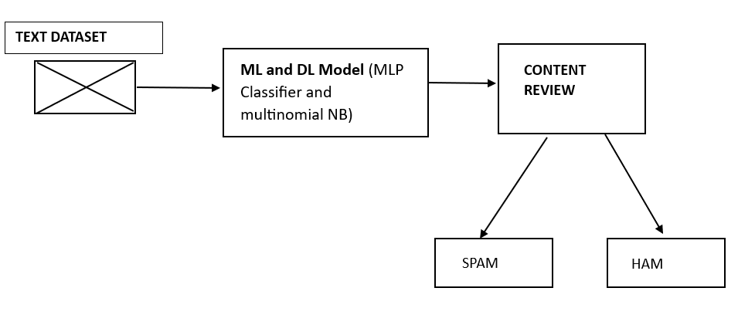
MODELLING

Slide 10
1. Dataset Description
The dataset consists of categories such as "spam" or "ham," along with the corresponding text that has been categorized.
2. Data Preprocessing
The data is pre-processed to identify outliers, missing values, and other anomalies.
3. Exploratory Data Analysis
Exploratory Data Analysis involves visually analysing the data to gain insights and understand patterns more effectively.
4. Training the model using algorithm
The machine learning algorithm is trained using MLP(Multilayer perceptron), Multinomial NaiyeBayes, and Bernoulli NaiyeBayes these are neural network algorithms.
5. Testing the model
After successfully training the model, it predicts accuracy scores and precision scores. Users can input messages to determine whether they are classified as spam or ham.
10

Slide 11
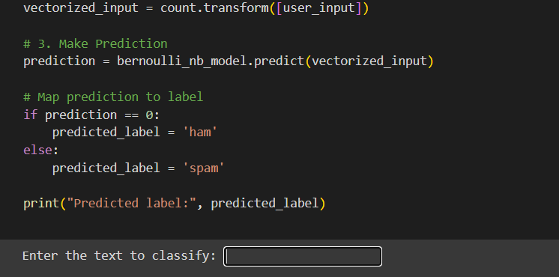
RESULTS
The user can enter the message that is subjected in the input box
11

Slide 12
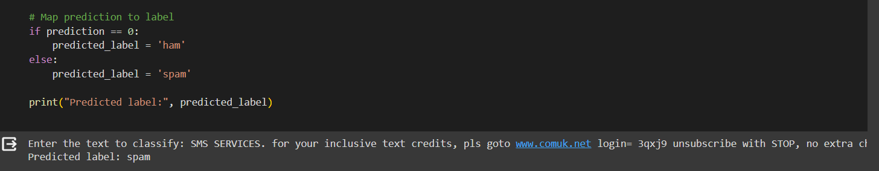
The system classifies the message as spam or ham.

