Slide 1
MLSA INTERNSHIP
RISHIKA AGARWAL( CS 5C )
2200290120135

Slide 2
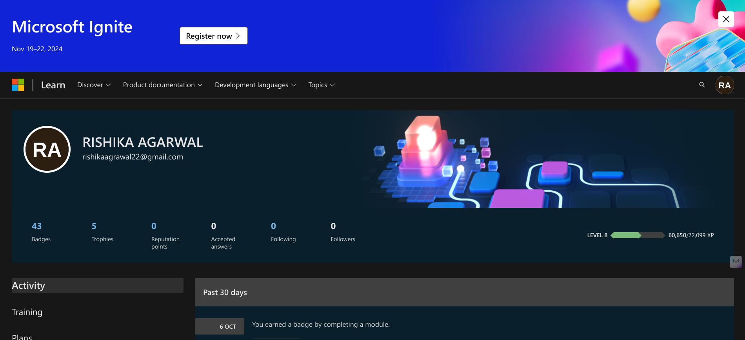
COURSE BADGES

Slide 3
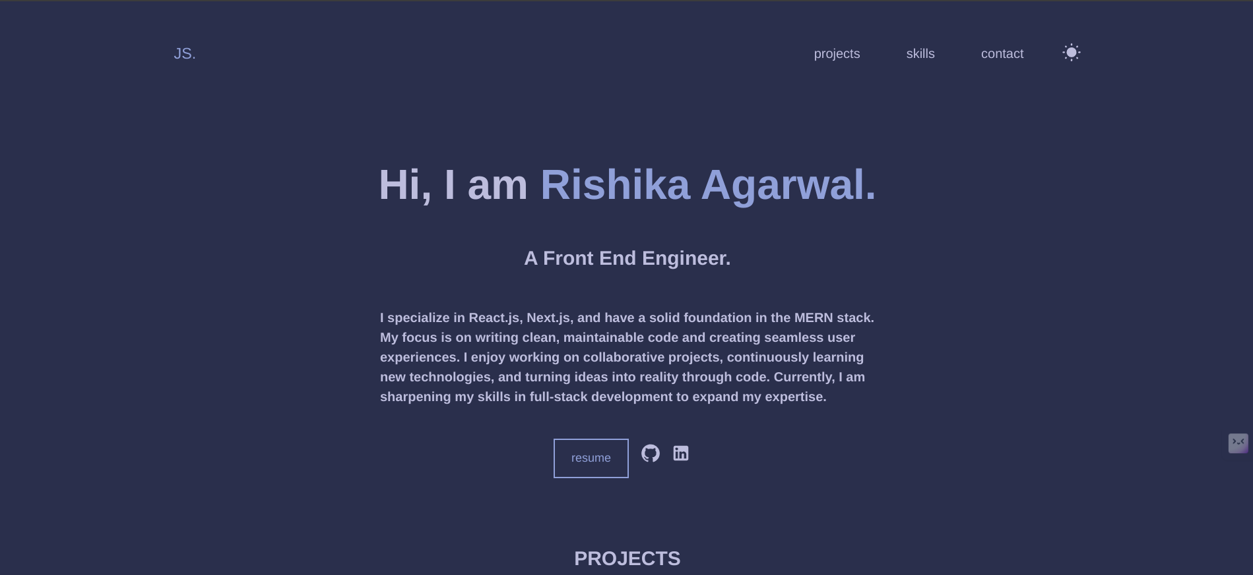
P1- Portfolio (Easy)

Slide 4
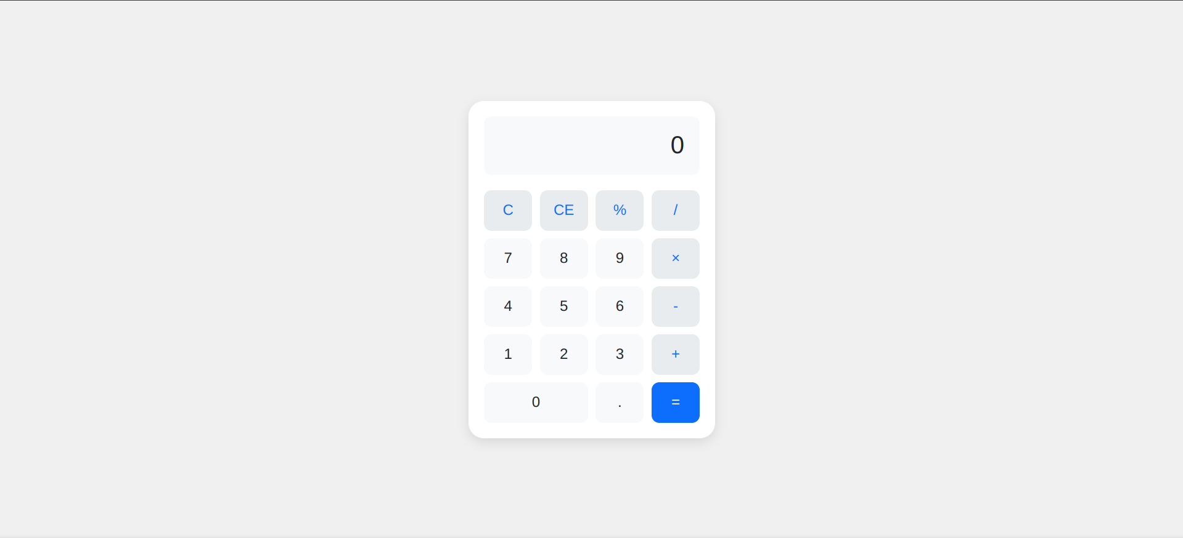
P2- Calculator App

Slide 5
THANKYOU

