Slide 1


Prediction Of Flares In RA Patient
Leveraging Machine Learning on Flow Cytometry Data

Slide 2


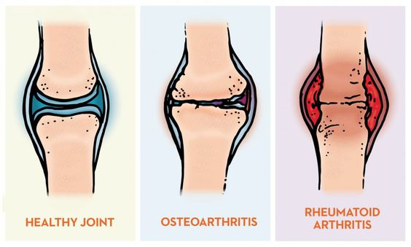
Introduction
Overview of Rheumatoid Arthritis (RA)
Hypothesis
Chronic autoimmune disorder
Characterized by inflammation, pain, and joint damage
Relapsing and remitting nature
RA comprises distinct pathotypes with varied flare mechanisms
Challenges in Understanding RA Flares
Importance of Personalized Treatment Strategies
Mechanisms remain elusive despite advances
Unpredictable nature complicates treatment planning
Tailoring treatments to individual patients
Enhancing efficacy and minimizing side effects
https://www.baptisthealth.com/-/media/images/migrated/blog-images/content-images/bh-rhuematoid-arthritis-1024x616.jpg?rev=82260ed4c7a74996b6a8a61c7d440802&hash=76A94C0AC5399F885D5F4F4ED16135D4​

Slide 3





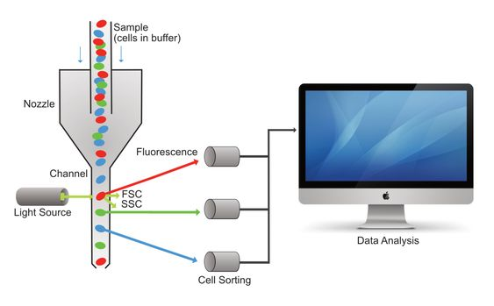
Background
Overview of Bioflare Project
6-month observational study
Collaboration between Newcastle University, University of Birmingham, and University of Glasgow
Research Focus
Addressing the lack of understanding in the pathogenesis of RA flares
Utilizing Advanced Techniques
Emphasis on flow cytometry for studying immune cell populations
Challenges and Solutions
Manual analysis limitations
Introduction of automated methods like OPTICS for improved analysis efficiency
Flow Cytometry
https://jaxmecfs.files.wordpress.com/2018/01/flow_figure.png​

Slide 4
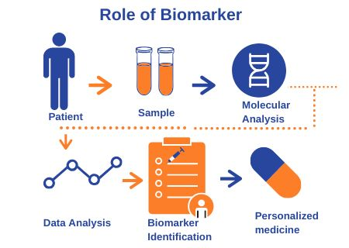
Research Question
Which subsets of biomarkers predict RA flares?
Tailoring treatments with biomarker subsets enhances efficacy, controls disease, and minimizes side effects, while gaining flare pathogenesis insights
https://www.proxzar.ai/wp-content/uploads/2019/11/Biomarker.png​

Slide 5



Objectives
Assessing Immune Cell Populations​
Identifying Distinct Subsets of RA Patients​
Comparing Immune Cell Profiles between Flare and Remission States​
Measure the similarity or dissimilarity between immune cell populations ​
Utilize distance metrics to quantify differences in immune cell profiles.
Utilizing Clustering to Distinguish Flare and Non-Flare RA Groups​
Examining Immune Cell Variations for RA Subgroup Identification
Compare immune profiles of RA patients in flare vs. remission​
Identify significant biomarkers between RA flare and remission​
https://www.technologynetworks.com/immunology/news/possible-role-for-newly-discovered-immune-cell-population-in-ms-341971 https://www.usfhealthonline.com/resources/health-informatics/why-is-patient-centered-care-important/ https://naturenews.africa/habits-that-negatively-affect-the-immune-system/

Slide 6



Methodology
Data Transformation
Clustering Analysis
Differential Analysis
Preprocessing flow cytometry data
Utilizing clustering algorithms to identify distinct subsets within immune cell populations
Comparing immune cell profiles to identify significant differences between flare and remission states
https://www.fivetran.com/blog/why-does-my-business-need-to-transform-data https://online.keele.ac.uk/wp-content/uploads/2023/07/data-clustering.jpg
https://www.simplilearn.com/data-analysis-methods-process-types-article

Slide 7
Data Transformation
Data Collection
Normalization
Feature Extraction
Quality Control
1
3
5
7
Collect flow cytometry data targeting immune cell populations from biological samples such as blood or synovial fluid
Standardize data across samples
Selecting relevant parameters such as fluorescence intensity
Extract meaningful features - cell surface markers or intracellular cytokines.
Ensure data quality and reliability
Address anomalies or artifacts
Remove errors or inconsistencies
Adjust range of values
Reduce number of features while preserving information
Format data into structured format
Data Preprocessing
Scaling
Dimensionality Reduction
Data Formatting
2
4
6
8

Slide 8

Clustering Analysis
Apply OPTICS Algorithm
Use OPTICS clustering algorithm​
Analyze flow cytometry data​
1
Generate reachability plot​
Visualize data ordering based on reachability distance​
Reachability Plot
2
Identify clusters from reachability plot​
Select points with low reachability distances​
Cluster Extraction
3
Analyze cluster characteristics​
Assess immune cell population composition​
Cluster Analysis
4
Interpretation and Validation
Interpret clustering results​
Validate clusters using independent datasets or experiments​
5
https://www.questionpro.com/blog/data-analytics-vs-data-analysis/

Slide 9
Differential Analysis
1
Statistical Analysis
Use appropriate statistical tests to compare immune cell profiles between disease states​
Identify features showing significant differential expression​
2
Prioritization of Biomarkers
Focus on markers indicative of disease activity​
Prioritize biomarkers known to play a role in RA pathogenesis​
3
Validate identified biomarkers using independent datasets or experimental validation techniques​
Validation
4
Functional Analysis
Investigate biological functions and pathways associated with identified biomarkers​
5
Integration with Clinical Data
Integrate biomarker data with clinical data to assess clinical relevance and predictive value​

Slide 10
Timeline
Task
April
May
June
July
August
September
October
W1
W2
W3
W4
W1
W2
W3
W4
W5
W1
W2
W3
W4
W1
W2
W3
W4
W1
W2
W3
W4
W5
W1
W2
W3
W4
W1
W2
W3
W4
Literature Review
Data Collection
Data Preprocessing and Cleaning
Exploratory Data Analysis
Feature Selection
Clustering Analysis
Differential Analysis
Statistical Analysis
Functional Analysis
Integration with Clinical Data
Validation of Results
Report Writing and Documentation
Expected results:​
Prediction models for RA flares based on identified biomarkers​
Personalized treatment approaches

Slide 11
Timeline
Task
May
June
July
August
September
October
W1
W2
W3
W4
W5
W1
W2
W3
W4
W1
W2
W3
W4
W1
W2
W3
W4
W5
W1
W2
W3
W4
W5
W1
W2
W3
W4
W5
Literature Review
Clustering Analysis --
Designing Distance Metrics
Optimising Parameters
Evaluation of
Clustering Results
Visualization
Differential Analysis
Report Writing and Documentation
Expected results:​
Identification of distinct immune cell populations with annotations indicating cell types.​
A list of biomarkers that are significantly different between flare and non-flare conditions within each identified cell population, providing insights into flare pathogenesis.

Slide 12
Summary
Collaborative effort to understand and predict rheumatoid arthritis (RA) flares.
Advanced methodologies like Optics and clustering analysis employed for data analysis.
Focus on identifying predictive biomarkers for RA flare prediction.
Expected outcomes include development of prediction models for RA flares and personalized treatment strategies.
Detailed timeline outlines project phases from literature review to result validation.
Future directions may involve further validation studies and clinical applications to improve RA management.

