Slide 1


Major Project - I
AI-POWERED MEETING SUMMARIZER
SUBMITTED BY:-
Name | SAP ID | Roll. No.
Anshi Mehta | 500101953 | R2142220034
Rishika Raj | 500101763 | R2142220279
Dhananjay Baliyan | 500106345 | R2142220915
Under Guidance of:
Dr. Pavinder
Assistant Professor
Data Science Cluster(SOCS)

Slide 2
Table Of Contents
Abstract
Introduction
Problem Statement
Objectives
Literature Review
System Requirements
System Architecture
Key Features
Tools and Technologies Used
Methodology
SWOT Analysis
Quantitative Results
Future Scope
Conclusion

Slide 3
Abstract
Privacy First
Ensures 100% data confidentiality by processing audio entirely on the user's local machine.
The Solution
Input: Raw Audio Files.
Engine: Whisper.cpp (STT) + Ollama (LLM).
Output: Concise, diarized summaries.
Interface: Simple Gradio Web UI.

Slide 4
Introduction
The Context
Corporate meetings consume massive amounts of time. Manual note-taking is prone to human error, bias, and loss of critical detail.
The Innovation
We leverage Open Source AI to bring enterprise-grade summarization to consumer hardware. No cloud subscriptions, no data leaks, just efficient insights.

Slide 5
Problem Statement
Data Privacy
Cloud tools (Otter.ai, Zoom AI) store transcripts externally, risking confidential data leaks.
Inefficiency
Re-listening to hour-long recordings to find one decision is a waste of resources.
Dependency
Most AI tools require high-speed internet. No offline option exists for field work.
Our FIX: A fully offline, local pipeline that solves all three issues simultaneously.

Slide 6
Objectives
Local Architecture:
Build a Python pipeline using FFmpeg, Whisper, and Ollama.
High Fidelity STT:
Convert audio to text with <10% Word Error Rate.
User Interface:
Create an intuitive Gradio dashboard.

Slide 7
Literature Review
Author & Year | Title | Methods Used | Strengths | Limitations
Sadia, B., Adeeba, F., Shams, S., & Javed, K.(2024) | Meeting the challenge: A benchmark corpus for automated Urdu meeting summarization | Creation of benchmark corpus, NLP techniques for Urdu, evalution with summarization models | Provides first Urdu specific meeting summarization dataset; supports future research in low-resource languages | Limited to Urdu; corpus may not generalize well across other languages/domains
Brahmachari, K.S., Hanumesh, M., Anitha, G., & Pattanaik, B.(2024) | Efficient Meeting Insights: NLP-Enhanced Summarization of Voice and Text | Speech-to-text conversion, NLP summarization models, evalution on voice+text data | Combines multimodal input(voice&text): shows practical meeting summarization application | May force errors due to speech recognition accuracy; scalabilty across diverse accents not tested
Vadlamudi, G., Vemuru, N., Vangapalli, S., Surapaneni, R.K., & Nimmagadda, S. (2022) | Meeting summarizer using Natural Languafe Processing | NLP pipeline for extracting key points from transcripts, summarization algorithms | Demonstrates early integration of NLP for meetings; relatively simple and easy to implement | Lacks advanced evalution; focuses only on text transcripts (no multimodal input)

Slide 8
System Requirements
Component | Requirement
OS | Windows/Linux/macOS
RAM | Min 8GB(16GB Recommended)
CPU | 4 Core (AVX Support)
Storage | 50GB (Model Weights)

Slide 9
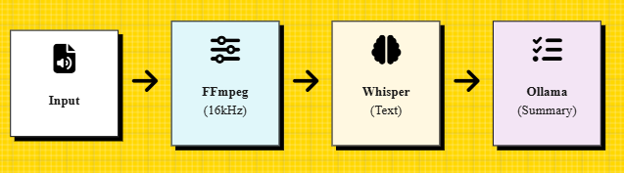
System Architecture

Slide 10
Key Features
Speaker Diarization:
Label speakers (e.g., [Speaker 0/Speaker 1]) to track contributions.
Format Standardization:
Auto-convert inputs to 16kHz WAV.
Optimization:
Ensure smooth performance on 8GB RAM systems.

Slide 11
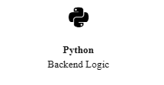
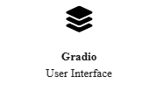

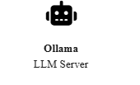
Tools and Technologies

Slide 12
Methodology
Pre-processing
Raw audio (mp3, m4a) is ingested via Gradio. FFmpeg normalizes it to Mono PCM WAV at 16kHz for optimal model compatibility.
Transcription
Whisper.cpp processes the WAV file locally. It performs beam search decoding to generate a time-stamped text transcript.
Diarization
The system distinguishes speaker turns based on audio clustering, inserting [Speaker X] tags into the text stream for context.
Summarization
The text is fed into a local LLM (via Ollama) with a system prompt: "Extract key decisions and action items."

Slide 13
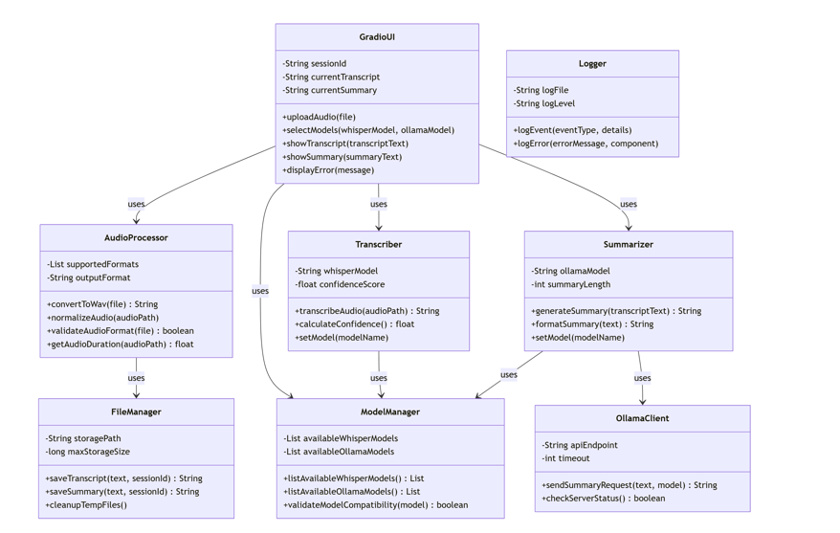
UML Class Diagram

Slide 14
SWOT Analysis
Strengths
Absolute Privacy: 100% local processing (No Cloud).
Cost-Effective: Zero operational cost after initial setup.
Offline Capability: Fully functional without internet.
Weaknesses
Hardware Dependency: Requires minimum 8GB RAM, 4-core CPU.
Speed Barrier: Slower than cloud APIs on low-end CPUs.
Model Maintenance: Manual updating of local LLM models.
Opportunities
Niche Market: Targets regulated industries (Legal, Medical).
Integration: Integrate with local desktop recording tools.
Threats
Cloud Competition: Major platforms adding local processing layers.

Slide 15
Quantitative Results
Performance
WER (Error Rate): ~7.1% (Low)
Processing Speed: ~1.3x Real-time on CPU.
Summary Quality: ROUGE-L Score of 0.42
92% Information Retention Rate

Slide 16
Future Scope
Real-Time Transcription: Integrate live audio processing to summarize meetings as they take place.
Advanced NLP: Automatically extract key decisions, action items, and keywords from the transcript.
Cloud Deployment: Create a scalable, multi-user version of the application.
User Authentication: Add user accounts to save and manage a history of meeting summaries.

Slide 17
Thank You

