Slide 1


WEALTH WHIZ
TEAM MEMBERS:-
(1)Vansh Sharma
2401730033
(2)Aditi Arora
2401730148
(3)Pushti Verma
2401730143
(4)Rishika Pasricha
2401730086

Slide 2
Problem Statement
In today’s world, many people find it difficult to manage their personal finances due to a lack of financial literacy, time constraints, or complex traditional tools. Most existing financial management tools are either too simplistic or too complex, leading to poor adoption among users. Our project addresses the gap by providing an intuitive platform tailored for effective budgeting, tracking, and savings optimization.
Many individuals struggle with managing their finances effectively.
There is a need for a tool that helps users track expenses, plan budgets, and optimize savings.
Traditional budgeting methods are often complex and not user-friendly.

Slide 3
Objectives of the website:-
The core objectives of the website are:
User-Friendly Financial Tracking: A simple interface to track income, expenses, and overall financial health.
Goal-Oriented Planning: Allow users to set financial goals (e.g., saving for a trip) and track their progress.
Spending Analysis: Use graphs and charts to show users where their money goes, helping them to make smarter financial decisions.

Slide 4
Methodology / Architecture / Tools Used
Our website is built using a robust tech stack that ensures performance, scalability, and user security.
(1)Frontend (React.js): Provides a dynamic and responsive user interface, enabling smooth interactions.
(2)Backend (Node.js with Express): Manages server-side operations including APIs, authentication, and data processing.
(3)Database (MongoDB): A NoSQL database used to store user data such as transactions, budgets, and goals securely.
(4)Architecture: The MVC (Model-View-Controller) pattern divides the logic into separate layers, making the application easier to manage and scale.
(5)Deployment: The website is deployed on a reliable cloud platform to ensure uptime, fast access, and seamless updates.

Slide 5
Key Features of the Website:
Dashboard Overview: Gives users a quick glance at their current financial status.
Expense Tracking: Users can log daily expenses, categorize them, and review spending patterns.
Budget Planning: Customizable budget creation to keep finances under control.
Goal Setting: Lets users define savings goals and get reminders to stay on track.
Data Visualization: Interactive charts and graphs enhance financial understanding.
Authentication: Secure login ensures user data privacy and integrity.

Slide 6
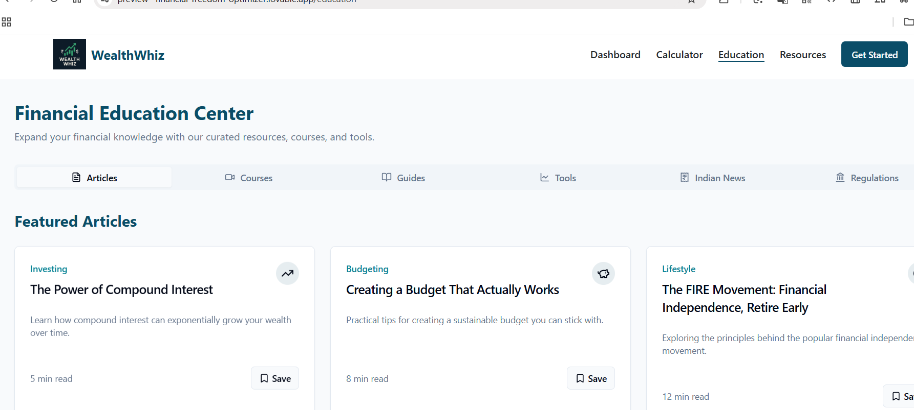
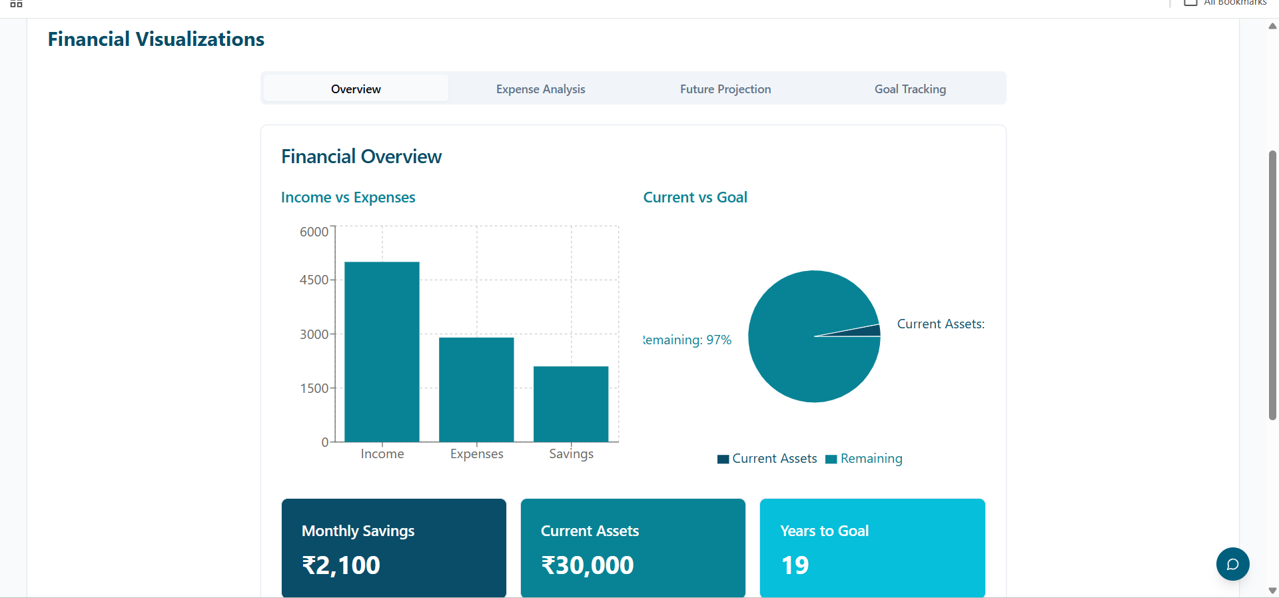
Screenshots of our Website:WEALTH WHIZ

Slide 7
Conclusion & Future Work:
Conclusion: The Financial Freedom Optimizer website successfully streamlines the personal finance management process. By offering features like intuitive dashboards, expense categorization, and budgeting tools, it empowers users to take control of their financial lives.
Future Work:
Integration with banking APIs to fetch and sync real-time financial data.
Optimization for mobile devices and tablets to ensure smooth usability on the go.
Addition of machine learning algorithms to provide personalized financial insights and recommendations based on user data and behavior.
Creating educational modules or tips to help users build better financial habits over time.

