Slide 1

Handover Probability in Drone Cellular Networks
Team Name: s1 g14 net Rishika Bothra (AU2544006)
Bhavyam Rajguru (AU2440249) Vansh Lilani (AU2320146) Fagun Rathod (AU2440111)
Aniruddha Wairagade (AU2440101)
Instructor Name: Prof. Dhaval Patel
Assigned TA: Rushi Moliya
School of Engineering and Applied Science
March 29, 2026
de
Module 4

Slide 2

Handover Probability in Drone Cellular Networks
Project Context and Motivation
Project Domain & Objectives
Analyzes a cellular network where mobile Drone Base Stations (DBSs) serve a stationary ground user.
Objective: Evaluate how drone mobility and parameter variations trigger network handovers over time.
The Role of Uncertainty
Real-world drone networks are highly dynamic; parameters like drone density, operating speeds, and distances change with every deployment.
Relying on a purely deterministic model only confirms mathematical theory at one specific set of values.
Incorporating uncertainty ensures our system models realistic, diverse scenarios rather than a single idealized state.
de
Module 4

Slide 3
Milestone 3 Recap
Deterministic Baseline Overview
The M3 Deterministic Setup
Modeled DBS initial positions using a Poisson Point Process (PPP).
Same Speed Model (SSM): All drones moved in straight lines at a fixed, constant speed.
Fixed Parameters: Density (1.0 × 10⁻⁶ DBS/m²), Speed (45 km/h), Exclusion radius (500 m), and Time window (400 s).
Limitations of the Deterministic Approach
A deterministic baseline only tests one specific, hand-picked setting.
It fails to prove if the underlying stochastic geometry theory holds true across the natural variations of real-world drone deployments.
de
Module 4

Slide 4
Simulation Architecture
System Pipeline Overview
End-to-End Pipeline
Initialization: randomised config.py
dynamically draws physical parameters.
Simulation: Monte Carlo realizations track drone movements and connections.
Theory: Analytical scripts load identical parameters to compute exact and
lower-bound probabilities.
Evaluation: Outputs are plotted to compare SSM vs. DSM metrics.
The Decision Rule
Nearest-Neighbor Policy:
The user always connects to the physically closest drone at every moment in time.
x ∗(t) = arg min_{i} ||x_{i} (t)||
A handover occurs when the index of this closest drone changes.
de
Module 4

Slide 5
Why Determinism Falls Short
Sources of Uncertainty
Key Sources of System Uncertainty
Spatial Distribution: Drones land and start at varying distances from ground users.
Network Density: The number of active drones deployed fluctuates per mission.
Drone Speeds: Individual drones move at different speeds due to hardware differences, battery levels, or wind.
The Need for Randomization
By drawing parameters randomly, every simulation run becomes a genuinely different experiment. If the theoretical math matches the simulation across all these variations, we prove the results are robust and generalizable, not just lucky for one special case.
de
Module 4

Slide 6
Distributional Assumptions
Random Variables in the System
The randomised config.py Module
Table: Sampled Distributions for Milestone 4
Random Variable Distribution & Range
Drone Density (λ₀) Mean Speed (v_{Mean} ) Speed Spread (v_{Diff} ) Exclusion Radius (u₀) Time Window (T )
Uniform (5 × 10⁻⁷ to 2 × 10⁻⁶ UAVs/m²)
Uniform (30 to 60 km/h)
Uniform (20 to 120 km/h)
Uniform (300 to 800 m) Uniform (200 to 400 s - integer)
Distributional Modeling:
Initial drone locations follow a Poisson Point Process (PPP).
Different Speed Model (DSM): Individual speeds (v ) are drawn from a Rayleigh or Uniform distribution.
de
Module 4

Slide 7
Introducing Parameter Variability
Randomized Algorithm Design
Design and Decision Component
Randomness is introduced via a central module called
randomised config.py.
This module draws five key physical parameters from Uniform distributions for each run.
The nearest-neighbor decision rule, handover detection logic, and straight-line drone motion remain exactly as they were in the baseline.
Table: Parameter Comparison: Deterministic vs. Randomized
Parameter | M3 Deterministic (Fixed) | M4 Randomized (Actual Draw)
Density (λ₀) | 1.00 × 10⁻⁶/m² | 1.44 × 10⁻⁶/m²
Mean Speed | 45.0 km/h | 53.1 km/h
Exclusion Radius (u₀) | 500 m | 335.8 m
Time Window (T ) | 400 s | 272 s
de
Module 4

Slide 8
The Anchor Drone Concept
Probabilistic Reasoning Behind the Algorithm
Addressing Uncertainty
Testing across many different randomly drawn settings provides a much more convincing and robust conclusion than testing a single hand-picked set of values.
Why Randomization Improves System Stability
Deterministic SSM: All drones move at the exact same speed. The swarm shifts uniformly, forcing rapid, unavoidable handovers.
Randomized DSM: Each drone gets a different speed drawn from a distribution.
The Result: Drones that randomly draw slow speeds act as natural “anchors.” They stay closest to the user for a much longer time before a faster drone can overtake them, naturally filtering for connection stability.
de
Module 4

Slide 9
Simulation Pipeline Workflow
Implementation of the Randomized Strategy
Integration Architecture
A save-and-load system guarantees the simulation and theoretical scripts evaluate the exact same randomized configurations.
Execution Workflow
1
Sample: handover dbs simulation.py calls sample params() to draw the variables.
Save: Parameters are saved immediately to a local JSON file.
Simulate: 10,000 Monte Carlo realizations run using the sampled density, speeds, and time vectors.
Validate: Theory scripts read the exact same JSON file to compute the analytical integrals.
Evaluate: plot handover.py aggregates the outputs and generates comparative figures.
2
3
4
5
de
Module 4

Slide 10
Domain-Specific Indicators
Evaluation Metrics
Handover Probability P[H(t)]: The foundational metric. Measures the probability that a ground user has had to switch their drone connection at least once by time t.
Expected Communication Cost: Measures resource utilization. A lower handover probability directly means less signaling overhead (authentication, resource allocation) and better bandwidth preservation.
Accumulated Latency: Measures user experience via service interruption. Each handover causes an approximate 40 ms interruption; delaying handovers reduces this latency.
Connection Stability CS (t): Defined mathematically as 1 − P[H(t)]. It measures the fraction of users who have not experienced any handover at time t.
de
Module 4

Slide 11
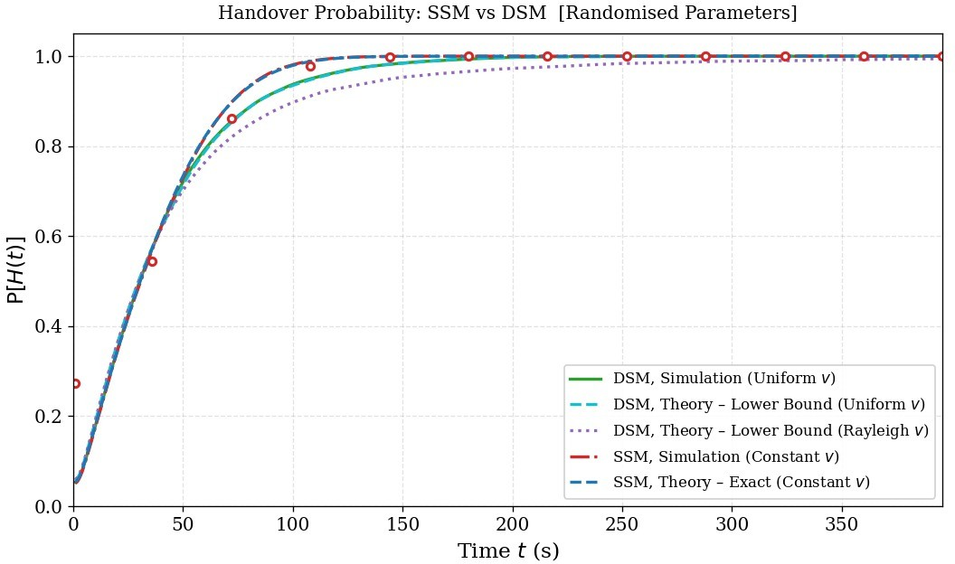
Handover Probability: SSM vs DSM
Comparative Results
Performance Comparison
DSM reaches 90% handover probability at 104 s, while SSM reaches it at only 60 s.
This 44-second improvement means randomized DSM users stay on their original drone significantly longer.
Resource Savings: The peak communication cost saving is 10.8% at t ≈ 88 s for the DSM approach.
Figure: Handover Probability over Time
de
Module 4

Slide 12
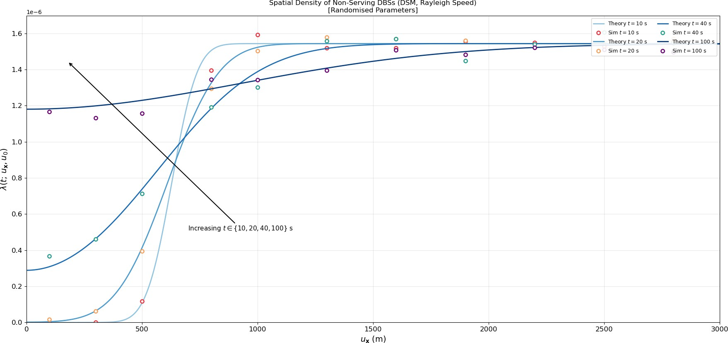
Conclusions and Remaining Challenges
Key Insights
Main Observations
Theory Robustness: The mathematical models are highly accurate even under randomized parameters (MSE of 6.2 × 10⁻⁶).
Density Impact: Higher drone densities speed up handovers due to increased competition for the nearest-neighbor position.
DSM Superiority: Variable-speed drones clearly provide better connection stability for users needing longer sessions.
Figure: Spatial Density over Time
Remaining Challenges
Drones drifting outside the finite 30 km simulation boundary slightly reduce effective density at late times, causing minor theory/simulation mismatches.
de
Module 4

