Slide 1




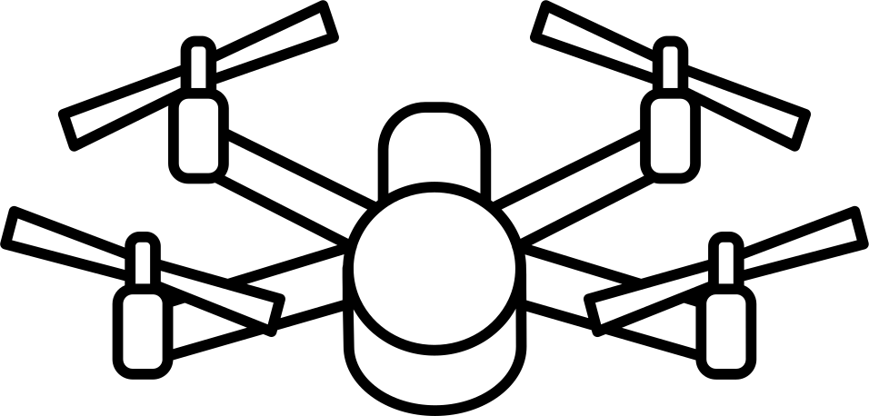
CSE 400 : s1_g14_net
HANDOVER PROBABLITY IN DRONE CELLULAR NETWORK
Motivation :
Drone Base Stations (DBSs) can provide temporary wireless coverage.
In drone networks, base stations move instead of users.
Movement causes frequent topology changes.
Even a static user may experience handovers.
System contains uncertainty due to:
1. random drone locations
2. random speeds
3. random movement directions
Goal: analyze handover behavior using simulation.

Slide 2
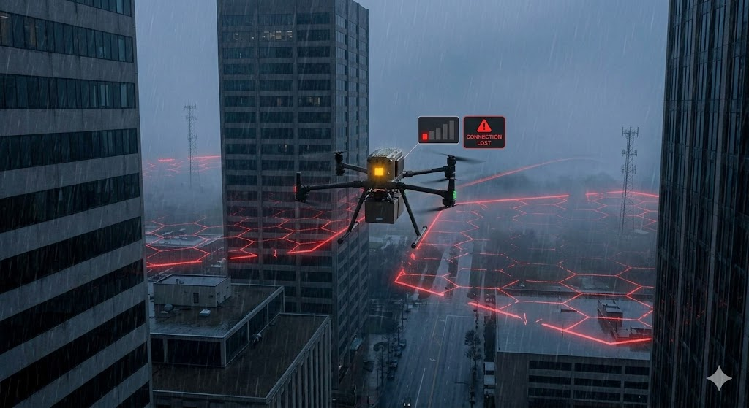




Project Objective and Deterministic Baseline
Objective :
Simulate drone cellular network.
Compute probability of handover before time t .
P(H(t)) = Probability that serving drone changes before time t
Deterministic baseline strategy :
User always connects to nearest drone.
No randomness in association rule.
Same rule used in reference paper.
Why reasonable :
Standard rule in cellular networks.
Used in theoretical analysis.
Allows study of mobility effects only.

Slide 3


System Pipeline Overview
PPP Deployment
Simulation pipeline:
Generate drone locations using Poisson Point Process.
Select nearest drone as serving drone.
Assign random speed and direction.
Move drones for time t.
Recalculate distances from user.
Detect handover event.
Monte-Carlo simulation – compute density and handover probability.
Where uncertainty enters:
(PPP) drone deployment
speed distribution
movement direction
Select Serving Drone
Assign Speed & Direction
Move Drones
Distance Calculation
Handover Check
Monte-Carlo Simulation & Results

Slide 4
Sources of Uncertainty
Uncertainty comes from stochastic modeling.
Sources
How uncertainty is handled
Purpose
PPP distribution of drones
Random number of drones
Random speed of drones
(Speed follow a probability distribution rayleigh/uniform)
Random movement direction
Simulation method:
Monte-Carlo simulation
Multiple realizations
Average over all results
Model realistic mobile network.
Compute Density and handover Probability

Slide 5
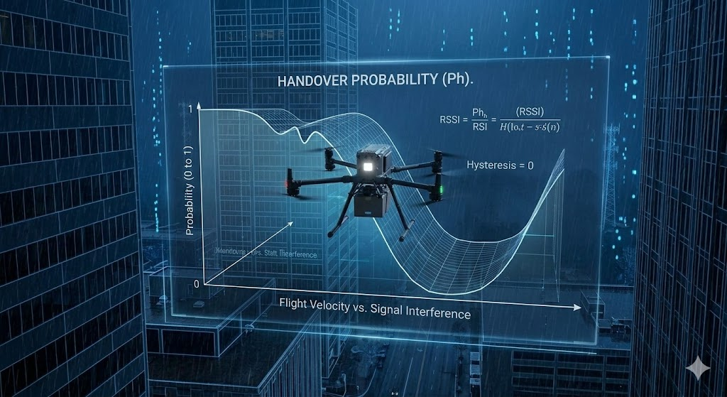





Key Random Variables
The simulation uses random variables to model drone mobility.
Variable | Meaning | Distribution
N | number of drones | Poisson
 | drone position | Uniform in region
 | drone speed | Rayleigh / Uniform
 | movement direction | Uniform (0, 2π)
 | distance to serving drone | random
 | distance to non-serving drone | random
These variables determine:
drone movement
density evolution
handover event

Slide 6

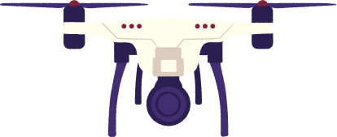


Probabilistic Modeling with Deterministic Decisions
Assumptions used in simulation:
Drone locations follow PPP : ΦD ∼ PPP(λ0)
Drone speed is random : V∼fv(v)
Movement direction is random : θ∼U(0,2π)
Deterministic baseline rule:
User always connects to nearest drone
No randomness in association decision
Handover event:
H(t)={∃ drone closer than serving drone}
So:
environment random
decision rule is fixed

Slide 7

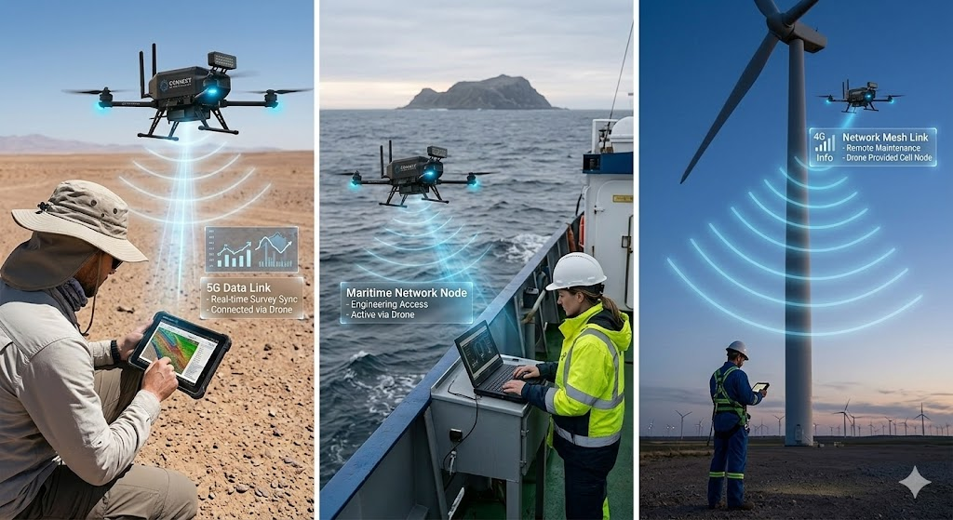

Deterministic Baseline Logic
The system uses a deterministic baseline association strategy in which the user always connects to the nearest drone base station.
Nearest–neighbor association rule:
Φ = set of drone base stations
o = user location
x* = serving drone
Logic behind deterministic baseline:
The nearest drone provides the strongest average signal.
This rule is commonly used in cellular network analysis.
It allows tractable modeling using stochastic geometry.
It ensures that randomness comes only from drone mobility.
Therefore, the deterministic baseline is used as a reference model
to study the effect of drone movement on handover probability.

Slide 8
Simulation Implementation
Simulation was implemented in Python based on the reference paper.
The original MATLAB simulation code was converted to Python and executed.
Two simulation modules were used:
Density simulation
Computes density of non-serving drone base stations over time
Handover simulation
Computes probability of handover for different time values
Implementation of Density Simulation:
Change speed parameters and use 3 different variations - 45kmh, 60kmh and 80kmh
Run simulation
Generate plots for density
Compare results with theoretical expressions
Implementation of Handover Simulation:
Implemented the simulation setup for both mobility scenarios: SSM and DSM.
Run simulation
Generate plots for density
Compare results with theoretical expressions

Slide 9

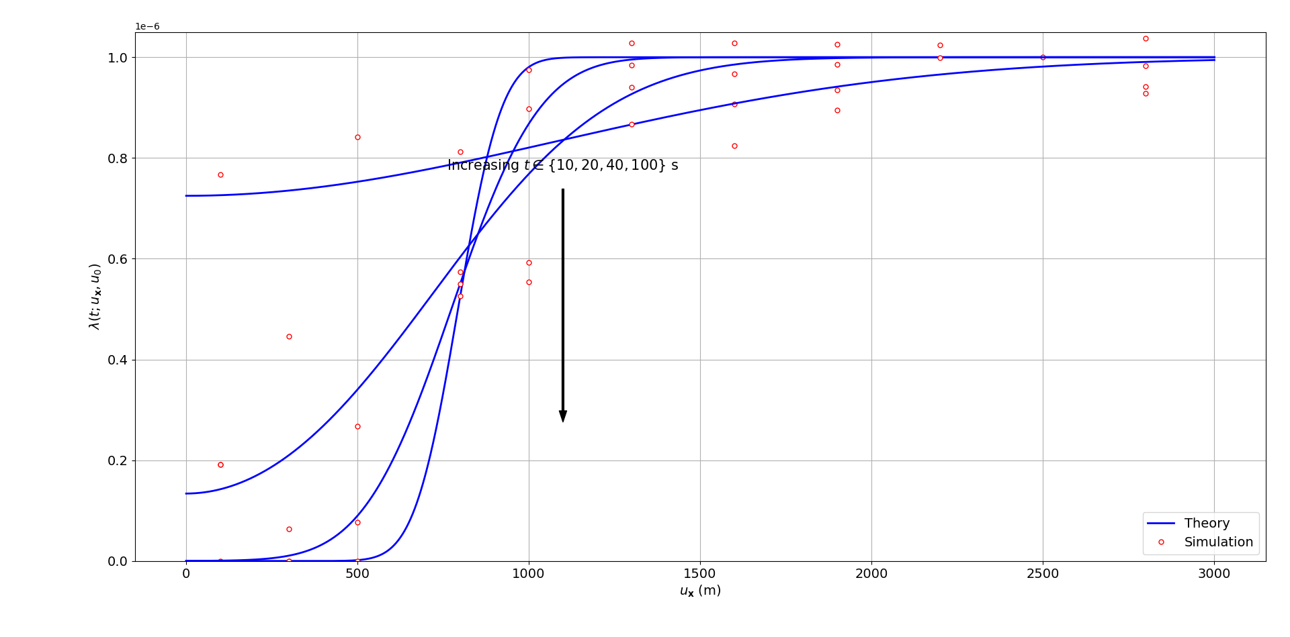
Results and Performance Analysis : Density Simulation
Speed 45 km/hr

Slide 10
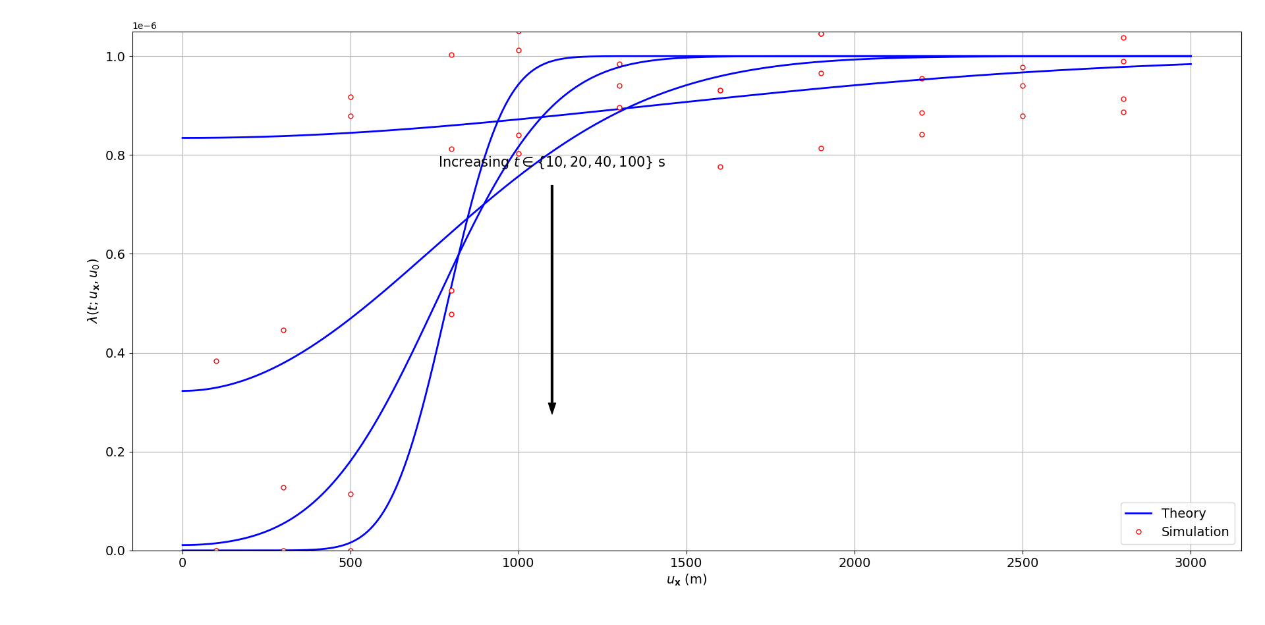
Results and Performance Analysis : Density Simulation
Speed 60 km/hr

Slide 11
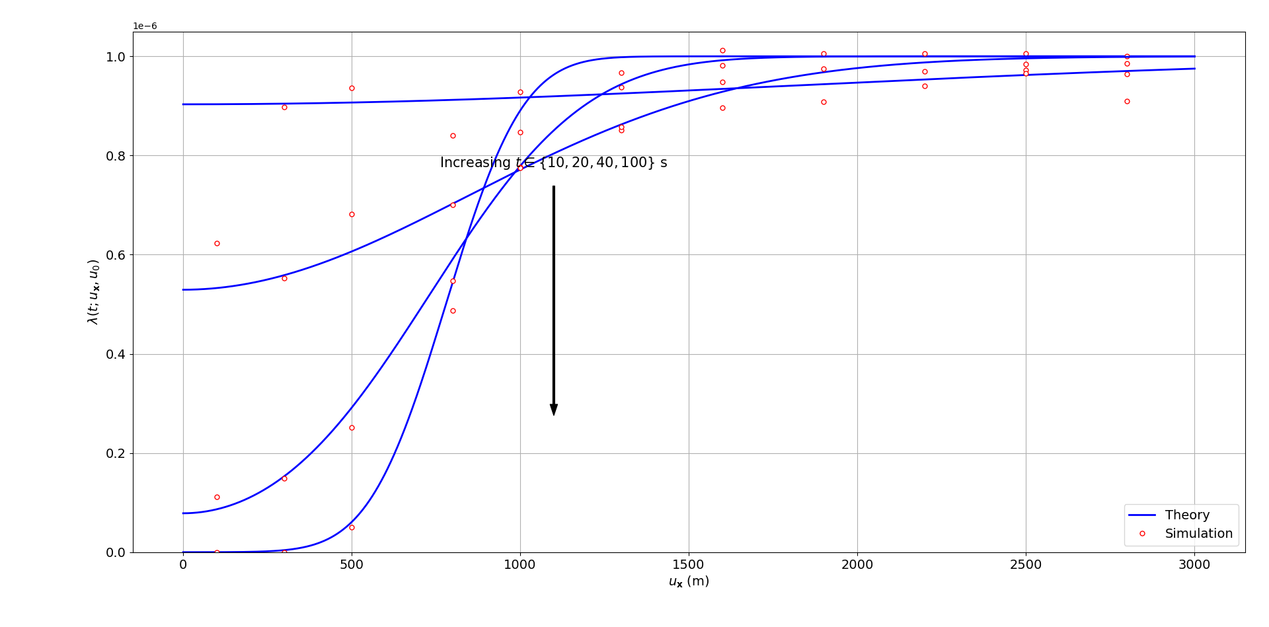
Results and Performance Analysis : Density Simulation
Speed 80 km/hr

Slide 12
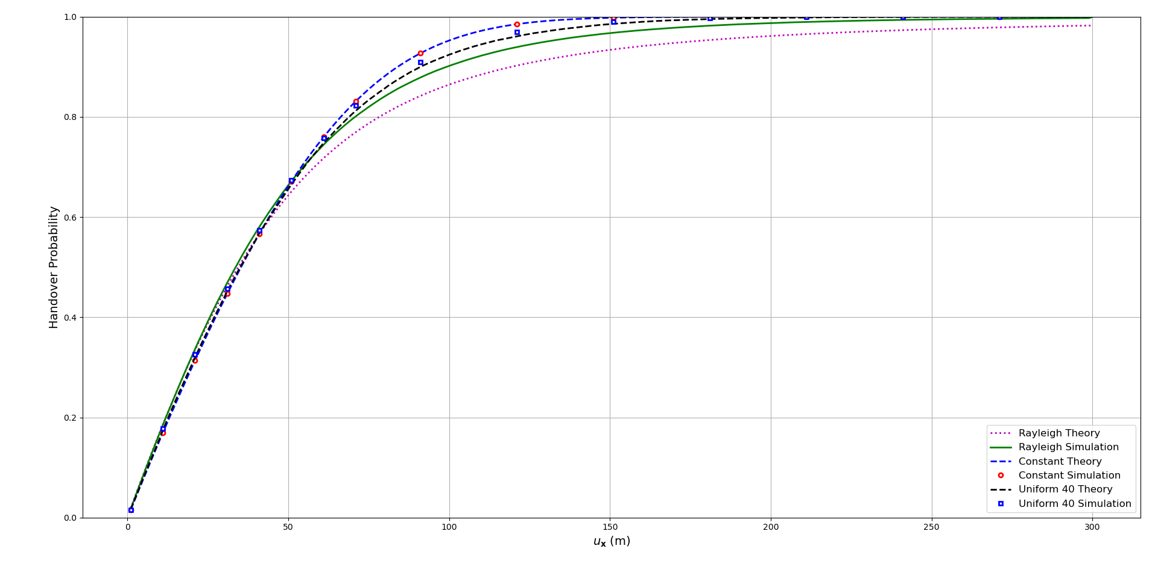
Results and Performance Analysis : Handover Simulation
1,00,000 Simulations

Slide 13
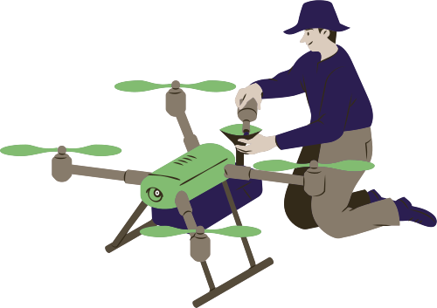
Limitations of Deterministic Strategy
Nearest-drone rule limitations:
ignores signal strength
ignores interference
ignores network load
sensitive to mobility
High speed → many handovers
High density → more switching
Need smarter strategies.

Slide 14

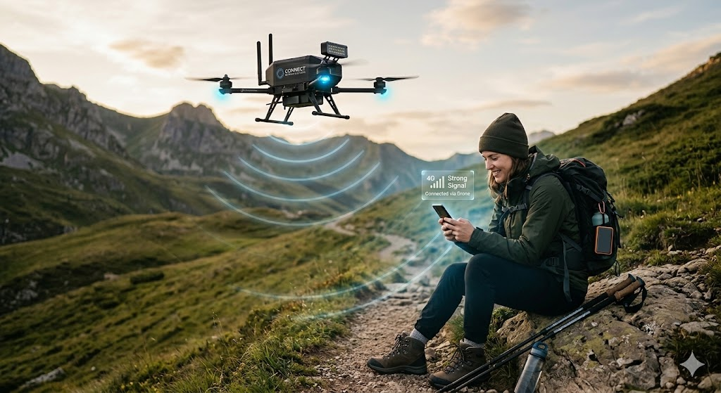
Summary and Transition to Randomized Strategies
Summary:
Drone network modeled using stochastic geometry.
Simulation used to verify theory.
Density and handover probability computed.
Deterministic nearest-drone rule used.
Observation:
mobility increases handovers
deterministic rule not always optimal
Future work:
adaptive association
probabilistic strategy
mobility-aware selection

