Slide 1






KONGU ENGINEERING COLLEGE
PERUNDURAI ERODE-638060
ONLINE FLOWER SHOP MANAGEMENT SYSTEM
GUIDE:Ms.K.Chitra .MCA., M.Phil.
Team Members:
PRIYA DHARSHINI Y.G 22MCR083
RAJEEV RAJAN 22MCR087
RISHIKA E 22MCR089
In association with:

Slide 2
AGENDA
Introduction
Abstract
Existing system and it’s Disadvantage
Proposed system and it’s Advantage
System Requirements
Data Flow Diagram
Class Diagram
Conclusion
Future Scope

Slide 3
INTRODUCTION
Shopping is one of the essential part of our daily life. We’re using different types of shops to buy different kind of things evetyday.
Today our life is divided into two parts
Physical Life: We met everyone physically
Virtual Life: We met people on a virtual world called ‘Internet’.

Slide 4
ABSTRACT
The project entitled “ONLINE FLOWER SHOP MANAGEMENT SYSTEM” aimed to automatic the flower shop in online mode. In the existing system, the admin has to do the work manually.
Online Flower Shop project is an advanced features supplied by e-commerce websites to improve the customer’s experience when making online purchase.
Nowadays, an increasing number of businesses are focusing on developing websites that allow customers to shop online from the comfort of their own homes.
The Online Flower Shop website contains a variety of things that customers can purchase. In this project we use Frontend as React JS Backend as Node JS and Database is Google Firebase.
In this Project, Customers can order flower items from the online portal in a quick and convenient manner. It also used to construct a user-friendly online application and to reduce the amount of manual work required by administrators in the current system.

Slide 5
PROBLEM STATEMENT
In this existing system have lots of defects due to rapid growth of technology, business organizations have switched over from the traditional method of selling products to electronic method of selling products.
Customers can purchase from the comfort of their own homes or work place. Selling flowers in online is to be made easier and convenient for the customer through internet.
The internet is being used to make selling flowers easier and more convenient for customers.
It’s also simple to reverse the transactions. Shipment delays are caused by long lead times and a lack of adequate management.
This frustrates the customer and prevents them from shopping online. Physical designs for flowers stores allow price negotiations between buyers and the seller.
The flower shops sales attendant representatives provide personal attention to customers and help them in purchasing products.

Slide 6
EXISTING SYSTEM
In the existing system admin have to do the work manually. All the customers will purchase the products via social or purchase directly in the shop. Admin have to take the orders separately and should respond the customers as per their needs.
Admin can show only limited number of customers. Admin have to maintain the stock levels, order details and customer details manually.
In the existing system, Customer can’t get their customized flowers.

Slide 7
DRABACKS OF EXISTING SYSTEM
In accuracy and error can be arising during transaction process.
Time consumption may be high to generate the reports.
Lot of paper work.
There may be a chance of error occurrence at the time of entering the data.
Less efficient.
It is a time-consuming process.
Slow data processing.
Not user-friendly environment.
Difficult to keep old record.

Slide 8
PROPOSED SYSTEM
The development of the new system contains the following activities, which try to automate the entire process keeping in view of the database integration approach.
To debug the existing system, remove manual procedures those cause data redundancy.
The drawbacks of existing system is overcomed in the proposed system.
Convenience of shopping at home. Wide variety/range of flowers are available. Good discounts /lower prices. It helps to save time and effort. Shopping from the comfort of your own home. There is a wide range of presents available. Discounts and reduced rates are available.
Customer’s can customize flowers based of their choice.

Slide 9
ADVANTAGES OF PROPOSED SYSTEM
User friendliness is provided in the application with various controls.
The system makes the overall project management much easier and flexible.
It can be accessed over the internet.
Admin can take the order efficiently with less time consumption.
Customer can have huge number of variety of products in a single website.
Enhancing the growth of online flower shop business.
Customer can get the flower items in their door itself.
Customer can pay using different mode of payment like cash on delivery, and scanning the QR Code.
Customer can customize the flowers based on their choice.

Slide 10
SYSTEM REQUIREMENTS
SOFTWARE REQUIREMENTS:
Operating System : Windows / Linux/Mac
Language : React JS
Backend : Node JS
Database : Firebase

Slide 11
HARDWARE REQUIREMENTS:
Processer : Intel Core i3
RAM : 2GB DDR4
Monitor : 15’’VGA Monitor
Hard Disk : 250GB
Keyboard : ACCUTYPE keyboard Mouse Optical Mouse

Slide 12
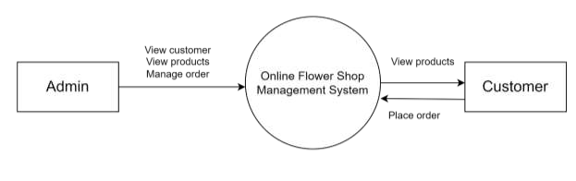
DATA MODELS
0th Level DFD

Slide 13
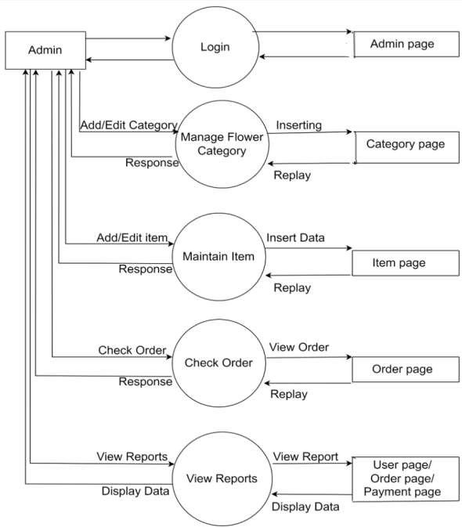
Admin Side 1st Level DFD

Slide 14
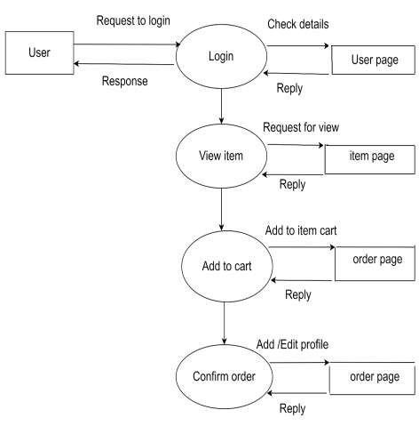
User Side 1st Level DFD

Slide 15
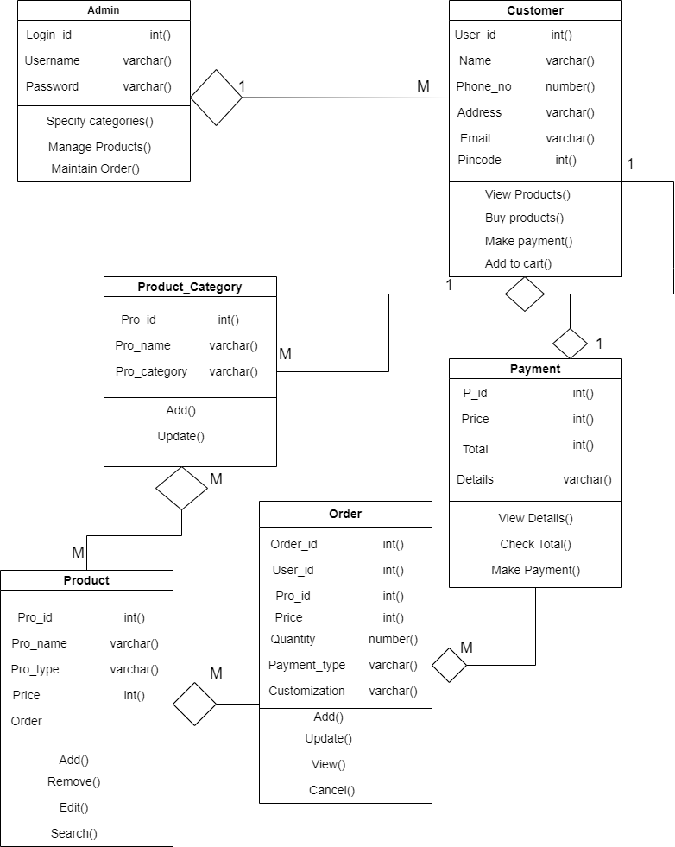
Class Diagram

Slide 16
MODULES AND DESCRIPTION
ADMIN MODULE:
Add product
View Details
Remove
ADD PRODUCT:
In this module, admin can add the products, admin can fill the details like product name,warrenty,description about the product,image and price.
VIEW DETAILS:
In this module, admin can view the details of the products and user registered on the website.
REMOVE:
In this module, admin can delete the details of the products and also the customer.

Slide 17
CUSTOMER MODULE:
Customer Registration
Customer Login
View Products
Buy Product
Payment
CUSTOMER REGISTRATION:
The customer registration form includes name, email id, mobile no, address and password. Only after the registration customer are allowed to login.
CUSTOMER LOGIN:
After completing the registration form only customer can able to login. In this login page user need to fill email and password to enter into the home page.

Slide 18
VIEW PRODUCTS:
After customer login, home page is displayed in that home page customer can view the product category, inside every category there are certain list of products. That product is displayed with the image, product name and price.
BUY PRODUCT:
If the customer want to buy the product, customer can order the product by adding into the cart. If the customer want customize the flowers based on their choice, they can enter the details in the customize page.
PAYMENT:
Customer can buy the products, after making the payment, the payment can be done in two ways one is cash on delivery and pay by scanning the QR Code.

Slide 19
CONCLUSION & FUTURE SCOPE
CONCLUSION:
The project "ONLINE FLOWER SHOP MANAGEMENT has been designed and developed as per the specification.
This application is up and running and meets all of the user's needs. This component can easily be integrated into a variety of other systems.
This component can be easily plugged in many other systems. It's really user friendly application to user. It will reduce the time of user and effort also. In future, we have to change application to a android application there by enabling to adopt for branches.
The new system eliminates the difficulties in the existing system. It is developed in a user friendly manner. The system is very fast according to the user wish that can be viewed or retaken at any level.

Slide 20
FUTURE SCOPE:
It is compatible to include any future enhancements, required by the system, In future the project, there is a chance to include some modules as well as large number of flower categories to enhance the communication and a relationship between the customers and the application, the future system would have enhanced activities appropriate for the future environment.
Some of the future enhancements that can be done to this system are:
It will be upgraded in favor of customer that cancellation of ordered products can be done.
Features like rating the products can be added.
Online payment will be facilitated and place of orders can be tracked.
The customers can give their customization option of the ordered products.
More Payement options can be added.

Slide 21
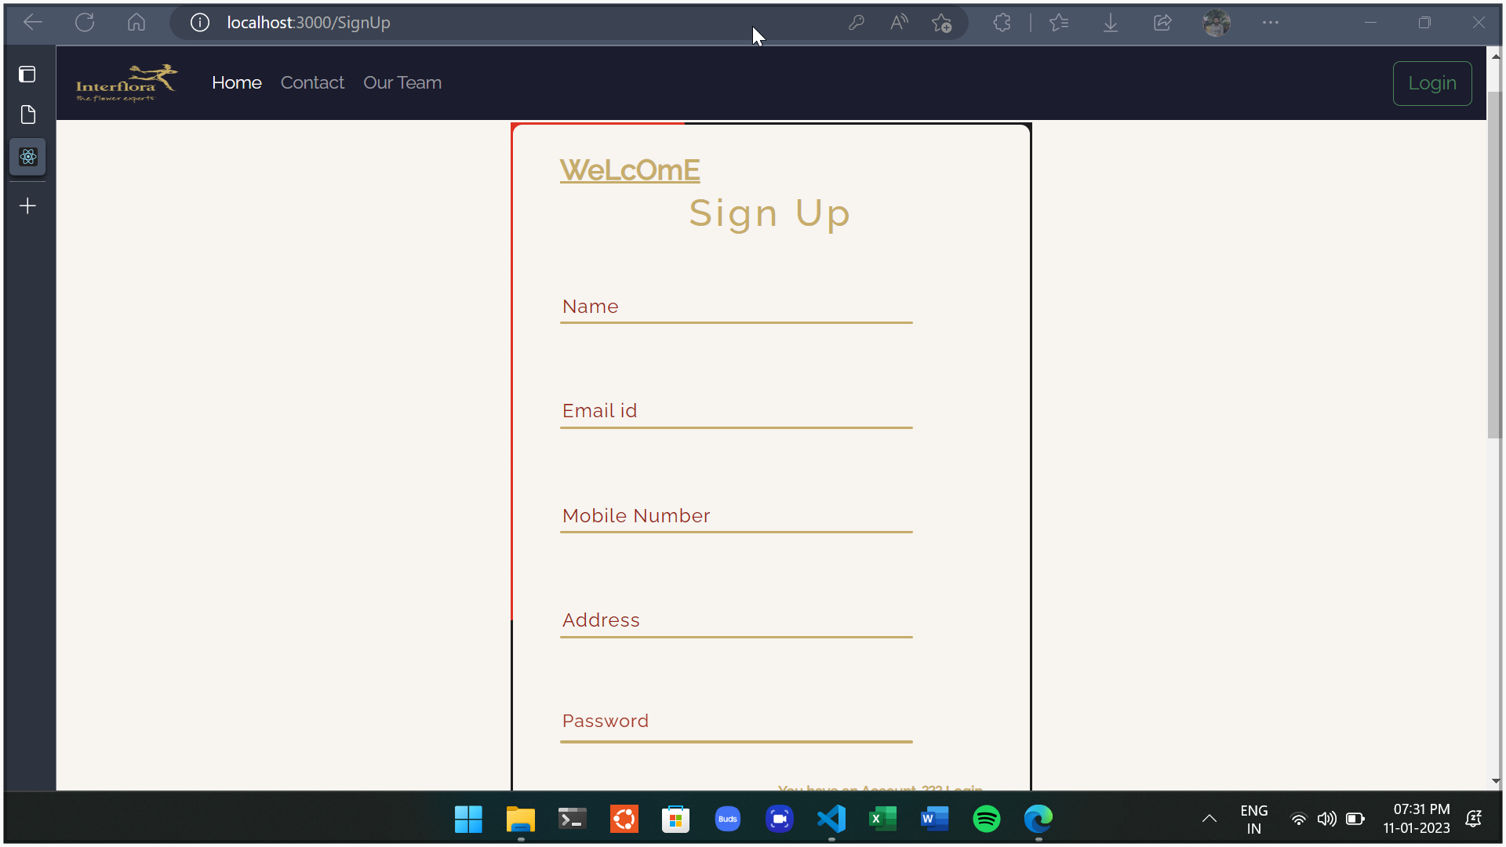
SCREENSHOTS
SIGN UP PAGE

Slide 22
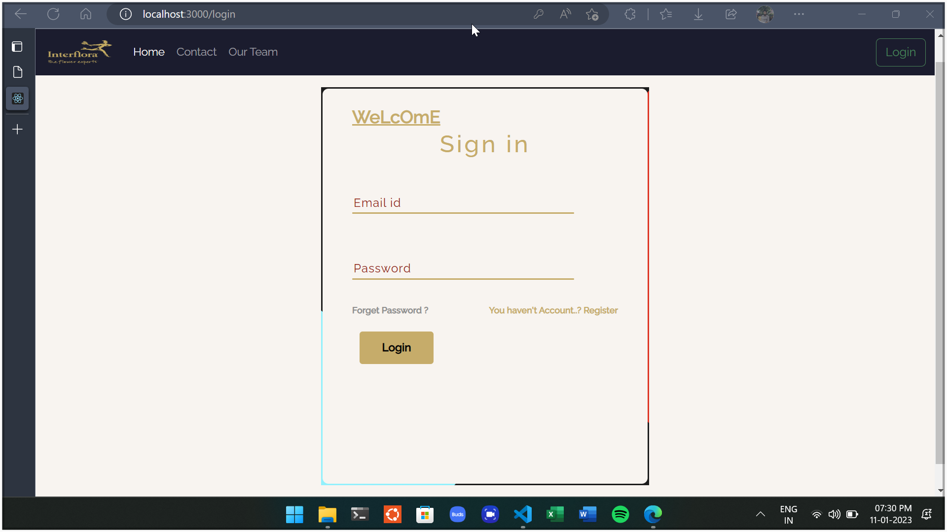
LOGIN PAGE

Slide 23

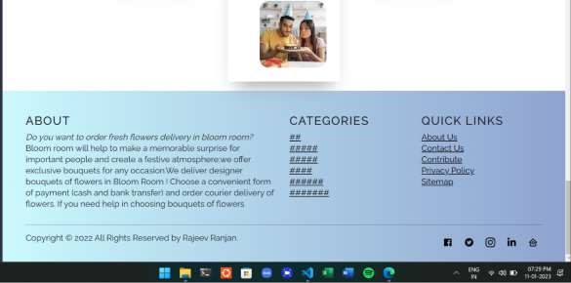
HOME PAGE

Slide 24
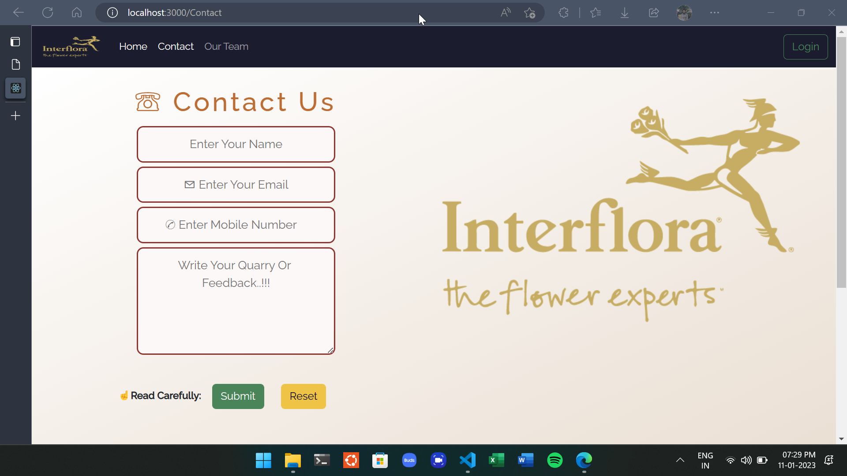
CONTACT PAGE

Slide 25
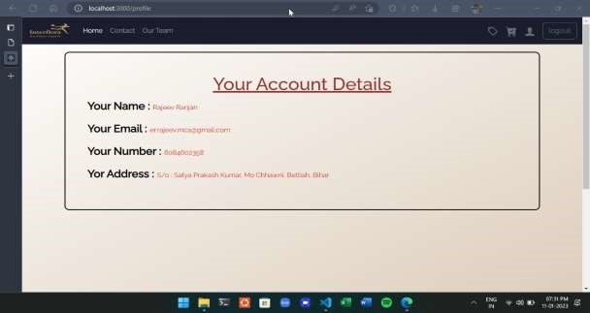
ACCOUNT DETAILS

Slide 26
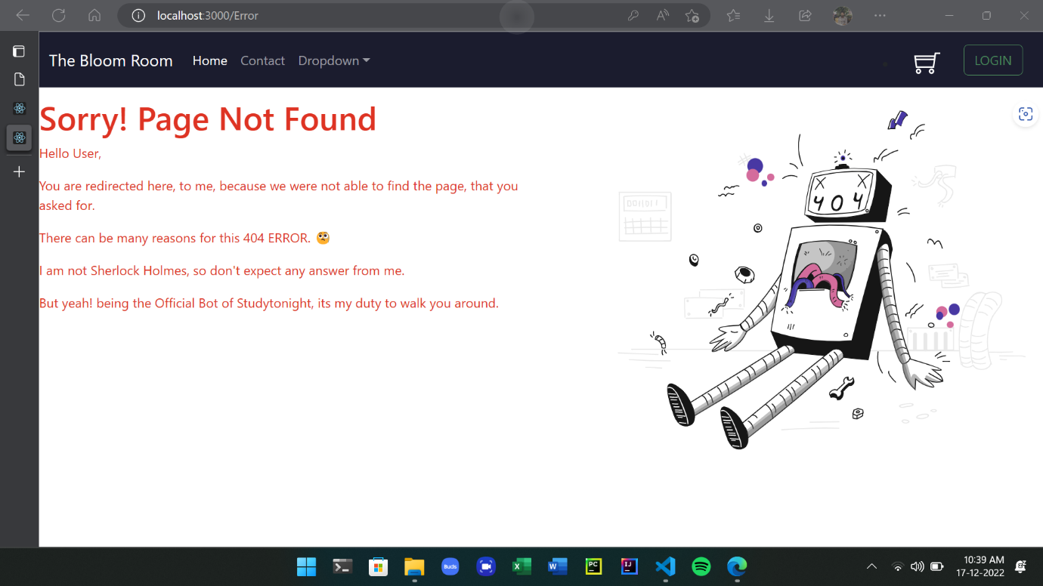
ERROR PAGE

Slide 27
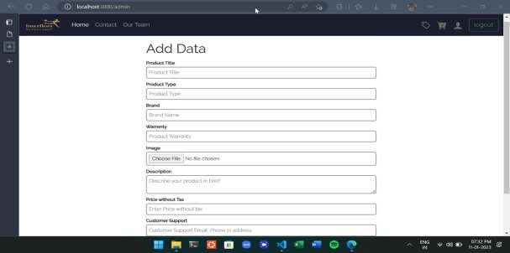
ADD PRODUCT PAGE

Slide 28
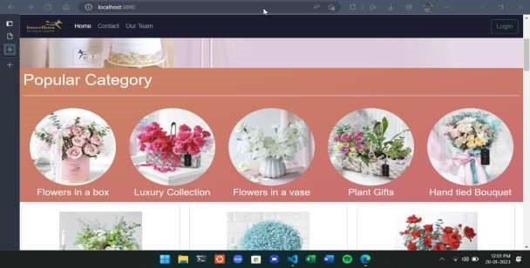
PRODUCT CATEGORY

Slide 29
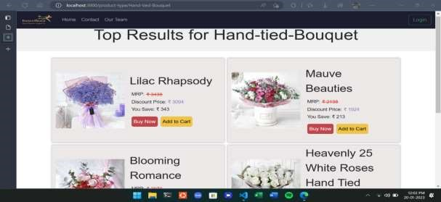
PRODUCTS

Slide 30
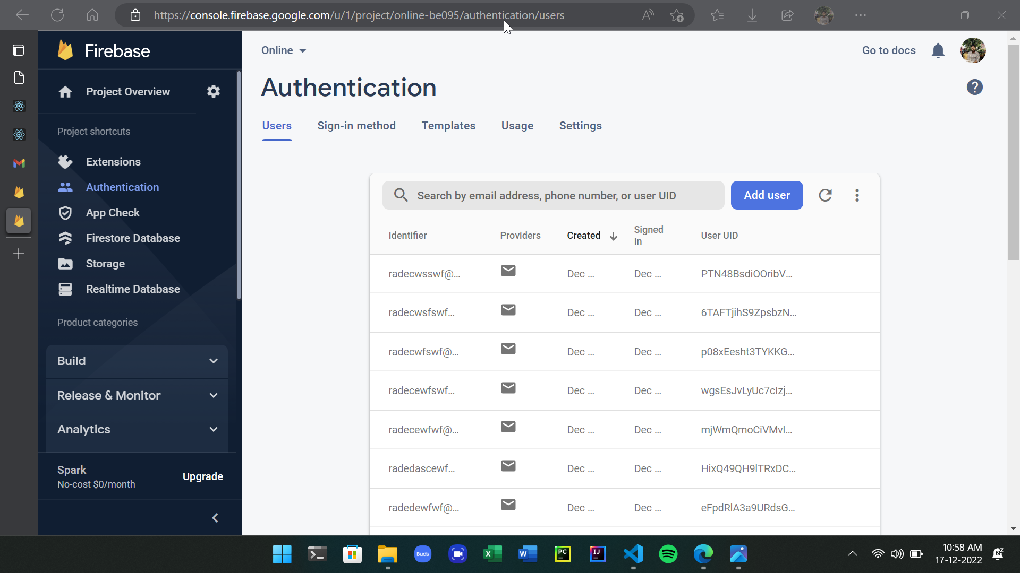
AUTHENTICATION PAGE

Slide 31
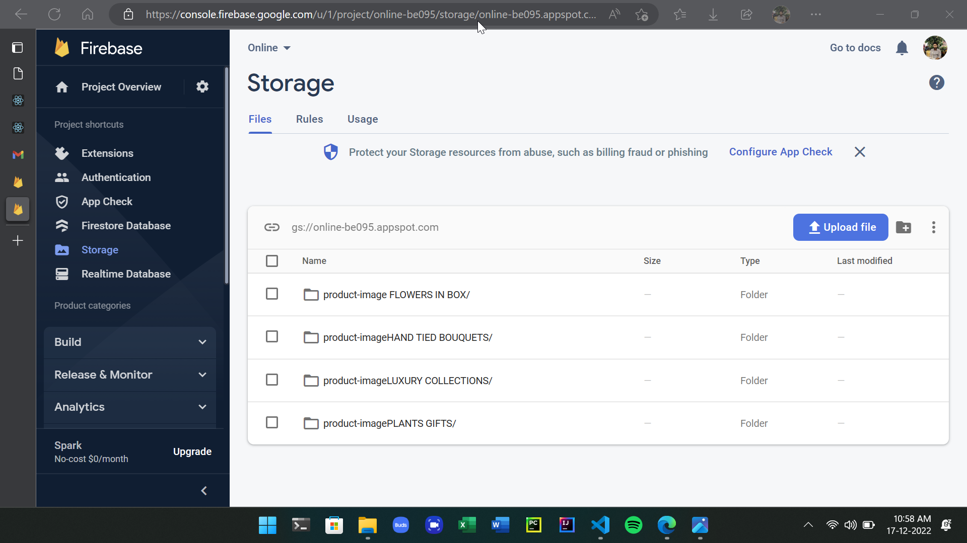
STORAGE PAGE

Slide 32
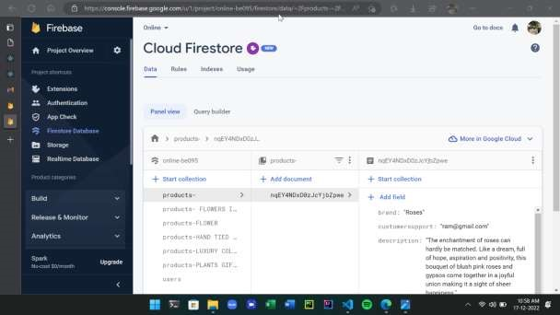
FIRESTORE DATABASE

Slide 33
REFERENCES
[1].Robin Wieruch (2017), The Road to Learn React: Your journey to master plain yet pragmatic React.js.
[2]. Mark Tielens Thomas. React in Action. Manning Publisher, 2018.
[3]. Azat Marden. React Quickly: Painless web apps with React, JSX, Redux, and GraphQL.Simon and Schuster published in 2017.
[4]. Konger, Snehasish (2022). "Advanced React Concepts that You need to Know". Scientyfic World.
[5]. Jonathan Wexler (2019). Get Programming with Node.js
[6]. https://www.geeksforgeeks.org/reactjs/
[7]. https://firebase.google.com/
[8]. https://www.geeksforgeeks.org/nodejs/
[9]. https://www.geeksforgeeks.org/firebase-introduction/

Slide 34
Thank You

