Slide 1
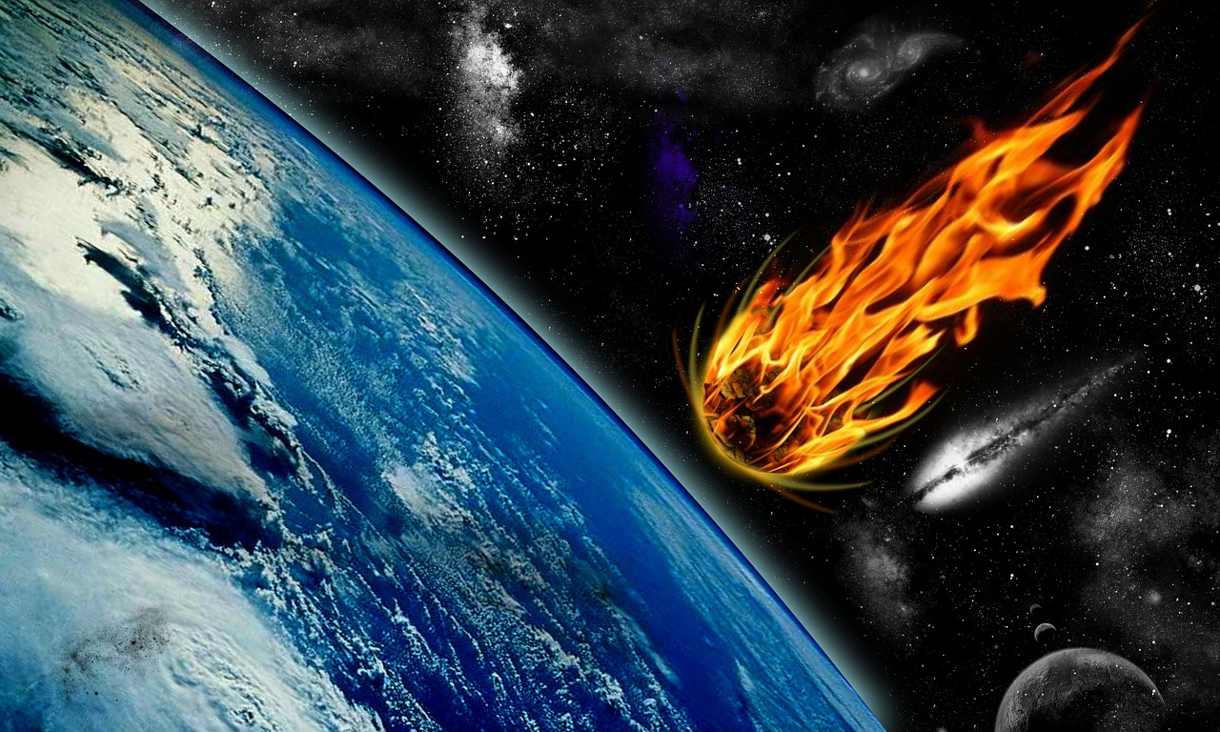
Deep Water Impact Asteroid Simulation
Group 2

Slide 2
Data Wrangling Tasks
Have you successfully downloaded all of the data? –
Yes (we created shell scripts to download all individual vti files. Kept them for downloading overnight. requested account for slate. This made it possible to download all the datasets)
Have you successfully visualized more than a few timesteps in ParaView?
Yes (we managed to load and visualize all time steps for all the datasets)
What is your strategy for breaking down the data size into manageable chunks?
We took a subset of vti files and tried to experiment with multiple filters and views and visualizations that help show the impact of the asteroid

Slide 3
Scientific Representations
What visualization representation(s) will you deliver?
Majority of our visualizations are in .movies, images and 3D sketchfab visualization which intended to show the difference between airburst and non airburst simulations and effect of tsunami or pressure waves on water.
We also plan to have supporting graphs to show the variations in parameters.
Also exploring visualizations on sketchFab as well.
Plan to improve the outreach infographic.
Show the intermediate or final results of your visualizations (not the work of contestant submissions.)
We have successfully explored different options of contours and different representations with different variables and got few visualizations.

Slide 4
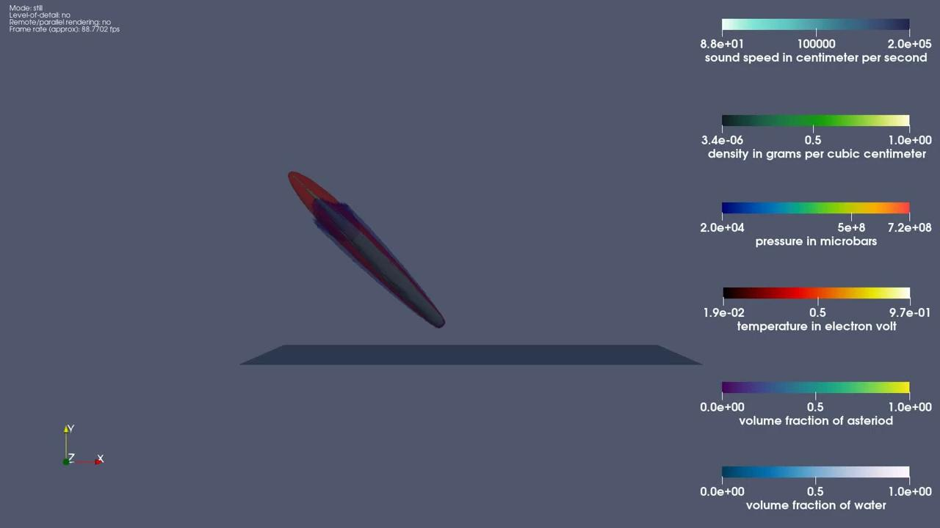
yA31 contour representation with most of the variables to note the 45 degree impact of asteroid without airburst on water to observe the pressure, temperature and sound waves:

Slide 5
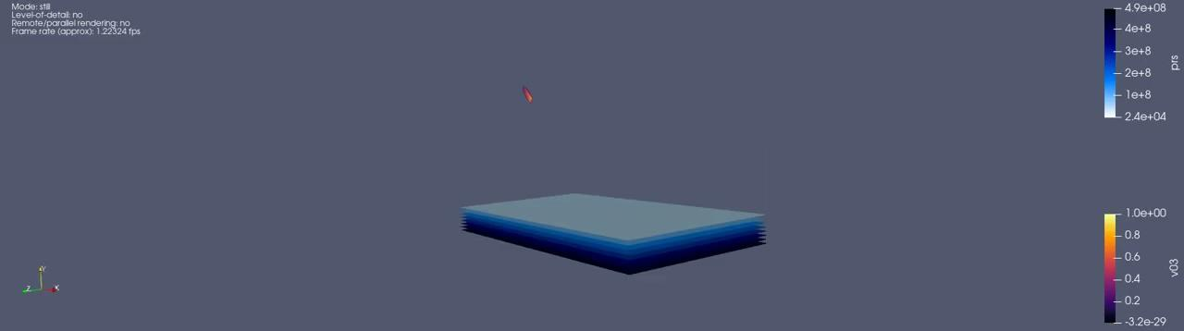
yB11 contour representation with pressure and volume fraction of asteroid to visualize the airburst

Slide 6
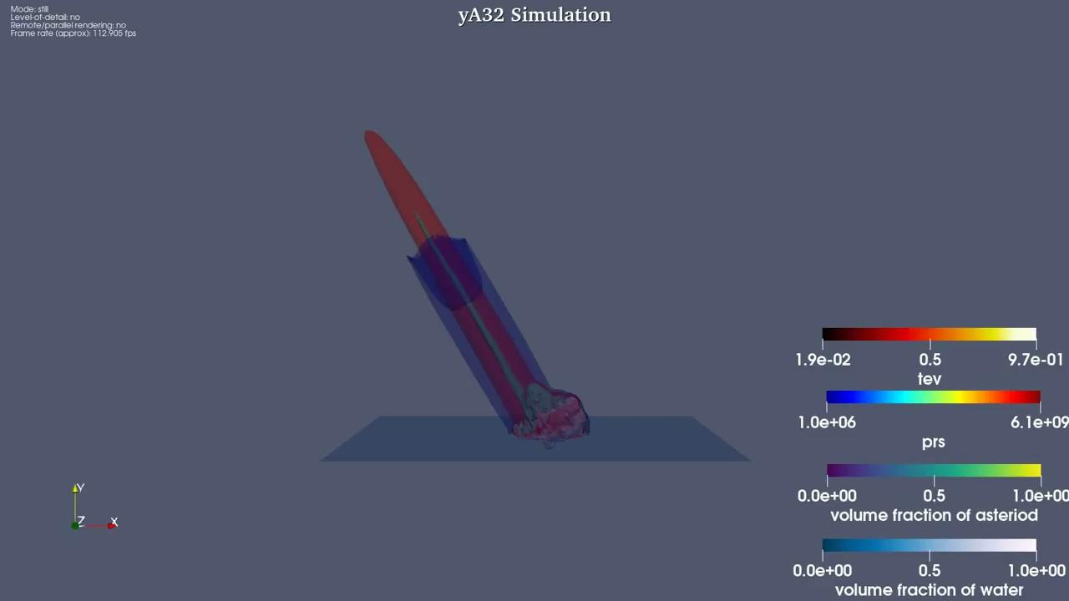
yA32 contour representation all most of the variables to note the 60 degrees impact of asteroid without airburst on water to observe pressure and temperature effects

Slide 7
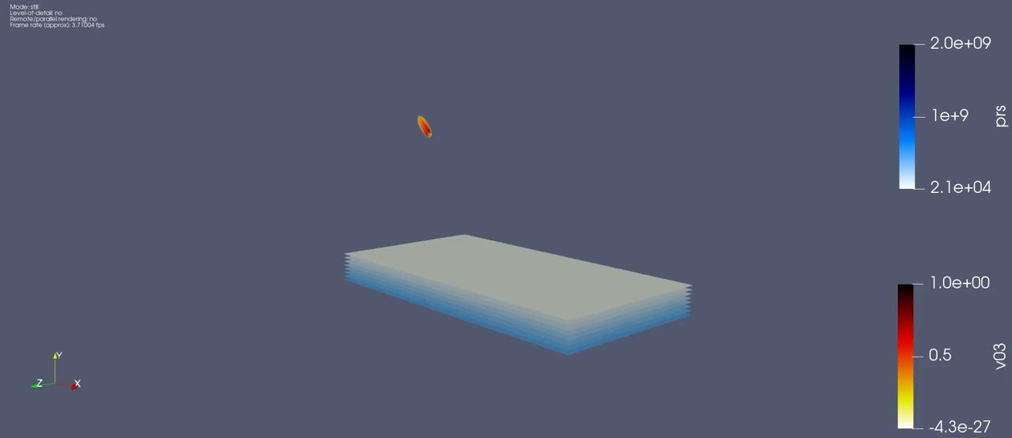
yB31 contour representation with pressure and volume fraction of asteroid

Slide 8
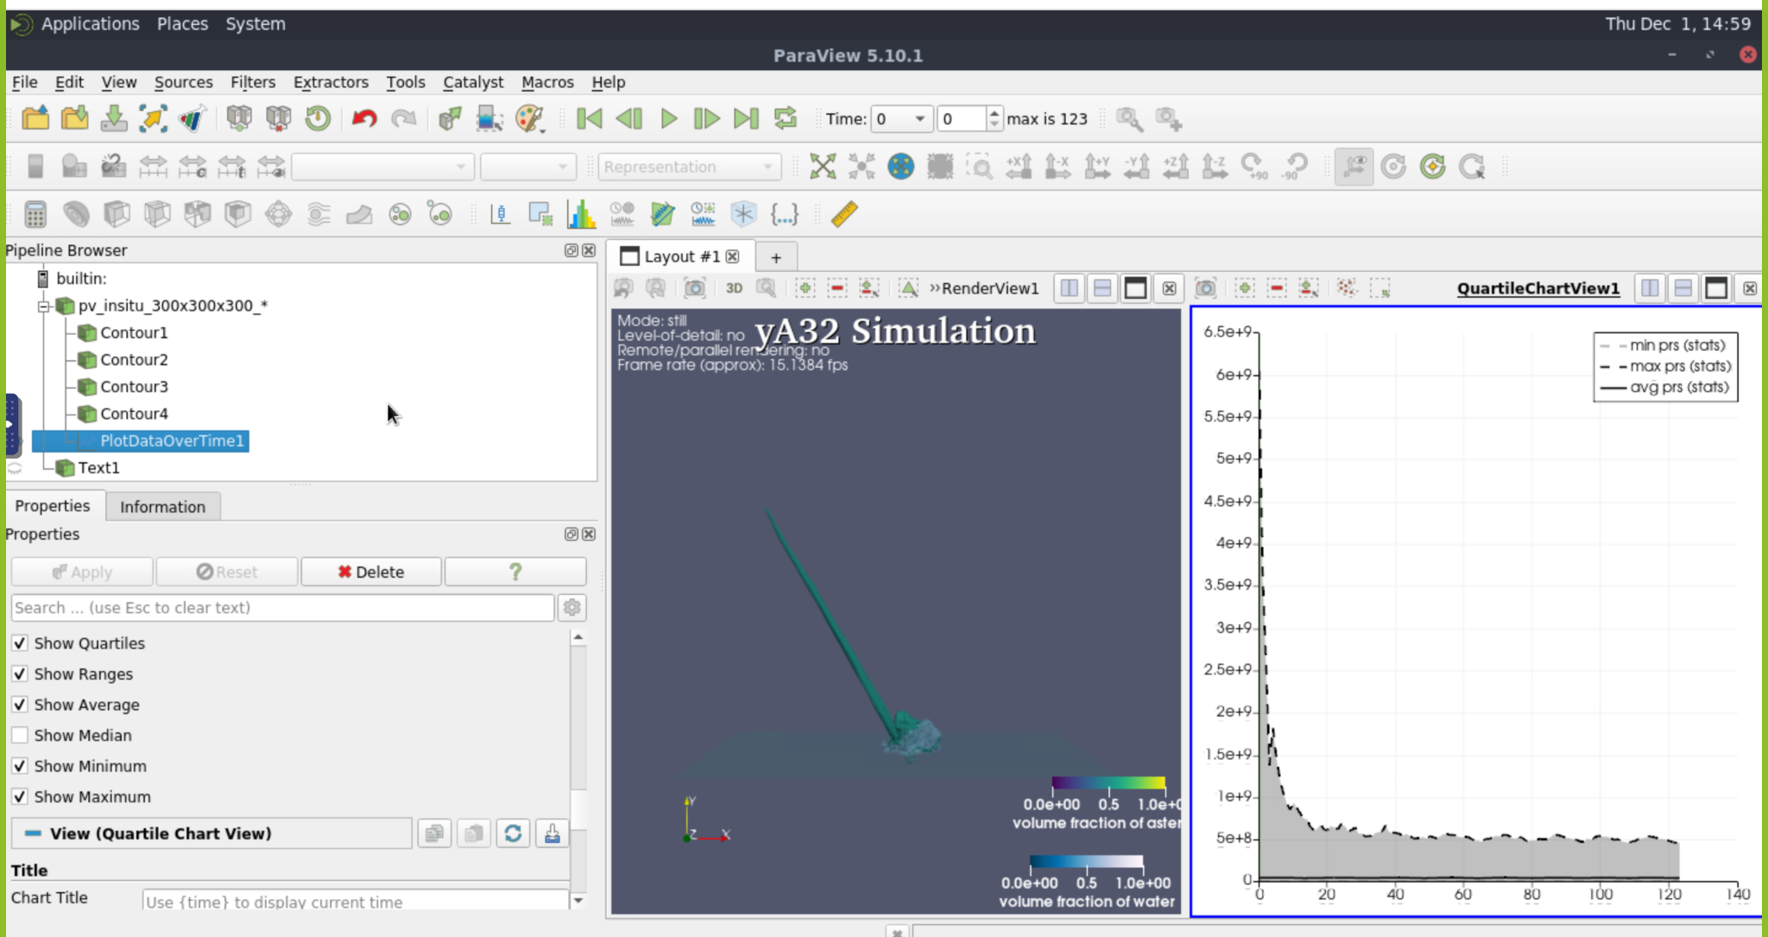
Graphs:

Slide 9
What visualization work remains to be completed?
Sketchfab visualizations
Final renderings of the videos
Looking into graphs options as it is taking long time
Adjusting Annotations and Layouts
Minor tweaks in infographic.

Slide 10
Education/Outreach Tasks
Describe your group's specific education/outreach task (e.g., "We are going to show the general public that studying eddy currents is important for understanding how pollution spreads in the Red Sea.") - Building an infographic and put a 3-D rendering to explain the task
What is the format for delivering this education/outreach visualization. (e.g., infographic, movie, online model, etc.) infographic and annotated sketchfab model
Show the intermediate or final result that includes your visualizations (not just the work of others.) – will show infographic poster and sketchfab

Slide 11
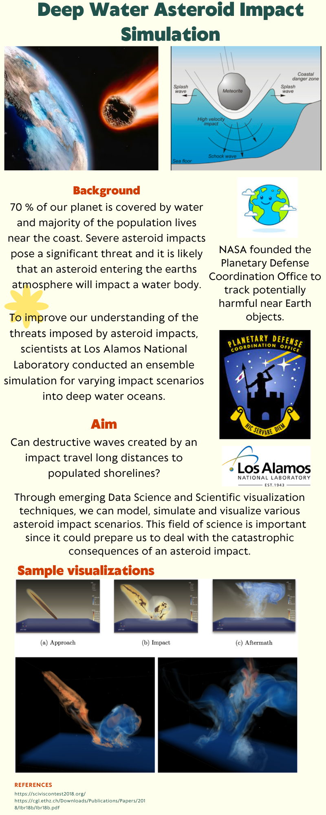
https://sketchfab.com/3d-models/yb31-1-a26b629e20164306ba6da2e5f2a4c2c3

Slide 12
Plan for the final stretch
What remains to be done? Who is responsible for which parts?
Team Member | Task | Due Date
Rohan | yC11, yC31 – rendering/ graphs SketchFab – 3D Animation | 12/04/2022
Adheesh | yB11 , yB31 - rendering/ graphs Collectome | 12/04/2022
Rishika | yA11 - rendering/ graphs Other/Glyphs exploration | 12/04/2022
Common | Final Presentation Slides

Slide 13
Questions from the group for Eric
After uploading gltf to sketchfab, contour is missing.
For images and pdf’s, we need to upload to iu pages right? Can we do it through Google Drive rather than using IU pages? COLLECTOME
Camera position fluctuations in the video.
Sftp isn’t working…cyberduck or terminal
Is it ok if we work on subsets for final presentation?
Glyphs and stream tracing only with scalar variables ?
Does it look too messy to show all the attributes together in simulation?
How to simultaneously save the animation and graph window
When will the google form be available for exam grading doubts?

