Slide 1
Sentimental Analysis on Movie Reviews using Classification techniques
Rishika Reddy Akavaram (R11523879)
CS-5341 Pattern Recognition
December 05, 2018

Slide 2
Introduction
Sentiment Analysis
A thought, view, or attitude, especially one based mainly on emotion instead of reason
Use of natural language processing (NLP) and computational techniques to automate the extraction or classification of sentiment from typically unstructured text
Notes:
We talk abt Sentiment Analysis which has a greater scope in the field of Natural Language Processing (NLP) and Machine Learning.
The Goal is to classify the movie reviews data to give either positive or negative ratings using Natural Language Processing techniques.

Slide 3
Motivation
Consumer information
Product reviews
Marketing
Consumer attitudes
Trends
Politics
Politicians want to know voters’ views
Voters want to know policitians’ stances and who else supports them
Social
Find like-minded individuals or communities
Notes:
Sentiment Analysis examines the problem of studying texts, like posts and reviews, uploaded by users on different platforms, forums, regarding the opinions they have about a product,date or service. The most common use of Sentiment Analysis is this of classifying a text to a class. Depending on the dataset , the sentimental classification here in this project is binary(positive or negative)
The Sentiment found within comments, feedback or critiques provide useful indicators
By polarity we tend to find out if a review is overall a positive one or a negative one. For example: 1)
Movie: is this review positive or negative?
Products: what do people think about the new iPhone?
Public sentiment: how is consumer confidence? Is despair increasing?
Politics: what do people think about this candidate or issue?
Prediction: predict election outcomes or market trends from sentiment

Slide 4
Challenges
Harder than topical classification, with which bag of words features perform well
Must consider other features due to…
Subtlety of sentiment expression
irony
expression of sentiment using neutral words
Domain/context dependence
words/phrases can mean different things in different contexts and domains
Effect of syntax on semantics
Notes:
Thwarted expectation:
“This film should be brilliant. It sounds like a great plot, the actors are first grade, and the supporting cast is good as well, and Stallone is attempting to deliver a good performance. However, it can't hold up"
“unpredictable”: good for movie plot, bad for car steering

Slide 5
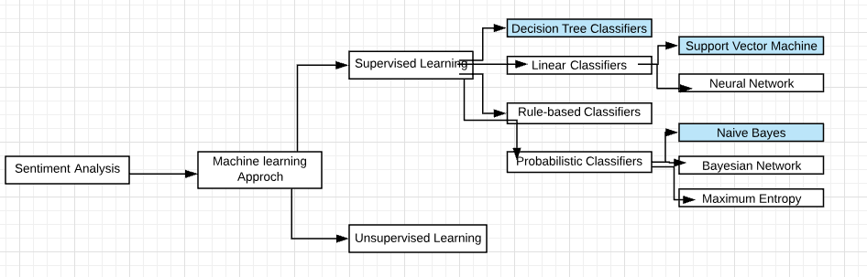
Sentiment Analysis
Notes:
Supervised Learning: In supervised learning test data or unclassified data is going to be classified based on the data available in the training dataset.
I am using supervised learning approch which are Naive based, SVM, DT,k-nn
and for the feature selection I used binary model as its better in predictiving the positive and negative reviews

Slide 6
Approches
Tokenization
Feature Extraction
Classification using Different Classifiers
Naïve Bayes
KNN
Decision Tree
SVM
Notes:
Accounts for conditional feature dependencies
Allowed reduction of discriminating features from thousands of words to about 20 (movie review domain
Machine learning
Strengths:
-perform fairly well within a given domain with sufficient training data
Weaknesses:
--in a given domain tends to overfit training data; hard to transfer learning to other domains
--need training data

Slide 7
Sentiment Tokenization Issues
Deal with HTML and XML markup
Reviews mark-up (names, hash tags)
Capitalization (preserve for words in all caps)
Phone numbers, dates
Emoticons
[<>]? # optional hat/brow
[:;=8] # eyes
[\-o\*\']? # optional nose
[\)\]\(\[dDpP/\:\}\{@\|\\] # mouth
| #### reverse orientation
[\)\]\(\[dDpP/\:\}\{@\|\\] # mouth
[\-o\*\']? # optional nose
[:;=8] # eyes
[<>]? # optional hat/brow

Slide 8
Extracting Features for Sentiment Classification
Example:
I didn’t like Mary Kom(negative review)
vs
I really like this movie (positive)
Which words to use?
All words
All words turns out to work better, at least on this data
Notes:
Positive Sentiment in subjective sentenc
Eg: ―I loved the movie
This sentence is expressed positive sentiment about the movie and we can decide that from the
sentiment threshold value of word ―loved‖

Slide 9
Dataset
The data set was taken from https://www.imdb.com/ , imdb-movie-reviews-dataset review data set
The Collection contains 1000 positive samples and 1000 negative samples
Positve and negative reviews were kept in two files pos.text in pos folder and neg.txt in neg folder
Two empty lists were taken for both the reviews, Calculate the accuracies
accuracy3=nltk.classify.util.accuracy(DecisionTree_classifier, testfeats)
Notes:
The collection consists of 2000 reviews (1000 positive samples and 1000
negative samples)
I have collected data from IMDB movie reviews dataset
for binary sentiment classification which provide a labelled
dataset of 25,000 highly popular movie reviews for
training, and 25,000 for testing. I have extracted rating and review from the dataset and randomized them for better results. The fields in our final dataset are:
ID: Unique id of each review. Rating: Rating given by each (rating¡=5 with sentiment score 0 and rating¿=7 with sentiment score 1). Review: Text of reviews given by user.
Sentiment: Sentiment of the review. 1 for positive reviews and 0 for negative reviews.

Slide 10
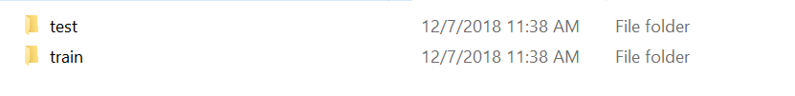
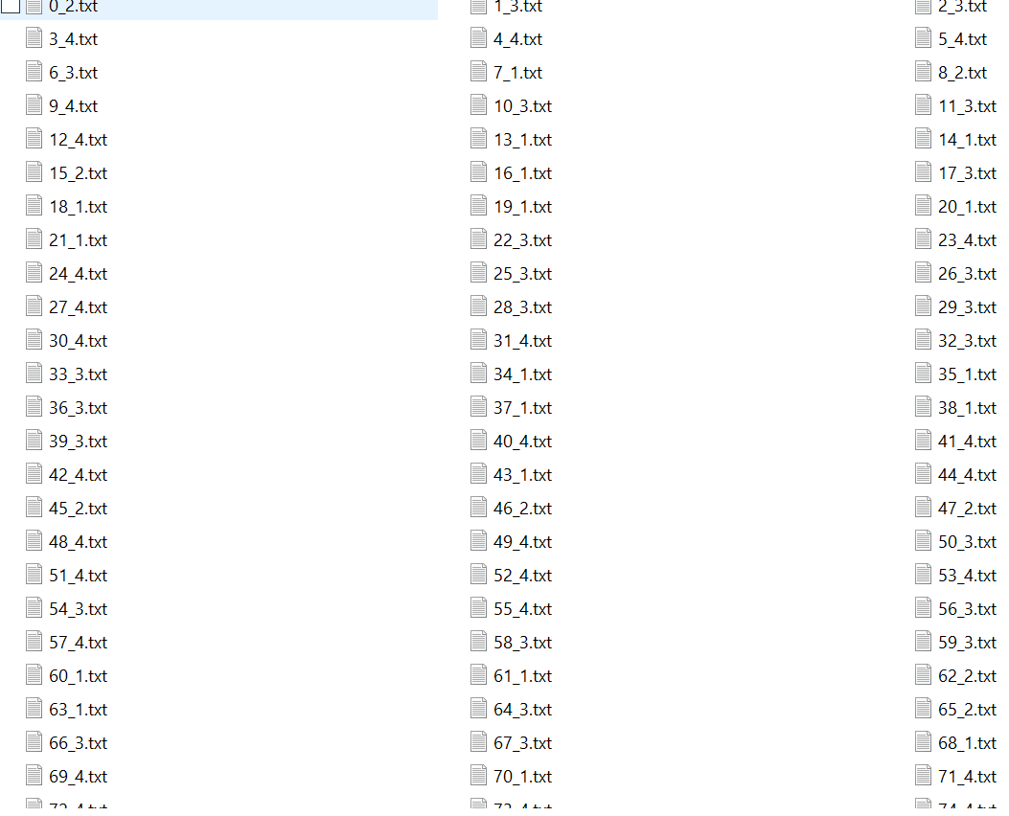
Dataset

Slide 11
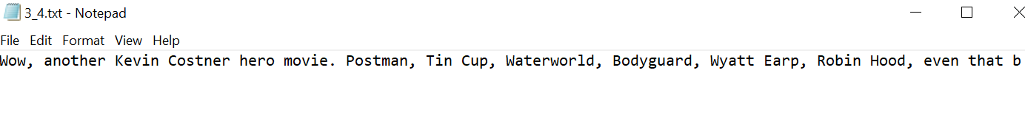
dataset
Positive review

Slide 12
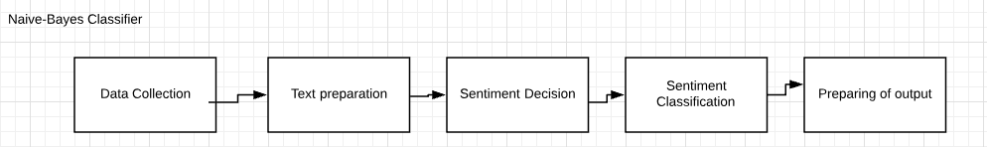
Naïve Bayes
Notes:
this is type of classifier works on bayes alg.which works on strong indep assumption for each feature. once the nltk is imported, then we gonna work on the classifer functionality using train function for training the data set, once we train the data- we can check for accuracy and the we can get the accuracy using nltk.classify.accuarcy() function for the respective test set.
we can also see the most classifier.show_most_informative_features() for the seeing most frequently popular words on both sides irrespective of positive and negative

Slide 13
Preprocessing
An initial step in text and sentiment classification is pre-processing. A significant amount of techniques is applied to data in order to reduce the noise of text, reduce dimensionality, and assist in the improvement of classification effectiveness. The most popular techniques include:
Remove numbers
Stemming
Part of speech tagging
Remove punctuation
Lowercase
Remove stopwords
Notes:
Advantage:
The techniques is to find the probabilities of categories given a text document by using the joint probabilities of words and categories
X is the data point and C represnt the class for the conditional probabolity in Bayes theorem:

Slide 14
Naïve Bayes
Naïve Bayes‘ classifier is a probabilistic classifier based on the Bayes‘ theorem, considering Naïve (Strong) independence assumption Sentiment analysis process

Slide 15
Naïve Bayes
From training corpus, extract Vocabulary
Calculate P(cj) terms
For each cj in C do
docsj ←all docs with class =cj
Notes:
For sentiment (and probably for other text classification domains)
Word occurrence may matter more than word frequency
The occurrence of the word fantastic tells us a lot
The fact that it occurs 5 times may not tell us much more.
Boolean Multinomial Naïve Bayes
Clips all the word counts in each document at 1

Slide 16
Naïve Bayes
First remove all duplicate words from d
Then compute NB using the same equation:
Notes:
For sentiment (and probably for other text classification domains)
Word occurrence may matter more than word frequency
The occurrence of the word fantastic tells us a lot
The fact that it occurs 5 times may not tell us much more.
Boolean Multinomial Naïve Bayes
Clips all the word counts in each document at 1

Slide 17
Cross-Validation
Break up data into 10 folds
(Equal positive and negative inside each fold?)
For each fold
Choose the fold as a temporary test set
Train on 9 folds, compute performance on the test fold
Report average performance of the 10 runs

Slide 18
Cross-Validation

Slide 19
KNN
K-NN is a type of instance-based learning, or lazy learning where the function is only approximated locally and all computation is deferred until classification.
In case of classification the output is class membership the object is classified by a majority vote of its neighbours, with the object being assigned to the class most common among its k nearest neighbours.
This rule simply retains the entire training set during learning and assigns to each query a class represented by the majority label of its k-nearest neighbours in the training set.

Slide 20
KNN
The distance with the smallest value corresponds to the sample in the training set closest to the unknown sample. Therefore, the unknown sample may be classified based on the classification of this nearest neighbours.
The K-NN is an easy algorithm to understand and implement, and a powerful tool we have at our disposal for sentiment analysis. K-NN is powerful because it does not assume anything about the data, other than a distance measure can be calculated consistently between two instances
As such, it is called non-parametric or non-linear as it does not assume a functional form.

Slide 21
KNN
KNN is insensitive to outliers
Similarity: Calculate the distance between two data instances.
Neighbors: Locate k most similar data instances.
Response: Generate a response from a set of data instances.
Accuracy: Summarize the accuracy of predictions.
Main: Tie it all together.

Slide 22
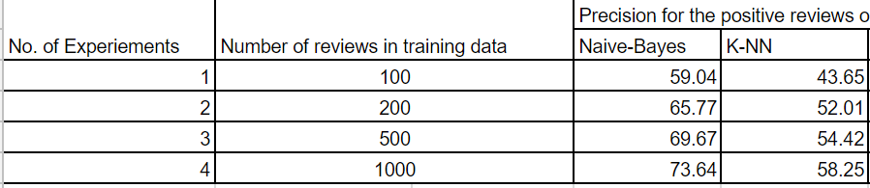
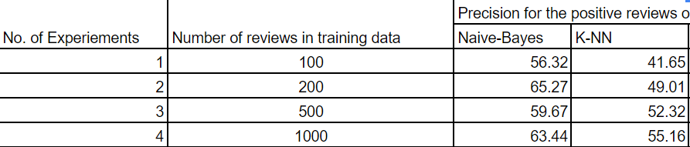
KNN
Precision for the positive reviews on the test dataset(Movie Reviews) for single words
Precision for the positive reviews on the test dataset(Movie Reviews) for bigrams

Slide 23
Decision Tree
Decision trees create a flowchart based classifier. At each level it utilizes decision stumps, a simple classifier that check for the presence of a single feature. The label is assigned to the sentence at the leaf nodes of the tree.
The decision tree is built by recursively partitioning the feature space into two parts.
At each step, the split that improves the error of the tree on the training data is used, and this greedy strategy continues until a tree of desired size is produced.

Slide 24
Feature selection and extraction
In order to perform machine learning, it is necessary to extract clues from the text that may lead to correct classification.
Clues about the original data are usually stored in the form of a feature vector, F~ = (f1, f2, . . . fn).
Each coordinate of a feature vector represents one clue, also called a feature, fi of the original text.
The value of the coordinate may be a binary value, 4 indicating the presence or absence of the feature,.

Slide 25
Feature selection and extraction
Using this model the sentence This is a great event may be represented by the following feature vector: F~ 0={’a’:1, ’event’:1, ’great’:1, ’is’:1, ’this’: 1}.
Extend the set of words, and incorporate them as the features in the feature vector. The set of features in this case would be
{’a’, ’event’,’great’, ’is’, ’it’, ’movie’, ’Startrek’, this’}.
Feature vectors that fully represent both sentences would be
F~ 1 = {’a’ : 1, ’event’: 1,’great’ : 1, ’is’ : 1, ’it’ :0, ’movie’ : 0, ’Startrek’: 0, ’this’ : 1}

Slide 26
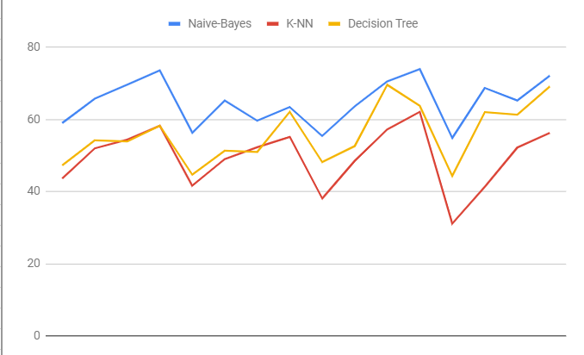
Performance
Notes:
Uses unigram features extracted from movie review data
Assumes that adjacent sentences are likely to have similar subjective-objective (SO) polarity
Uses a min-cut algorithm to efficiently extract subjective sentences
Document with three sentences: Y, M, N – nodes in the graph
Assign weights for each node’s (sentence’s) preference for being in each of two classes (positive or negative)
Assign weights for each node’s (sentence’s) preference for being in the same class as adjacent nodes.

Slide 27
SVM
SVM belongs to the supervised category of machine learning algorithms.
Supervised machine learning algorithm is one which has to be trained first with the pre identified output class (training data)
Support Vector Machine (SVM) finds an optimal* solution.
Maximizes the distance between the hyperplane and the “difficult points” close to decision boundary
Notes:
and then it makes itself capable to classify the real input data (test data).
SVM is good at handling missing data;,
The decision function is fully specified by a subset of training samples, the support vectors.

Slide 28

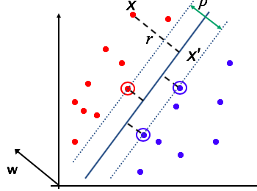
SVM
Distance from example to the separator is
Examples closest to the hyperplane are support vectors.
Margin p=width
of seperation
Notes:
Margin p of the separator is the width of separation between support vectors of classes.
If the training data is not linearly separable, slack variables ξi can be added to allow misclassification of difficult or noisy examples.
Allow some errors
Let some points be moved to where they belong, at a cost
Still, try to minimize training set errors, and to place hyperplane “far” from each class (large margin)
One intuition: if there are no points near the decision surface, then there are no very uncertain classification decisions

Slide 29
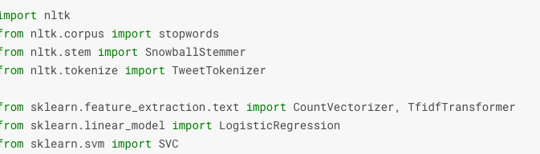
data loading and data cleaning
First undergoing through data loading and data cleaning
Notes:
To visualize the results of Sentiment Analysis, many people employ well-known techniques, such as graphs, histograms, and confusion matrices.But for the current project -------------. This is the Visualization technique I used

Slide 30
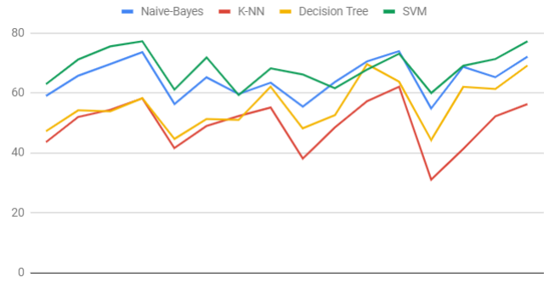
Results
SVM outperforms Naive based and decision trees, knn with the highest accuracy of 77.9%. they worked on movie review dataset which contains 1000 +ve and -ve reviews from the movie data set provided by IMDB reviews

Slide 31
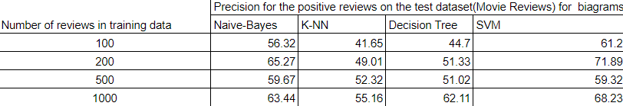
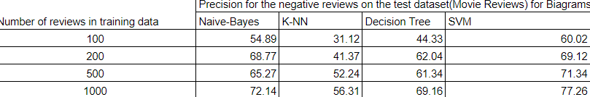
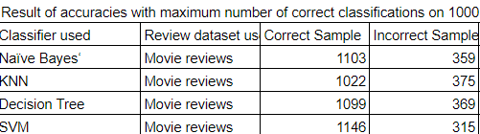
Results
.
Notes:
To visualize the results of Sentiment Analysis, many people employ well-known techniques, such as graphs, histograms, and confusion matrices.But for the current project -------------. This is the Visualization technique I used graphs n confusion matrix to evaluate the performance

Slide 32
Results
Accuracy of movie reviews on the test set gives 52%
We can see the performance metrix of different classifiers
24.6% Sentimental words with Objective<1.0
Many terms are classified with some degree of subjectivity
Notes:
Only a few terms are classified as definitively subjective
Difficult (if not impossible) to accurately assess performance
e.g. Zhang and Zhang.H used words in corpus with subjectivity score of 0.5 or greater (use id to select feature(+/-)

Slide 33
.
Thank You

Slide 34


