Slide 1
STOCK MARKET ANALYSIS
USING
MACHINE LEARNING
Rishika Bhat
18311A12L9

Slide 2
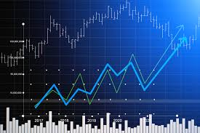
ABSTRACT
Predicting how the stock market will perform is one of the most difficult things to do. There are so many factors involved in the prediction – physical factors vs. physiological, rational and irrational behaviour, etc. All these aspects combine to make share prices volatile and very difficult to predict with a high degree of accuracy. We can use machine learning as a game changer in this domain.
In this project, we will work with historical data about the stock prices of a publicly listed company. Using features like the latest announcements about an organization, their quarterly revenue results, etc., machine learning techniques have the potential to unearth patterns and insights we didn’t see before, and these can be used to make unerringly accurate predictions.

Slide 3

INTRODUCTION
The stock market is basically an aggregation of various buyers and sellers of stock. A stock (also known as shares more commonly) in general represents ownership claims on business by a particular individual or a group of people. The attempt to determine the future value of the stock market is known as a stock market prediction. The prediction is expected to be robust, accurate and efficient The most prominent and promising technique involves the use of Artificial Neural Networks, Recurrent Neural Networks, that is basically the implementation of machine learning.
Machine learning involves artificial intelligence which empowers the system to learn and improve from past experiences without being programmed time and again. Traditional methods of prediction in machine learning use algorithms like Backward Propagation, also known as Backpropagation errors. Lately, many researchers are using more of ensemble learning techniques. It would use low price and time lags to predict future highs while another network would use lagged highs to predict future highs. These predictions were used to form stock prices.

Slide 4


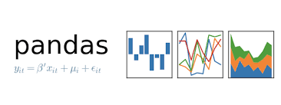
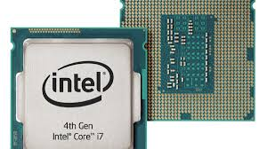
SOFTWARE REQUIREMENTS
Python
Navigator
Jupyter Notebook
Numpy
Pandas
Matplotlib
Sklearn
HARDWARE REQUIREMENTS
Processor :: INTEL Quad Core Processor or higher.
System Specifications :: 8 GB RAM DDR4 , 64-bit-Operating System
Hard disk :: 20 GB

Slide 5

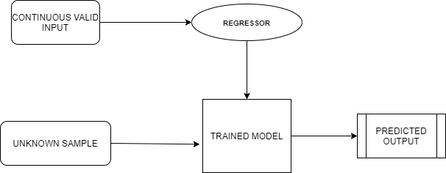
DESIGN
System design is the process of envisioning and defining software solutions to one or more sets of problems.
Architectural Design

Slide 6
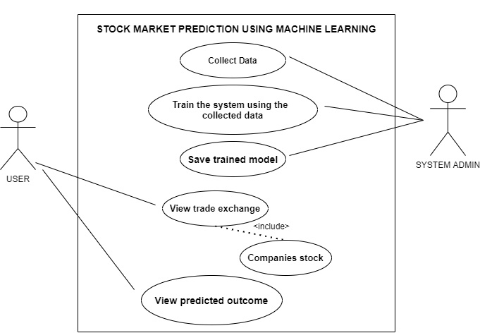
UML DIAGRAMS
USE CASE DIAGRAMS
Use case diagram for process of project

Slide 7
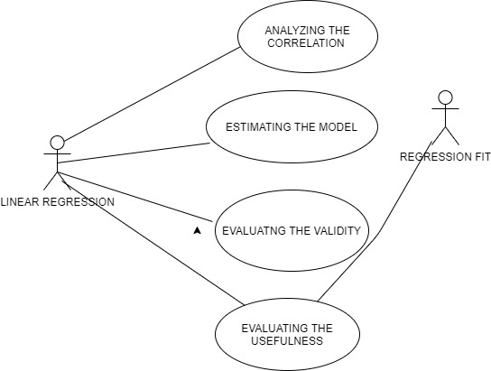
Use case diagram for Linear Regression

Slide 8
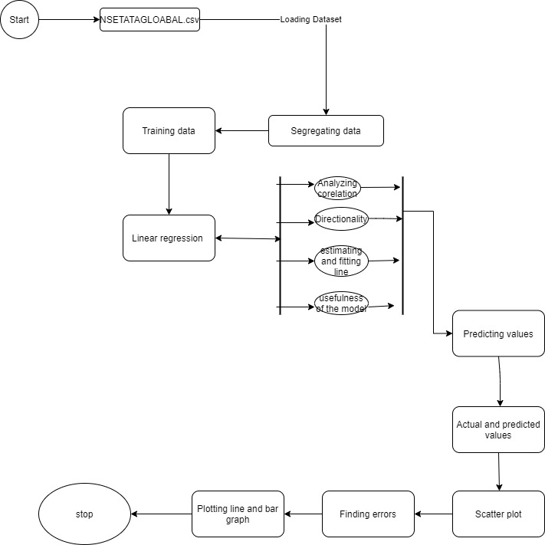
ACTIVITY DIAGRAM

Slide 9
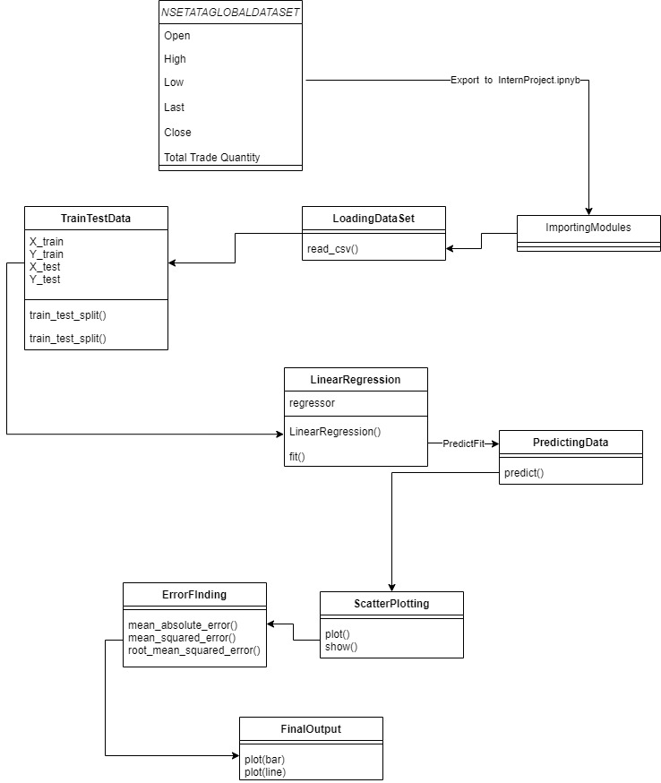
CLASS DIAGRAM

Slide 10
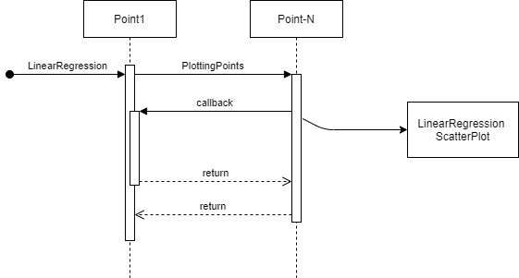
SEQUENCE DIAGRAM

Slide 11
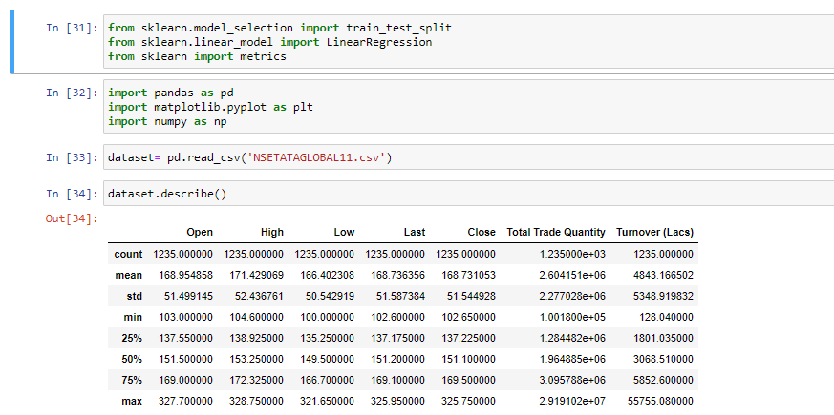
IMPLEMENTATION SCREENSHOTS AND OUTPUTS
1. IMPORTING MODULES
2. IMPORTING DATASET

Slide 12
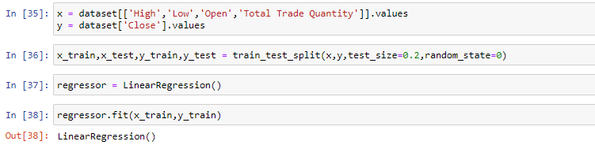
3. DECLARING x AND y VALUES
4. TRAINING DATASET

Slide 13
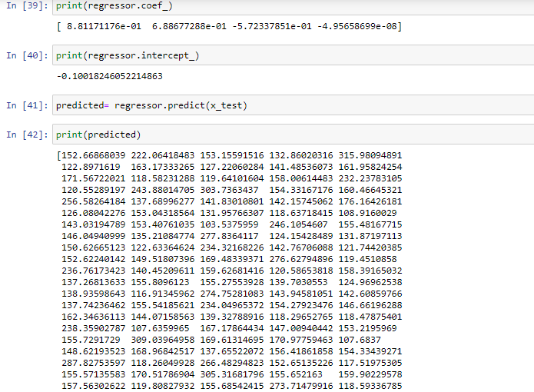
5. LINEAR REGRESSION

Slide 14
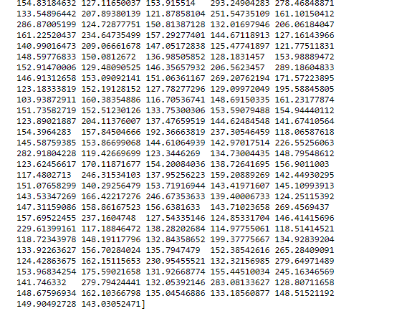
6. PREDICTING THE REGRESSION SET

Slide 15
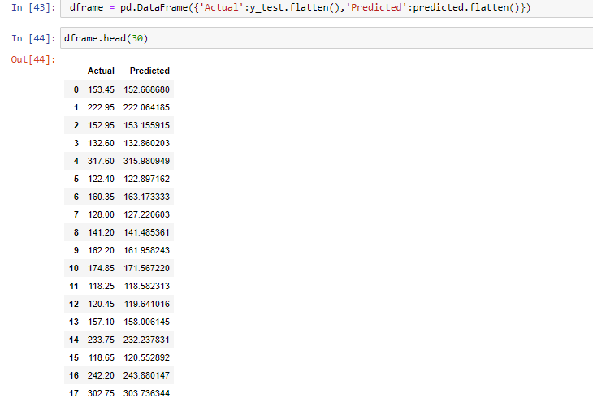
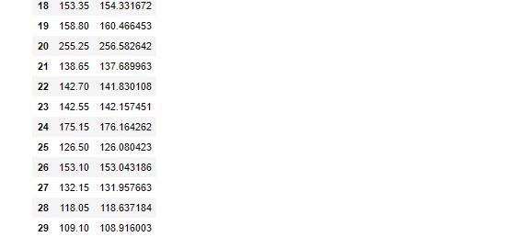
7.FINDING ACTUAL AND PREDICTED VALUES

Slide 16
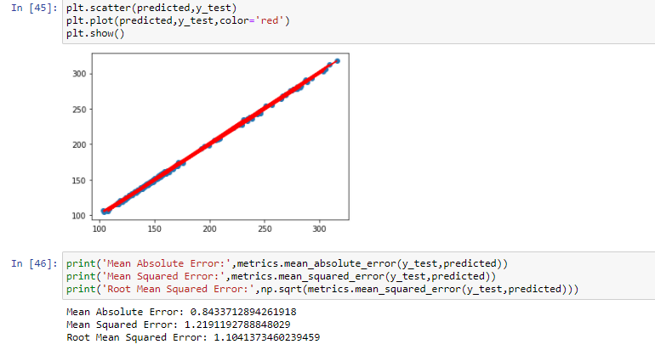
8. PLOTTING SCATTERPLOT
9. FINDING ERRORS

Slide 17
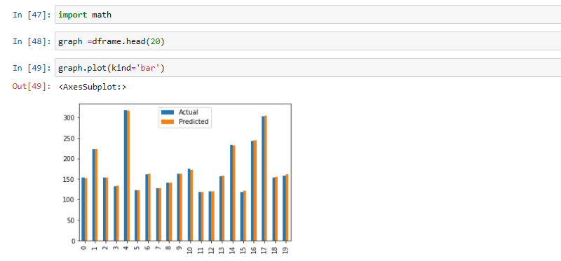
10. PLOT BAR GRAPH

Slide 18
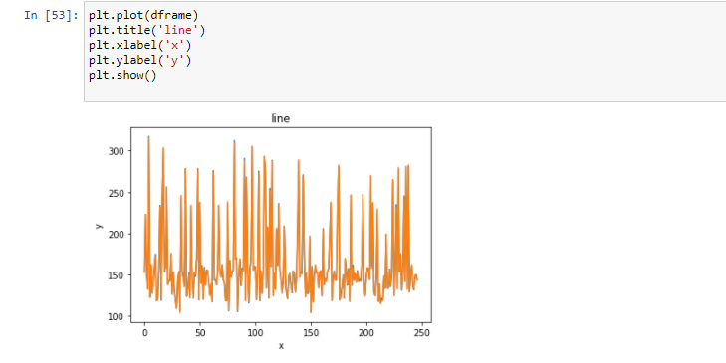
11. PLOT LINE GRAPH

Slide 19
CONCLUSION AND FUTURE SCOPE
By measuring the accuracy of the different algorithms, we found that the most suitable algorithm for predicting the market price of a stock based on various data points from the historical data is the LSTM algorithm. The algorithm will be a great asset for brokers and investors for investing money in the stock market since it is trained on a huge collection of historical data and has been chosen after being tested on a sample data. The project demonstrates the machine learning model to predict the stock value with more accuracy as compared to previously implemented machine learning models.

Slide 20
BIBLIOGRAPHY
Pei-Yuan Zhou , Keith C.C. Chan, Member, IEEE, and Carol XiaojuanOu, “Corporate Communication Network and Stock Price Movements: Insights From Data Mining”, IEEE 2018.
https://developers.google.com/machine-learning/crash-course/
3 .https://www.statisticssolutions.com/how-to-conduct-linear-regression/

Slide 21
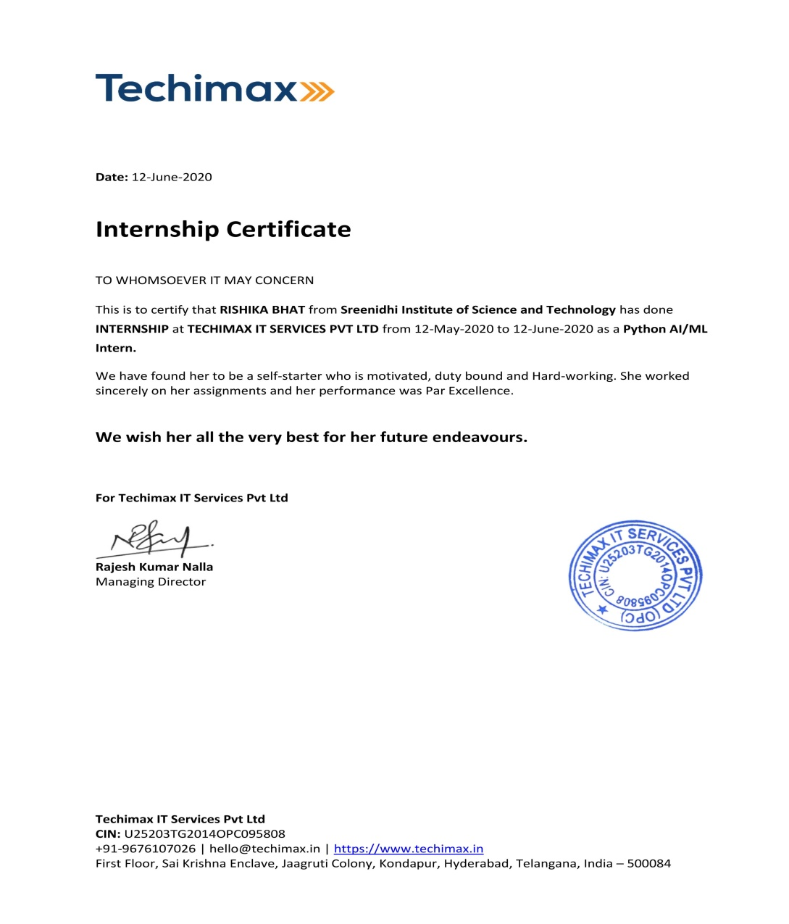
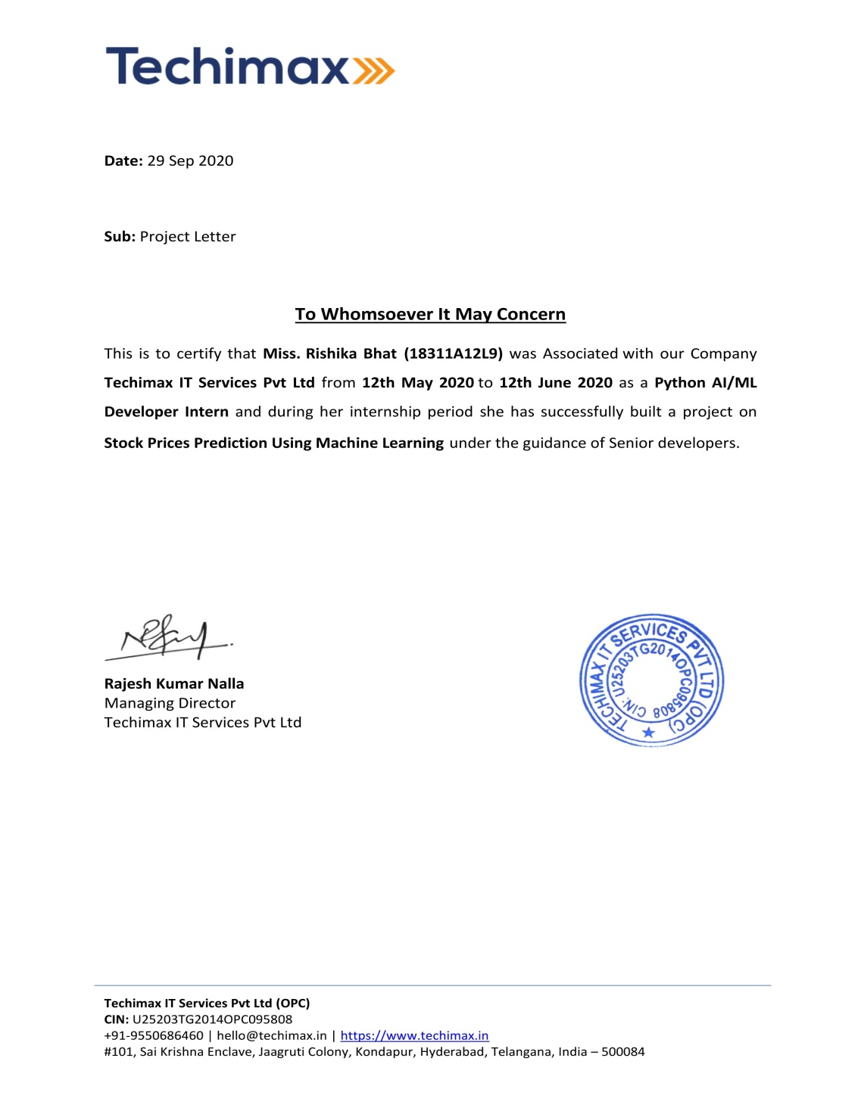
Rishika Bhat
18311A12L9
Company- Techimax
Address- 101,Sai Krishna Enclave, Plot No:75, Jaagruti Colony, Survey No.70, Kondapur, Hyderabad, Telangana 500084

Slide 22
THANKYOU

