Slide 1

Bank Portal Authentication System
Rishikant Sharma | Roll Number: CS-23411287 | IILM University

Slide 2

🔐 Project Overview
Secure by Design
Multi-Layer Security
A robust authentication system built specifically for bank portal environments, protecting user data at every layer.
Combines JWT token management and Two-Factor Authentication for defence-in-depth security.
User-Friendly Flows
Intuitive registration and login workflows designed for clarity without sacrificing security.

Slide 3

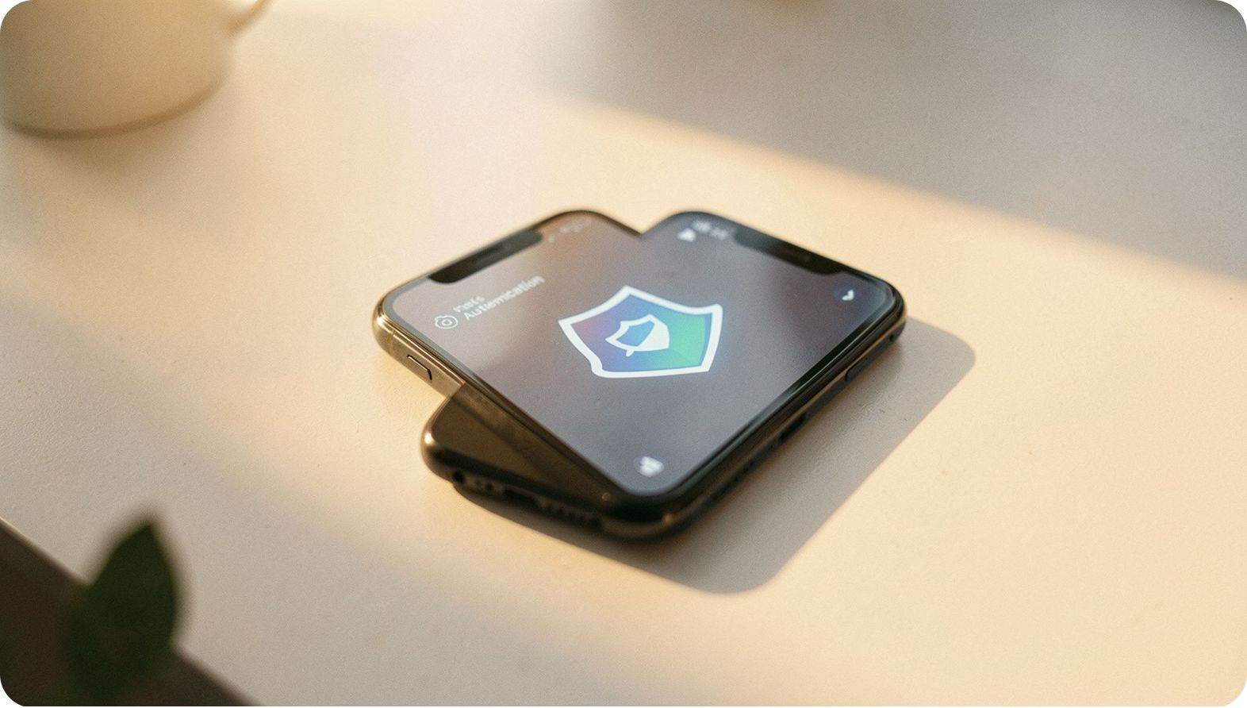
Key Features
User Registration
Sign up with email and phone number for a verified account identity.
Email OTP Verification
One-time passcodes sent via email activate and validate each account.
Secure Login & Password Hashing
bcrypt-encrypted credentials ensure passwords are never stored in plain text.
JWT Session Management
Stateless token-based sessions keep the portal fast and secure.
TOTP Two-Factor Authentication
Time-based one-time passwords add a critical second layer of protection.

Slide 4
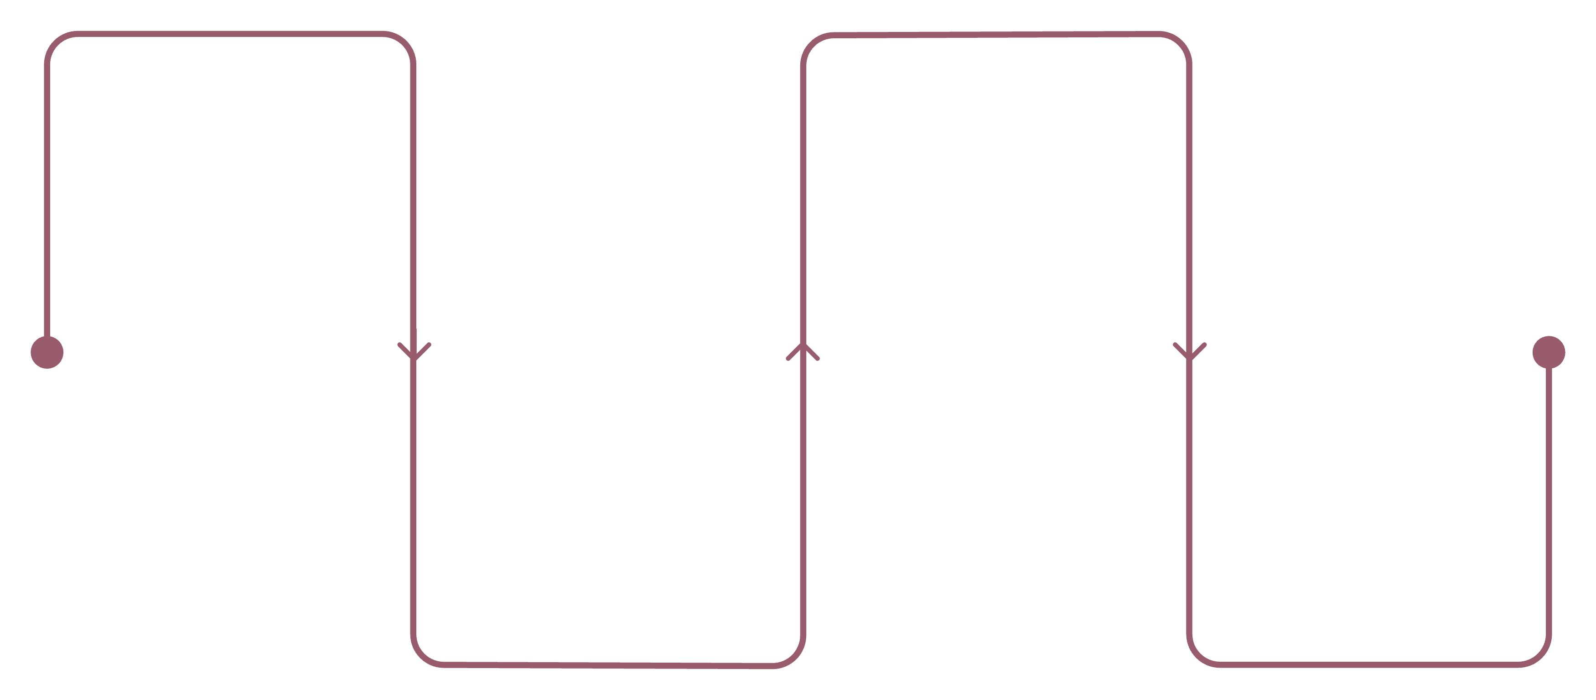
Registration Process
Open Register
Verify OTP
Click Register in navigation
Enter OTP sent to your email
Enter Details
Complete
Provide email, phone, password
Account verified and ready
A streamlined four-step process ensures every account is verified and secure before access is granted.

Slide 5

Login Process
Step-by-Step Login Flow
1
Navigate to Login
Click "Login" in the portal navigation bar.
2
Enter Credentials
Provide your registered email address and password.
3
2FA Verification
If 2FA is enabled, enter the 6-digit authenticator code.
4
Access Dashboard
Gain secure access to your personal bank dashboard.

Slide 6





Two-Factor Authentication Setup
Prompted After Login
Scan QR Code
System prompts 2FA setup on first successful login.
Use any authenticator app (Google, Authy) to scan the displayed QR code.
Verify 6-Digit Code
2FA Active
Enter the time-based code generated by your authenticator app.
All future logins now require the authenticator code for access.
TOTP codes refresh every 30 seconds — ensuring no code can be reused by an attacker.

Slide 7




Authentication Features
Email OTP Verification
Secure account activation through one-time passcodes delivered to the registered email.
Password Hashing
bcrypt encryption ensures all passwords are salted and hashed — never stored in plain text.
JWT Tokens
Stateless session management via signed JSON Web Tokens for scalable, secure access control.
TOTP 2FA
Time-based one-time passwords provide a dynamic second factor that expires every 30 seconds.

Slide 8






Backend Technologies
Powering the Secure Backend
Node.js Runtime
High-performance JavaScript runtime for handling concurrent authentication requests.
Express.js Framework
Lightweight and flexible REST API framework powering all authentication routes.
JWT · bcrypt · Speakeasy
Industry-standard libraries for token signing, password hashing, and TOTP generation.
Nodemailer
Reliable email delivery service for dispatching OTP verification codes to users.

Slide 9



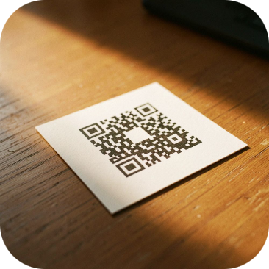
Frontend Technologies
HTML5
CSS3
JavaScript ES6+
QR Code Library
Semantic markup delivering accessible, well-structured portal interfaces.
Modern styling for a clean, responsive bank portal experience across devices.
Dynamic client-side scripting enabling real-time validation and interactive flows.
The qrcode library renders TOTP QR codes for seamless authenticator app setup.

Slide 10
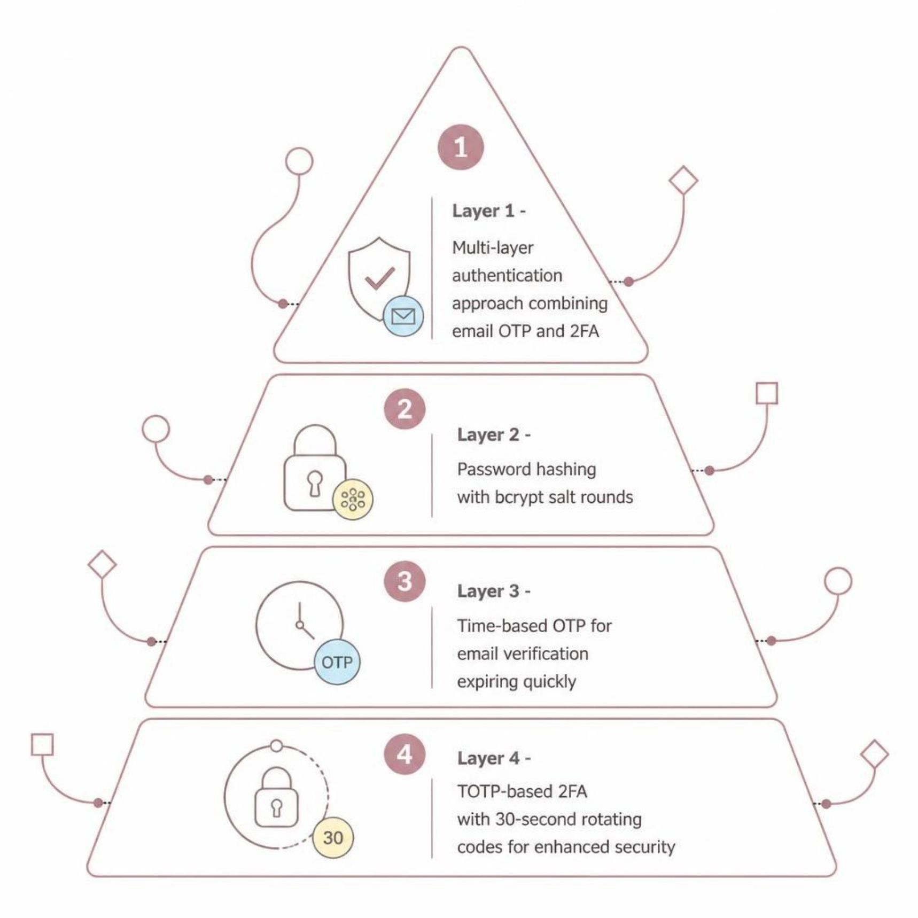
Security Highlights & Benefits
Why This Architecture?
The Bank Portal Authentication System is built on four complementary security layers, each addressing a distinct threat vector:
Multi-layer authentication ensures no single point of failure exists in the login flow.
bcrypt password hashing makes brute-force attacks computationally infeasible.
Time-limited OTPs for email verification prevent replay attacks.
TOTP 2FA guarantees that even stolen credentials cannot grant unauthorized access.
Together, these layers deliver enhanced security, a seamless user experience, and industry-standard practices — with a scalable architecture ready for future enhancements.

Slide 11

Thank You
Rishikant Sharma
Roll Number: CS-23411287
IILM University
BANK PORTAL AUTHENTICATION SYSTEM
ACADEMIC PROJECT PRESENTATION

