Slide 1

Polyhouse
Crop Yield
CAPSTONE PROJECT
Machine Learning
in Agriculture
Prediction System
Using Sensor Data & Machine Learning Models
Rishika P
2025–2026
Linear Regression
Random Forest
Streamlit
Notes:
Welcome everyone. My name is Rishika P, and today I'll be presenting my capstone project: the Polyhouse Crop Yield Prediction System. This project applies machine learning to the domain of controlled-environment agriculture — specifically, predicting crop yield from environmental sensor readings. The presentation is structured across 12 slides covering the problem, methodology, results, deployment, and future roadmap. Duration: approximately 10–15 minutes.

Slide 2
AGENDA
What We'll Cover Today
01
Problem Statement & Motivation
06
Results & Comparison
02
Dataset Overview
07
Hyperparameter Tuning
03
Data Preprocessing & EDA
08
Deployment – Streamlit App
04
Feature Engineering & Pipeline
09
Future Improvements
05
Model Training & Evaluation
10
Conclusion
Notes:
Here's a quick roadmap of the presentation. I'll start with why this problem matters, walk through the data and preprocessing steps, then explain the models I trained and how they performed. I'll also cover the deployment via Streamlit and close with future improvements. Feel free to hold questions until the end.

Slide 3



01 PROBLEM STATEMENT
Why Predict Crop Yield in a Polyhouse?
Environmental Sensitivity
Lack of Predictive Tools
Economic Impact
Polyhouse crops are highly sensitive to temperature, humidity, and CO₂ variations — even small deviations can drastically reduce yield.
Farmers rely on intuition and reactive measures. There are no real-time predictive systems using sensor data for yield forecasting.
Yield unpredictability leads to resource wastage, overplanting, and revenue loss in controlled agriculture environments.
Goal: Build a data-driven ML model to accurately predict crop yield from Temperature, Humidity, and CO₂ sensor readings.
Notes:
The core problem is: polyhouse farmers lack a reliable predictive tool. Crops in controlled environments are sensitive to micro-changes in temperature, humidity, and CO₂. Currently, most interventions are reactive — farmers notice a problem only after yield has already dropped. Our goal is to change that by building a machine learning model that can forecast yield from continuous sensor readings, enabling proactive decision-making.

Slide 4
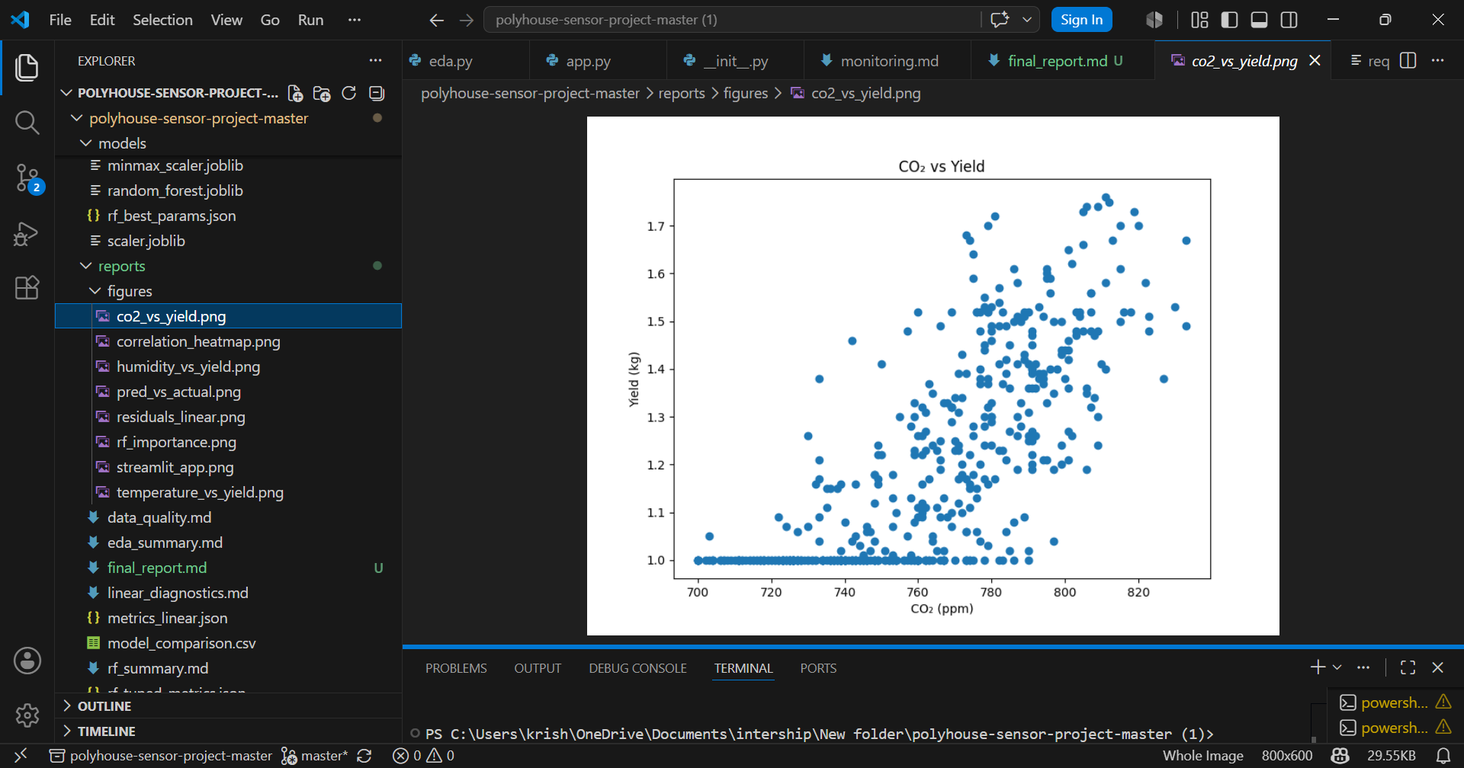
02 DATASET OVERVIEW
Sensor Data from Polyhouse Environment
3
Yield
80/20
Features
Target
Split
Temp · Humidity · CO₂
Normalized (kg)
Temporal — no leakage
🌡 Temperature
Ambient temperature (°C). Affects plant metabolism and growth rate. Range: 23–27°C.
💧 Humidity
Relative humidity (%). Impacts transpiration and nutrient uptake. Range: 82–92%.
🌿 CO₂ Level
Carbon dioxide concentration (ppm). Key photosynthesis driver. Range: 700–830 ppm.
CO₂ vs Yield — positive correlation confirmed
Notes:
The dataset consists of time-series sensor readings collected inside a polyhouse. Our three input features are temperature (°C), relative humidity (%), and CO₂ concentration (ppm). The target variable is crop yield, normalized to a 0–1 scale for modeling. Importantly, we used a temporal train-test split — earlier records form the training set and later records form the test set — to prevent data leakage, which is critical for time-series data. The chart on the right shows a clear positive correlation between CO₂ and yield.

Slide 5
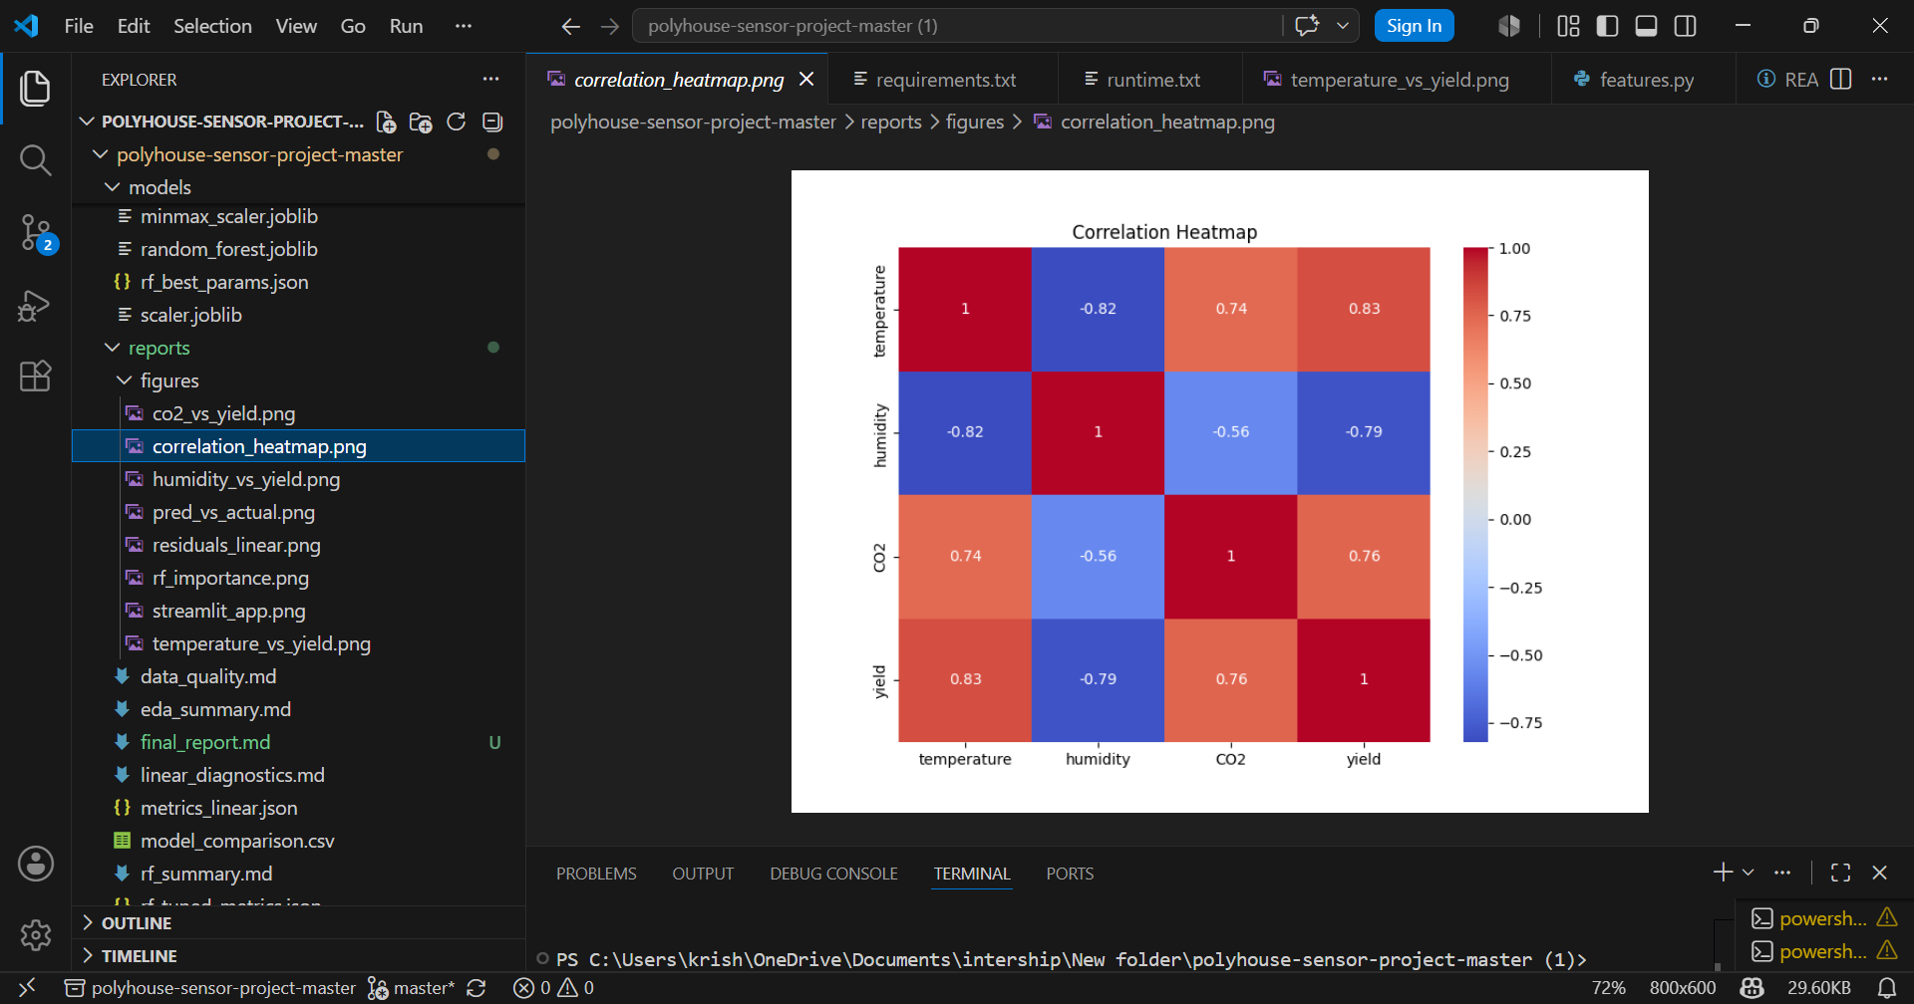
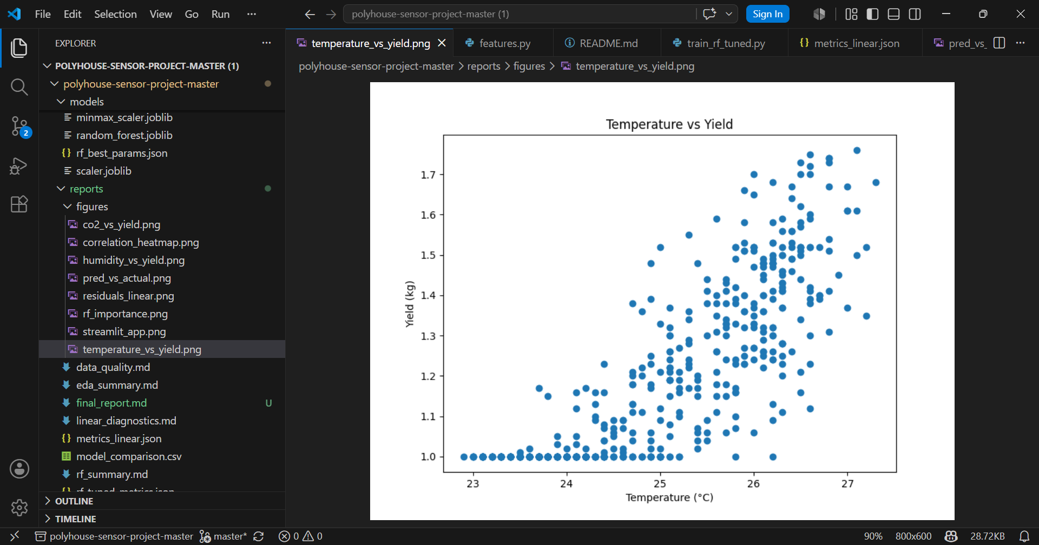
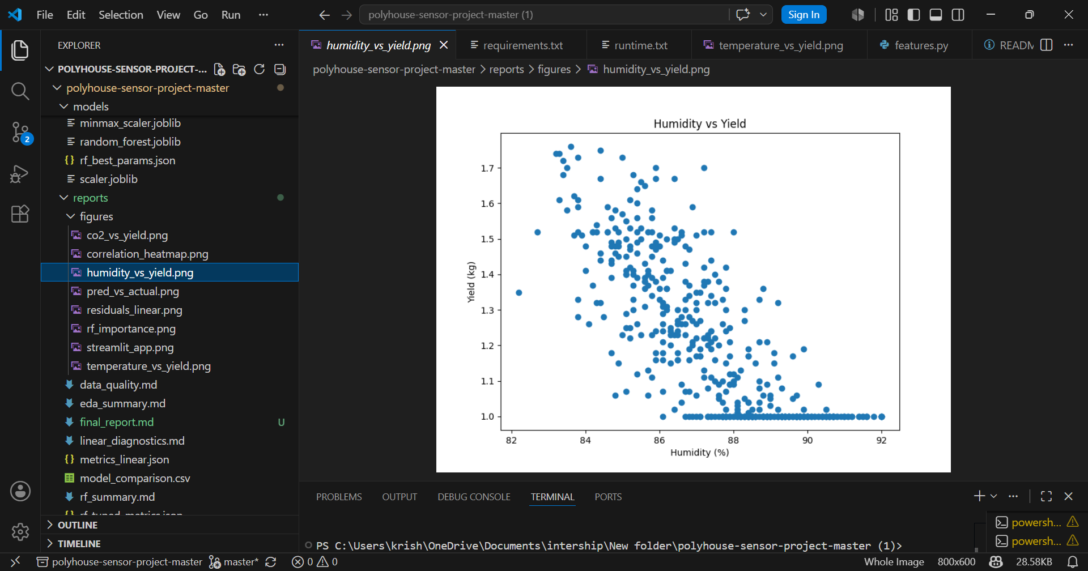
03 EXPLORATORY DATA ANALYSIS
Understanding Feature–Yield Relationships
Correlation Heatmap — CO₂ & Temp strongest predictors
Temperature vs Yield — positive nonlinear trend
Humidity vs Yield — moderate inverse relationship
CO₂ vs Yield — strong positive correlation (r=0.76)
Notes:
EDA revealed four critical insights. The correlation heatmap shows temperature (0.83) and CO₂ (0.76) are the strongest predictors of yield. Temperature vs Yield shows a clear positive trend but with spread, suggesting some nonlinearity. Humidity has a moderate negative relationship with yield — higher humidity correlates with lower yield, possibly due to disease pressure. CO₂ shows the cleanest positive correlation. These findings motivated using both a linear and a nonlinear model.

Slide 6
04 FEATURE ENGINEERING & PIPELINE
Preprocessing Pipeline with MinMaxScaler
Raw
Sensor Data
Null &
Outlier Removal
Feature
Selection
MinMax
Scaler
Model
Input
▶
▶
▶
▶
MinMaxScaler Formula
Why Temporal Split?
X_scaled = (X − X_min) / (X_max − X_min)
Standard random split on time-series data creates data leakage — future values leak into training.
Temporal split ensures the model learns from the past and predicts the future, mimicking real deployment conditions.
• Output range: [0, 1] for all features
• Prevents scale-dominant features from biasing the model
• Scaler fitted only on training data; applied to test set
Notes:
The preprocessing pipeline is simple but deliberate. After cleaning, we apply MinMaxScaler to scale all three features to [0,1]. Critically, the scaler is fitted only on training data and then applied to the test set — this avoids information leakage. The temporal train-test split is a key methodological decision: since sensor readings are time-ordered, we use the first 80% of timestamps for training and the remaining 20% for testing. Screenshot to add: scikit-learn pipeline code snippet or a before/after scaling distribution plot.

Slide 7
05 MODEL TRAINING
Linear Regression vs. Random Forest
Linear Regression
Random Forest
Baseline Model
Ensemble Model + GridSearchCV Tuning
✓ Assumes linear relationship between features and yield
✓ Ensemble of decision trees — handles nonlinearity well
✓ Fast to train; highly interpretable coefficients
✓ Robust to outliers and does not require feature scaling
✓ Works well when CO₂–yield relationship is approximately linear
✓ Hyperparameter tuning via GridSearchCV over max_depth, n_estimators, and min_samples_leaf
✓ Serves as baseline to benchmark complex models against
✓ Built-in feature importance scores for interpretability
Notes:
I trained two models. Linear Regression serves as the interpretable baseline — it's fast and provides coefficient-level insights into which feature drives yield the most. Random Forest is the complex model: it's an ensemble of decision trees that captures nonlinear interactions between temperature, humidity, and CO₂. I also applied GridSearchCV to tune the Random Forest's hyperparameters systematically. Both models were evaluated on the same held-out temporal test set using MAE, RMSE, and R².

Slide 8
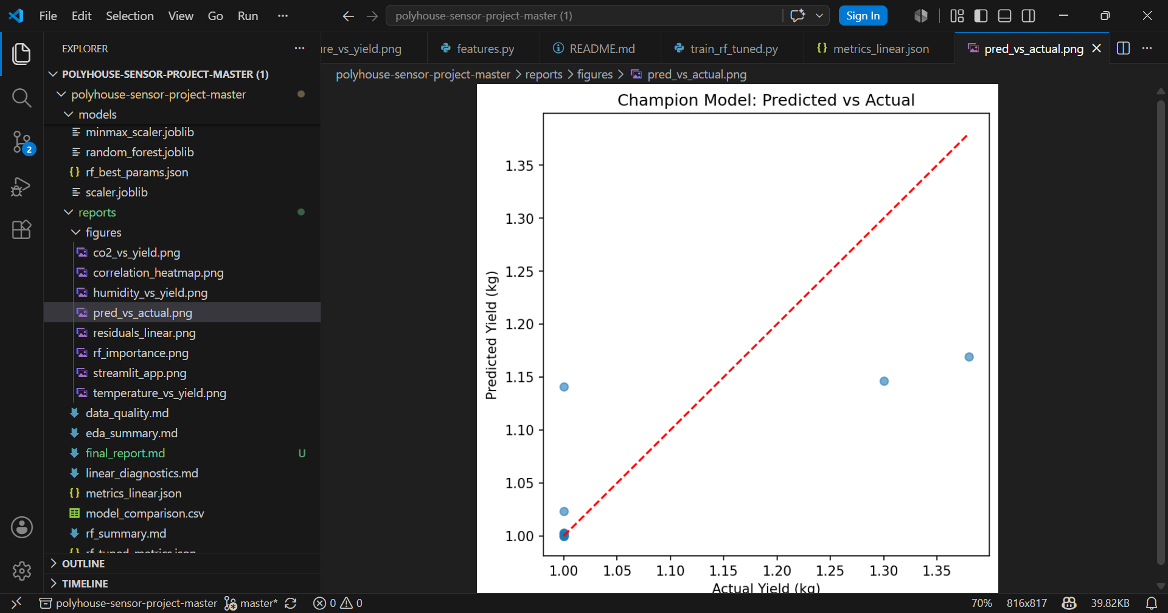
06 RESULTS & MODEL COMPARISON
Performance Metrics on Test Set
Metric
Linear Regression
Random Forest (Tuned)
MAE
0.0704
0.0535 ✓
RMSE
0.0995
0.0940 ✓
R²
0.8015 ✓
0.5307
💡 Insight: LR captures global variance better (R²=0.80), while RF achieves lower per-prediction error (MAE=0.054). Together they offer complementary strengths.
*Lower MAE & RMSE = better. Higher R² = better. ✓ = winner for that metric.
Champion Model: Predicted vs Actual
Notes:
Let's look at the results. Linear Regression achieved an MAE of 0.070, RMSE of 0.100, and R² of 0.80 — meaning it explains 80% of the variance in yield. Random Forest Tuned achieved a lower MAE (0.054) and RMSE (0.094), meaning its point-level predictions are closer to actual values. However, its R² is 0.53 — lower than LR. This is a nuanced result: RF is more accurate per-prediction but LR fits the overall trend better. The Predicted vs Actual chart on the right shows how the champion model's predictions compare to ground truth.

Slide 9
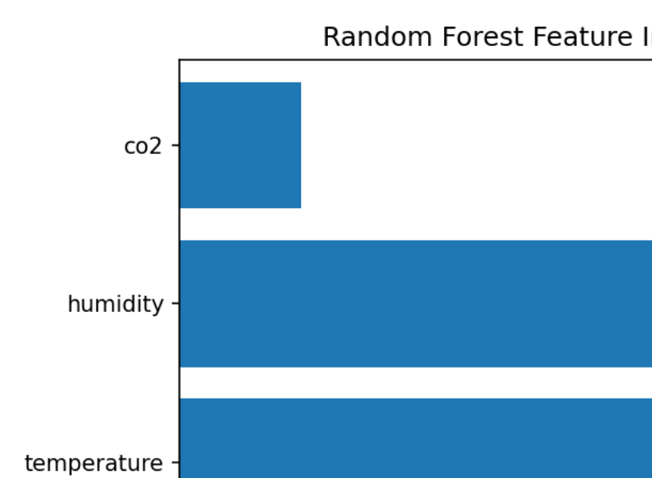
07 HYPERPARAMETER TUNING
GridSearchCV — Best Parameters & Feature Importance
GridSearchCV exhaustively searches over a parameter grid using 5-fold cross-validation, selecting the combination that minimizes validation error — eliminating manual trial-and-error.
max_depth
BEST
Limits tree depth to prevent overfitting on small training sets
8
Tested: [4, 6, 8, 10, None]
n_estimators
BEST
Enough trees for a stable ensemble without excessive compute
100
Tested: [50, 100, 200]
min_samples_leaf
BEST
Fine-grained splits — each leaf needs at least 1 sample
1
Tested: [1, 2, 4]
Humidity > Temperature > CO₂ in RF importance
Notes:
For the Random Forest, I ran GridSearchCV across three hyperparameters. max_depth = 8 balances complexity and generalization. n_estimators = 100 trees provides stable predictions without excessive training time. min_samples_leaf = 1 allows fine-grained splits. The feature importance chart on the right reveals a surprising finding: the Random Forest assigned highest importance to Humidity, followed by Temperature, then CO₂. This contrasts with the linear correlation (where CO₂ ranked highest), suggesting the RF captures different nonlinear patterns in the data. GridSearchCV used 5-fold cross-validation on the training set only.

Slide 10
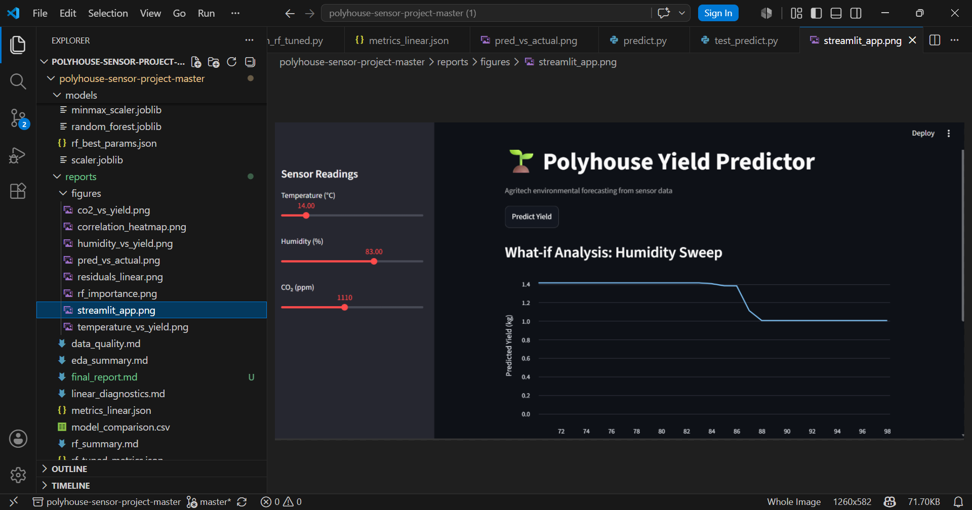


08 DEPLOYMENT
Streamlit Application & Monitoring
Sensor
Input
Preprocessing
Pipeline
ML Model
(LR / RF)
Streamlit
UI
Prediction
Logger
→
→
→
→
Temp · Humidity · CO₂
MinMaxScaler
Trained model
Prediction display
CSV / DB log
Prediction Logging
Every prediction logged with timestamp, inputs, and predicted yield to CSV for retrospective accuracy analysis.
What-if Analysis
Humidity sweep chart lets users explore how yield changes across the full sensor range without running the model manually.
Monitoring Strategy
Drift detection via periodic retraining checks; alerts triggered when input distributions shift vs. training baseline.
Live Streamlit App — Polyhouse Yield Predictor with What-if Analysis
Notes:
The trained models are deployed as a Streamlit web application. As shown in the screenshot, users input current sensor readings via sliders and instantly receive a predicted yield. The app also features a What-if Analysis panel — a humidity sweep that shows predicted yield across the full humidity range, giving farmers actionable insight. Prediction logging saves every prediction with timestamp and inputs to a CSV file, enabling trend analysis and drift monitoring over time.

Slide 11




09 FUTURE IMPROVEMENTS
Roadmap — What Comes Next?
Phase 1
Phase 2
Phase 2
IoT Sensor Integration
Automated Retraining
Real-Time Dashboard
Connect directly to MQTT/HTTP-based IoT sensors for live data streaming, replacing manual slider input.
Drift-triggered retraining pipelines via MLflow or Airflow to keep models current as growing conditions evolve.
Expand Streamlit into a multi-panel dashboard with live charts, historical comparisons, and alert thresholds.
Phase 3
Phase 3
Phase 4
Deep Learning Models
Cloud Deployment
Multi-Crop Support
Explore LSTM or Transformer-based models to better capture temporal dependencies in sensor time-series.
Deploy on AWS/GCP with Docker + Kubernetes containerization for scalability across multiple polyhouse sites.
Extend to handle multiple crop types with per-crop yield models, enabled by richer labeled datasets.
Notes:
Looking ahead, there are six key improvement areas organized into four phases. Phase 1 is IoT integration — replacing manual slider inputs with live sensor feeds. Phase 2 covers automated retraining pipelines and a richer real-time dashboard. Phase 3 brings deep learning — LSTMs are especially promising for time-series sensor data — and cloud deployment for scalability. Phase 4 extends the system to support multiple crop types, making it commercially viable for diverse polyhouse operations.

Slide 12

CONCLUSION
Key Takeaways
01
Data-Driven Agriculture Works
02
Two Models, Complementary Strengths
Sensor data alone predicts polyhouse yield with strong accuracy (LR R² = 0.80).
LR outperforms on global variance (R²); RF wins on local precision (MAE, RMSE).
03
Temporal Split is Non-Negotiable
04
Streamlit Makes ML Accessible
Proper time-series methodology prevents leakage and ensures deployment-realistic evaluation.
Web app deployment bridges the gap between data science and end-user adoption in agriculture.
💻 GitHub: github.com/rishika-p/polyhouse-sensor-project
⚡ Streamlit: polyhouse-yield-predictor.streamlit.app
Thank You • Questions Welcome
Notes:
To conclude: This project demonstrated that environmental sensor data from a polyhouse can reliably predict crop yield using machine learning. Linear Regression achieved an R² of 0.80 — strong global fit — while Random Forest Tuned achieved better per-prediction accuracy with lower MAE and RMSE. The deliberate use of temporal splitting ensures our evaluation is fair and deployment-realistic. The Streamlit deployment makes the model actionable for non-technical farming staff. The project is available on GitHub and the live app is accessible via Streamlit Cloud. Thank you for listening — happy to take any questions.

