Slide 1

HOLY MARY INSTITUTE OF TECHNOLOGY & SCIENCE (Approved by AICTE, New Delhi, Affiliated to JNTU, Hyderabad)
BOGARAM(V),KEESARA(M),MEDCHAL DISTRICT-501301
2021-2022
DEPARTMENT OF COMPUTER SCIENCE ENGINEERING
CREDIT CARD FRAUD DETECTION
Under the guidance of:
Name:Miss.MD.FOUZIYA
By:
Veerasena Reddy(18C91A0517)
Rishika Reddy(18C91A0524)
Badshah Alam(18C91A0505)

Slide 2



Abstract
Now a day’s online transactions have become an important and necessary part of our lives. It is vital that credit card companies are able to identify fraudulent credit card transactions so that customers are not charged for items that they did not purchase.
As frequency of transactions is increasing, number of fraudulent transactions are also increasing rapidly. Such problems can be tackled with Machine Learning with its algorithms.
The Credit Card Fraud Detection Problem includes modelling past credit card transactions with the data of the ones that turned out to be fraud. This model is then used to recognize whether a new transaction is fraudulent or not.
This project intends to illustrate the modelling of a data set using machine learning with Credit Card Fraud Detection.

Slide 3
.
EXISTING SYSTEM:
In existing system, the K-means clustering model produced a low accuracy. Using K-means there were quite a few non-fraudulent activities, which wrongly got detected as frauds. Therefore, K-means would not be the preferred model, as it doesn’t correctly predict frauds and it also produced a lot of false positives.

Slide 4

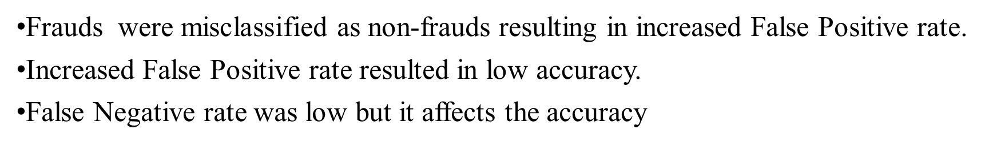

Slide 5

PROPOSED SYSTEM:
The proposed system is a machine learning application to detect frauds in credit card transactions using Random Forest algorithm. These algorithms are used to classify the credit card data set and then regression is performed.
The Random Forest Algorithm has been found to produce a good estimate of the generalization error and to be resistant to over fitting. This algorithm has been found to produce a good accuracy and precision.

Slide 6

One of the biggest advantages of random forest is its versatility. It can be used for both regression and classification tasks.
Random forest algorithm builds multiple decision trees and merges them together to get a more accurate and stable prediction.
The random forest algorithm also works well when data possess missing values.

Slide 7


SOFTWARE REQUIREMENTS :
Operating system : Windows 10
Programming Language : Python 3.8
IDE : jupyter/syder,Anaconda Python
HARDWARE REQUIREMENTS :
System : Intel i5 core
Hard Disk : 100GB
Ram : 4 GB

Slide 8
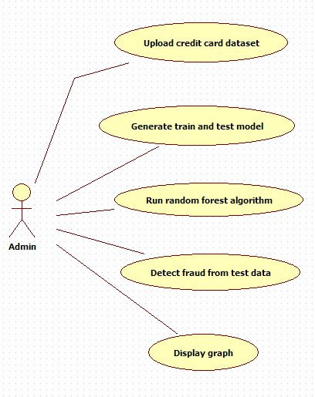
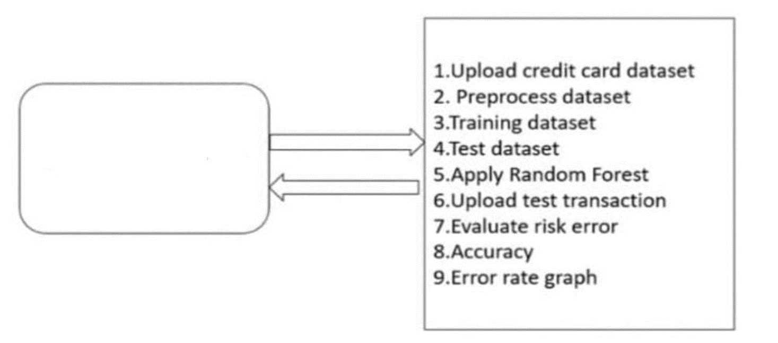

SYSTEM DESIGN
Software Architecture
UML Diagram

Slide 9
SYSTEM ANALYSIS
Data Collection: Dataset used in this model are transactions made by credit cardholders.
Data Pre-Processing:
Formatting: It is the process of putting the data in a legitimate way that it would be suitable to work with. Most recommended format is .csv files.
Cleaning: Data cleaning is a very important procedure in the path of data science as it constitutes the major part of the work. It includes removing missing data and complexity with naming category and so on.
Sampling: This is the technique of analyzing the subsets from whole large datasets, which could provide a better result and help in understanding the behaviour and pattern of data.
Feature Extraction: Feature extraction is the process of studying the behaviour and pattern of the analyzed data and draw the features for further testing and training.
Display Graph: Representation of classified data in the form of graphs. Accuracy is well-defined as the proportion of precise predictions for the test data. It can be calculated easily by mathematical calculation i.e. dividing the number of correct predictions by the number of total predictions.

Slide 10
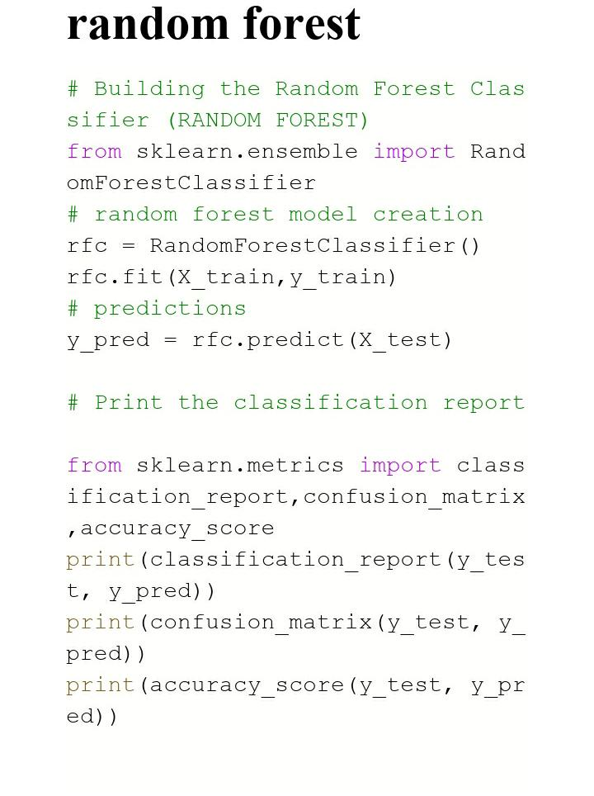
IMPLEMENTATION

Slide 11
SYSTEM TESTING
The purpose of testing is to discover errors. Testing is the process of trying to discover every conceivable fault or weakness in a work product. It provides a way to check the functionality of components, sub assemblies.
Software system meets its requirements and user expectations and does not fail in an unacceptable manner. Each test type addresses a specific testing requirement.
Unit testing
Unit testing involves the design of test cases that validate that the internal program logic is functioning properly, and that program inputs produce valid outputs.
It is the testing of individual software units of the application .it is done after the completion of an individual unit before integration.Unit tests perform basic tests at component level and test a specific business process, application.
Integration testing
Integration tests are designed to test integrated software components to determine if they actually run as one program. Testing is event driven and is more concerned with the basic outcome of screens or fields.
Integration tests demonstrate that although the components were individually satisfaction, the combination of components is correct and consistent. Integration testing is specifically aimed at exposing the problems that arise from the combination of components.

Slide 12
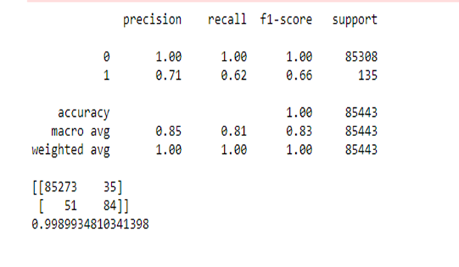
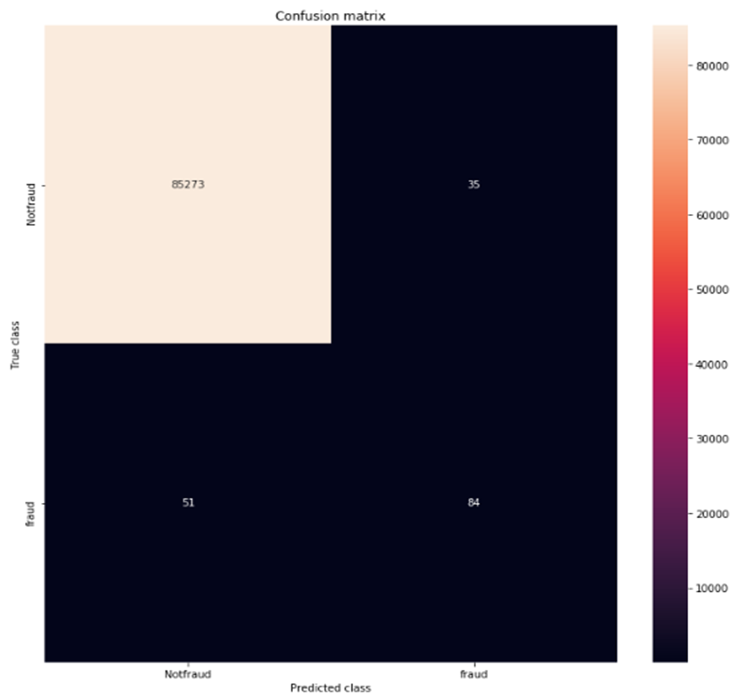
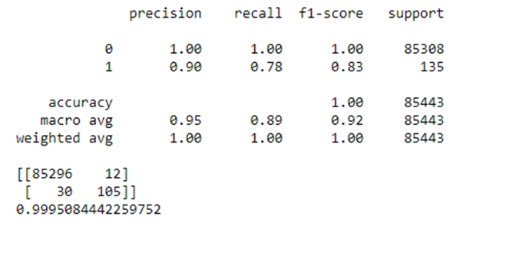
RESULTS
Logistic regression
Random forest

Slide 13

Future Scope
Technology changes can be added to know the pattern of fraudulent transactions and alert the respective card holders and bankers when fraud activity is identified.
The dataset available on day to day processing may become outdated, it is compulsory to have updated data for effective fraud behavior identification.
To this extent, the incremental approach is necessary in making the system to learn from past as well as present data and capable of handling the both.

Slide 14
CONCLUSION
This system is capable of providing most of the essential features required to detect fraudulent and legitimate transactions.
The Random forest algorithm will perform better with a larger number of training data.

Slide 15

Thank you

