Slide 1

PROJECT-2 ENPM-667
CR-7
(Cleaning Robot-7)
Differential drive mobile robot
with a robotic Arm
Rishikesh Jadhav (rjadhav1)
Nishant Pandey (npandey2)

Slide 2
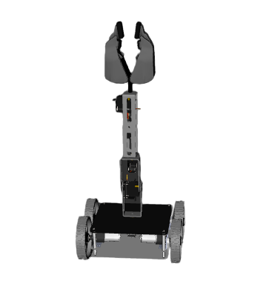
PROJECT-2 ENPM-662
7
CR-7
(Cleaning Robot-7)
Differential drive mobile robot
with a robotic Arm
Rishikesh Jadhav (rjadhav1)
Nishant Pandey (npandey2)

Slide 3
TABLE OF CONTENTS
S.N. | Topics | P.N | S.N | Topics | P.N
1. | Introduction | 3 | 8. | FK and IK Validation Proof | 11
2. | Motivation | 4 | 9. | Workspace | 14
3. | Process | 5 | 10. | Problems Faced | 15
4. | Robot Description | 6-8 | 11. | Results | 16
5. | Forward Kinematics | 9-11 | 12. | Conclusion | 17
6. | DH-Table | 10 | 13. | Individual Contributions | 19
7. | Inverse Kinematics | 12-13 | 14. | References | 20
*Note: S.N.- Serial Number, P.N.-Page Number

Slide 4
INTRODUCTION
Modeling a robot with a robotic arm mounted on top of a mobile robot.
Analyzing the kinematics (Inverse and forward) of the robot and validating the same.
Spawning the robot on Gazebo(in the desired environment), RViz.
To use the derived equations to use the robot for the desired application (moving to the goal location and pick and place object from one place to another).

Slide 5
MOTIVATION
No matter how many links are attached to the robotic arm the workspace of any arm still is not enough for wide area applications.
As the D. O. F of the arm increases the complexity of calculation also increases. To satisfy variety of demands a more well rounded robot becomes the need of the hour.
Applications like cleaning a room with scattered objects can be easily executed because of less weight of the objects to pick and place.
Small size of the bot facilitates operations in crowded space.

Slide 6
PROCESS FOLLOWED TO ACHIEVE THE GOAL
Selection of the desired design is done based on the application.
The model is spawned in Gazebo and RViz.
The URDF is modified to add desired transmissions.
Wrote the required .yaml, .launch files(including the custom world).
Created a DH table
Forward and inverse kinematics analysis along with it’s validation are done.
Application is simulated.

Slide 7
Robot Description
Total obtained DoF (9)=Robotic arm DoF (6)+ Mobile robot DoF (3)
Chassis property(units): Length: 0.19, Width: 0.19, Height: 0.070
Wheel property: Radius(units):0.055, width: 0.022, Mass=0.2
Shoulder roll link(units): Length: 0.09, Width: 0.047, Height: 0.035
Shoulder pan link(units): Length: 0.09, Width: 0.047, Height: 0.035
Elbow pan Link(units): Length: 0.09, Width: 0.047, Height: 0.035
Elbow pitch Link(units): Length: 0.09, Width: 0.047, Height: 0.035
Gripper(units): Length: 0.05, Width: 0.010

Slide 8
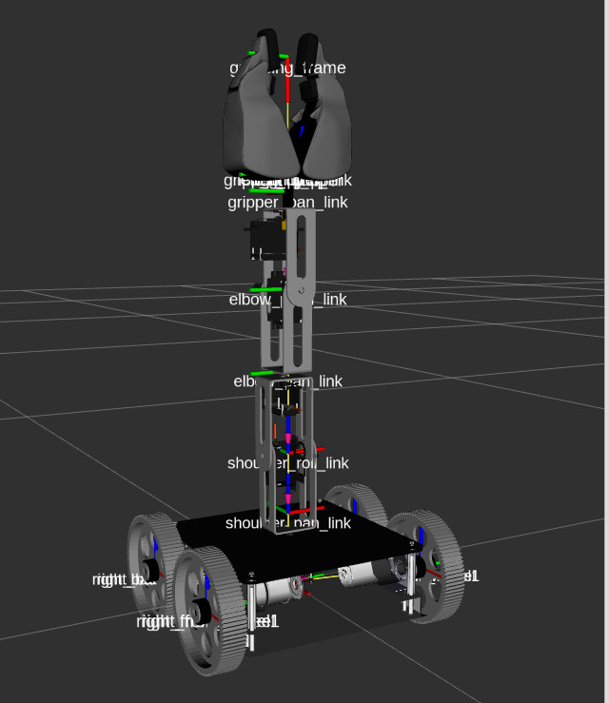

Slide 9
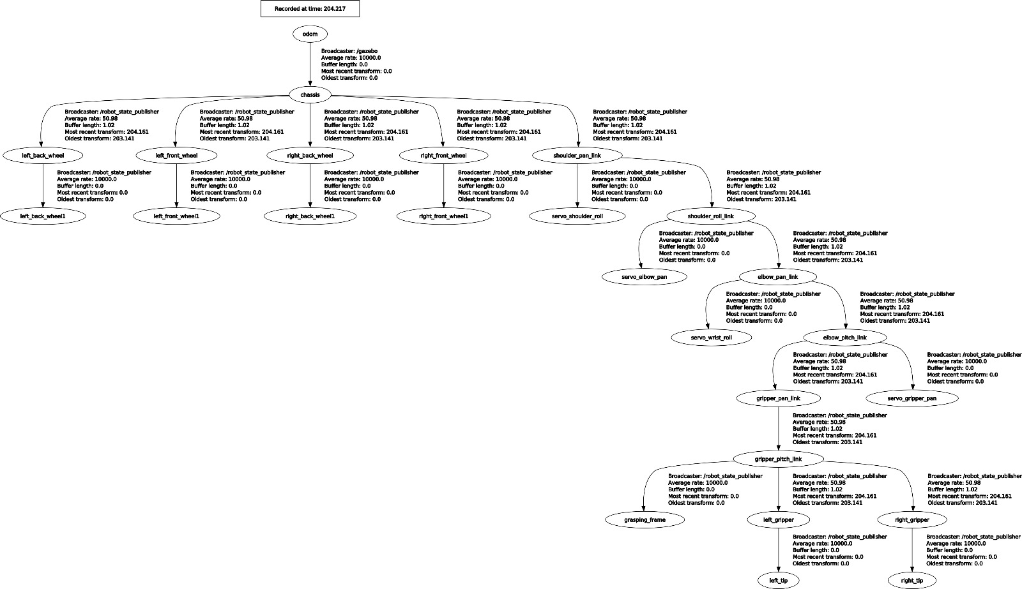

Slide 10
FORWARD KINEMATICS
DH parameter are assigned.
Calculation of Transformation matrices for all joints w.r.t. base frame.
The angles are all assumed to be zero and then the verification of the final frame (elbow_pitch joint) positions is done in RViz.
Final Transformation Matrix:
H6=T1*T2*T3*T4*T5*T6

Slide 11
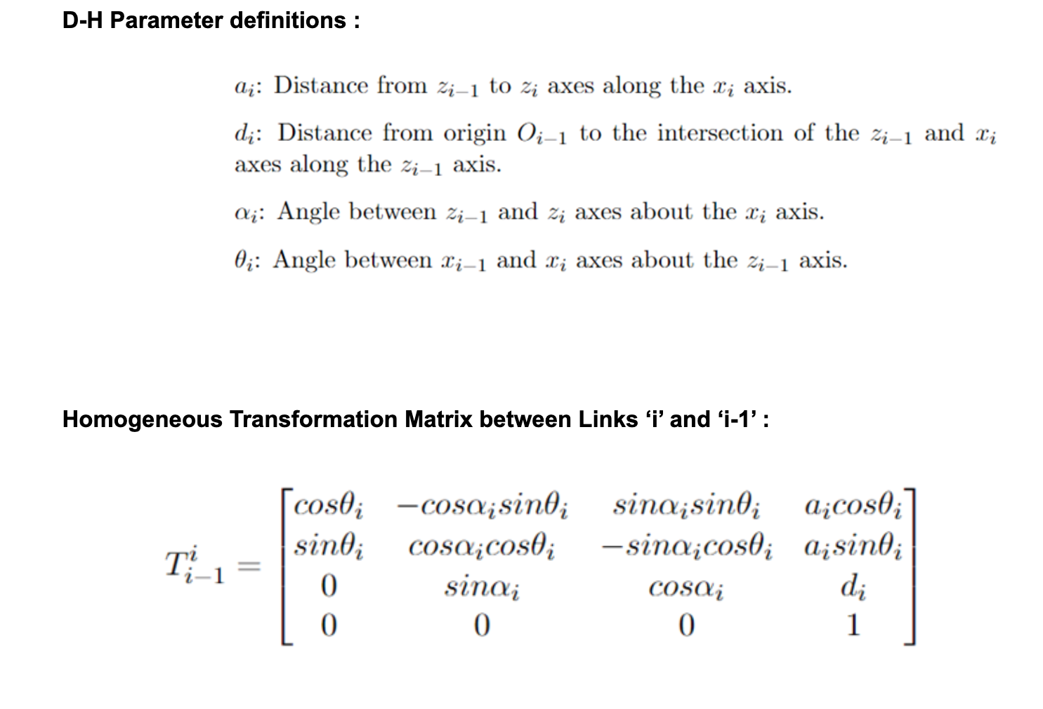
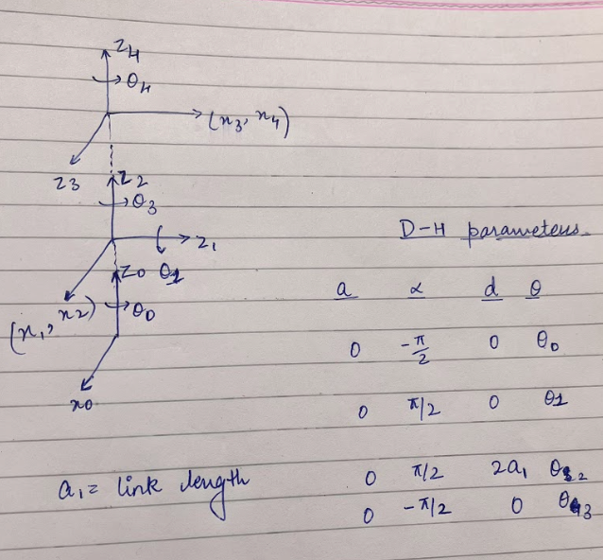

Slide 12
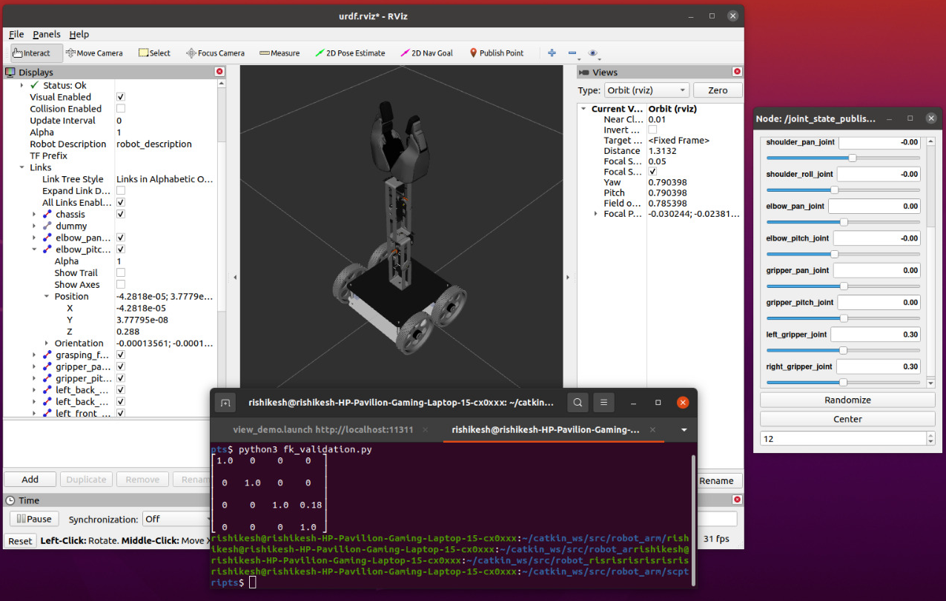
The Matrix obtained shows the value of end effector with respect to the first link but the value of pose in RViz is with respect to ground frame. To complete the verification the half of the chassis height and the wheel radius should be added. This gives the final output same as RViz hence the completing the verification.

Slide 13
INVERSE KINEMATICS
Formula for calculating the Jacobian to represent the velocity kinematics for the robot arm is applied.
Where the upper half gives the linear velocity component for each link and he lower half gives the angular velocity component for each link.
Both Jv and Jw vary based on type of joint, i.e they are different for revolute and prismatic joints.
Then the results are obtained and the verification is done.

Slide 14
The results obtained and verification are in this link:
https://drive.google.com/drive/folders/1QW7Eak2PbWma0Tb0El4jjWCQnswvXPuF?usp=share_link

Slide 15
WORKSPACE
Workspace in the application simulation

Slide 16
PROBLEMS FACED
Correctly spawning the robot in gazebo and Rviz which was spawning with dislocated parts.
Finding the DH parameters as the robot used by us is not universal.
Multiple errors were solved which we faced while creating the launch and yaml files.
Writing the python script for forward, inverse kinematics and a closed loop controller for the differential drive robot.
Correctly simulating the application
Sensors could not be added due to complications instead had to use Gazebo odometer to write the closed loop controller for the mobile robot.

Slide 17
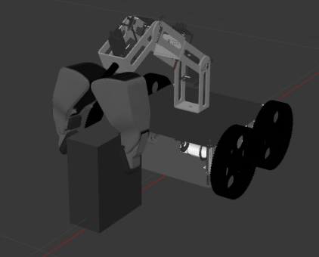
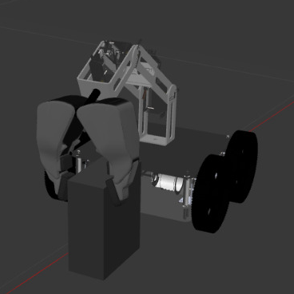
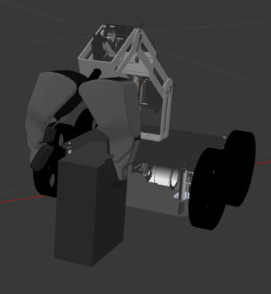
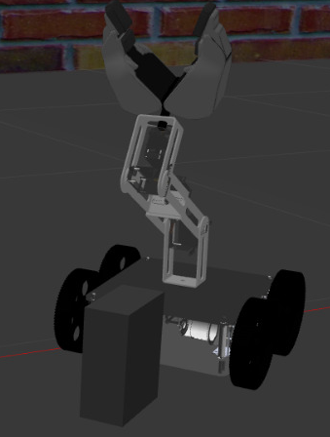
RESULTS
After using the closed loop controller to go to the goal the pick and place process is executed.
STEP 1
STEP 2
STEP 3
STEP 4

Slide 18
CONCLUSION
The URDF file was properly spawned in rviz and gazebo.
Wrote a joint state publisher gui and checked the working of joints.
Created an rqt_robot_steering, teleop, closed loop controller to make sure the differential drive robot was able to traverse the world properly.
Created a custom test world for the robot environment.
Created the .launch and .Yaml files.
Wrote the Python scripts for finding the Homogeneous transformation matrix via the DH-table and the found the Jacobian as well and verification of forward and inverse kinematics was conducted.
Application simulation was done.

Slide 19
INDIVIDUAL CONTRIBUTIONS
Rishikesh Jadhav- Forward kinematic analysis, Wrote the launch, .yaml files and transmissions, Presentation and report.
Nishant Pandey- Inverse Kinematic analysis, closed loop controller code for differential drive robot Application simulation, Presentation and report.

Slide 20
REFERENCES
Robot Modeling and Control, Mark W. Spong, Seth Hutchinson, and M. Vidyasagar
ros.org
gazebosim.org

