Slide 1

Predicting Safe Move

Slide 2
The aim of this project is to find a safe and secure location for opening of commercial establishments in Vancouver, Canada. Specifically, this report will be targeted to stakeholders interested in opening any business place like Grocery Store in Vancouver City, Canada.
The first task would be to choose the safest borough by analysing crime data for opening a grocery store and short listing a neighbourhood, where grocery stores are not amongst the most commom venues, and yet as close to the city as possible.
We will make use of our data science tools to analyse data and focus on the safest borough and explore its neighborhoods and the 10 most common venues in each neighborhood so that the best neighborhood where grocery store is not amongst the most common venue can be selected.

Slide 3
Based on definition of our problem, factors that will influence our decission are:
finding the safest borough based on crime statistics
finding the most common venues
choosing the right neighbourhood within the borough
We will be using the geographical coordinates of Vancouver to plot neighbourhoods in a borough that is safe and in the city's vicinity, and finally cluster our neighborhoods and present our findings.
Following data sources will be needed to extract/generate the required information:

Slide 4
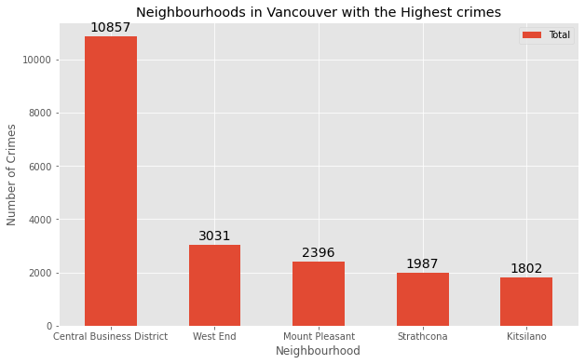
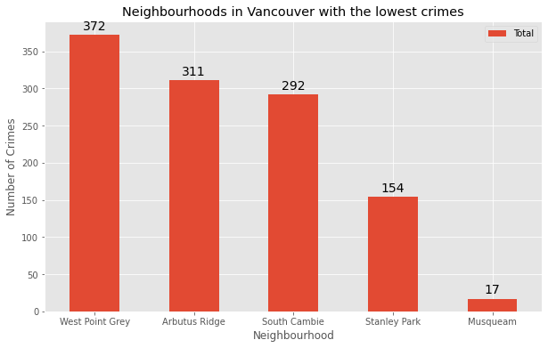
Graph of neighbourhoods Higher crime vs lowest

Slide 5
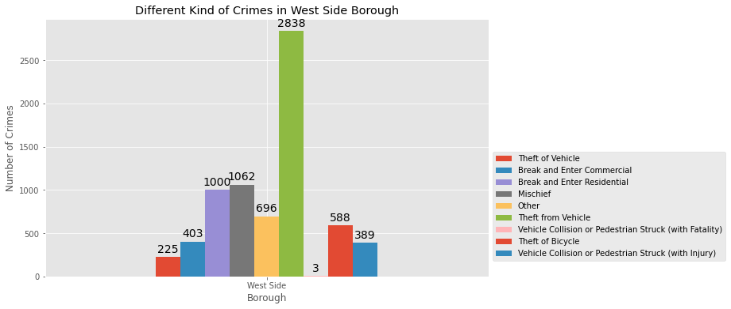
Different kinds of crimes in West side borough

Slide 6
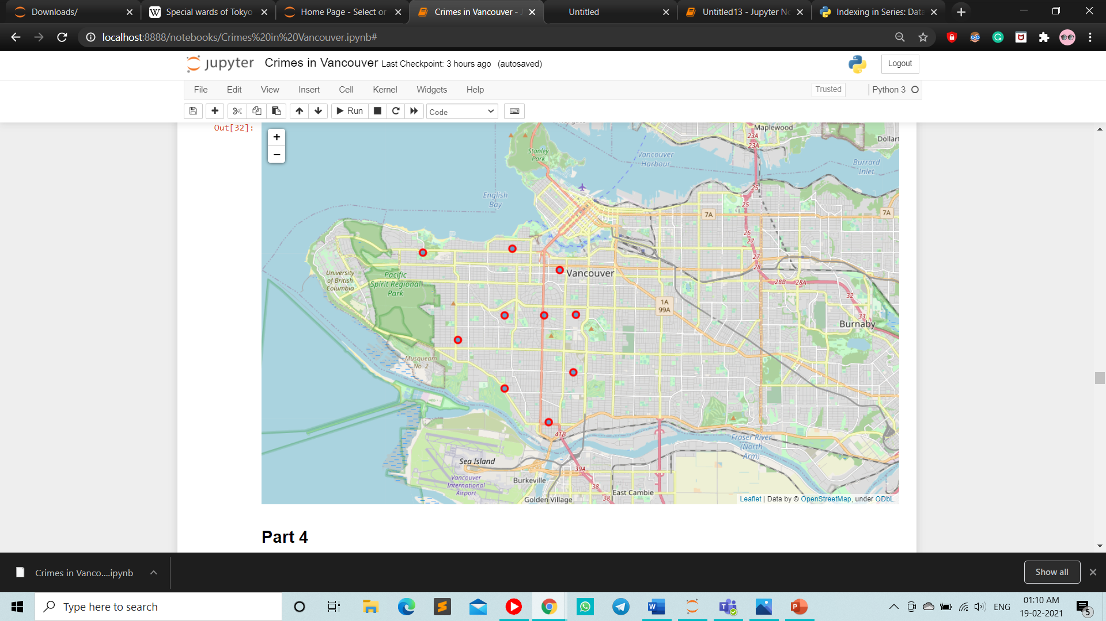
Similar neighborhood in west bund borough

Slide 7
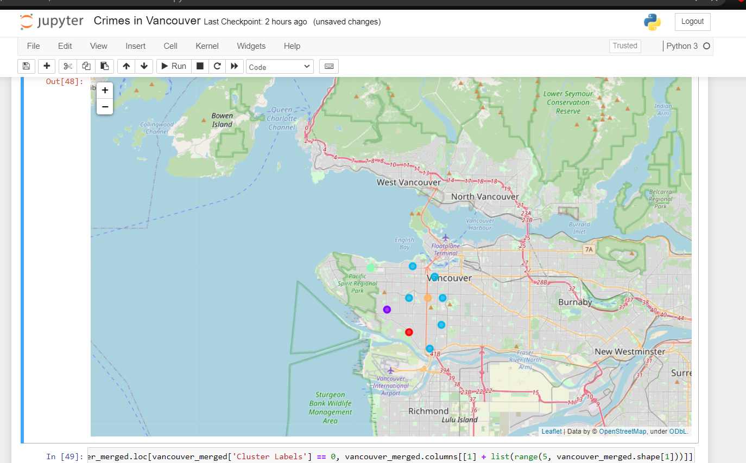
Cluster distributed

Slide 8
Results and Discussion
The objective of the business problem was to help stakeholders identify one of the safest borough in Vancouver, and an appropriate neighborhood within the borough to set up a commercial establishment especially a Grocery store. This has been achieved by first making use of Vancouver crime data to identify a safe borugh with considerable number of neighborhood for any business to be viable. After selecting the borough it was imperative to choose the right neighborhood where grocery shops were not among venues in a close proximity to each other. We achieved this by grouping the neighborhoods into clusters to assist the stakeholders by providing them with relavent data about venues and safety of a given neighborhood.

Slide 9
Conclusion
We have explored the crime data to understand different types of crimes in all neighborhoods of Vancouver and later categorized them into different boroughs, this helped us group the neighborhoods into boroughs and choose the safest borough first. Once we confirmed the borough the number of neighborhoods for consideration also comes down, we further shortlist the neighborhoods based on the common venues, to choose a neighborhood which best suits the business problem.

Slide 10

Thank You
someone@example.com

