Slide 1
Digital Portfolio
STUDENT NAME: RISHIKESH R S
REGISTER NO AND NMID: 2426J1548
DEPARTMENT: II B.SC.IT "B"
COLLEGE: KPR COLLEGE OF ARTS, SCIENCE AND RESEARCH / BHARATHIYAR UNIVERSITY

Slide 2
PROJECT TITLE
🔹 AI-Powered Portfolio

Slide 3


AGENDA
Problem Statement
Project Overview
End Users
Tools and Technologies
Portfolio design and Layout
Features and Functionality
Results and Screenshots
Conclusion
Github Link
3/21/2024 Annual Review

Slide 4

PROBLEM STATEMENT
In today’s digital world, a personal portfolio is essential to showcasean individual’s skills, projects, and achievements. However,traditional portfolios are static and require visitors to manuallybrowse through multiple sections to find specific information. Thiscan reduce engagement and make it harder for recruiters, clients, orcollaborators to quickly learn about the portfolio owner.​
To solve this, an AI-powered portfolio chatbot can be integrated. Thechatbot acts as an interactive assistant that answers commonquestions such as “What are your skills?”, “Tell me about yourprojects,” or “How can I contact you?”. By enabling conversationalinteraction, the portfolio becomes more engaging, accessible, anduser-friendly, while also reflecting the owner’s technical ability tobuild intelligent systems
.

Slide 5

PROJECT OVERVIEW
The AI-Powered Portfolio is an interactive personal website designed to present an individual’s professional profile in an engaging and modern way. Unlike traditional static portfolios, this project integrates a chatbot assistant that allows visitors to interact conversationally and receive instant responses to their queries.
The chatbot is designed to answer common questions such as:
“What are your skills?”
“Tell me about your projects.”
“How can I contact you?”
The portfolio showcases not only the user’s skills and achievements but also demonstrates their ability to apply web development, AI, and automation concepts.
The solution is lightweight, runs directly in the browser, and does not require a backend server for basic functionality. It can be further enhanced by connecting to an AI API (e.g., OpenAI GPT) for more dynamic and human-like conversations.
Overall, the project bridges the gap between a static personal website and an intelligent interactive platform, making it more engaging for recruiters, clients, and collaborators.

Slide 6

WHO ARE THE END USERS?
Recruiters / Hiring Managers
They can quickly learn about your skills, projects, and experience through chatbot queries without navigating multiple sections.
Saves their time and makes your portfolio more interactive.
Clients / Potential Collaborators
For freelancers or developers, clients can ask about expertise, past projects, or services offered.
Makes it easier to showcase relevant information instantly.
Peers / Networking Contacts
Fellow students, professionals, or connections who want to know more about your background, projects, or contact info.
General Visitors
Anyone browsing your portfolio who wants a user-friendly, conversational way to explore your work.

Slide 7

TOOLS AND TECHNIQUES
1. Tools Used
HTML5 – for structuring the portfolio and chatbot interface.
CSS3 – for styling the website and making the chatbot widget visually appealing.
JavaScript (Vanilla JS) – to implement chatbot logic, handle user inputs, and display responses dynamically.
Code Editor (VS Code / Sublime / Atom) – for writing and debugging code.
Web Browser (Chrome, Firefox, Edge) – for testing and running the portfolio locally.
(Optional) OpenAI API / Similar AI APIs – to extend the chatbot with natural language understanding instead of static responses.
2. Techniques Applied
Responsive Web Design – ensuring the portfolio and chatbot work well on desktop and mobile devices.
Event Handling in JavaScript – capturing user input and displaying interactive responses.
Predefined FAQ Matching – mapping common questions (like "skills", "projects") to appropriate chatbot responses.
DOM Manipulation – dynamically updating the chat window with user queries and bot replies.
Asynchronous Interaction (if using API) – sending user queries to an AI API and displaying real-time intelligent responses.
UI/UX Design Principles – designing the chatbot widget to be clean, simple, and user-friendly.

Slide 8
POTFOLIO DESIGN AND LAYOUT
The AI-Powered Portfolio is designed with a clean, modern, and user-friendly interface to ensure smooth navigation and interactive engagement. The layout is divided into key sections that highlight personal and professional details, while integrating a chatbot for conversational interaction.
1. Header Section
Contains the portfolio owner’s name, logo, and navigation menu.
Provides quick access to different sections like Home, About, Skills, Projects, Contact.
2. Hero Section
A welcoming banner with a short introduction and tagline.
Includes a professional photo or illustration.
Acts as the first impression for visitors.
3. About Section
Brief personal introduction, background, and career summary.
Highlights personality and professional interests.
4. Skills Section
Displays technical and soft skills using progress bars, badges, or icons.
Example: Python, Web Development, AI, Communication, Problem-Solving.
5. Projects Section
Showcases key projects with descriptions, images, and links (GitHub, live demo).
Each project card includes tools used and outcomes achieved.
8

Slide 9
FEATURES AND FUNCTIONALITY
1. Portfolio Features
Responsive Design – Works seamlessly across desktops, tablets, and mobile devices.
Navigation Menu – Smooth scrolling and quick access to different portfolio sections.
About Section – Highlights personal background, career goals, and achievements.
Skills Showcase – Displays technical and soft skills using icons, bars, or badges.
Project Gallery – Showcases key projects with descriptions, screenshots, and links (GitHub/live demo).
Contact Section – Provides email, social links, and/or a contact form for easy communication.
Clean UI/UX – Minimalist, modern design that ensures a professional look.
2. Chatbot Features
Interactive Assistant – A floating chat widget that users can open and interact with.
FAQ-Based Responses – Handles predefined queries like:
“Tell me about your skills”
“Show me your projects”
“How can I contact you?”
Real-Time Messaging – Displays user input and bot responses instantly in the chat window.
Error Handling / Default Replies – Provides fallback answers when a query is not recognized.
Expandable to AI API – Can be integrated with OpenAI or other APIs for more natural, intelligent responses.
3. Functionalities in Action
Visitors can browse portfolio sections manually OR chat with the bot to find information quickly.
The chatbot enhances accessibility by giving recruiters and clients an interactive way to explore skills and projects.
The portfolio functions as both a showcase of work and a demonstration of technical ability.

Slide 10

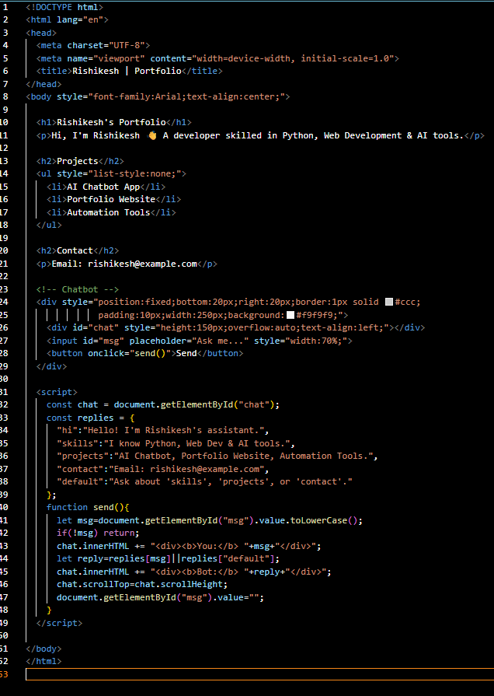
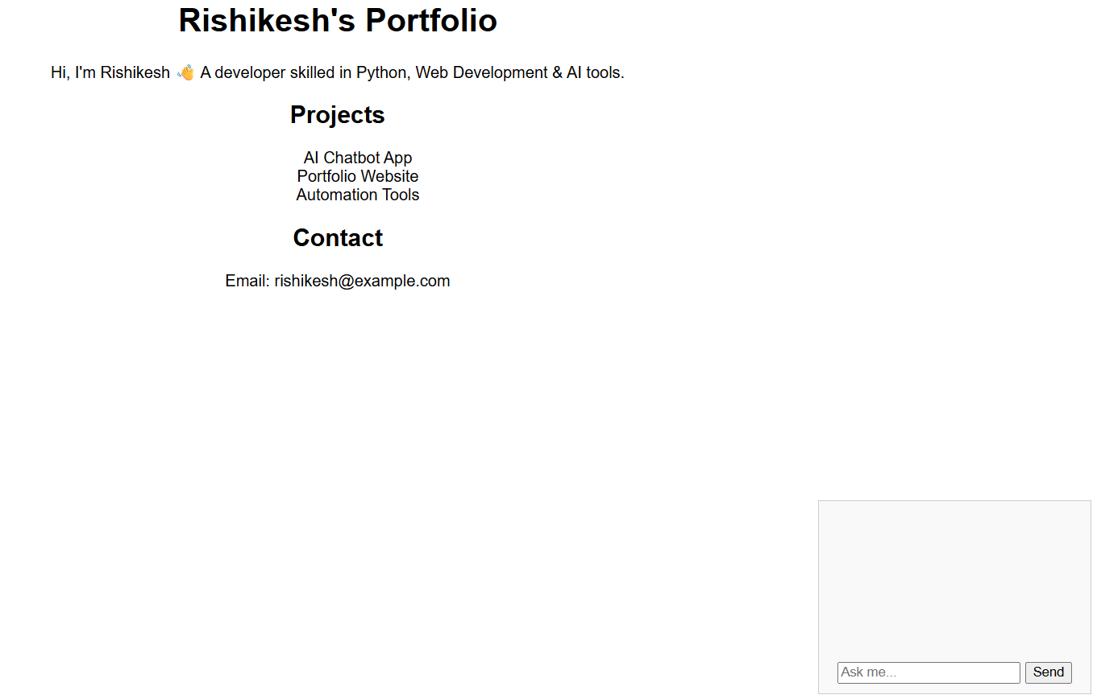
RESULTS AND SCREENSHOTS
3/21/2024 Annual Review
10

Slide 11
CONCLUSION
The AI-Powered Portfolio with Chatbot successfully transforms a traditional static portfolio into an interactive and engaging platform. By combining modern web design with a conversational chatbot, the project allows recruiters, clients, and visitors to access relevant information quickly and conveniently.
The portfolio not only highlights personal skills, projects, and achievements but also demonstrates technical proficiency in web development, JavaScript interactivity, and AI concepts. The chatbot enhances user experience by providing instant answers to common queries such as skills, projects, and contact details, reducing the need for manual navigation.
Overall, this project bridges the gap between professional presentation and intelligent interaction, making it more appealing to end users. It reflects the growing importance of AI integration in personal branding and sets the foundation for future enhancements such as real AI-powered responses, voice interaction, and advanced analytics.
https://rishikesh-cyber022.github.io/index/
11

