Slide 1
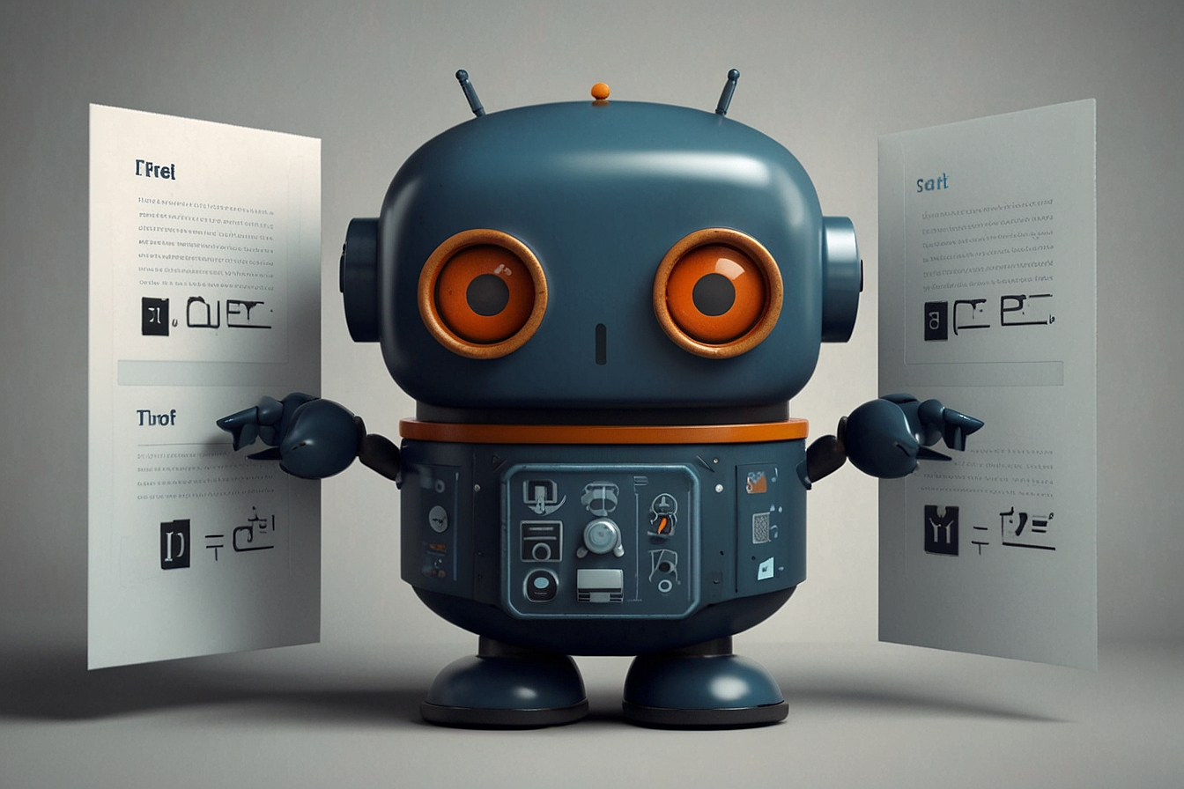
EDUGUIDEBOT
Prafulla Raj Pokharel
Rishikesh Paudel
Rohan Thapa

Slide 2

Problem Statement
In the ever-evolving landscape of education, aspiring engineering students often encounter challenges in navigating the complexities of entrance exams, application processes, and associated fees. To address these issues, this project proposes the development of an intelligent Engineering Entrance Chatbot. Leveraging advanced technologies such as Natural Language Processing (NLP) and machine learning, the chatbot aims to provide tailored guidance and information to streamline the journey of prospective engineering students.

Slide 3

Problem Statement
In the ever-evolving landscape of education, aspiring engineering students often encounter challenges in navigating the complexities of entrance exams, application processes, and associated fees. To address these issues, this project proposes the development of an intelligent Engineering Entrance Chatbot. Leveraging advanced technologies such as Natural Language Processing (NLP) and machine learning, the chatbot aims to provide tailored guidance and information to streamline the journey of prospective engineering students.

Slide 4
EDUGUIDEBOT
A sophisticated chatbot with text processing and AI/ML capabilities, this project aims to provide a user-friendly solution for engineering entrance exam aspirants, helping them navigate the complexities of the application process, fees, and other related queries.

Slide 5
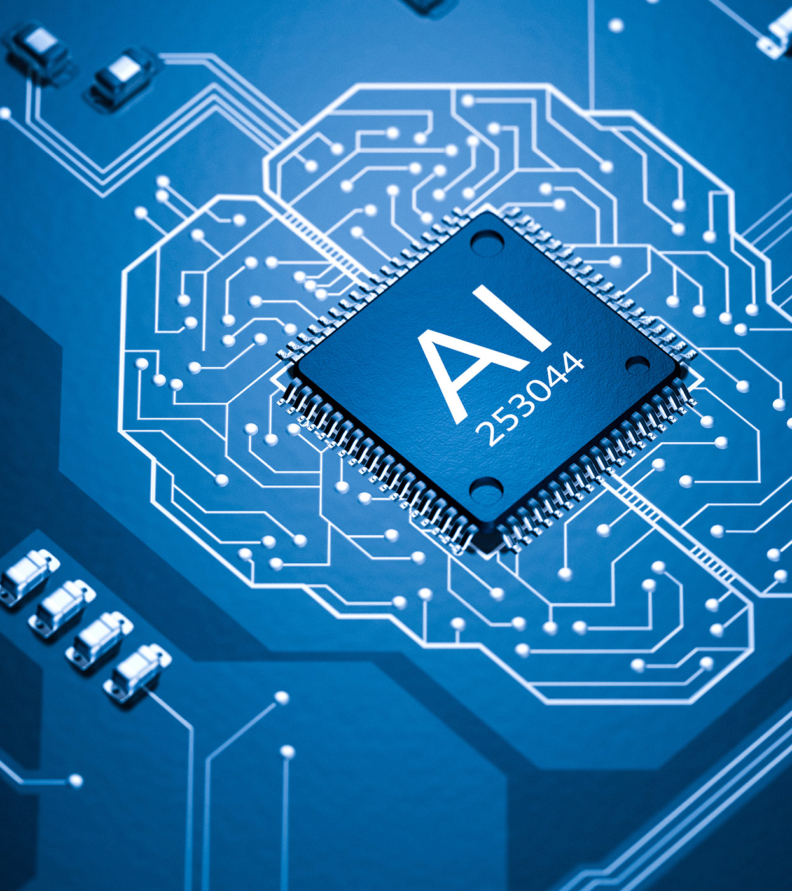
Features
Natural Language Processing
Information Retrieval
Intent Recognition

Slide 6
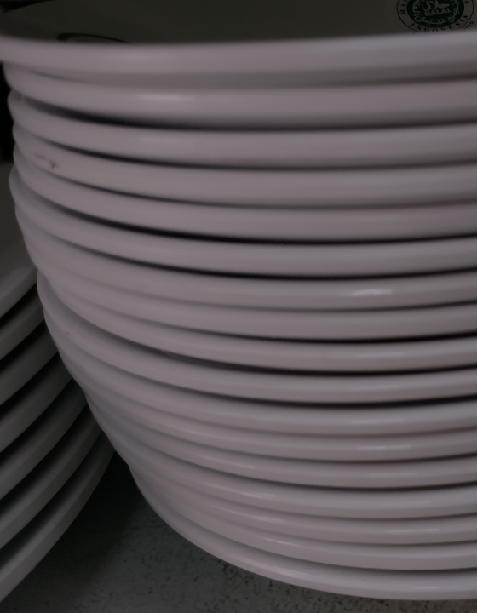
Product overview
Unique
First to market
Only product specifically dedicated to the restaurant industry
First beautifully designed product that's both stylish and functional​
Tested
Authentic
Conducted testing with restaurants in the area
Designed with the help and input of restaurant and service workers in the field ​

Slide 7
Thank You

