Slide 1
Coursera
IBM Capstone Project:
New York Hotel Analysis for Investors

Slide 2
Background:
How should a new business person decide where to open a hostel?
What factors should he look at before investing?
Which neighborhood venues affect a user's rating for location of hostel?

Slide 3
Questions an investor might look for:
How does price vary with location?
Where are most of the hotels located ?
Where are least of the hotels located ?
Which is the most costly locality?
How does different ammenities affect the charge of hotel?
Which amenities are more common near hotels?

Slide 4
Data Requirements:
New York Hostel Dataset:Since 2008, guests and hosts have used Airbnb to expand on traveling possibilities and present more unique, personalized way of experiencing the world. This dataset describes the listing activity and metrics in NYC, NY for 2019.
Foursquare API: This API will help me get the venues around the hotel which I will use for EDA and clustering.
New York Land Price: I will scrape this website to get land prices of various neighborhoods in NYC.
I have downloaded following excel files:
rollindsales_bronx.xls
rollindsales_brooklyn.xls
rollindsales_statenisland.xls
rollindsales_queens.xls
rollindsales_manhattan.xls

Slide 5
Analysis process
Firstly, I will use exploratory data analysis(EDA) to uncover hidden properties of data and provide useful insights to the reader, both future traveller and investor.
Secondly, I will use prescriptive analytics to help a business person decide a location for new hotel. I will use clustering (KMeans)

Slide 6
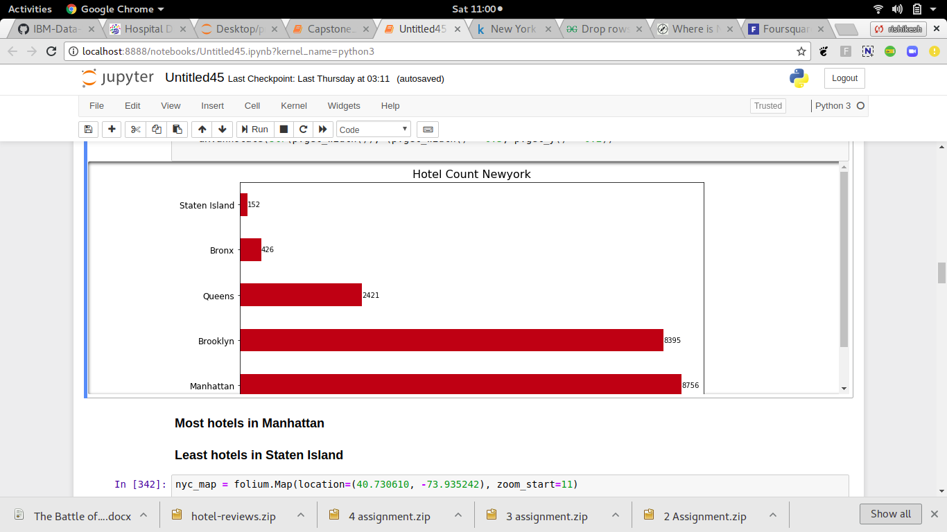
Analysis Results Hotel Distribution
.

Slide 7
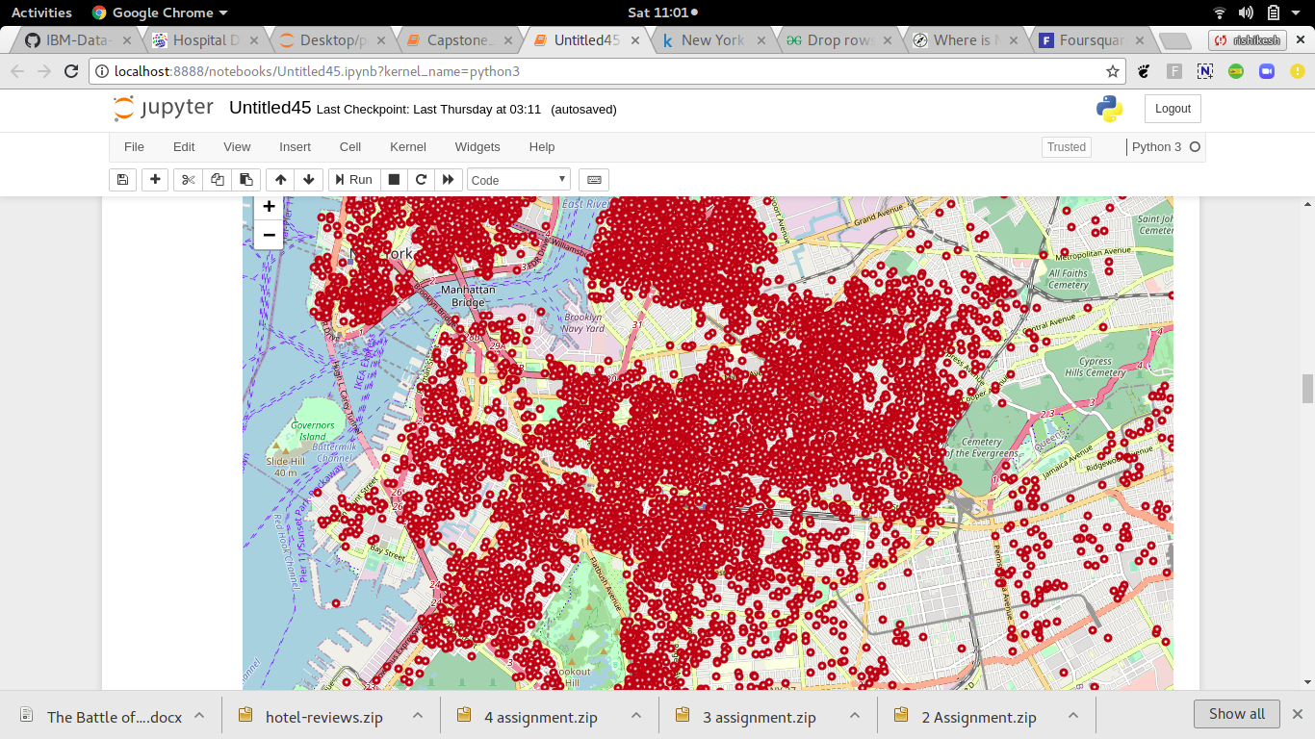
Analysis Results Visualization

Slide 8
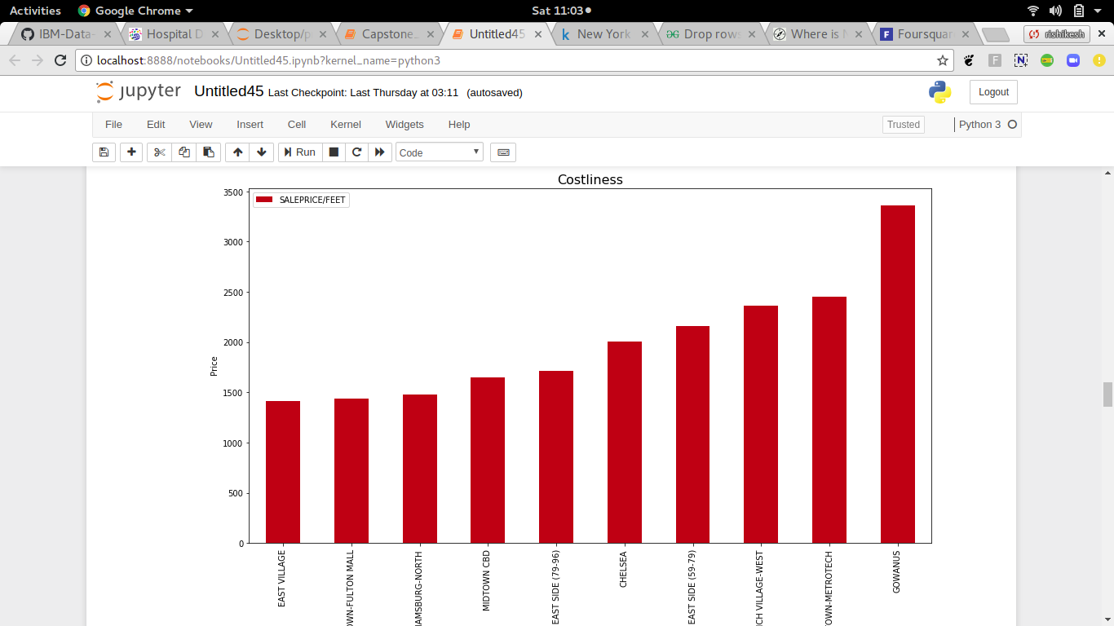
Analysis Results Costliest Neighborhood

Slide 9
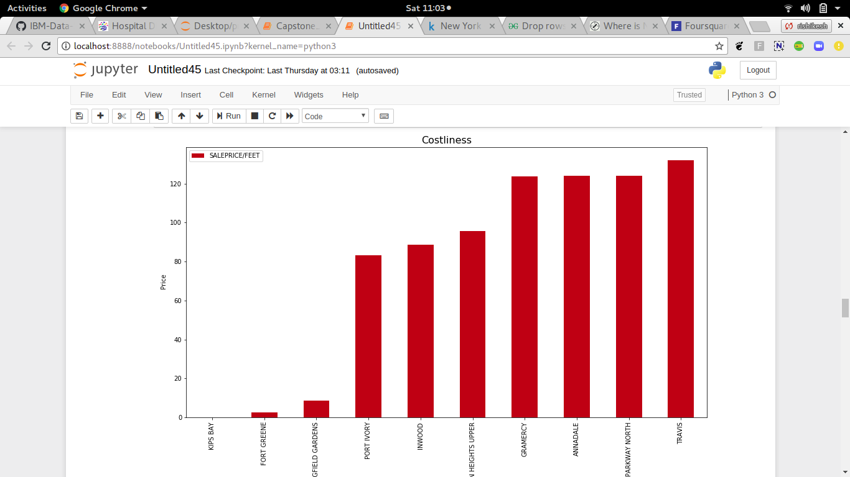
Analysis Results Least Costly Neighborhood

Slide 10
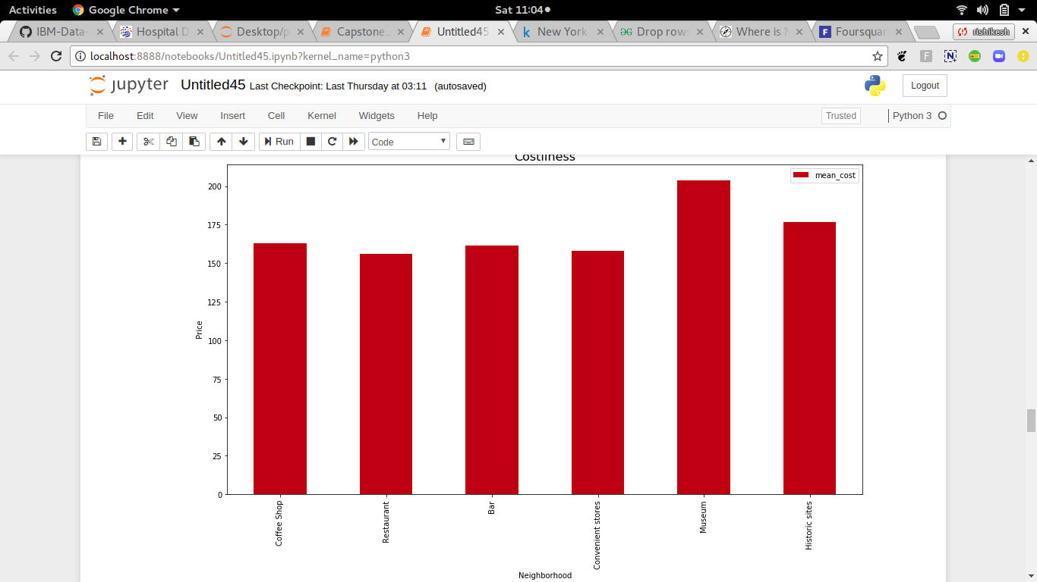
Analysis Results Amenities wise Costing

Slide 11
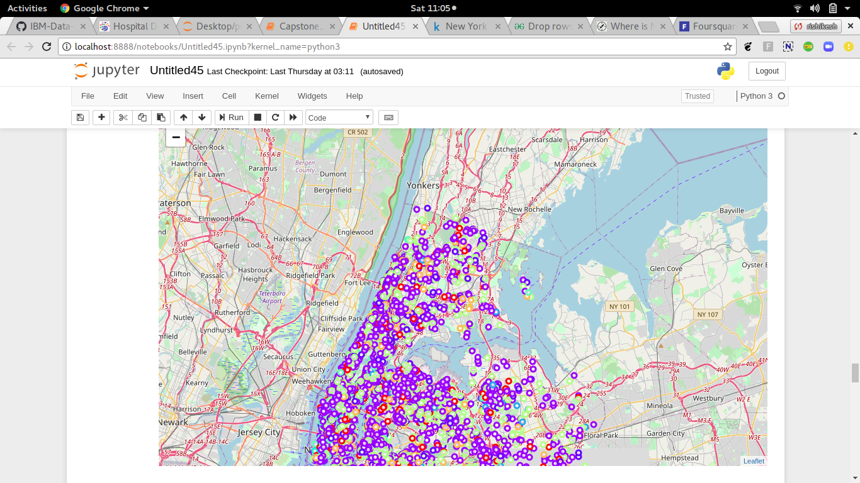
Analysis Results Cluster based on prices

Slide 12
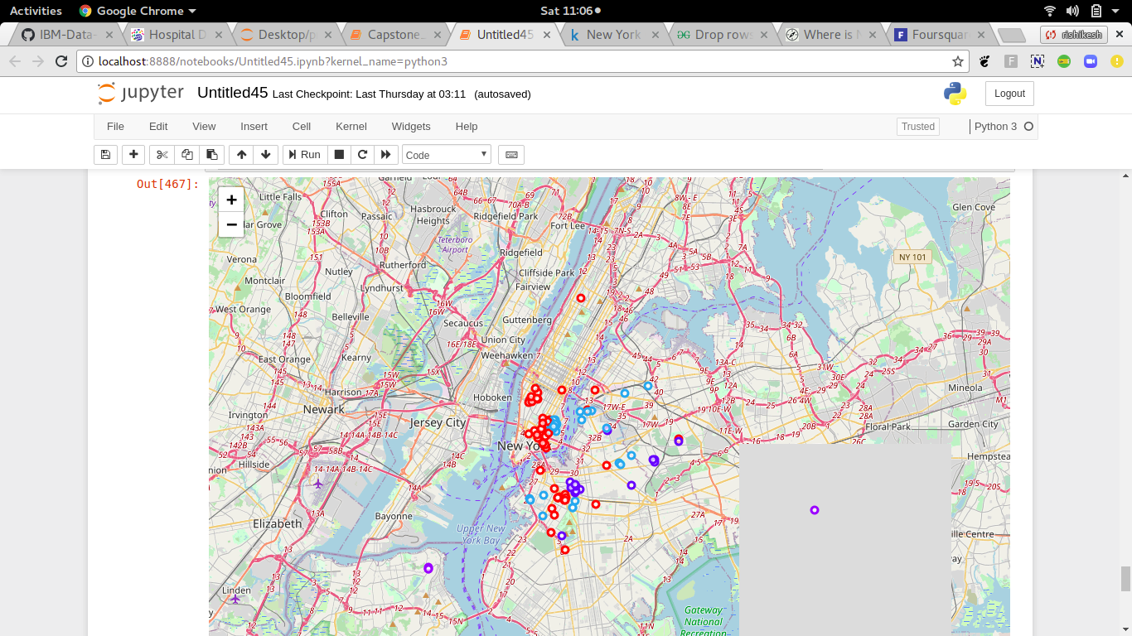
Analysis Results Clusters based on Neighborhoods

Slide 13
Results:
Williamsburg seems to be an interesting locality since it is close to Manhattan and 4th cheapest neighborhood.
Most of the hotels are supposed to be in Williamsburg.
The starting price of hostels does not vary much depending on its distance from the city centre.
Most of the hotels in Gowanus are costly.
Proximity to a Museum or a historic site positively affects the hostel rating.
Hostels rated highly for being value for money are comparatively cheaper and are located away from the city centre

Slide 14
Discussion
According to the above analysis, opening a hotel in Harlem is the most appropriate option. It already contains the highest number of hotels from our dataset. This means that these wards must attract lot of tourists, no other reason appropriately justifies why they house so many hotels inspite of being very costly.
Harlem is a neighbour of Gowanus and is almost 41% cheaper than Gowanus.
It also contains decent amount of hostels but not as many as Willaimsburg, which leaves space for new opportunities.

Slide 15
Conclusion
In the above study, we explored and analysed various aspects of the hotels scene in New York using data science. We used an existing dataset and combined it with data collected from Foursquare API as well as data scraped from a website. We performed EDA and clustering on these datasets in our pursuit of solutions. We were able to find satisfactory answers to the questions we posed before the study.
The study is based on limited data, but it is nevertheless a significant step in shedding light on the hotel scene in New York city . This study can be repeated easily for other cities of the world.

