Slide 1



Department Of ENTC Engineering
Secure Hotel Network Design with Cisco Packet Tracer
Course: ISCPS
Prof: Vaibhav Gijare
Name: Rushikesh Sabale PRN: 202201070107 DIV: B2

Slide 2

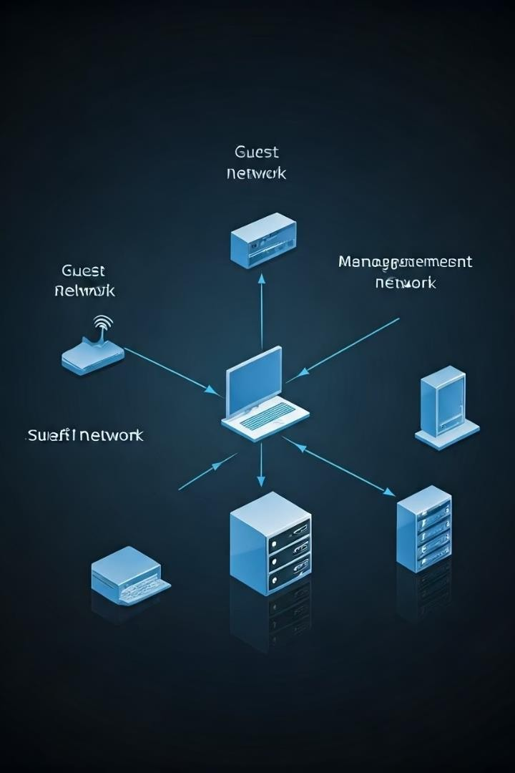
Network Design Goals
Segmentation
Use VLANs to separate guest, staff, and management networks.
Security
Deploy firewalls, encryption, and strong authentication methods.
Accessibility
Provide stable and secure Wi-Fi for all users.
Efficiency
Optimize bandwidth while minimizing latency.

Slide 3

Network Architecture and Implementation
VLAN Setup
Configured VLAN 10 for guests, 20 for staff, 30 for management.
IP Addressing
DHCP server automatically assigns IPs across VLANs.
Wireless Access
Secure WPA2/3- Enterprise Wi-Fi ensures robust connectivity.
Routing
Layer 3 switch enables inter-VLAN routing effectively.

Slide 4
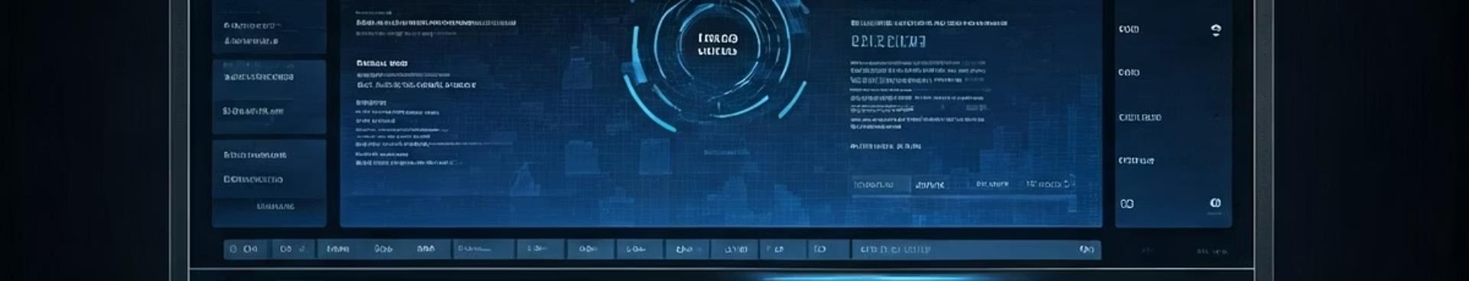

Security Measures
Firewall
Cisco ASA protects the network perimeter from threats.
Encryption
VPNs and SSL/TLS encrypt data and web traffic
securely.
Traffic Control
Access Control Lists restrict unauthorized VLAN communication.
Authentication
RADIUS server verifies staff network access
credentials.

Slide 5

Threat Identification
Unauthorize d Access
Prevent intrusions from unauthorized users.
Wi-Fi Security
Guard against eavesdropping and rogue access points.
DDoS
Attacks
Implement rate limiting to protect from traffic floods.
Malware
Use endpoint protection and network segmentation to isolate threats.

Slide 6


Solutions Implemented
VLAN Segmentation
Isolated guest from sensitive hotel data to reduce risks.
Firewall Policies
Block malicious traffic and support intrusion detection.
Password Enforcement
Require complex passwords for all users to enhance security.
Regular Updates
Keep network devices patched to fix vulnerabilities.

Slide 7

Testing and Validation
1
Connectivity
Pings between VLANs verified plus internet access checked.
2
Security Audits
Performed vulnerability scans and penetration testing.
3
Performance
Monitored bandwidth use and latency for optimal service.
4
User Feedback
Collected guest and staff input on network reliability.

Slide 8

Conclusion and Future Improvements
Summary
The network meets all goals: secure, segmented, reliable.
Future Plans
Implement Intrusion Detection System
Add Security Information and Event Management
Continuous audits and network scaling

