Slide 1

ECEN 5613
Embedded System Design
Automobile Alert System with OS: Warning System for Approaching Vehicles with Temperature Monitoring.
Suraj Ajjampur, Rishikesh Sundaragiri

Slide 2


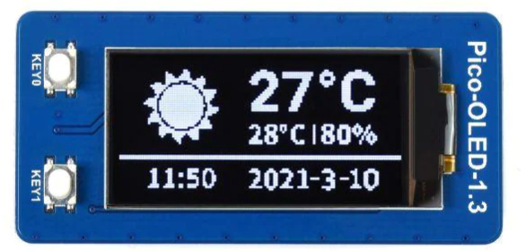
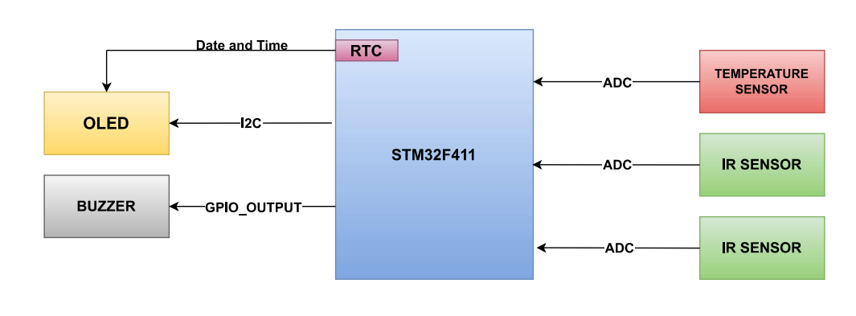




Project Description
This endeavor revolves around an STM MCU integrated with a temperature sensor, two IR sensors, and an OLED display. The objective is to furnish vehicles with a sophisticated sensory system. The temperature sensor is instrumental in indicating the prevailing temperature on the OLED display along with current time and date. Moreover, the IR sensors identify incoming vehicles in the automobile's blind spots, thereby triggering an alert by sounding a buzzer and presenting a warning animation on the OLED display. The programming approach is bare metal-based and complements an operating system tailored for time-critical operations
Figure 1. Project Block Diagram
s Automobile Alert System with OS – Suraj Ajjampur, Rishikesh Sundaragiri

Slide 3
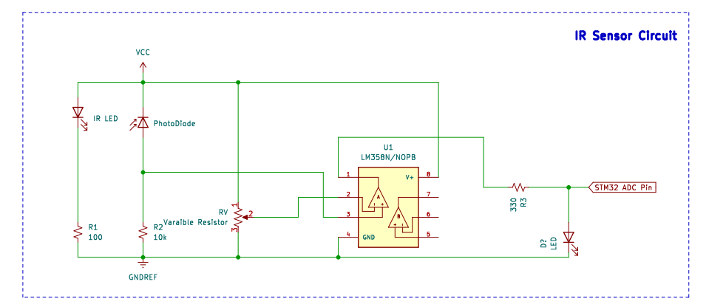
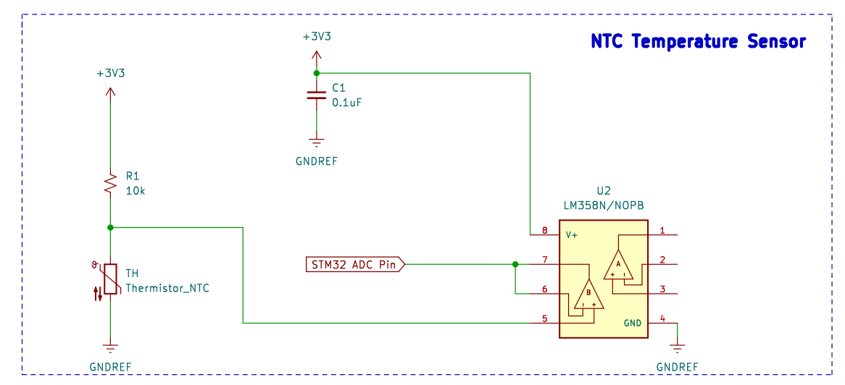
Hardware Elements
2 Custom built sensors
s Automobile Alert System with OS – Suraj Ajjampur, Rishikesh Sundaragiri

Slide 4
Software Elements
Bare metal Programming with STM32
a) ADC implementation
b) I2C protocol
c) RTC Module
2. OLED application
3. OS capabilities
Creating Tasks (with unique name, priority level and code to execute)
Co-operative multitasking [Scheduler to relinquish control from tasks to task]
Inter-task communication [using queues, semaphores and mutexes]
Real-time functionality* [using task priorities and timers]
Inter process communication* [event groups and software timers]
*- Stretch goals
s Automobile Alert System with OS – Suraj Ajjampur, Rishikesh Sundaragiri

Slide 5
Organizational Diagram
MAIN
SCHEDULER
Temperature Sensor
IR Proximity Sensor
RTC
OLED Display
ADC
Buzzer
Rendering
GPIO
I2C
Text
Generated animations
s Automobile Alert System with OS – Suraj Ajjampur, Rishikesh Sundaragiri

Slide 6
Milestone
Tasks | Start Date | Expected Completion Date
Source components | 12th March 2023 | 14th March 2023
ADC and RTC module program | 15th March 2023 | 20th March 2023
OLED animations , I2C integration | 21st March 2023 | 2nd April 2023
Build Sensors and test raw values | 3rd April 2023 | 4th April 2023
Program and Integrate sensors with STM32 | 5th April 2023 | 11th April 2023
Program and integrate of OLED with STM32 | 12th April 2023 | 16th April 2023
Full System Test w/o OS | 17th April | 19th April 2023
FreeRTOS implementation | 20th April | 25th April 2023
Compare responsiveness of with and w/o OS implementation | 26th April | 28th April 2023
Demo Preparation and video | 29th April | 30th April 2023
Report Presentation | 2nd May | 4th May 2023
s Automobile Alert System with OS – Suraj Ajjampur, Rishikesh Sundaragiri

Slide 7
References and Fallback Plan
References
https://www.ti.com/product/LM358
https://www.st.com/en/microcontrollers-microprocessors/stm32f411ve.html
http://www.hiletgo.com/ProductDetail/2169507.html
Fallback Plan
For hardware : If the designed sensor doesn't work then we have of the shelf sensors as a backup component to use For Software : If the bare metal programming doesn't work for any module then we will use HAL library as an alternative
s Automobile Alert System with OS – Suraj Ajjampur, Rishikesh Sundaragiri

