Slide 1
Module: Security
Upon completion of this module, you should be able to:
Describe key security threats in the cloud
Discuss key security mechanisms deployed in the cloud
Describe infrastructure security(network, host, application)
Discuss data security and storage
Notes:
This module focuses security cross-layer function of the cloud computing reference model. This module focuses on key security threats to a cloud infrastructure. It focuses on the various security mechanisms that enables the cloud service providers to mitigate these threats. For Infrastructure security refer Chapter 3 from Page number 35 of textbook written by Tim Mather (54/335). For Data security and storage refer to Chapter 4 from Page number 61 of the same book (80/335).

Slide 2
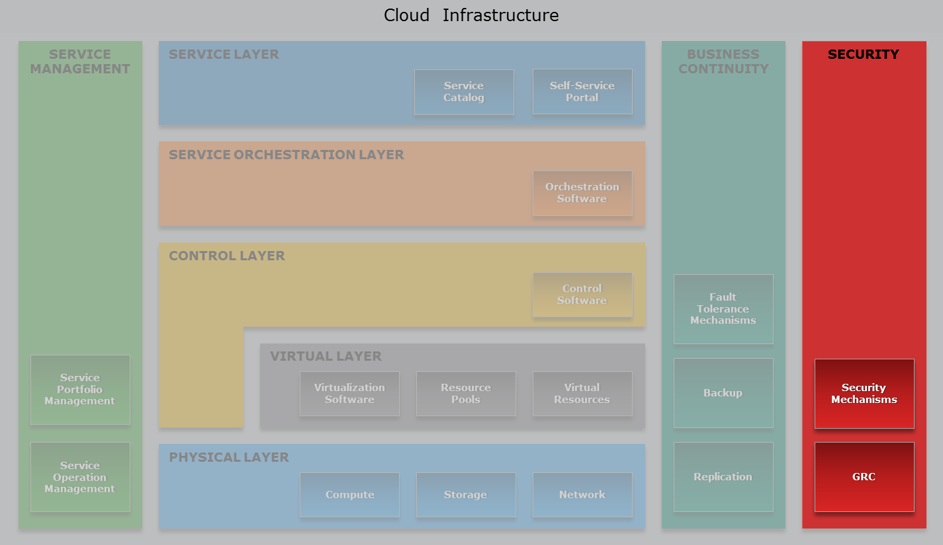
Cloud Computing Reference Model
Security Cross-layer Function
Notes:
Although, cloud computing offers several benefits, such as flexibility, scalability, and agility, security is one of the key factors that consumers are concerned about while adopting cloud. Therefore, it is important for a service provider to deploy the required security tools and mechanisms to offer a secure cloud environment to their consumers. The fundamental requirements of information security and compliance pertain to both non-cloud and cloud infrastructure management. In both the environments, there are some common security requirements. However, in a cloud environment there are important additional factors, which a service provider must consider, that arise from information ownership, responsibility and accountability for information security, and the cloud infrastructure’s multi-tenancy characteristic. Therefore, providing secure multi-tenancy is a key requirement for building a cloud infrastructure.
Apart from multi-tenancy, cloud infrastructure provides rapid elasticity, a feature rarely found in traditional data centers. Therefore, tools used to provide information security must have the ability to detect newly provisioned resources and integrate with these scaled resources to provide security. Without these capabilities, it is difficult to monitor and manage the security of such an environment.
The security mechanisms deployed in the cloud environment not only provide protection to the five layers (physical, virtual, control, service orchestration, and service layers), but it also provides protection to the two cross layer functions (service management and business continuity).

Slide 3
Drivers for Securing Cloud Infrastructure
Information is an organization’s most valuable asset
Various tools are deployed to protect the assets
Trust is one of the key concerns of consumers adopting cloud
Managing security has become increasingly important for cloud service providers
Trust = Visibility + Control
Notes:
Today, many organizations (consumers) run their applications in a cloud environment to take advantage of the capabilities discussed throughout this course. As organizations (consumers) adopt cloud, one of the key concerns they have is trust. Trust depends on the degree of control and visibility available to the information’s owner.
Information is an organization’s most valuable asset. Traditionally, organizations deploy various tools within their infrastructure to protect the asset. These tools must be deployed on various infrastructure assets, such as compute (processes information), storage (stores information), and network (carries information) to protect the information. In a cloud environment, security management enables cloud service providers to protect vital information of the consumers stored in the cloud. Managing the security of the infrastructure, which is an on-going effort that has become increasingly important for cloud service providers.

Slide 4
Information Security
Information Security
A term that includes a set of practices that protect information and information systems from unauthorized access, use, information disclosure, disruption, modification, or destruction.
— US Federal law (Title 38 Part IV, Chapter 57, Subchapter III USC 5727)
Goal of information security is to provide:
Confidentiality, integrity, and availability
Security mechanisms ensure right users have access to right resources at the right time
Auditing enables assessing effectiveness of the security mechanisms
Notes:
Information security is a term that includes a set of practices that protect information and information systems from unauthorized access, use, information disclosure, disruption, modification, or destruction.

Slide 5
Key Security Threats in a Cloud Environment
Key security threats according to CSA and ENISA
Data leakage
Data loss
Account hijacking
Insecure APIs
Malicious insiders
Denial of service
Abuse of cloud services
Shared technology vulnerabilities
Insufficient due diligence
Loss of governance and compliance
Notes:
According to the Cloud Security Alliance (CSA) and European Network and Information Security Agency (ENISA), the key threats in a cloud environment are: data leakage, data loss, account hijacking, insecure APIs, denial of service, malicious insiders, abuse of cloud services, insufficient due diligence, shared technology vulnerabilities, and loss of governance and compliance. Apart from describing these threats, this lesson also recommends various control mechanisms that a cloud service provider must consider while building cloud infrastructure to mitigate the threats.

Slide 6
Data Leakage
Occurs when an attacker gains access to a cloud consumer’s confidential data
Unauthorized access to confidential data may be gained by:
Compromising password database
Exploiting poor application design
Exploiting poor segregation of network traffic
Exploiting poor encryption implementation
Through a malicious insider
Control measure
Data encryption (both data at-rest and in-transit)
Data shredding and multi-factor authentication
Notes:
Data leakage occurs when an unauthorized entity (an attacker) gains access to a cloud consumer’s confidential data stored on the cloud infrastructure. An attacker may gain unauthorized access to consumers’ confidential data in a variety of ways, such as a compromised password database, poor application design, poor segregation of network traffic, poor encryption implementation, or through a malicious insider. Consider an example in which an attacker compromises the database that stores consumers’ passwords. It allows the attacker to impersonate a consumer or other legitimate user, thus exposing the consumer’s data. To mitigate the risk of such data leakage, providers may deploy a multi-factor authentication technique. When multi-factor authentication is used, a compromised password database will expose only a part of the authorization credential set, thus reducing the likelihood of a breach or attack.
Consider the example of cross-VM side channel attack to gain access to the consumer’s information. This attack is carried out in two steps: VM placement and information extraction.
In the VM placement step, a malicious VM is placed on a compute system on which the target virtual machine is running. One of the ways to accomplish that is by creating multiple virtual machines. Due to load balancing techniques employed by the hypervisor, new virtual machines may be placed on different compute systems. The attacker then probes each virtual machine created to identify its neighbors. The process is repeated until the target virtual machine is identified, allowing for the second step to be carried out.
(Cont'd)

Slide 7
Data Leakage
Occurs when an attacker gains access to a cloud consumer’s confidential data
Unauthorized access to confidential data may be gained by:
Compromising password database
Exploiting poor application design
Exploiting poor segregation of network traffic
Exploiting poor encryption implementation
Through a malicious insider
Control measure
Data encryption (both data at-rest and in-transit)
Data shredding and multi-factor authentication
Notes:
In the information extraction step, information about the target virtual machine is extracted by monitoring activity, such as keystrokes, cache data, and network traffic. This type of attack could reveal information related to a consumers’ critical business activity. The risks associated with this form of attack can be minimized by encrypting data, which reduces the exposure of confidential data of the consumers.
Additionally, an attacker may exploit multi-tenancy to gain visibility to the residual data or traces of operations of a consumer. This kind of attack may also provide access to consumer’s confidential information. Further, providers may also use data shredding capability to delete the residual data after a consumer has discontinued a cloud service. Encrypting and shredding data helps to prevent exposure of consumers’ confidential data to an attacker.

Slide 8
Data Loss
Occurs due to various reasons other than malicious attacks
Causes of data loss in the cloud include:
Accidental deletion by the provider
Destruction resulting from natural disasters
Providers are often responsible for data loss
Control measure
Data backup and replication
Notes:
Data loss can occur in the cloud due to various reasons other than malicious attacks. Some of the causes of data loss may include accidental deletion by the provider or destruction resulting from natural disasters. The provider is often responsible for data loss resulting from these causes and appropriate measures such as data backup can reduce the impact of such events. Providers must publish the protection mechanisms deployed to protect the data stored in cloud. Also, providers must ensure appropriate terms and conditions related to data loss and the associated penalties as part of the service contract. The service contract should also include various BC/DR options, such as backup and replication, offered to the consumers.

Slide 9
Account Hijacking
Occurs when an attacker gains access to consumers’ accounts
Controls measures: multi-factor authentication, IPSec, IDPS, and firewall
Types of attack | Description
Phishing | Social engineering attack used to deceive users Carried out by spoofing email containing link to a fake website Users credentials entered on the fake site are captured
Installing keystroke-logging malware | Attacker installs malware in a consumer’s VM Malware captures users credentials and sends to the attacker
Man-in-the-middle | Attacker eavesdrops on the network to capture credential
Notes:
Account hijacking refers to a scenario in which an attacker gains access to consumers’ accounts using methods such as phishing or installing keystroke-logging malware on consumers’ virtual machines.
Phishing is an example of a social engineering attack that is used to deceive users. Phishing attacks are typically carried out by spoofing email – an email with a fake but genuine-appearing address, which provides a link to a website that masquerades as a legitimate website. After opening the website, users are asked to enter details such as their login credentials. These details are then captured by the attacker to take over the user’s account. For example, a consumer may receive an email that is designed to appear as if the provider has sent it. This email may ask the consumer to click the link provided in the email and update their details. After clicking the email, the user is directed to a malicious website where their details are captured.
Another way to gain access to a user’s credentials is by installing keystroke-logging malware. In this attack, the attacker installs malware in the consumer’s virtual machine which captures user credentials and sends them to the attacker. After capturing the credentials, an attacker can use them to gain access to the consumer’s account. The attacker may then eavesdrop on the user’s activities and transactions, manipulate data, return falsified information, and redirect the clients to illegitimate sites. The attacker may also use the identity of the stolen account to launch subsequent attacks.
A “man-in-the-middle” attack is another way to hack users’ credentials. In this attack, the attacker eavesdrops—overhears the conversation—on the network channel between the consumer and the VM, and captures the credentials transmitted over the network. Use of multi-factor authentication and IPSec (a suite of algorithms, protocols, and procedures used for securing IP communications by authenticating and/or encrypting each packet in a data stream) can prevent this type of attack.
Intrusion detection and prevention systems and firewalls, which will be discussed later in this module are additional controls that may reduce the risk of such attacks.

Slide 10
Insecure APIs
APIs are used to perform activities such as:
Resource provisioning and configuration
Resource monitoring and management
Orchestration
APIs may be open or proprietary
Security of cloud services depends on security of APIs
Control measures
Design and develop APIs following security best practices
Perform security review of APIs
Access to APIs must be restricted to authorized users
Notes:
Application programming interfaces (APIs) are used extensively in cloud infrastructures to perform activities such as resource provisioning, configuration, monitoring, management, and orchestration. These APIs may be open or proprietary. The security of cloud services depends upon the security of these APIs. An attacker may exploit vulnerability in an API to breach a cloud infrastructure’s perimeter and carry out an attack. Therefore, APIs must be designed and developed following security best practices such as requiring authentication and authorization, and avoiding buffer overflows. Security review of the APIs must be performed by providers. Also, access to the APIs must be restricted to authorized users. These practices provide protection against both accidental and malicious attempts to bypass security.

Slide 11
Denial of Service (DoS) Attack
Prevents legitimate users from accessing resources or services
Could be targeted against compute systems, networks, or storage resources
Exhaust key resources, preventing production use by legitimate consumers
Example 1: Exhausting network bandwidth or CPU cycles
Example 2: Exploiting weaknesses in communication protocols
Example 3: Corrupting domain name server’s cache
Notes:
A Denial of Service (DoS) attack prevents legitimate users from accessing resources or services. DoS attacks can be targeted against compute systems, networks, or storage resources. In all cases, the intent of DoS is to exhaust key resources, such as network bandwidth or CPU cycles, thereby preventing production use. For example, an attacker may send massive quantities of data to the target with the intention of consuming bandwidth. This prevents legitimate consumers from using the bandwidth. Such an attack may also be carried out by exploiting weaknesses of a communications protocol. For example, an attacker may cause DoS to a legitimate consumer by resetting TCP sessions or corrupting the DNS server cache.
Consider another example of DoS attack specific to cloud environments where consumers are billed based on resource utilization. While conducting a network based DoS attack to prevent the consumer from using cloud services, the attacker can consume CPU cycles and storage capacity, resulting in non-productive expenses for the legitimate consumer. Apart from DoS attack, an attacker may also carry out Distributed DoS attack.

Slide 12
Distributed Denial of Service (DoS) Attack
DDoS is a variant of DoS attack
Several systems launch a coordinated DoS attack on target(s)
DDoS master program is installed on a compute system
Master program communicates to agents at designated time
Agents initiate the attack on receiving the command
Attacker is able to multiply the effectiveness of the DoS attack
Control measure
Impose restrictions and limits on resource consumption
Notes:
A Distributed DoS (DDoS) attack is a variant of DoS attack in which several systems launch a coordinated, simultaneous DoS attack on their target(s), thereby causing denial of service to the users of the targeted system(s). In a DDoS attack, the attacker is able to multiply the effectiveness of the DoS attack by harnessing the resources of multiple collaborating systems which serve as attack platforms. Typically, a DDoS master program is installed on one compute system. Then, at a designated time, the master program communicates to a number of "agent" programs installed on compute systems. When the agents receive the command, they initiate the attack.
The principal control mechanism that can minimize the impact of DoS and DDoS attack is to impose restrictions and limits on network resource consumption. For example, when it is identified that the amount of data being sent from a given IP address exceeds the configured limits, the traffic from that IP address may be blocked. This provides a first line of defense. Further, restrictions and limits may be imposed on resources consumed by each compute system, providing an additional line of defense.

Slide 13
Malicious Insiders
Malicious Insiders
An organization’s current or former employee, contractor, or other business partner who has or had authorized access to an organization's compute systems, network, or storage.
— Computer Emergency Response Team (CERT)
Intentional misuse of access to negatively impact CIA
Control measures:
Strict access control policies
Security audit and data encryption
Disable employee accounts immediately after separation
Segregation of duties (role-based access control)
Background investigation of candidates before hiring
Notes:
Today, most cloud service providers are aware of the security threats posed by outsiders. Countermeasures such as firewalls, malware protection software, and intrusion detection systems can minimize the risk of attacks from outsiders. However, these measures do not reduce the risk of attacks from malicious insiders. According to Computer Emergency Response Team (CERT), a malicious insider could be a organization’s (cloud service provider’s) current or former employee, contractor, or other business partner who has or had authorized access to a cloud service provider's compute systems, network, or storage. These malicious insiders may intentionally misuse that access in ways that negatively impact the confidentiality (data leakage), integrity, or availability of the cloud service provider’s information or resources.
For example, consider a former employee of a cloud service provider who had access to the cloud resources. This malicious insider may be aware of security weaknesses in that cloud infrastructure. This is a serious threat because the malicious insider may exploit the security weakness and can impact confidentiality, integrity, and availability. Control measures that can minimize the risk due to malicious insiders include strict access control policies, disabling employee accounts immediately after separation from the company, security audit, encryption, and segregation of duties (role-based access control, which is discussed later in this module). Also, a background investigation of a candidate before hiring is another key measure that can reduce the risk due to malicious insiders.

Slide 14
Abuse of Cloud Services
Cloud resources can be misused to perform unauthorized activities such as
Cracking an encryption key in minutes or hours
Distributing pirated software
Control measures
Difficult to mitigate merely with the help of tools
Establish agreement with consumers that have guidelines for acceptable use of cloud resources
Notes:
As discussed throughout this course, cloud computing offers several advantages to service providers and consumers. However, these cloud resources can be misused to perform unauthorized or illicit activities. For example, an attacker might require years to crack an encryption key using a personal compute system. However, the same key might be cracked in minutes or hours by using the extensive computing resources available from a cloud-based infrastructure. Alternately, an attacker may use cloud computing resources to perform illegal activities such as distributing pirated software. This could place providers and consumers in legal jeopardy. These types of threats are difficult to mitigate merely with the help of tools. However, service providers can establish an agreement with consumers that have guidelines for acceptable use of cloud resources.

Slide 15
Insufficient Due Diligence
Understanding the full scope of the undertaking while offering cloud services
Increase risks if services are offered without complete understanding of operational responsibilities such as:
Incident response
Encryption
Governance and compliance
Security monitoring
Notes:
Cloud service provider should pay due diligence towards understanding full scope of the undertaking while offering cloud services. For example, in a hybrid cloud environment, where cloud service provider connects to one or more cloud infrastructure(s) to leverage their capabilities, complete understanding of operational responsibilities is required. These responsibilities include incident response, encryption, governance, compliance, and security monitoring. Insufficient due diligence towards understanding these responsibilities may increase risk levels.
Similarly, understanding operational responsibilities are essential when a service provider may act as a broker by connecting to multiple cloud service providers to integrate their capabilities and offer services to the consumers. For example, if a cloud service broker offers services using resources from multiple cloud service providers that do not meet the security requirements of the consumers may expose consumers’ data to increased risk. This risk can be minimized by thoroughly understanding and evaluating the cloud providers’ services and their terms, ensuring that they provide security controls that can meet the consumer’s security requirements. Further, it is important to understand the consumers’ risk profile to ensure that the risks involved are within acceptable levels.

Slide 16
Shared Technology Vulnerabilities
An attacker may exploit the vulnerabilities of tools used to enable multi-tenant environments
Examples of threats:
Failure of mechanisms that provide separation of memory and storage
Hyperjacking attack involves installing a rogue hypervisor that takes control of compute system
Control measure
Securing components that are part of trusted computing base
Notes:
Technologies that are used to build a cloud infrastructure provide a multi-tenant environment enabling the sharing of resources. Multi-tenancy is achieved by using mechanisms that provide separation of computing resources such as memory and storage for each consumer. Failure of these mechanisms may expose consumer’s data to other consumers, raising security risks. Compromising a hypervisor is a serious event because it exposes the entire environment to potential attacks. Hyperjacking is an example of this type of attack in which the attacker installs a rogue hypervisor that takes control of the compute system. The attacker now can use this hypervisor to run unauthorized virtual machines in the cloud and carry out further attacks. Detecting this attack is difficult and involves examining components such as program memory and the processor core registers for anomalies. It may be possible to prevent hyperjacking by securing components that are part of the trusted computing base.

Slide 17
Loss of Compliance
Loss of Compliance
Occur when a cloud service provider or cloud broker does not adhere to, and demonstrating adherence to external laws and regulations as well as corporate policies and procedures.
Regulations mandate vulnerability assessment when using certain type of data
Aimed at discovering potential security vulnerabilities
Example: PCI compliance for handling credit card data
Participating cloud provider may prohibit through contract terms
Cloud brokers and consumers have to rely on provider’s vulnerability assessment results
Notes:
Loss of compliance may occur when a cloud service provider or cloud broker does not adhere to, and demonstrating adherence to, external laws and regulations as well as corporate policies and procedures.
For example, there are regulations that mandate businesses to perform vulnerability assessment when dealing with certain types of data. Vulnerability assessment is aimed at discovering potential security vulnerabilities in the environment by “scanning” the compute, storage, and network resources. Payment Card Industry (PCI) compliance is an example that governs the guidelines for handling credit card data. A cloud broker offers services using resources from multiple cloud service providers may not allow a consumer to perform vulnerability assessment. This is because performing vulnerability assessment may be prohibited by the cloud providers, participating in the broker service, through their contract terms, since any scan employed has the potential to disrupt services to other consumers. In such a scenario, the cloud broker and consumers have to rely on the results of the vulnerability assessment performed by the cloud service providers.

Slide 18
Loss of Governance
Causes of loss of governance:
Provider outsource its services to third-parties
Impact of outsourcing services to third-parties:
No control over third-parties, and may impact commitments of the provider
Security controls of provider may change impacting terms and conditions of provider
Provider may not be able to supply evidence of meeting their providers’ compliance requirements
Notes:
The effectiveness of governance processes (which determines the purpose, strategy and operational rules by which companies are directed and managed) may be diminished when the cloud provider outsources some or all of its services to third-parties, including cloud brokers. In such a scenario, provider may not have control over many aspect that have been outsourced and therefore may impact the commitments given by the provider. Also, the security controls of the third-party may change, which may impact the terms and conditions of the provider. Further, if a third party is unable to supply the evidence of meeting the providers' compliance requirements, this may put the provider at risk.
To better prepare for the threats discussed in this lesson, cloud service providers deploy various security mechanisms. These security mechanisms are discussed in the following lessons.

Slide 19
Lesson Summary
During this lesson the following topics were covered:
Data leakage and data loss
Account hijacking and insecure APIs
Malicious insiders and denial of service
Abuse of cloud services and shared technology vulnerabilities
Insufficient due diligence
Loss of compliance and governance
Notes:
This lesson covered key security threats in a cloud environment. These threats are data leakage, data loss, account hijacking, insecure APIs, malicious insiders, denial of service, abuse of cloud services, shared technology vulnerabilities, insufficient due diligence, loss of compliance, and loss of governance.

Slide 20
Lesson: Security Mechanisms – I
This lesson covers the following topics:
Physical security
IAM concepts
Notes:
This lesson covers physical security and identity and access management deployed in cloud environment.

Slide 21
Introduction to Security Mechanisms
Security mechanisms can be classified as:
Technical security mechanisms must be deployed at:
Compute level
Network level
Storage level
Mechanisms | Description
Administrative | Security and personnel policies or standard procedures to direct the safe execution of various operations
Technical | Usually implemented through tools or devices deployed on computer systems, networks, or storage
Notes:
Any security mechanism should account for three aspects: people, process, and technology, and the relationships among them. Security mechanisms can be administrative or technical. Administrative mechanisms include security and personnel policies or standard procedures to direct the safe execution of various operations. Technical mechanisms are usually implemented through tools or devices deployed on the IT infrastructure.
To protect cloud infrastructure, various technical security mechanisms must be deployed at the compute, network, and storage levels.

Slide 22
Physical security
IAM concepts as given below:-
OAuth
Multi-factor authentication
Kerberos and CHAP
OpenID

Slide 23
Physical Security
Foundation of overall IT security strategy
Some of the measures to secure cloud infrastructure are:
Disabling all unused devices and ports
24/7/365 onsite security
Biometric or security badge-based authentication to grant access to the facilities
Surveillance cameras to monitor activity throughout the facility
Sensors and alarms to detect motion and fire
Notes:
Physical security is the foundation of any overall IT security strategy. Strict enforcement of policies, processes, and procedures by cloud service providers are critical elements of successful physical security. To secure the cloud infrastructure, the following physical security measures may be deployed:
Disable all unused IT infrastructure devices and ports
24/7/365 onsite security
Biometric or security badge-based authentication to grant access to the facilities
Surveillance cameras [CCTV] to monitor activity throughout the facility
Sensors and alarms to detect motion and fire

Slide 24
Identity and Access Management concepts :Slide 25 to 31
Identity and Access Management
A process of managing consumers’ identifiers, and their authentication and authorization to access cloud resources.
Cloud providers deploy both traditional and new authentication and authorization mechanisms
Mechanisms | Description | Examples
Authorization | Restricts accessibility and sharing of files and folders | Windows ACLs, UNIX permissions, and OAuth
Authentication | Enables authentication among client and server | Multi-factor authentication, Kerberos, CHAP, and OpenID
Notes:
Identity and access management is the process of managing consumers’ identifiers and their authentication and authorization to access cloud resources. It also controls access to resources by placing restrictions based on consumer identities. In today’s cloud environment, an organization may collaborate with multiple cloud service providers to access various cloud-based applications. This requires deploying multiple authentication systems to enable the organization to authenticate employees and provide access to cloud-based applications.
The cloud environment uses both traditional and new authentication and authorization mechanisms to provide identity and access management. The key traditional authentication and authorization mechanisms deployed in an environment are Windows ACLs, UNIX permissions, Kerberos, and Challenge-Handshake Authentication Protocol (CHAP). Alternatively, the organization can use Federated Identity Management (FIM) for authentication. A federation is an association of organizations and cloud service providers (referred to as trusted parties) that come together to exchange information about their users and resources to enable collaboration. Federation includes the process of managing the trust relationships among the trusted parties beyond internal networks or administrative boundaries. FIM enables the service providers to offer services without implementing their own authentication system. The organization can choose an identity provider to authenticate their users. This involves exchanging identity attributes between the cloud service provider and the identity provider in a secure way. New identity and access management mechanisms used in cloud include OpenID and OAuth.

Slide 25
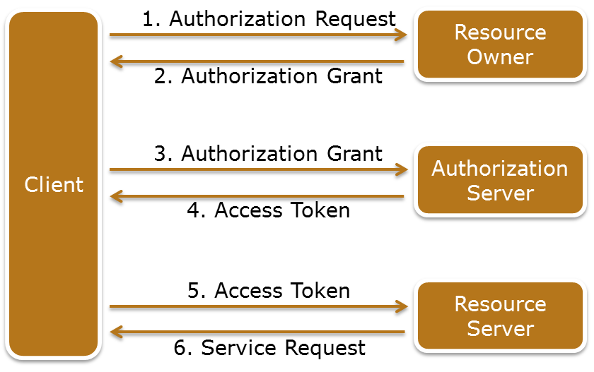
OAuth
OAuth
An open authorization mechanism allows a client to access protected resources from a resource server on behalf of a resource owner.
Entities involved in authorization:
Resource owner
Resource server
Client
Authorization server
Notes:
OAuth is an open authorization mechanism that allows a client to access protected resources from a resource server on behalf of a resource owner. There are four entities involved in the authorization mechanism: resource owner, resource server, client, and authorization server. A resource owner is an entity capable of granting access to a protected resource. A resource server is the compute system hosting the protected resources, capable of accepting and responding to protected resource requests using access tokens. A client is an application making protected resource requests on behalf of the resource owner with the resource owner’s authorization. An authorization server is the compute system issuing access tokens to the client after successfully authenticating the resource owner and obtaining authorization. The authorization server may be the same server as the resource server or a separate entity.
The figure on the slide illustrates the steps involved in OAuth process as described in Request for Comments (RFC) 6749 published by Internet Engineering Task Force (IETF):
The client requests authorization from the resource owner. The authorization request can be made directly to the resource owner, or indirectly via the authorization server.
The client receives an authorization grant, which is a credential representing the resource owner's authorization to access its protected resources. It is used by the client to obtain an access token. Access tokens are credentials used to access protected resources. An access token is a string representing an authorization issued to the client. The string is usually opaque to the client. Tokens represent specific scopes and durations of access, granted by the resource owner, and enforced by the resource server and authorization server.
The client requests an access token by authenticating with the authorization server and presenting the authorization grant.
(Cont'd)

Slide 26
OAuth
OAuth
An open authorization mechanism allows a client to access protected resources from a resource server on behalf of a resource owner.
Entities involved in authorization:
Resource owner
Resource server
Client
Authorization server
Notes:
The authorization server authenticates the client and validates the authorization grant, and if valid, issues an access token.
The client requests the protected resource from the resource server and authenticates by presenting the access token.
The resource server validates the access token, and if valid, serves the request.

Slide 27
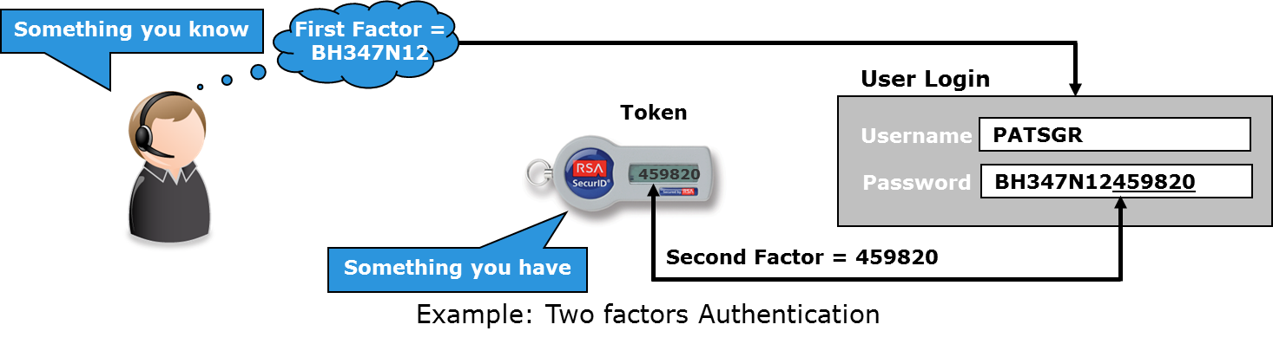
Multi-factor Authentication
Multiple factors for authentication:
First factor: What a user knows? For example, a password
Second factor: What the user has? For example, a token
Third factor: Who is the user? or What the user did? For example, a unique ID or user’s past activity
Access is granted only when all the factors are validated
Notes:
Multi-factor authentication uses more than one factor to authenticate a user. A commonly implemented two-factor authentication process requires the user to supply both something he or she knows (such as a password) and also something he or she has (such as a device). The second factor might also be a password generated by a physical device (known as token), which is in the user’s possession. The password generated by the token is valid for a pre-defined time. The token generates another password after the pre-defined time is over. To further enhance the authentication process, additional factors may also be considered. Examples of additional factors that may be used include unique ID number, and user’s past activity. A multi-factor authentication technique may be deployed using any combination of these factors. A user’s access to the environment is granted only when all the required factors are validated.

Slide 28
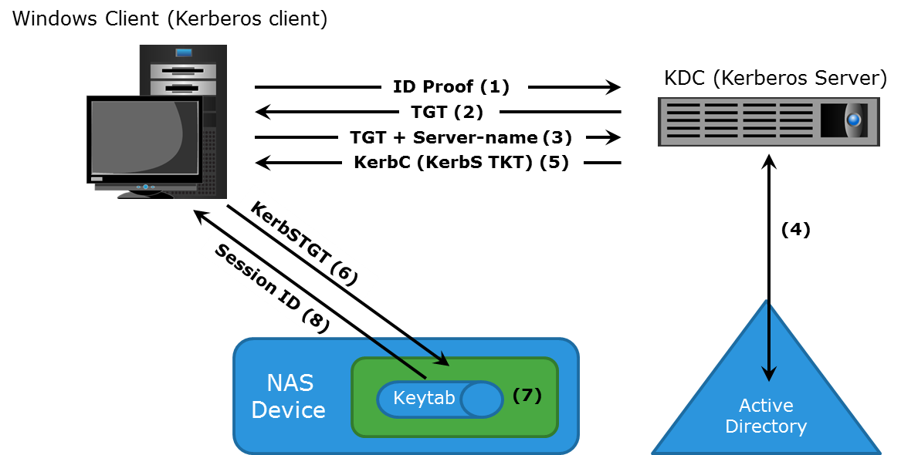
Kerberos
Kerberos
A network authentication protocol, which provides strong authentication for client/server applications by using secret-key cryptography. A client and server can prove their identity to each other across an insecure network connection.
Notes:
Kerberos is a network authentication protocol, which is designed to provide strong authentication for client/server applications by using secret-key cryptography. It uses cryptography so that a client and server can prove their identity to each other across an insecure network connection. After the client and server have proven their identities, they can choose to encrypt all their communications to ensure privacy and data integrity. In Kerberos, authentications occur between clients and servers. The client gets a ticket for a service and the server decrypts this ticket by using its secret key. Any entity, user, or compute system that gets a service ticket for a Kerberos service is called a Kerberos client. The term Kerberos server generally refers to the Key Distribution Center (KDC). The KDC implements the Authentication Service (AS) and the Ticket Granting Service (TGS). In Kerberos, users and servers for which a secret key is stored in the KDC database are known as principals. The KDC has a copy of every password associated with every principal, so it is absolutely vital that the KDC remain secure.
(Cont'd)

Slide 29
Kerberos
Kerberos
A network authentication protocol, which provides strong authentication for client/server applications by using secret-key cryptography. A client and server can prove their identity to each other across an insecure network connection.
Notes:
Consider an example of NAS environment in which Kerberos is primarily used when authenticating against a Microsoft Active Directory domain, although it can be used to execute security functions in UNIX environments.
The Kerberos authorization process includes the following steps:
The user logs on to the workstation in the AD domain using an ID and a password. The client computer sends a request to the AS running on the KDC for a Kerberos ticket. The KDC verifies the user’s login information from AD (step not shown in the figure).
The KDC responds with an encrypted Ticket Granting Ticket (TGT) and an encrypted session key. TGT has a limited validity period. TGT can be decrypted only by the KDC, and the client can decrypt only the session key.
When the client requests a service from a server, it sends a request, consisting of the previously generated TGT, encrypted with the session key and the resource information to the KDC.
The KDC checks the permissions in AD and ensures that the user is authorized to use that service.
The KDC returns a service ticket to the client. This service ticket contains fields addressed to the client and to the server hosting the service.
The client then sends the service ticket to the server that houses the required resources.
The server, in this case the NAS device, decrypts the server portion of the ticket and stores the information in a keytab file. As long as the client’s Kerberos ticket is valid, this authorization process does not need to be repeated. The server automatically allows the client to access the appropriate resources.
A client/server session is now established. The server returns a session ID to the client, which is used to track the client activity as long as the session is active.

Slide 30
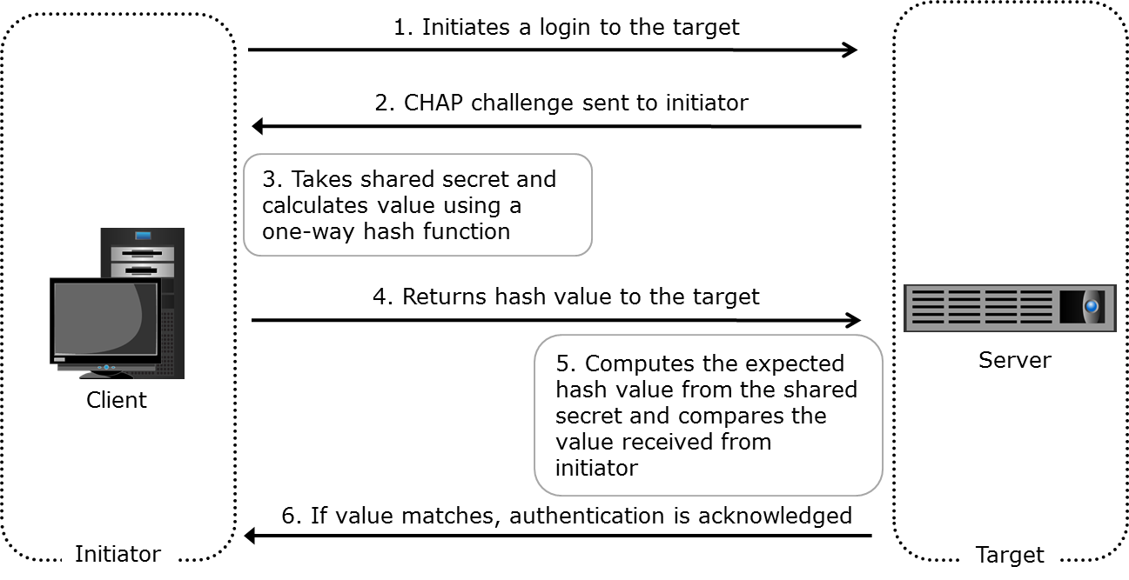
Challenge Handshake Authentication Protocol
Provides a method for initiators and targets to authenticate each other by utilizing a secret code
Notes:
The Challenge-Handshake Authentication Protocol (CHAP) is a basic authentication mechanism that has been widely adopted by network devices and compute systems. CHAP provides a method for initiators and targets to authenticate each other by utilizing a secret code or password. CHAP secrets are usually random secrets of 12 to 128 characters. The secret is never exchanged directly over the communication channel; rather, a one-way hash function converts it into a hash value, which is then exchanged. A hash function, using the MD5 algorithm, transforms data in such a way that the result is unique and cannot be changed back to its original form.
If the initiator requires reverse CHAP authentication, the initiator authenticates the target by using the same procedure. The CHAP secret must be configured on the initiator and the target. A CHAP entry, composed of the name of a node and the secret associated with the node, is maintained by the target and the initiator. The same steps are executed in a two-way CHAP authentication scenario.
After these steps are completed, the initiator authenticates the target. If both authentication steps succeed, then data access is allowed. CHAP is often used because it is a fairly simple protocol to implement and can be implemented across a number of disparate systems.

Slide 31
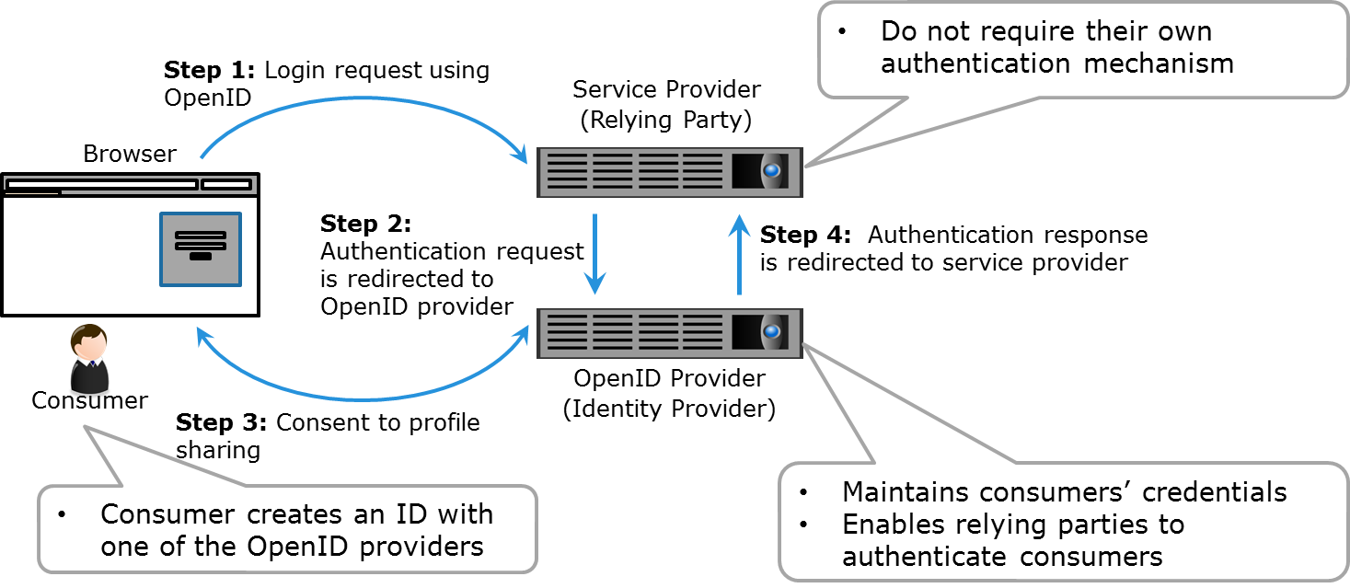
OpenID
OpenID
An open standard for authentication in which a service provider uses authentication services from an OpenID provider.
Notes:
OpenID is an open standard for authentication in which a service provider (known as the relying party) uses authentication services from an OpenID provider (known as the identity provider). An OpenID provider maintains consumers’ credentials on their authentication system and enables relying parties to authenticate consumers requesting the use of the relying party’s services (in this case, a cloud-based service). This eliminates the need for the relying party to deploy their own authentication systems. In the OpenID mechanism, a consumer creates an ID with one of the OpenID providers. This OpenID then can be used to sign-on to any provider (relying party) that accepts Open ID authentication.
The figure on the slide illustrates the OpenID concept by considering a consumer who requires services from the relying party. For the consumer to use the services provided by the relying party an identity (user ID and password) is required. The relying party does not provide their own authentication mechanism, however they support OpenID from one or more OpenID providers. The consumer can create an ID with the identity provider and then uses this ID with the relying party. The relying party, after receiving the login request, authenticates it with the help of identity provider and then grants access to the services.

Slide 32
Lesson Summary
During this lesson the following topics were covered:
Physical security
IAM concepts as given below:-
OAuth
Multi-factor authentication
Kerberos and CHAP
OpenID
Notes:
This lesson covered physical security, Windows ACLs, UNIX permissions, Oauth, multi-factor authentication, Kerberos, CHAP, and OpenID.

Slide 33
Lesson: Security Mechanisms – I
This lesson covers the following topics:
Role-based access control
Network monitoring and analysis
Firewall and intrusion detection and prevention system
Notes:
This lesson covers role-based access control, network monitoring and analysis, firewall, intrusion detection and prevention system, adaptive security, port binding and fabric binding, virtual private network, virtual LAN, virtual SAN, zoning, and iSNS discovery domain mechanisms deployed in a cloud environment.

Slide 34
Key Security Mechanisms -II
Role-based access control
Network monitoring and analysis
Firewall
Intrusion detection and prevention system
Data related security---
Data encryption
Data shredding

Slide 35
Role-based Access Control
An approach to restrict access to authorized users based on their respective roles
Only those privileges are assigned to a role that are required to perform tasks associated with that role
Separation of duties ensure that no single individual can both specify an action and carry it out
Notes:
Role-based access control (RBAC) is an approach to restricting access to authorized users based on their respective roles. A role may represent a job function, for example, a storage administrator. The only privileges assigned to the role are those required to perform the tasks associated with that role.
It is advisable to consider administrative controls, such as separation of duties, when defining data center security procedures. Clear separation of duties ensures that no single individual can both specify an action and carry it out. For example, the person who authorizes the creation of administrative accounts should not be the person who uses those accounts.

Slide 36
Network Monitoring and Analysis
A proactive measure to detect and prevent network failure or performance problems
Network monitoring can be performed in two ways:
Mechanisms used to monitor, detect, and prevent attacks are:
Firewalls, IDPS and network analysis/forensics systems
Monitoring | Description
Active | Monitoring tools transmit data between two endpoints that are monitored
Passive | Information about a link or device is collected by probing the link or device
Notes:
Monitoring and analyzing the network are important for the smooth and continuous operation of a cloud infrastructure. Network availability can be compromised by DoS attacks and network device failures. Proactive network monitoring and analysis can detect and prevent network failures or performance problems.
Network monitoring can be performed in two ways: active monitoring and passive monitoring. In active monitoring, the monitoring tools transmit data between the two endpoints that are monitored. The measurement includes parameters such as availability, delay, loss, and bandwidth. In passive monitoring, instead of transmitting data and then measuring, information about a link or device is collected by probing the link or device. As the data passes through the link or device, information is captured. This information is then used to analyze, detect, and troubleshoot any issues related to performance, availability, or security. Some of the mechanisms used to monitor, detect, and prevent attacks are firewalls, intrusion detection systems, intrusion prevention systems, and network analysis/forensics systems.

Slide 37
Firewall
Firewall
A security mechanism designed to examine data packets traversing a network and compare them to a set of filtering rules.
Can be deployed at:
Network level
Compute level
Hypervisor level
Can be physical or virtual
Uses various parameter for traffic filtering
Examples of filtering parameters:
Source address
Destination address
Port numbers and protocols
Notes:
A firewall is a security mechanism designed to examine data packets traversing a network and compare them to a set of filtering rules. Packets that are not authorized by a filtering rule are dropped and are not allowed to continue to the requested destination. A rule may use various filtering parameters such as source address, destination address, port numbers, and protocols. Some firewalls may support filtering parameters that enable packet inspection for content. These rules can be set for both incoming and outgoing traffic. The effectiveness of a firewall depends on how robustly and extensively the security rules are defined. Firewalls can be deployed at the network, compute system, and hypervisor levels.
A network-level firewall is typically used as first line of defense for restricting certain type of traffic from coming in and going out from a network. This type of firewall is typically deployed at the entry point of a cloud’s network.
At the compute system-level, a firewall application is installed as second line of defense in a defense-in-depth strategy. This type of firewall provides protection only to the compute system on which it is installed.
In a virtualized environment, there is the added complexity of virtual machines running on a smaller number of compute systems. When virtual machines on the same hypervisor communicate with each other over a virtual switch, a network-level firewall cannot filter this traffic. In such situations, a virtual firewall can be used to filter virtual machine traffic. A virtual firewall is a software appliance that runs on a hypervisor to provide traffic filtering service. Virtual firewalls give visibility and control over virtual machine traffic and enforce policies at the virtual machine level.
(Cont'd)

Slide 38
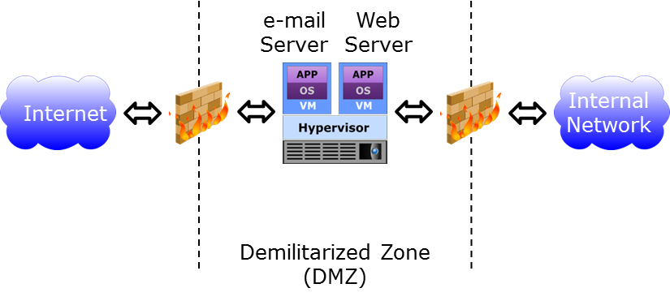
Firewall
Demilitarized Zone
Secure internal assets while allowing Internet-based access to resources
Notes:
Compute systems that are most vulnerable to attack are those that connect to an external network such as e-mail servers or web servers. These compute systems are exposed not only to the external network, but also require access to resources such as storage or end-user machines on the internal network. To reduce vulnerability, the exposed compute systems or virtual machines are placed in a demilitarized zone. A demilitarized zone is a mechanism to secure internal assets while allowing Internet-based access to selected resources. In a demilitarized zone environment, servers that need Internet access are placed between two sets of firewalls, as illustrated in the figure on the slide. The servers in the demilitarized zone may or may not be allowed to communicate with internal resources. Application-specific ports such as those designated for HTTP or FTP traffic are allowed through the firewall to the demilitarized zone servers. However, no Internet-based traffic is allowed to go through the second set of firewalls and gain access to the internal network.

Slide 39
Intrusion Detection and Prevention System
Intrusion Detection and Prevention System
A security tool that automates the process of detecting and preventing events that can compromise the confidentiality, integrity, or availability of IT resources.
Signature-based detection technique
Scans for signatures to detect an intrusion
Effective only for known threats
Anomaly-based detection technique
Scans and analyzes events to detect if they are statistically different from normal events
Has the ability to detect various events
Examples of events detected:
Multiple login failures
Excessive process failure
Excessive network bandwidth consumed by an activity
Notes:
Intrusion detection is the process of detecting events that can compromise the confidentiality, integrity, or availability of IT resources. An intrusion detection system (IDS) is a security tool that automates the detection process. An IDS generates alerts, in case, anomalous activity is detected. An intrusion prevention system (IPS) is a tool that has the capability to stop the events after they have been detected by the IDS. These two mechanisms usually work together and are generally referred to as intrusion detection and prevention system (IDPS). The key techniques used by an IDPS to identify intrusion in the environment are signature-based and anomaly-based detection.
In the signature-based detection technique, the IDPS relies on a database that contains known attack patterns, or signatures, and scans events against it. A signature can be an email with a specific subject or an email attachment with a specific file name that is known to contain a virus. This type of detection is effective only for known threats and is potentially circumvented if an attacker changes the signature (the email subject or the file name in the attachment, in this example). In the anomaly-based detection technique, the IDPS scans and analyzes events to determine whether they are statistically different from events normally occurring in the system. This technique can detect various events such as multiple login failures, excessive process failure, excessive network bandwidth consumed by an activity, or an unusual number of emails sent by a user, which could signify an attack is taking place.

Slide 40
Intrusion Detection and Prevention System
Types of implementations
IDPS Implementation | Description
Compute system-based | Analyzes activity such as system logs and running processes IDPS software is susceptible to attacks
Network-based | Monitors and analyzes network traffic, network devices, network protocol, and application protocol behavior Deployed in the form of appliance or software on compute system Usually isolated from malicious applications on compute systems
Hypervisor-based | Monitors for anomalies in a hypervisor Detection policies are typically kernel-specific
Notes:
The IDPS can be deployed at the compute system, network, or hypervisor levels. A compute system-based IDPS analyzes activity that includes system logs, running processes, application activities, file access and modification, and system and application configuration changes. Because IDPS software and malicious programs might be running on the same compute system, compute system-based IDPS is less isolated from attacks. In this scenario, the malicious program first attacks and disables IDPS and then carries out the main attack.
A network-based IDPS monitors network traffic and network devices. It also analyzes network and application protocols behavior for unusual activities. Network-based IDPS resides on the network in the form of an appliance or software installed on a dedicated compute system, and is usually isolated from malicious applications on the compute systems. After a network-based IDPS detects an anomaly, it stops the suspicious activity by dropping the packets or blocking ports. Since a network-based IDPS operates at the network level, it cannot monitor activities happening within the compute system.
A hypervisor-based IDPS is deployed at the hypervisor level. In this type of IDPS, detection policies are typically kernel-specific. Any anomaly detected in the kernel is immediately alerted or corrected depending on the specific IDPS configuration. Hypervisor-based IDPS is typically deployed in a cloud environment.

Slide 41
Lesson: Security Mechanisms – III
This lesson covers the following topics:
Data encryption
Data shredding
-Security controls
Notes:
This lesson covers security hypervisor and management server, virtual machine hardening, securing operating system and applications, LUN masking, data encryption, and data shredding mechanisms deployed in a cloud environment.

Slide 42
Data Encryption
Data Encryption
A cryptographic technique in which data is encoded and made indecipherable to eavesdroppers or hackers.
Enables securing data in-flight and at-rest
Provides protection from threats, such as data tampering, media theft, and sniffing attacks
Data encryption mechanism can be deployed at compute, network, and storage
Data should be encrypted as close to its origin as possible
Notes:
Data encryption is a cryptographic technique in which data is encoded and made indecipherable to eavesdroppers or hackers. Data encryption is one of the most important mechanisms for securing data in-flight and at-rest. Data in-flight refers to data that is being transferred over a network and data at-rest refers to data that is stored on a storage medium. Data encryption provides protection from threats such as tampering with data which violates data integrity, media theft which compromises data availability, and confidentiality and sniffing attacks which compromise confidentiality.
Data should be encrypted as close to its origin as possible. If it is not possible to perform encryption on the compute system, an encryption appliance can be used for encrypting data at the point of entry into the storage network. Encryption devices can be implemented on the fabric to encrypt data between the compute system and the storage media. These mechanisms can protect both the data at-rest on the destination device and data in-transit. Encryption can also be deployed at the storage-level, which can encrypt data-at-rest.
Another way to encrypt network traffic is to use cryptographic protocols such as Transport Layer Security (TLS) which is a successor to Secure Socket Layer (SSL). These are application layer protocols and provide an encrypted connection for client-server communication. These protocols are designed to prevent eavesdropping and tampering of data on the connection over which it is being transmitted.
Some cloud providers may perform data mining and analytics on consumers’ data so that they can offer new services to them based on their usage and nature of data. However, this may cause consumers to be concerned about the loss of confidentiality of their data, even if the cloud provider does not misuse the data. Therefore, a provider may offer data encryption capability to protect consumers’ data.

Slide 43
Data Shredding
Data Shredding
A process of deleting data or residual representations (sometimes called remanence) of data and making it unrecoverable
Techniques for shredding data stored on tapes:
Overwriting tapes with invalid data
Degaussing media
Destroying tapes
Techniques for shredding data stored on disks and flash drives:
Shredding algorithms
Shred all copies of data including backup and replicas
Notes:
Data shredding is the process of deleting data or residual representations (sometimes called remanence) of data and making it unrecoverable. Typically, when data is deleted, it is not made unrecoverable from the storage and an attacker may use specialized tools to recover it. The threat of unauthorized data recovery is greater in the cloud environment as consumers do not have control over cloud resources. After consumers discontinue the cloud service, their data or residual representations may still reside in the cloud infrastructure. An attacker may perform unauthorized recovery of consumers’ data to gain confidential information.
Cloud service providers can deploy data shredding mechanisms in the cloud infrastructure to protect from loss of confidentiality of consumers’ data. Data may be stored on disks or on tapes. Techniques to shred data stored on tape include overwriting it with invalid data, degaussing the media (a process of decreasing or eliminating the magnetic field), and physically destroying the tape. Data stored on disk or flash drives can be shredded by using algorithms that overwrite the disks several times with invalid data.
Cloud service providers may create multiple copies (backups and replicas) of consumer’s data at multiple locations as part of business continuity and disaster recovery strategy. Therefore, cloud service providers must deploy data shredding mechanism at all location to ensure that all the copies are shred.

Slide 44
Security Controls – Host Level
Threat outlook | High
Preventive controls | Host firewall, access control, patching, hardening of system, strong authentication
Detective controls | Security event logs, host-based IDS/IPS

Slide 45
Identity and Access management-Challenges and standards
1- Why IAM?
2- Challenges in IAM
3- IAM standards
4 –Securing virtual servers
5-Securing virtual servers

Slide 46
Module: Identity and Access Management
Upon completion of this module, you should be able to:
Describe trust boundaries and IAM
Discuss IAM challenges
Describe IAM standards and protocols for cloud services

Slide 47
Why IAM ?
Accelerates adoption of new cloud services and migration of IT applications from trusted corporate networks into a trusted cloud service model.
Improves operational efficiency
Regulatory compliance management
Enables new IT delivery and deployment models (cloud services)
Enables enterprises and CSP to bridge security domains through web single sign-on and federated user provisioning

Slide 48
IAM Challenges
Managing access for diverse user populations (employees, contractors, partners, etc.) accessing internal and externally hosted services
Turnover of users within the organization
Access policies for information are seldom centrally and consistently applied
Initiatives to improve IAM can span several years and incur considerable cost

Slide 49
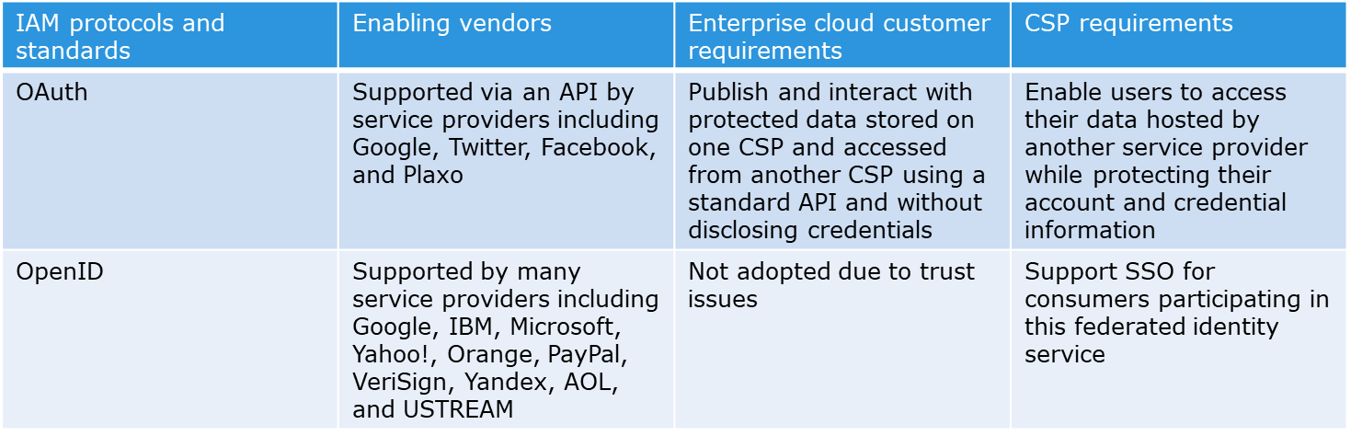
IAM Standards and Protocols

Slide 50
Securing Virtual Servers
Do not allow password-based authentication for shell access.
Run a host firewall and open only ports necessary to support the services on an instance.
Run only the required services and turn off the unused services (e.g., turn off FTP, print services, network file services, and database services if they are not required).
Install a host-based IDS such as OSSEC or Samhain.
Enable system auditing, event logging and log the security events to a dedicated log server. Isolate the log server with higher security protection, including accessing controls

Slide 51
RSA algorithm

Slide 55
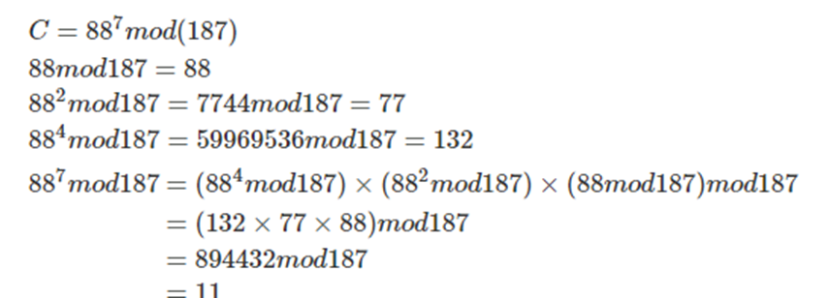
encryption process

Slide 56
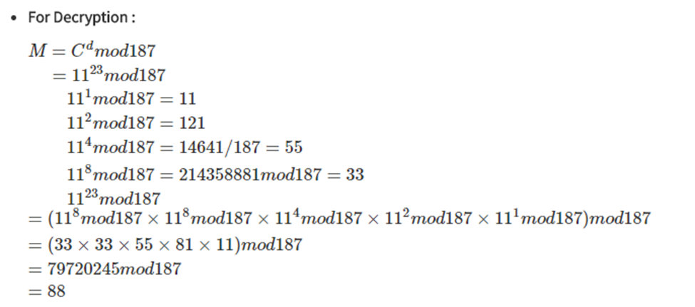
decryption process

Slide 57
AES Algorithm

Slide 59
Advantages of AES

Slide 60
Disadvantages of AES

Slide 61
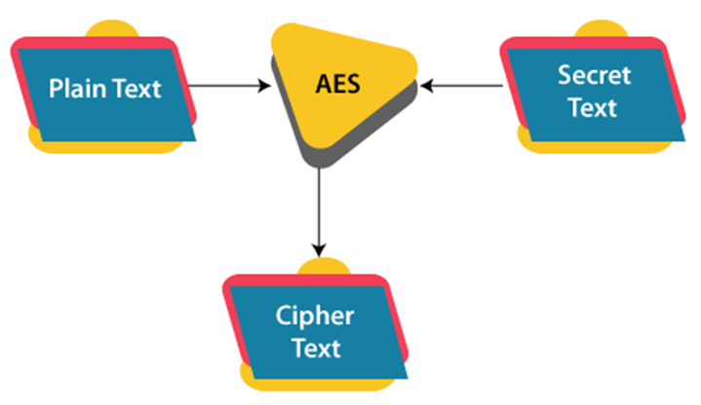

Slide 62
AES is a block cipher.
The key size can be 128/192/256 bits.
Encrypts data in blocks of 128 bits each.
That means it takes 128 bits as input and outputs 128 bits of encrypted cipher text as output. AES relies on substitution-permutation network principle which means it is performed using a series of linked operations which involves replacing and shuffling of the input data.

Slide 63
ES performs operations on bytes of data rather than in bits. Since the block size is 128 bits, the cipher processes 128 bits (or 16 bytes) of the input data at a time.
The number of rounds depends on the key length as follows :
128 bit key – 10 rounds
192 bit key – 12 rounds
256 bit key – 14 rounds
Creation of Round keys :
A Key Schedule algorithm is used to calculate all the round keys from the key. So the initial key is used to create many different round keys which will be used in the corresponding round of the encryption.

Slide 64
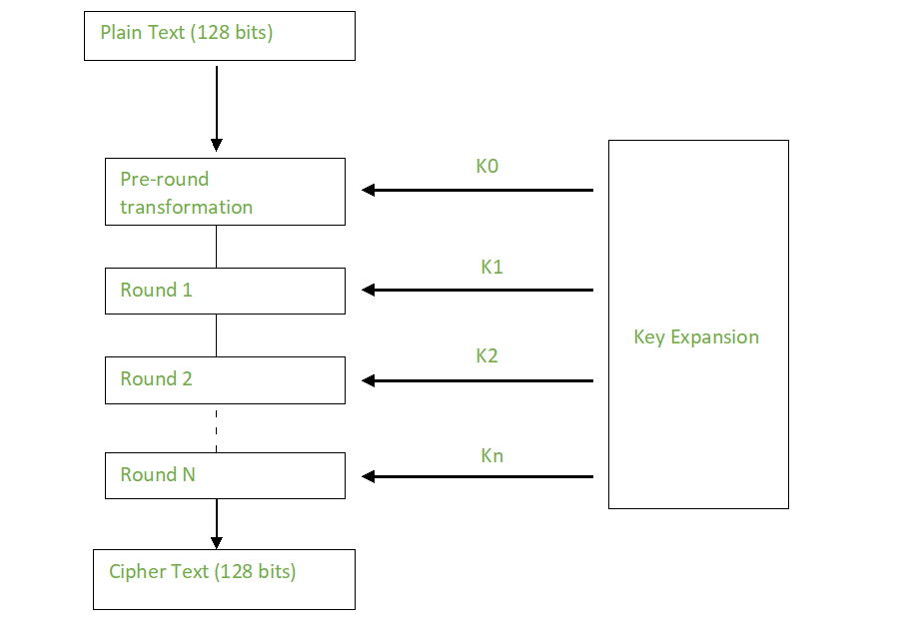

Slide 65
A Key Schedule algorithm is used to calculate all the round keys from the key. So the initial key is used to create many different round keys which will be used in the corresponding round of the encryption.

Slide 66
AES considers each block as a 16 byte (4 byte x 4 byte = 128 ) grid in a column major arrangement.
[ b0 | b4 | b8 | b12 |
| b1 | b5 | b9 | b13 |
| b2 | b6 | b10| b14 |
| b3 | b7 | b11| b15 ]

Slide 67
Each round comprises of 4 steps :
SubBytes
ShiftRows
MixColumns
Add Round Key
The last round doesn’t have the MixColumns round.

Slide 68
SubBytes :
This step implements the substitution.
In this step each byte is substituted by another byte. Its performed using a lookup table also called the S-box. This substitution is done in a way that a byte is never substituted by itself and also not substituted by another byte which is a compliment of the current byte. The result of this step is a 16 byte (4 x 4 ) matrix like before.

Slide 69
ShiftRows :
This step is just as it sounds. Each row is shifted a particular number of times.
The first row is not shifted
The second row is shifted once to the left.
The third row is shifted twice to the left.
The fourth row is shifted thrice to the left.

Slide 70
left circular shift is performed.)
[ b0 | b1 | b2 | b3 ] [ b0 | b1 | b2 | b3 ]
| b4 | b5 | b6 | b7 | -> | b5 | b6 | b7 | b4 |
| b8 | b9 | b10 | b11 | | b10 | b11 | b8 | b9 |
[ b12 | b13 | b14 | b15 ] [ b15 | b12 | b13 | b14 ]

Slide 71
MixColumns :
This step is basically a matrix multiplication. Each column is multiplied with a specific matrix and thus the position of each byte in the column is changed as a result.
This step is skipped in the last round.
[ c0 ] [ 2 3 1 1 ] [ b0 ]
| c1 | = | 1 2 3 1 | | b1 |
| c2 | | 1 1 2 3 | | b2 |
[ c3 ] [ 3 1 1 2 ] [ b3 ]

Slide 72
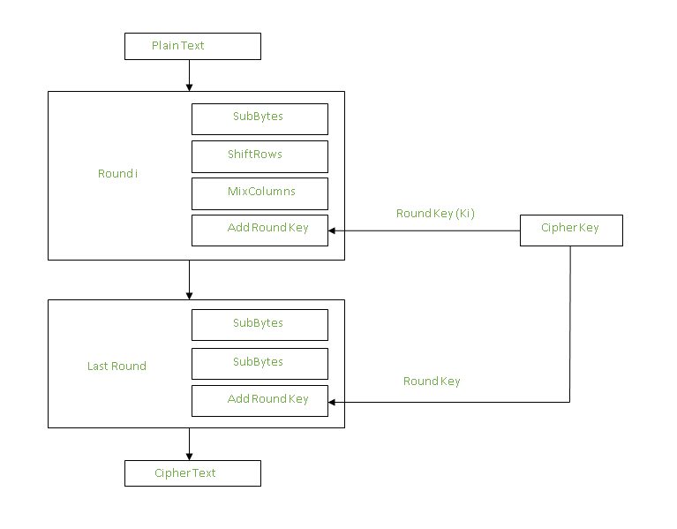
Add round keys

Slide 73
After all these rounds 128 bits of encrypted data is given back as output. This process is repeated until all the data to be encrypted undergoes this process.

Slide 74
Decryption
Decryption :
The stages in the rounds can be easily undone as these stages have an opposite to it which when performed reverts the changes.Each 128 blocks goes through the 10,12 or 14 rounds depending on the key size.
The stages of each round in decryption is as follows :
Add round key
Inverse MixColumns
ShiftRows
Inverse SubByte

Slide 75
Inverse MixColumns :
This step is similar to the MixColumns step in encryption, but differs in the matrix used to carry out the operation.
[ b0 ] [ 14 11 13 9 ] [ c0 ]
| b1 | = | 9 14 11 13 | | c1 |
| b2 | | 13 9 14 11 | | c2 |
[ b3 ] [ 11 13 9 14 ] [ c3 ]
Inverse SubBytes :
Inverse S-box is used as a lookup table and using which the bytes are substituted during decryption.

Slide 76
Applications:
AES is widely used in many applications which require secure data storage and transmission. Some common use cases include:
Wireless security: AES is used in securing wireless networks, such as Wi-Fi networks, to ensure data confidentiality and prevent unauthorized access.
Database Encryption: AES can be applied to encrypt sensitive data stored in databases. This helps protect personal information, financial records, and other confidential data from unauthorized access in case of a data breach.
Secure communications: AES is widely used in protocols like such as internet communications, email, instant messaging, and voice/video calls.It ensures that the data remains confidential.
Data storage: AES is used to encrypt sensitive data stored on hard drives, USB drives, and other storage media, protecting it from unauthorized access in case of loss or theft.
Virtual Private Networks (VPNs): AES is commonly used in VPN protocols to secure the communication between a user’s device and a remote server. It ensures that data sent and received through the VPN remains private and cannot be deciphered by eavesdroppers.

Slide 77
URL
https://www.geeksforgeeks.org/advanced-encryption-standard-aes/

Slide 78
THANK YOU

