Slide 1
Introduction to Python
A readable, dynamic, pleasant, flexible, fast, and powerful language
Strongly and Dynamically typed, high-level, interpreted language
Easy to learn, beginner friendly
Multi-purpose(Web, GUI, Scripting, etc)
OOPS Concept

Slide 2
Which platforms uses Python
Google
NASA
Dropbox
IBM
Instagram
Mozilla
Yahoo
Quora
Reddit
Red Hat
Git hub
Cisco, etc

Slide 3
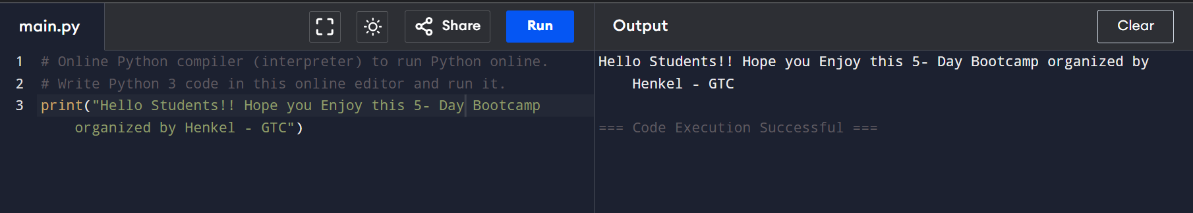
First Program
Comments
Single-line comment: #Comment
Multi-line comment: “””Comment”””
To print a message on screen
We must save the file as filename.py
Print(“Hello World!!”)
print() is used to display output.

Slide 4
Indentation
Most programming languages does not care about indentation.
Python uses indentation as a fundamental part of its syntax to denote blocks of code.
Incorrect or inconsistent indentation will lead to IndentationError or TabError exceptions, preventing the code from running.
Pretty printer

Slide 5
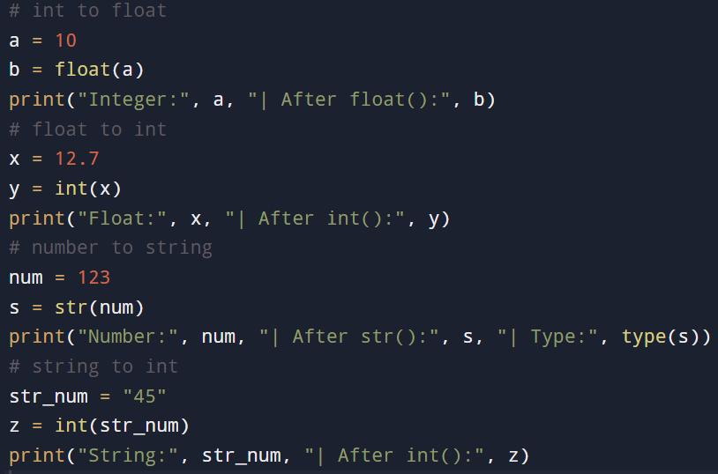
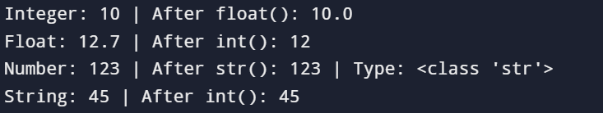
Type Casting
Typecasting means converting one data type into another.

Slide 6
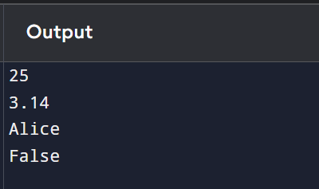
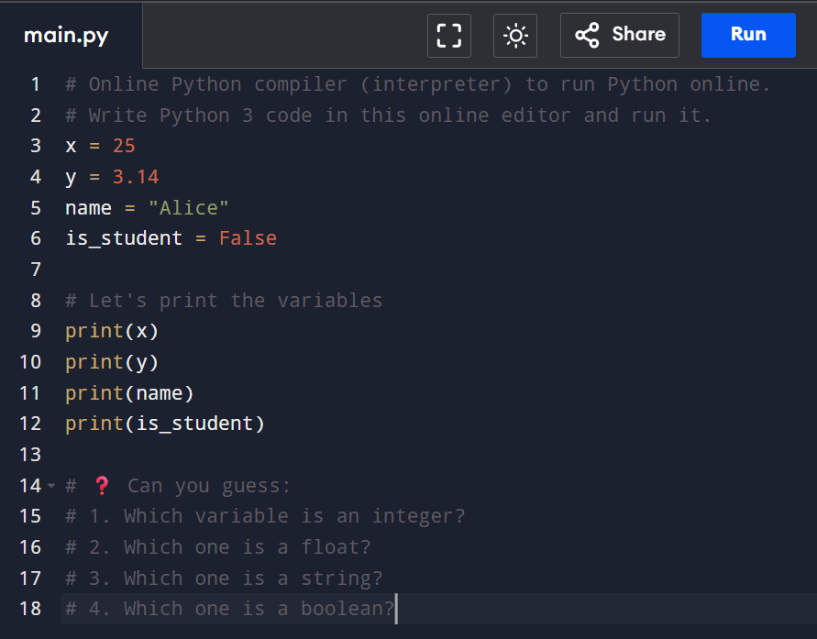
Variables and Data Types
Python is a case-sensitive language
Variables are reserved memory locations that stores value.
Variables are examples of identifiers. Identifiers is the name given to identify something.
Data Types
Int, float, String, bool

Slide 7
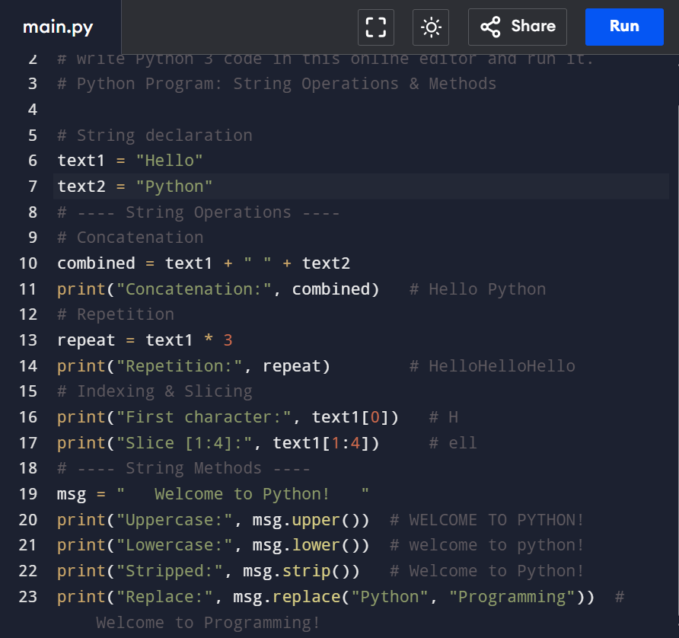
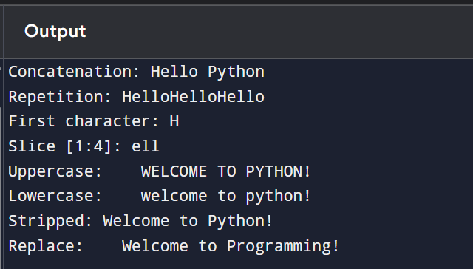
Strings
Strings are text inside quotes.
A method is like a function that belongs to an object (in this case, a string) - upper(), lower(), strip(), replace()
Operations on strings – Concatenation, multiplication (or string repetition), and slicing

Slide 8
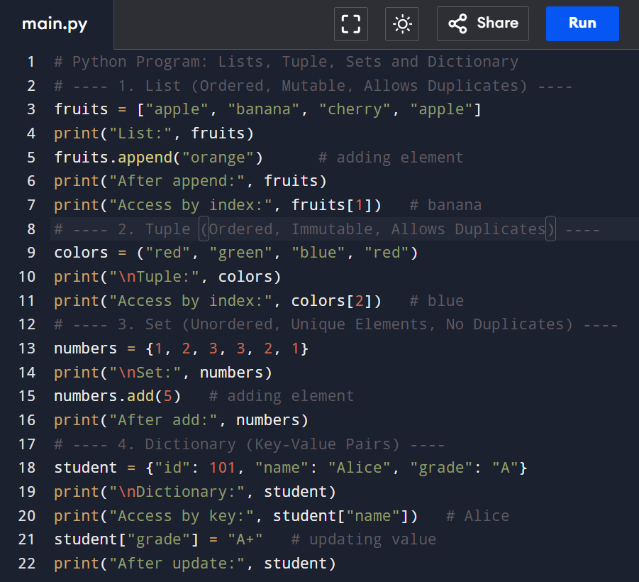
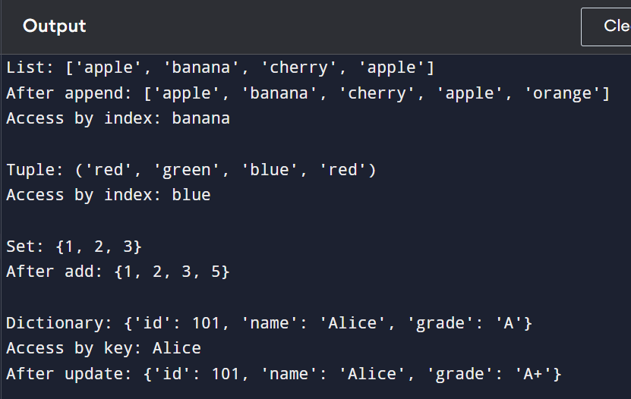
Other Data Types – Lists, Tuple, Sets and Dictionary
Lists: ordered, mutable collection, EG: fruits = ['apple’, 'banana']
Tuple: ordered, immutable collection, EG: t = (1,2,3)
Sets: Unordered, unique values, EG: s = {1,2,2,3}
Dictionary: Key-value pairs, EG: student = {'name':'Ana','age':20}

Slide 9
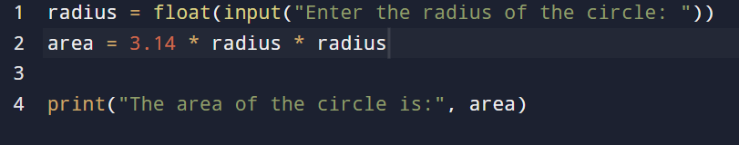

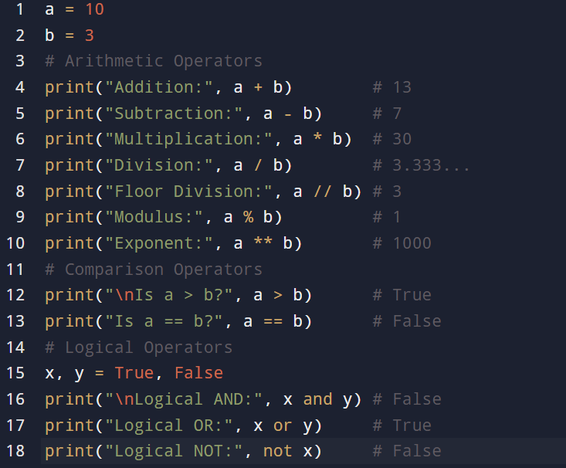
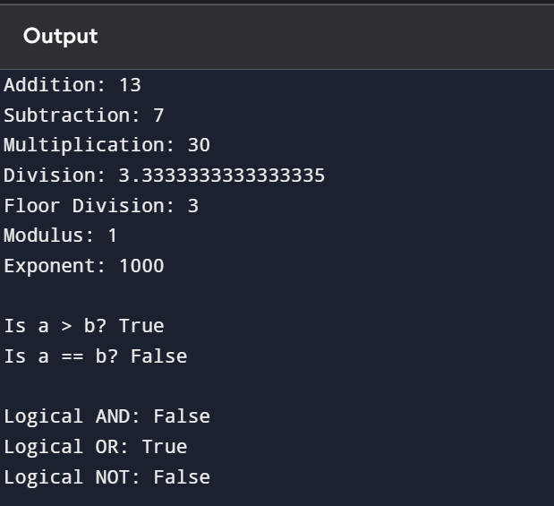
Q: Write a program to calculate the area of circle
Operators:
Basic Operators: +, -, *, /, %, **, //

Slide 10
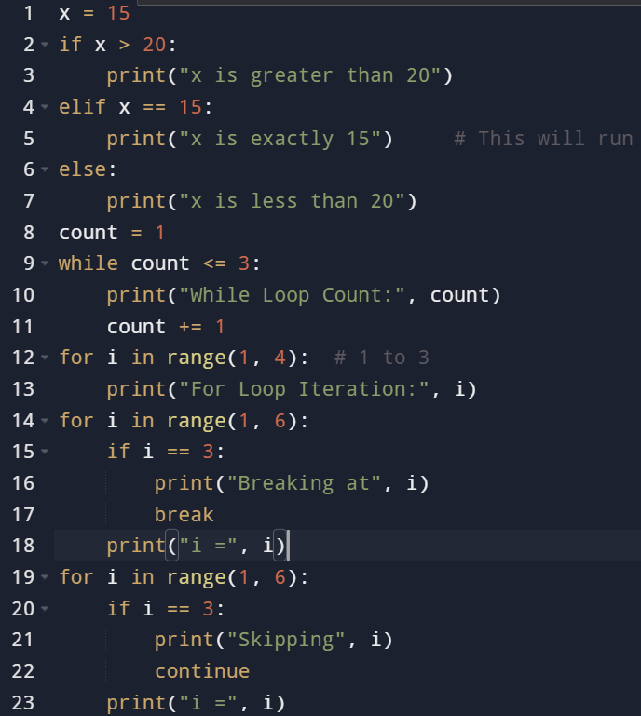
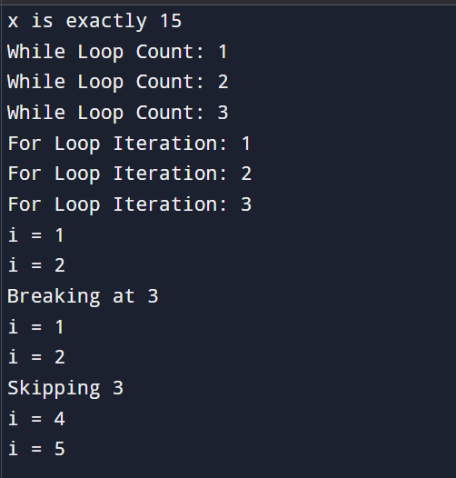
Decision Control Statements
Selection/conditional branching statements: If, if-else, if-else-if
Basic loop structures/iterative statements: while, for
Break
Continue

Slide 11
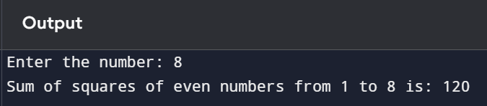
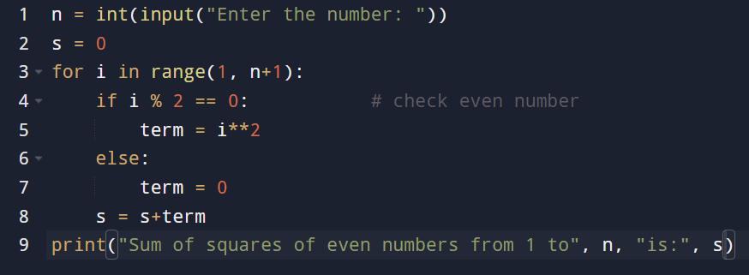
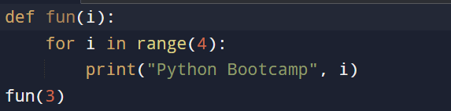
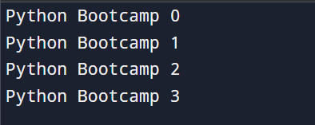
Q: Write a program to sum the squares of even numbers
Functions
Reusable code blocks.
Function definition:
Function call:

Slide 12
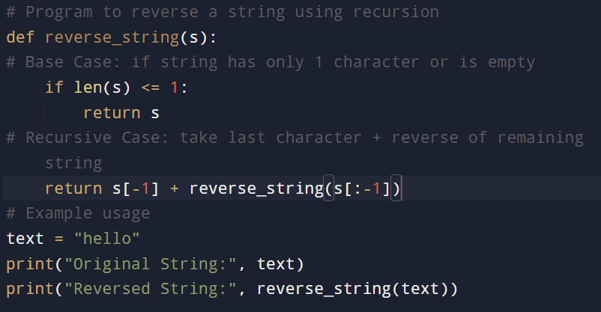

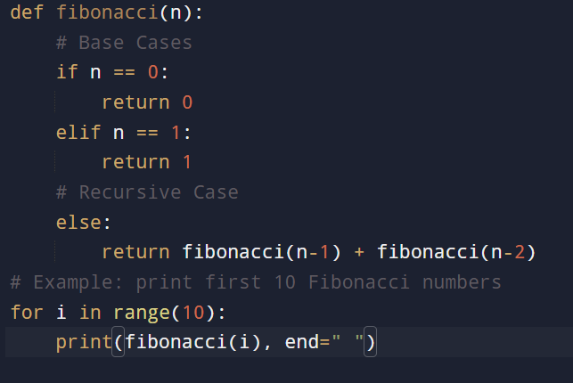

Recursion
Function that calls itself to solve a smaller version of its task.
Base case
Recursive case
Q: Write a program to print the Fibonacci series using recursion:

Slide 13
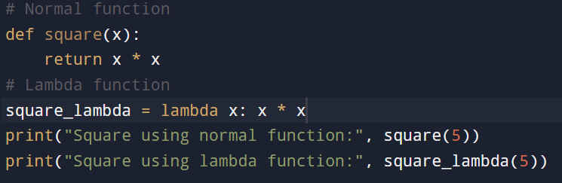

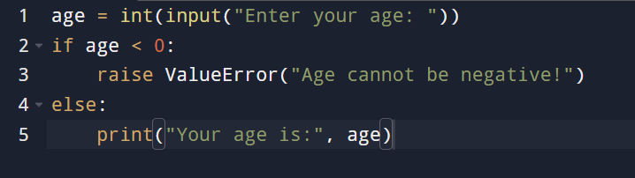
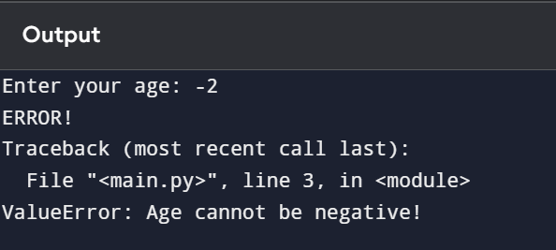
Lamda Function
A lambda function is a small anonymous function (without a name).
It can have any number of arguments but only one expression.
Syntax- lambda arguments: expression
Error Handling or Exception Handling
Error handling allows you to deal with runtime errors (like dividing by zero, invalid input, or file not found) without crashing your program.
Python uses try – except – finally
Division by zero
Handling Multiple errors
Custom errors

Slide 14
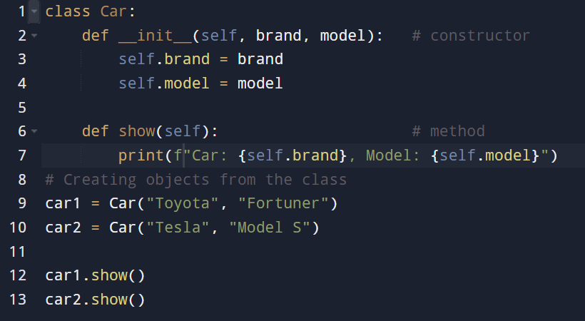

OOPS
OOP helps us organize code into objects (real-world entities) using classes. The 4 main pillars of OOP are:
Encapsulation – Binding data (variables) and methods (functions) together in a class.
Abstraction – Hiding implementation details and showing only essential features.
Inheritance – One class can inherit properties & methods of another class.
Polymorphism – Same method name can behave differently for different objects.
A class is a template or blueprint for creating objects, it defines attributes(variables) and methods(functions) that its objects will have.
An object is a real-world instance of class. If class is a blueprint, then an object is the actual product built from it.

Slide 15
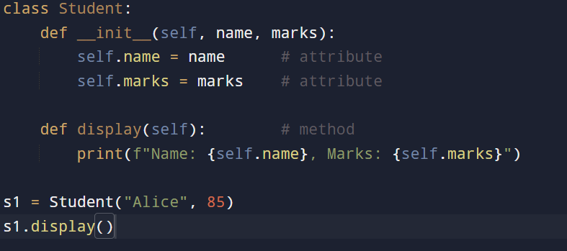

Encapsulation
wrapping data & methods inside a class.
Data (name, marks) and method (display) are encapsulated inside class.

Slide 16
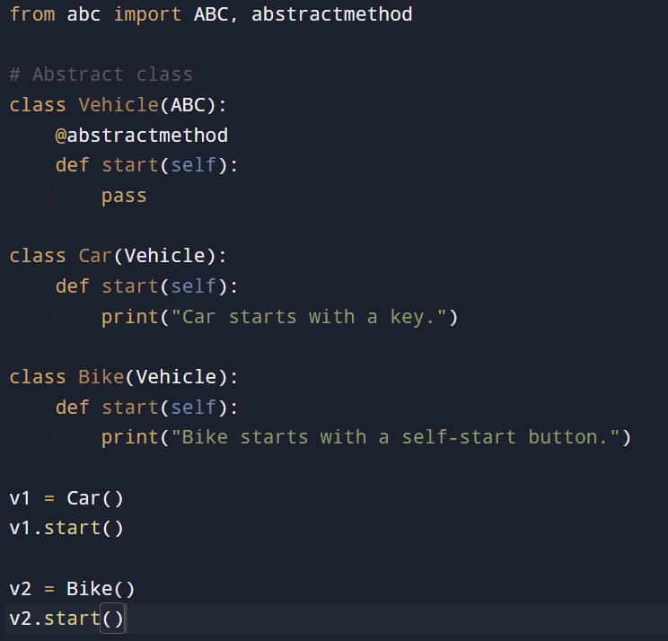

Abstraction
hiding implementation details (via abstract classes).
abc – abstract base class module
ABC – used to define an abstract class
Vehicle() – abstract class, method start() is abstract – it has no body, only pass. It means we cannot create an object of vehicle directly.
Any subclass must provide its own version of start, but it can inherit.

Slide 17
Inheritance
Inheritance allows a class (child/derived class) to acquire properties and methods from another class (parent/base class).
It promotes code reusability.
Child class can use parent’s features and also override or extend them.
Types of Inheritance in Python
Single Inheritance → One child inherits from one parent. Parent → Child.
Multiple Inheritance → One child inherits from more than one parent. Child inherits from multiple parents.
Multilevel Inheritance → A class inherits from a child class (grandparent → parent → child). Grandparent → Parent → Child.
Hierarchical Inheritance → Multiple children inherit from the same parent. One parent, many children.
Hybrid Inheritance → Combination of above types. Combination of above.

Slide 18
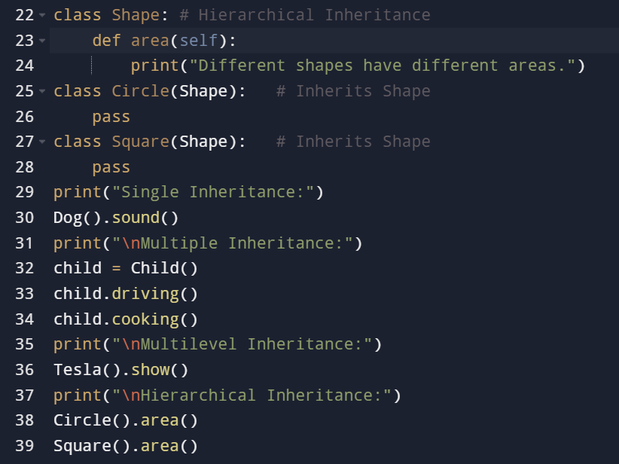
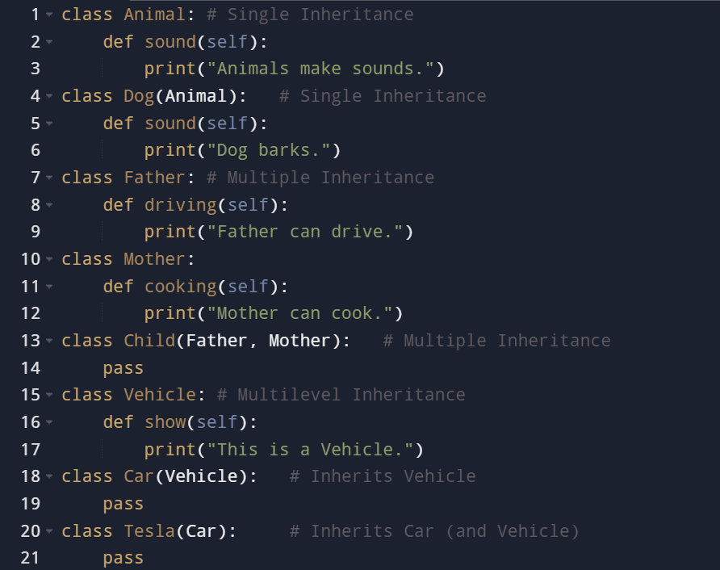
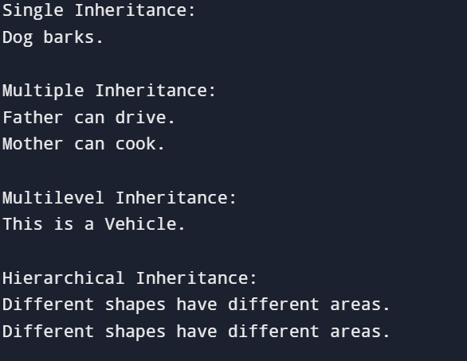

Slide 19
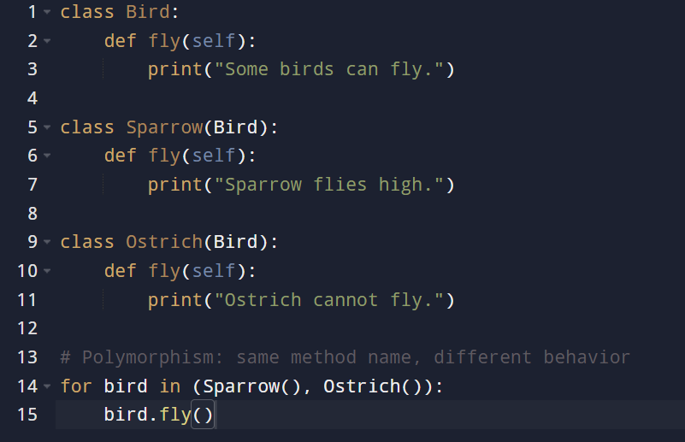

Polymorphism
same method, different behavior.
Fly() behaves differently depending on the object.

Slide 20
File Handling
A file is a collection of data stored on a secondary storage device like hard disk.
Types of file:
ASCII text files – a stream of characters that can be sequentially processed in a forward direction.
Binary files – a file which may contain any type of data
File operations
Open() method – using with keyword and close() method
write() and writelines() methods
append() method
read() and readline() method
rename() method
remove() method
split() method

Slide 21
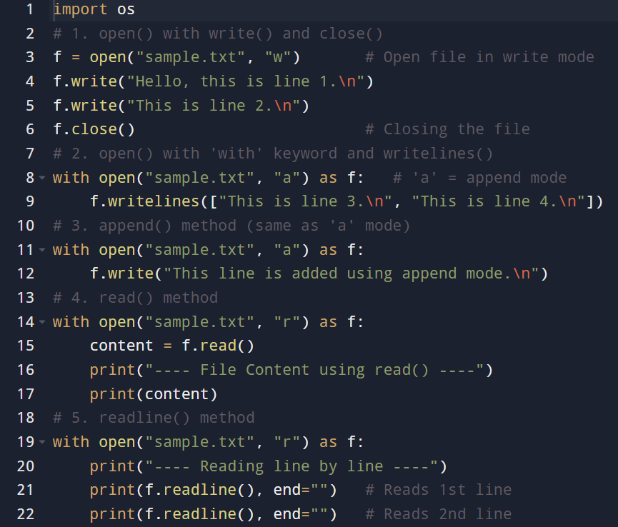
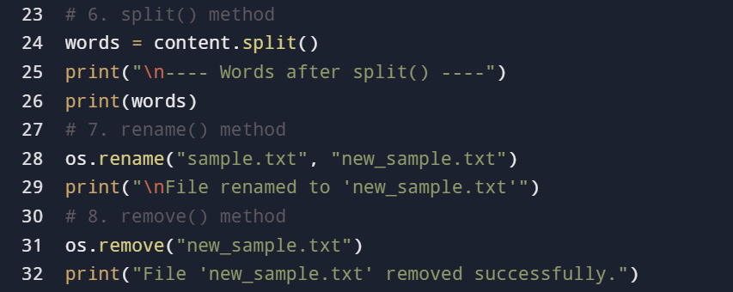

Slide 22
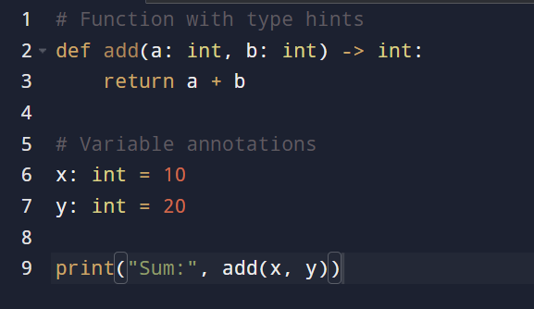
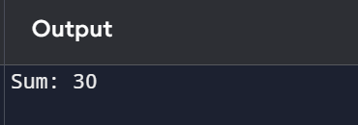
Type Hints
Type hints (introduced in Python 3.5) allow you to specify the expected data types of variables, function arguments, and return values. They don’t enforce types at runtime (Python is still dynamically typed), but they help with:
Readability (easy to understand the code)
Debugging (catch mistakes early with tools like mypy)
IDE support (auto-suggestions, error highlighting)
Syntax:
def function_name(parameter: datatype) -> return_type:

Slide 23
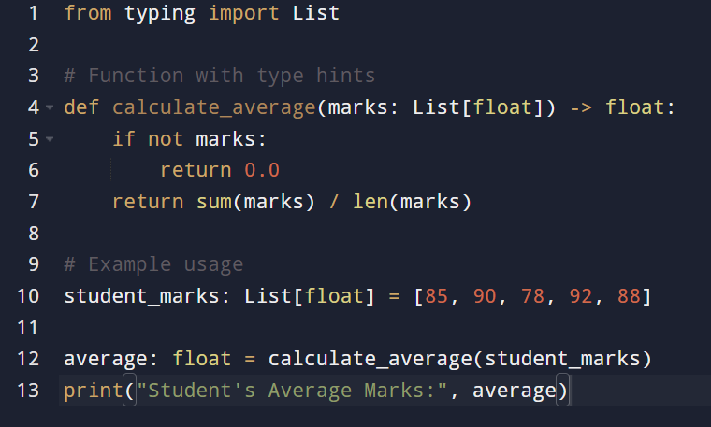
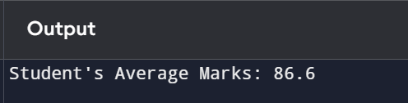
Q: Write a Python program using type hints to calculate the average marks of a student.
Use a function calculate_average that accepts a list of marks (integers or floats) and returns a float value.

Slide 24
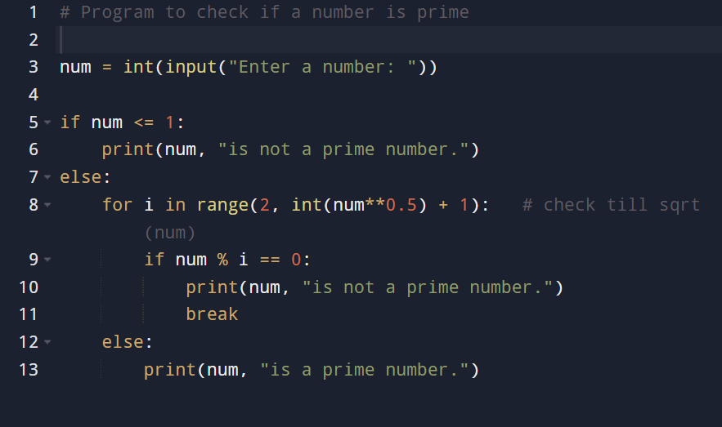

Q: Write a python program to check prime number

Slide 25
THANKYOU

