Slide 1


Department of Electronics and Communication Engineering
FAKE NEWS DETECTION
NAME | USN
MANSI DANDIN | 02FE21BEC049
HRISHIKESH KAMAT | 02FE21BEC039
KUSHAL HIREMATH | 02FE21BEC038
PRAJWAL HALGI | 02FE21BEC059

Slide 2
Problem Statement
DETECTING THE NEWS WHETHER IT IS TRUE OR FALSE.

Slide 3
Introduction
Fake news can be a result of misinformation, or it can be an intentional attempt to intentionally mislead people. Now it has become harder and harder to recognize whether the news is legitimate news from fake news as social media has grown a lot.
At the same time identifying and rectifying fake news is a significant concern for any news organization, so here comes machine learning, which can help in doing so.

Slide 4
BLOCK DIAGRAM
Data collection
Data pre-processing
Word embedding
RNN Algorithm
Training the data
Detection
Evaluation
Deployment
Continuous Monitoring

Slide 5
EXPLANATION :
Data collection:- Collect news articles as datasets.
Data pre-processing:- Removing the tags and text symbols which are not necessary.
Word embedding:- Convert required collection into numerical values to specify the dataset.
RNN:- Apply the Recurrent Neural Network Algorithm to train model.
Training:- Splitting up the datasets and validating.
Evaluation:- Working on the final procedure.
Deployment:- Adjusting the parameters with satisfaction model’s performance.
Continuous Monitoring:- Keep track of new data collection when it becomes available.

Slide 6
SI NO | TITLE | OBJECTIVE | Methods/Techniques/Algorithm used | Limitations /Disadvantages
1. | A smart System for Fake News Detection Using Machine Learning | The primary objective is to combat the spread of fake news on social media platforms. Leveraging machine learning and natural language processing techniques to analyze and categorize news content as either real or fake. | Data Aggregation Support Vector Machine Model Comparison | Data Quality Dependency on Features Scalability
2. | FAKE DETECTOR: Effective Fake News Detection with Deep Diffusive Neural Network | objective is to investigate and understand the principles, methodologies, and algorithms for detecting fake news. | Deep Diffusive Network Model Performance Evaluation Feature Extraction | Dependence on Textual Information Scope of Evaluation
3. | Fake News Detection Using Recurrent Neural Networks | The study aims to leverage deep learning (DL) and natural language processing (NLP) methods for categorizing texts based on their content, with a particular focus on the use of distributed representations of words and Recurrent Neural Networks (RNNs) for text classification tasks | Evaluation of Classification Performance Comparison with Other Architectures | Model Complexity Context Understanding

Slide 7
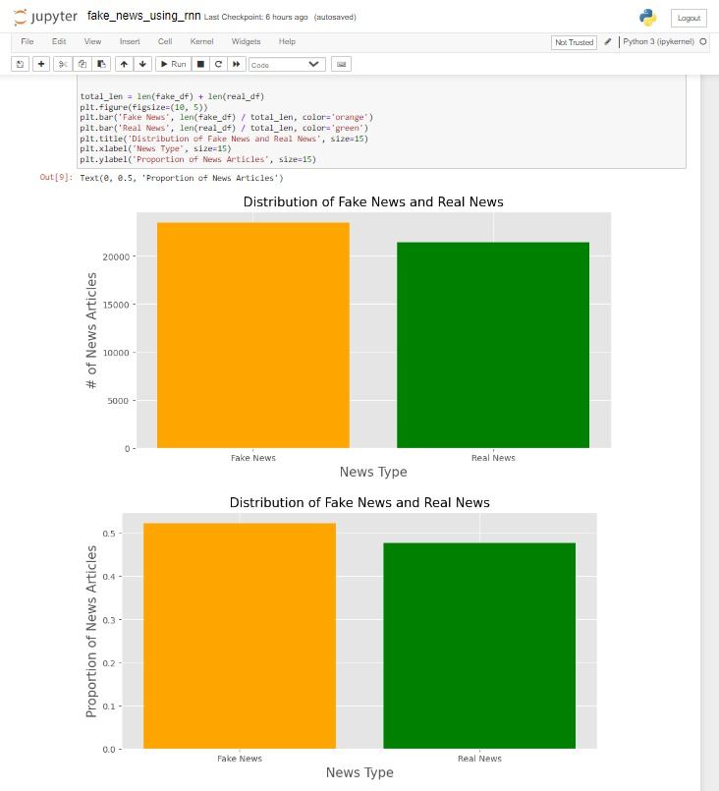
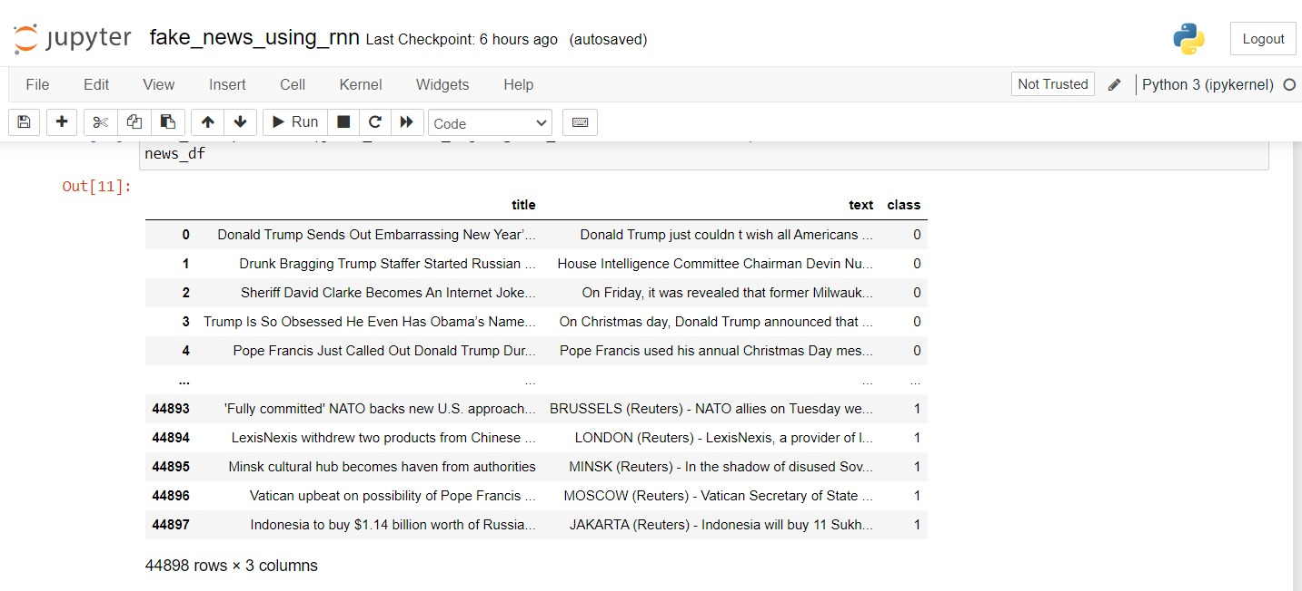
RESULTS:

Slide 8
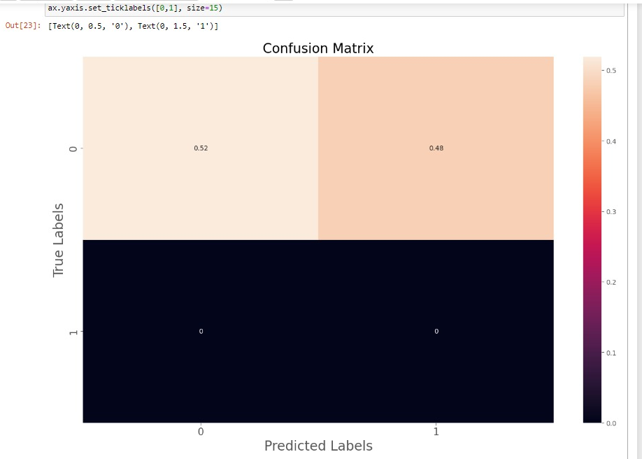
RESULT:

Slide 9
References for survey:
https://www.researchgate.net/publication/339022255
Jiawei Zhang1 , Bowen Dong2 , Philip S. Yu2 1 IFM Lab, Department of Computer Science, Florida State University, FL, USA 2BDSC Lab, Department of Computer Science, University of Illinois at Chicago, IL, USA jzhang@ifmlab.org, {bdong, psyu}@uic.edu
Guilherme Zanini Moreira1 , Marcelo Romero2 , Manasses Ribeiro ´ 1 1Catarinense Federal Institute of Education, Science and Technology, Videira, Brazil 2Universite de Lorraine, CNRS, CRAN, F-54000 Nancy, France ´ gzaninimoreira@gmail.com, nmarceloromero@gmail.com, manasses.ribeiro@ifc.edu.br.

Slide 10
GitHub Link
https://github.com/Rishikeshkamat18/-Group_1_Machine-learning

Slide 11
Thank You

