Slide 1


Title: Web Scraping and Exploratory Data Analysis of Eazy Dinner Restaurant Finder

Slide 2
About Us:
We K.Chandu Goud and S.Rishikesh reddy B.Tech graduate passionate about Data Analytics and Visualization.
Exploring data-driven insights through real-world datasets.
Interested in web data extraction and business trend analysis.
LINKEDIN(Chandu): https://www.linkedin.com/in/k-chandu-goud-32482a29a/
GITHUB: https://github.com/chandu63012
LINKEDIN(Rishikesh): https://www.linkedin.com/in/rishikesh-reddy-3013a5233
GITHUB: https://github.com/rishikeshreddy1405/Workco.git

Slide 3


Introduction:
Eazy Dinner is an online restaurant discovery platform that provides details such as Restaurant names, Cuisines, Ratings,Price,Offers and Locations.
This project focuses on web scraping data from the EazyDiner website (Hyderabad) using Python (BeautifulSoup, Requests, Pandas) to collect, clean, and analyze restaurant information.
The main goal is to extract structured data to identify popular cuisines, top-rated restaurants, and dining trends across Hyderabad.
This end-to-end project highlights the use of data automation and analysis for real-world insights in the food industry.
Additionally, it demonstrates how web scraping simplifies data collection from large dynamic websites.
The project serves as a foundation for future visualization and trend analysis using Power BI or Tableau.

Slide 4

Business Problem:
Restaurant information on EazyDiner is unstructured and spread across multiple web pages, making manual data collection time-consuming.
No direct access to a consolidated dataset for analyzing restaurant ratings, cuisines, or location-based trends.
Difficulty in comparing restaurants across areas due to inconsistent or incomplete online data formats.
Lack of automated tools to extract and update restaurant insights regularly for analytics or visualization purposes.

Slide 5
Objectives:
Extract structured restaurant data (Name, Cuisine, Rating,Offers,Prices and location) from the EazyDiner website using Python-based web scraping.
Clean and preprocess the collected data to ensure consistency, accuracy, and usability for analysis.
Analyze restaurant trends to identify popular cuisines, highly rated areas, and dining patterns in Hyderabad.
Build a foundation for future visualization and interactive dashboards using tools like Power BI or Tableau.
Automate data extraction and updates to enable continuous monitoring of restaurant performance and emerging food trends.

Slide 6
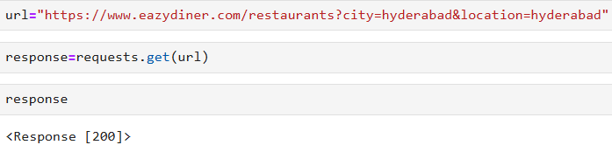
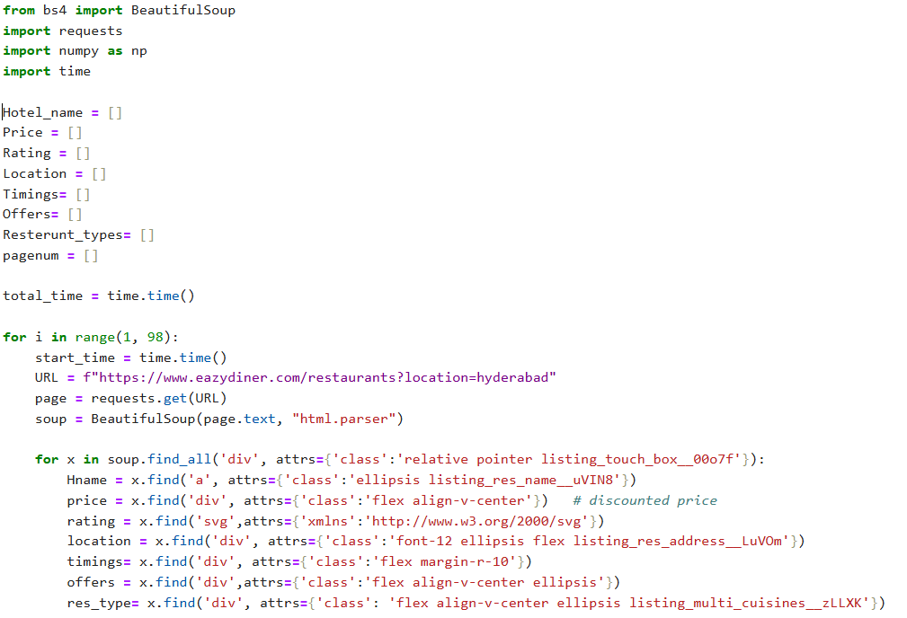
Web Scraping:
EazyDiner’s Official website was selected as the main data source for restaurants information in Hyderabad.
Used browser developer tools(inspect Element) to identify relevant HTML elements containing restaurant names,cuisine,ratings,price,offers and location
Used BeautifulSoup and Requests libraries in python to extract structured restaurants data from the web pages.
Sent automated HTTP requests to retrieve multiple restaurant listings across different pages.
Cleaned and consolidated the scraped data into a structured dataset for further analysis and visualization.

Slide 7






Tools Used:

Slide 8

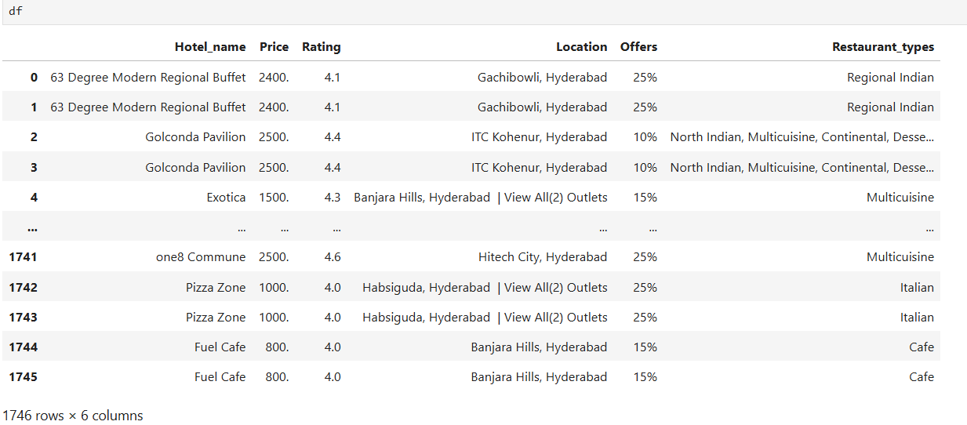
Data Cleaning Steps:
Removed Unwanted Characters & Formatting:
Cleaned restaurant names, cuisines, and location fields by removing special symbols, extra spaces, and inconsistent text formats to ensure uniformity.
Handled Missing & Incomplete Values:
Replaced null or missing entries in rating and cuisine columns with suitable defaults or “Not Available” to maintain data integrity and avoid errors during analysis.
Data Type Conversion & Standardization:
Converted rating columns from string/object type to numeric (float) for accurate statistical analysis and visualization. Ensured consistent text casing for categorical fields like cuisine and city.
Verified Location & Structured Dataset:
Cross-checked location and address information for accuracy, formatted city names properly, and stored the cleaned output into a structured DataFrame and CSV for further analysis.

Slide 9
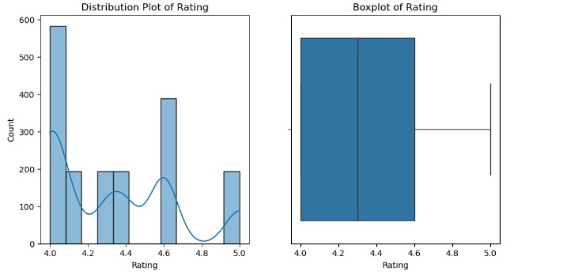
Data Visualization:
Uni-Variate Analysis
The distribution plot shows most restaurants have ratings between 4.0 and 4.7, indicating generally high customer satisfaction on the platform.
The KDE curve shows multiple small peaks, suggesting slight variation in rating popularity, but still concentrated around the higher range.
The boxplot confirms a high median rating, with a small interquartile range, meaning most restaurants consistently receive good ratings.
There are few outliers near the upper end (~5.0), indicating only a limited number of exceptionally high-rated restaurants.

Slide 10
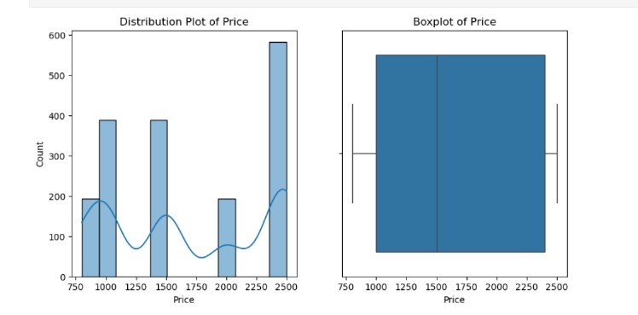
Data Visualization:
The distribution plot shows that restaurant prices mostly fall between ₹1,000 and ₹2,500, indicating a mix of mid-range to premium dining options.
Multiple peaks in the KDE curve suggest varied pricing clusters, showing presence of both budget and premium restaurants.
The boxplot confirms a wide price range, with the median price leaned toward the higher side, meaning many restaurants are moderately expensive.
The whiskers show few extreme values, indicating limited outliers and that most prices lie within a consistent and expected range.

Slide 11
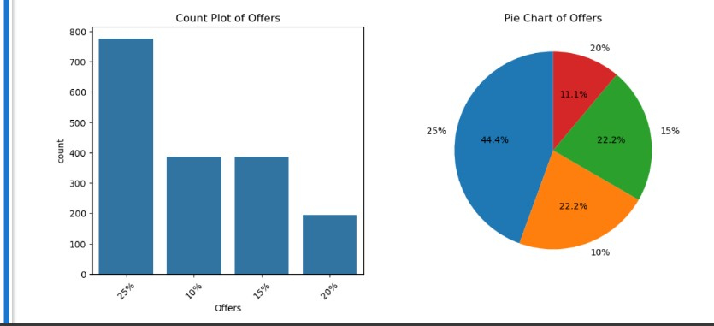
Data Visualization:
The count plot shows that 25% offers are the most common, followed by 10% and 15%, while 20% offers are the least frequent rating trend on EazyDiner.
The pie chart confirms this trend visually, with 25% offers making up the largest share and 20% offers contributing the smallest portion.
The distribution suggests that restaurants tend to provide higher discount rates (25%) more frequently to attract customers.
The variety of offer percentages indicates a competitive pricing and discount strategy among restaurants to drive customer traffic.

Slide 12
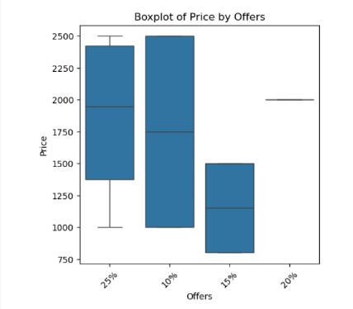
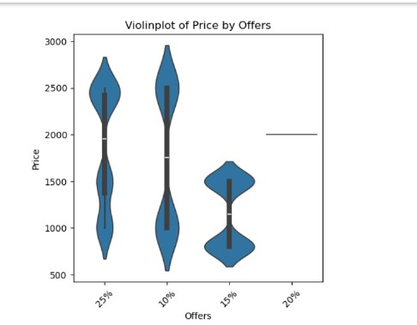
Data Visualization:
Bi-Variate Analysis
These visualizations compare restaurant price ranges across different offer percentages (25%, 10%, 15%, and 20%).
The boxplot highlights the median, inter-quartile range, and outliers, showing price variation within each offer category.
The violin plot provides a deeper view of data distribution and density, showing how frequently certain price points appear within each offer level.
Restaurants with 25% and 10% offers have higher price ranges, indicating premium restaurants tend to offer attractive discounts.
The 15% and 20% offer groups show lower and narrower price ranges, suggesting more budget-friendly restaurants offer smaller, consistent discounts.

Slide 13
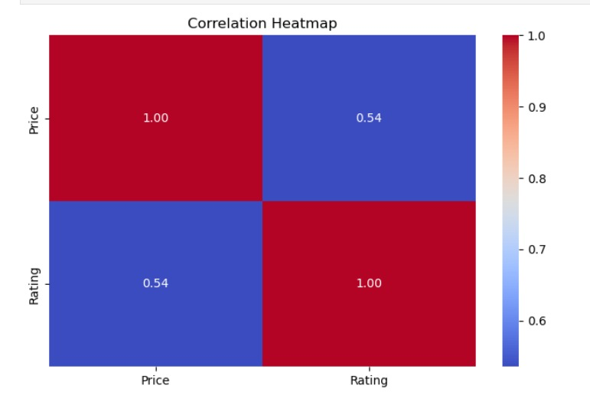
Data Visualization:
This heatmap shows the correlation between restaurant price level and customer ratings..
The diagonal values are 1.00, representing perfect self-correlation of each variable.
The correlation value of 0.54 between price and rating indicates a moderate positive relationship.
This suggests that higher-priced restaurants tend to receive better ratings, although the relationship is not very strong.
The heatmap uses color intensity to clearly show the strength of correlation — red for strong positive correlation and blue for weaker relationships.

Slide 14
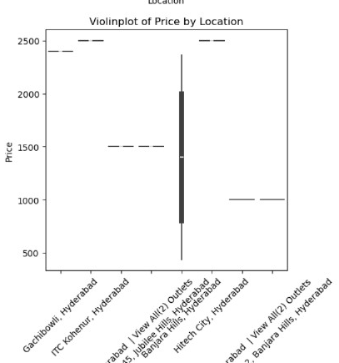
Data Visualization:
This violin plot compares restaurant price ranges across different locations in Hyderabad.
Locations like Gachibowli, ITC Kohenur, and Jubilee Hills show higher price ranges, indicating premium dining zones.
Areas such as Hitech City and Banjara Hills show a broader spread, meaning a mix of budget and high-end restaurants.
The distribution reveals that restaurant pricing varies significantly by locality, showing how location influences dining cost and target customer group.

Slide 15
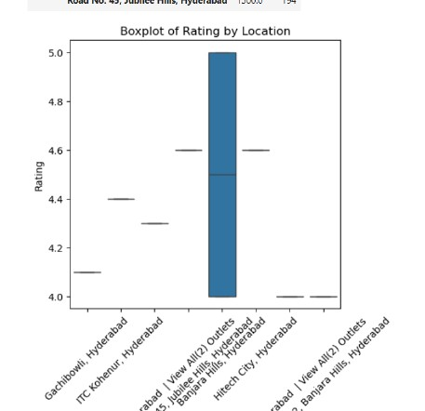
Data Visualization:
This boxplot compares restaurant ratings across different locations in Hyderabad.
Locations such as Banjara Hills and Jubilee Hills show higher median ratings, indicating strong customer satisfaction in premium areas.
Some locations like Gachibowli and Hitech City display a wider spread in ratings, meaning a mix of both average-rated and high-rated restaurants.
The presence of consistent higher ratings in top areas suggests these locations offer better service quality and dining experience.
Lower variation in ratings for certain areas reflects consistent performance, while higher variation indicates diverse restaurant quality levels within that locality.

Slide 16
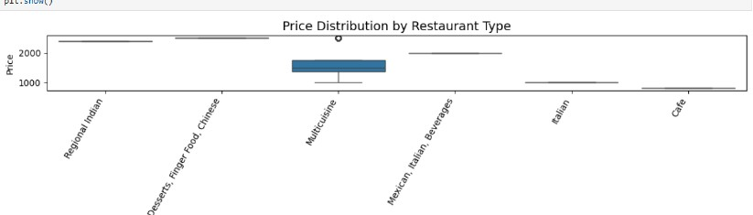
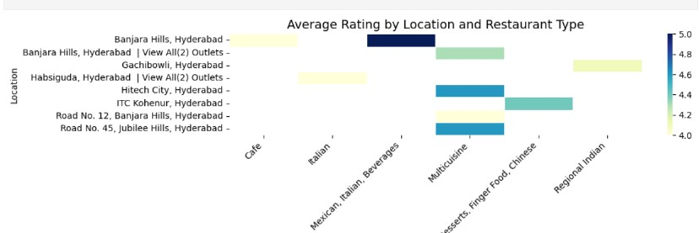
Data Visualization:
Multi-Variate Analysis
The boxplot shows that restaurant pricing varies significantly by restaurant type — with Regional Indian, Chinese, and Desserts/Finger Food restaurants having higher price ranges, while Cafes and Italian outlets tend to be more budget-friendly.
Multicuisine restaurants show a wider spread in price, indicating the presence of both mid-range and premium dining options in this category.
The heatmap highlights that premium areas like Banjara Hills, Jubilee Hills, and Gachibowli consistently achieve higher average ratings, especially for Multicuisine and International-style restaurants.
The combined view suggests that location and restaurant type together influence pricing and ratings, with upscale areas showing higher-priced and better-rated restaurants.

Slide 17
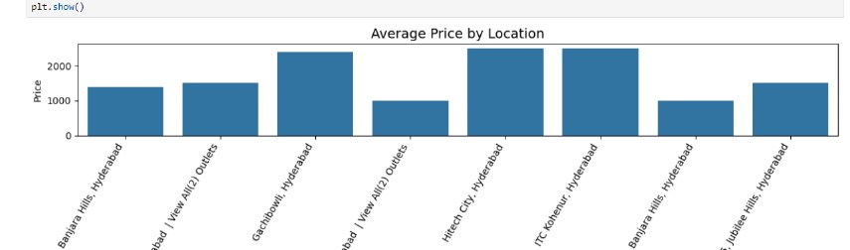
Data Visualization:
The chart shows how average restaurant pricing varies across key locations in Hyderabad, highlighting differences in dining affordability.
Premium areas like Gachibowli, Hitech City, and ITC Kohenur have the highest average prices, indicating a strong presence of upscale restaurants.
Locations like Banjara Hills and Jubilee Hills show moderately high prices, reflecting a mix of luxury and mid-range dining options.
Areas with lower average prices suggest more budget-friendly restaurants, catering to a wider audience and casual dining crowd.

Slide 18
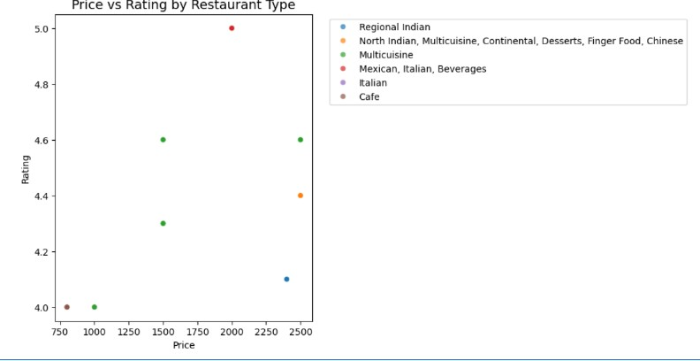
Data Visualization:
This scatter plot compares restaurant pricing with customer ratings across different cuisine/restaurant types.
Higher-priced categories like Multicuisine and International (Mexican/Italian/Beverages) tend to show higher ratings, indicating premium dining often aligns with better customer satisfaction.
Some budget-friendly segments like Cafes and Regional Indian outlets have lower price points with moderate ratings, showing affordability but mixed experiences.
The spread reflects that while higher price generally correlates with better ratings, quality varies by cuisine type, and customer preferences differ across restaurant segments.

Slide 19
Key Business Questions
Which areas in Hyderabad have the most restaurants?
What are the most popular cuisines?
Which locations have the highest-rated restaurants?
How are restaurant ratings distributed across the city?
Do certain cuisines receive higher ratings consistently?

Slide 20
Conclusion:
Successfully scraped restaurant data from the Eazy Diner platform using Python & Beautiful Soup.
Performed data cleaning and formatting to convert raw HTML data into a structured dataset.
Conducted analysis on top locations, cuisines, and restaurant ratings across Hyderabad.
Observed that Banjara Hills, Jubilee Hills, and Gachibowli have the highest restaurant concentration and top ratings.
Identified North Indian, Chinese, and Multicuisine as the most preferred cuisines among users.
This project demonstrates a complete data workflow: Web Scraping → Data Cleaning → Exploratory Analysis → Visualization and highlights how web data can support real-world business insights.

Slide 21
Q&A

Slide 22
Experience– Web Scraping & Data Analysis:
Scraped restaurant data from EazyDiner.com using Python, BeautifulSoup, and Requests.
Extracted key information including restaurant names, cuisines, locations, and ratings from multiple pages.
Cleaned and standardized data by removing noisy characters, handling missing values, and formatting columns for consistency.
Performed exploratory data analysis to identify top restaurant zones, popular cuisines, and rating patterns in Hyderabad.
Completed end-to-end workflow: Scraping → Cleaning → Analysis → Visualization → Insights Presentation.

Slide 23
Challenges – Web Scraping & Data Analysis:
Dynamic and inconsistent HTML structure across restaurant pages
Extracting complete details for each restaurant (name, cuisine, location, rating)
Handling missing, duplicated, and unclean text data
Managing pagination and avoiding request restrictions during scraping
Selecting clear and meaningful visualizations to highlight insights

Slide 24


