Slide 1

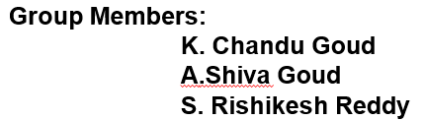

Telangana Weather Data Analysis

Slide 2
Agenda
Project Overview
Data Source
Data preparation
Dashboard Visualizations
Applications & Recommendations
Conclusion & Q&A

Slide 3
Project Overview
Average & Total Rainfall (mm)
This project focuses on analyzing Telangana’s weather conditions using Power BI to derive actionable insights from multi-year meteorological data.
The analysis covers rainfall, temperature, humidity, and wind speed across 33 districts from 2021–2024.
The objective is to track weather trends, identify anomalies, and compare climatic patterns across districts and time periods for informed environmental planning and agricultural forecasting.
Key metrics visualized include:
Average & Total Rainfall (mm)
Average Temperature (°C) and Temperature Range
Average Humidity (%) and Humidity Range
Wind Speed (Kmph) and Trend Analysis

Slide 4
Data Source
The dataset includes Telangana district-level weather records obtained from meteorological repositories.
Key columns include:
District, Mandal, Year, Month, Quarter, Rainfall (mm), Max/Min Temp (°C), Max/Min Humidity (%), Max/Min Wind Speed (Kmph)
Data cleaning involved:
Removing missing/null values
Formatting date and time attributes
Ensuring consistent measurement units
This refined dataset was used to generate district- and year-level KPIs and dynamic visuals.

Slide 5
Data preparation
Data preparation and modeling were performed in Power BI using Power Query and DAX:
Created calculated columns for Average Rainfall, Temperature Range, Humidity Range, and Wind Speed Range.
Established relationships between Year, District, and Weather Metrics tables.
Applied transformations for seasonal and quarterly analysis.
Built measures for Trend Analysis, Sum of Metrics, and Average Calculations.
Enabled drill-through, slicers, and interactive filters for detailed district comparisons.

Slide 6
Dashboard Visualizations
Developed 7 interactive dashboards, each highlighting a different weather aspect:
Average of Rain Dashboard – Yearly rainfall anomalies and district comparisons.
Comprehensive Insights Dashboard – Combined overview of rainfall, temperature, humidity, and wind speed.
Humidity Insights Dashboards (1 & 2) – Quarterly and district-level humidity variation and trend tracking.
Rainfall Analysis Dashboard – District rainfall distribution by year and mandal-level contribution.
Rainfall Values Dashboard – Geographic rainfall mapping and annual trends.
Temperature Insights Dashboard – Yearly and monthly temperature fluctuations across districts.
Wind Speed Insights Dashboard – Wind speed range and trends with district-wise breakdowns.

Slide 7
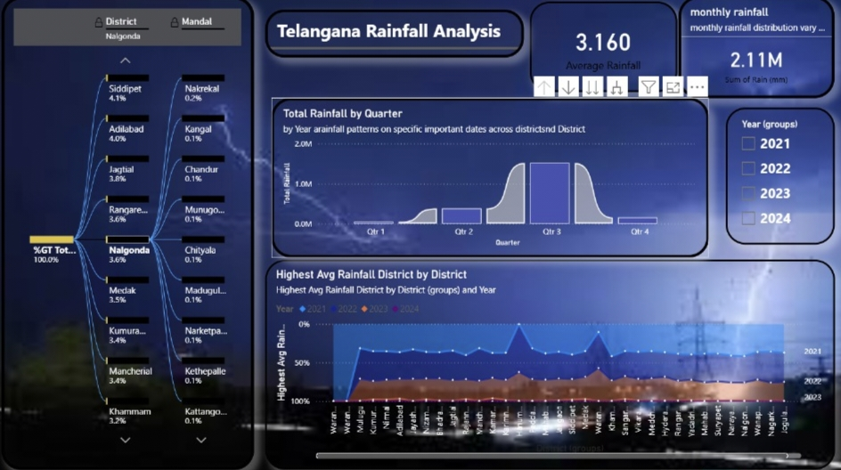

Slide 8
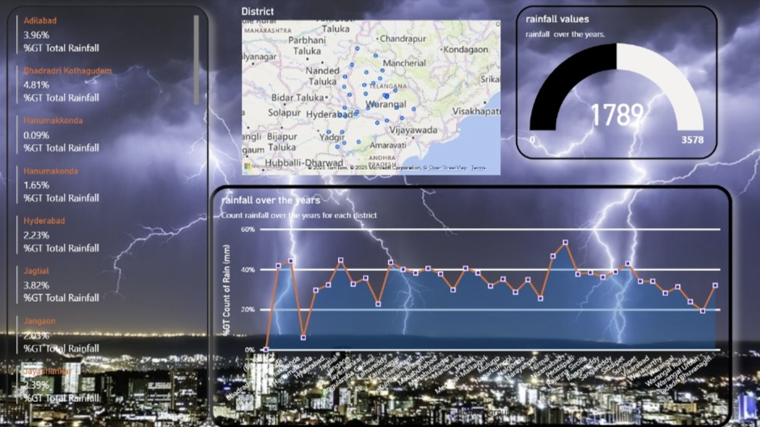

Slide 9
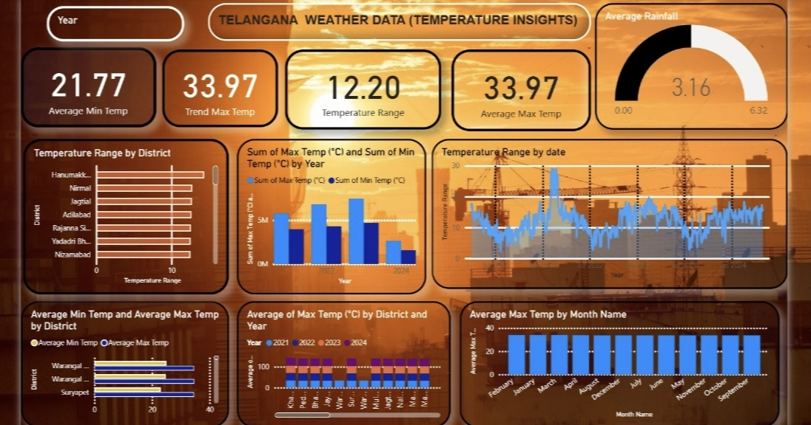

Slide 10
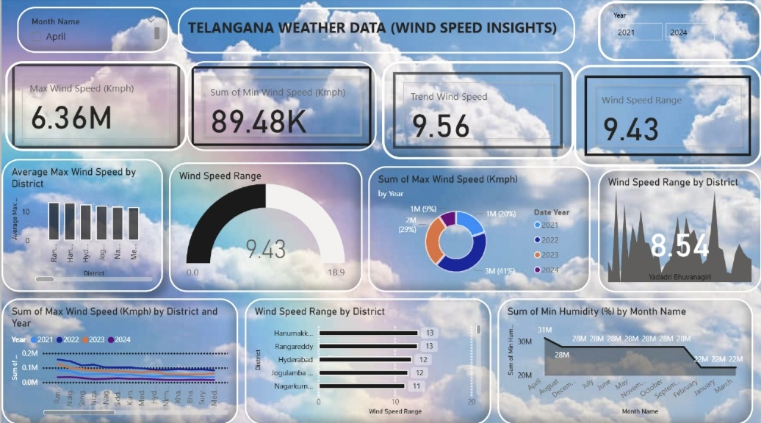

Slide 11
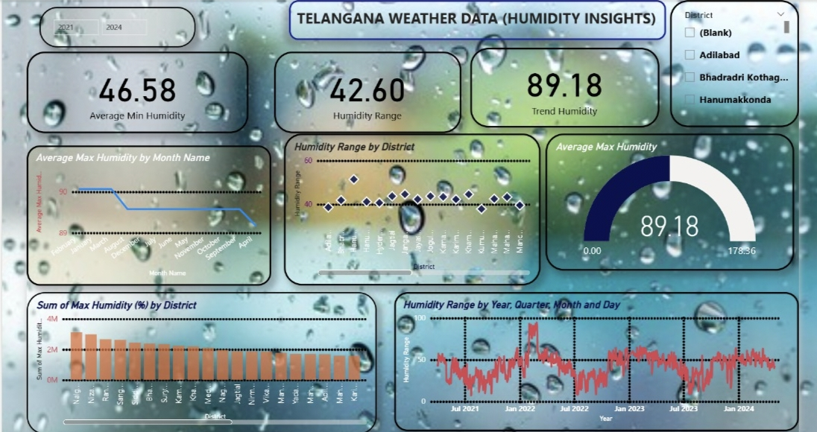

Slide 12
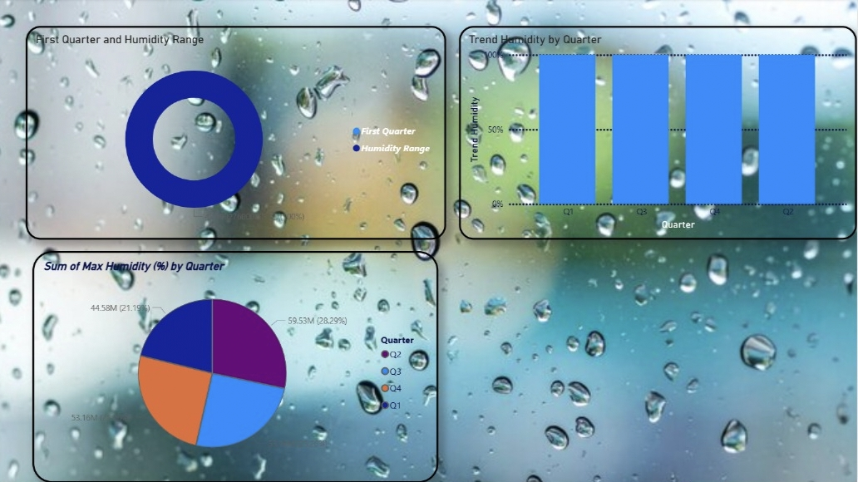

Slide 13
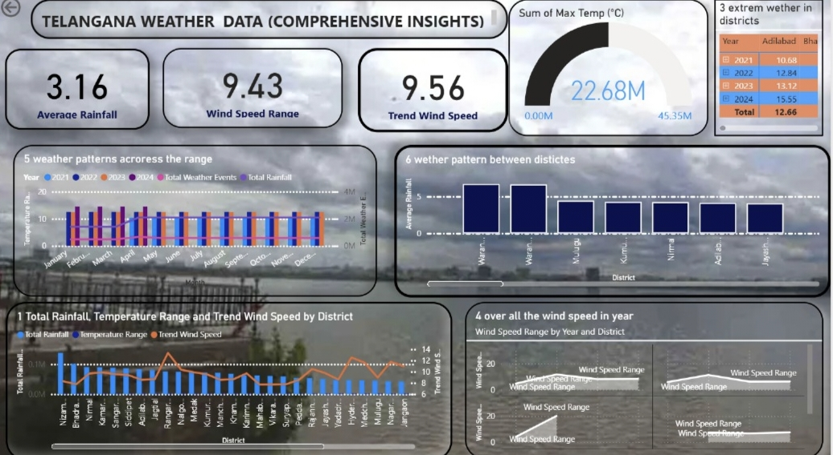

Slide 14
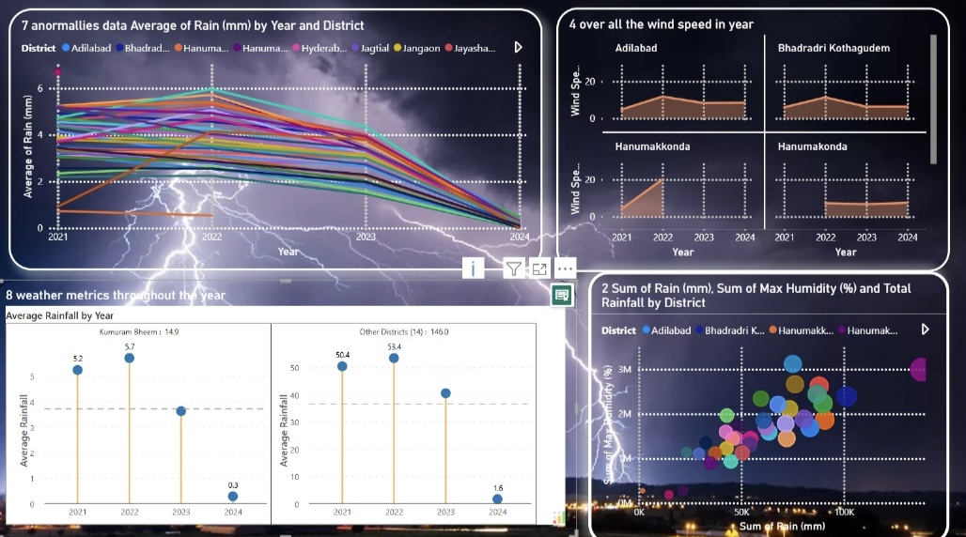

Slide 15
Applications & Recommendations
Applications:
Monitor climate trends to assist agricultural planning and water management.
Identify extreme weather patterns and rainfall anomalies for risk mitigation.
Support regional policy decisions with district-level data-driven insights.
Track humidity and wind patterns to forecast monsoon intensity and duration.
Recommendations:
Integrate with real-time meteorological APIs for live updates.
Extend analysis to predictive weather modeling using AI/ML.
Use automated alerts for rainfall deviations and extreme temperature conditions.
Visualize seasonal climate shifts for better resource allocation.

Slide 16
Conclusion & Q&A
The Telangana Weather Data Analysis project effectively visualizes multi-year climatic trends and district-level variations using Power BI dashboards.\
It demonstrates the potential of data visualization in environmental analytics, enabling proactive planning and decision-making.
Future enhancements can include predictive forecasting and real-time data dashboards for continuous monitoring.

Slide 17
THANK YOU

