Slide 1
SXSW Event’s Sentiment Analysis

Slide 2
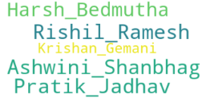
Team Machine

Slide 3

Problem Statement
Twitter has now become a useful way to build one's business as it helps in giving the brand a voice and a personality.
Identifying the sentiments about the product/brand can help the business take better actions.
If the tweet expressed positive, negative, or no emotion towards a product/brand and labelled accordingly.

Slide 4


Slide 5


Slide 6
Let the data speak
Data Distribution
What are the most common words in the entire dataset?
What are the most common words in the dataset for negative, positive, neutral and can’t tell tweets, respectively?
How many hashtags are there in a tweet?
Which trends are associated with our dataset?
Which trends are associated with either of the sentiments? Are they compatible with the sentiments?

Slide 7
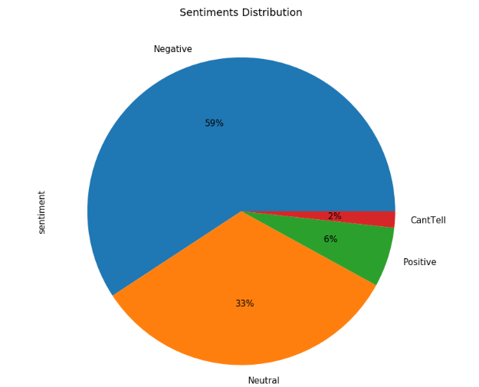
Train
Data

Slide 8
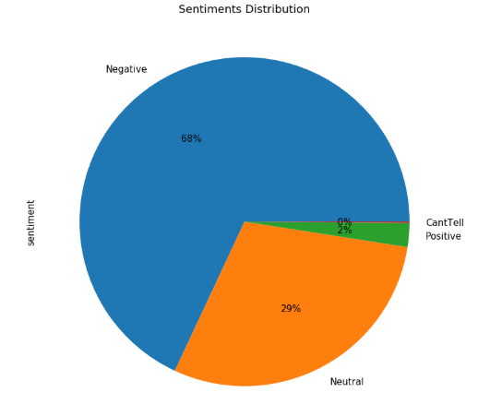
Test Data

Slide 9
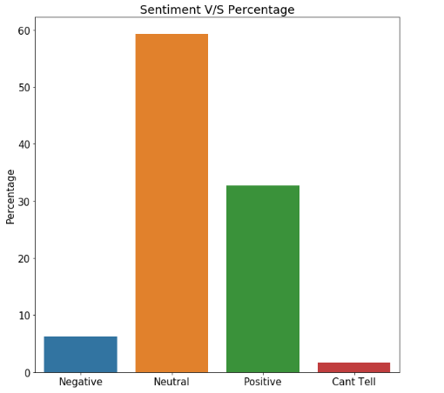
Train Data Distribution

Slide 10
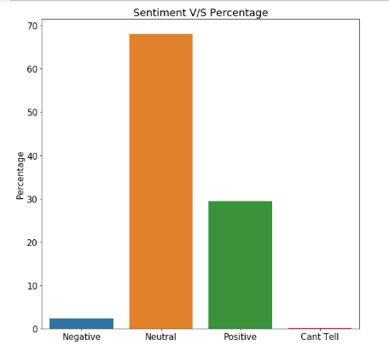
Test Data Distribution

Slide 11
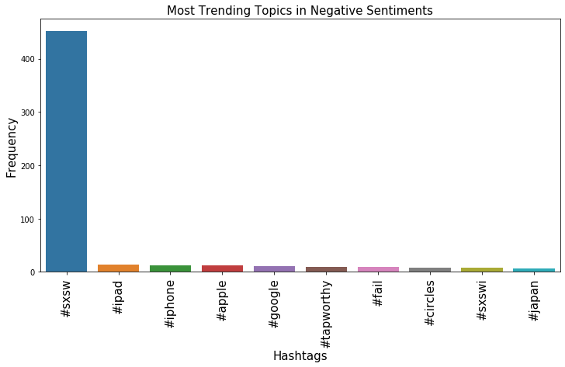
Trending Topics - Negative

Slide 12
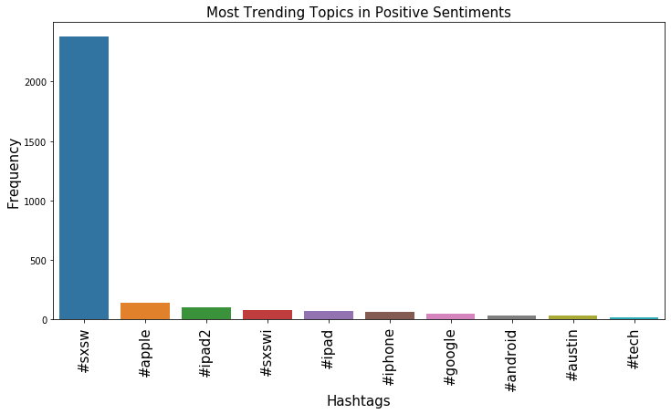
Trending Topics - Positive

Slide 13
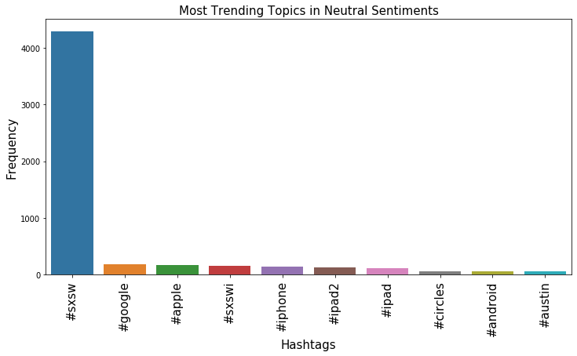
Trending Topics - Neutral

Slide 14
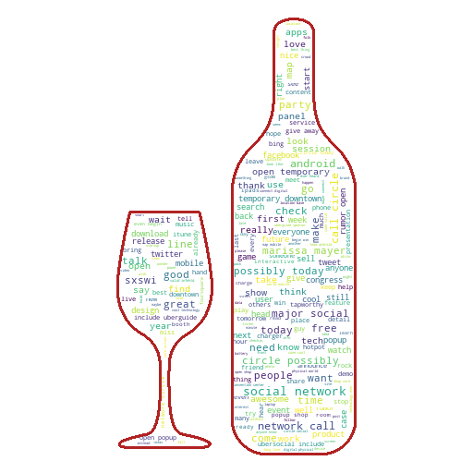
All Words

Slide 15
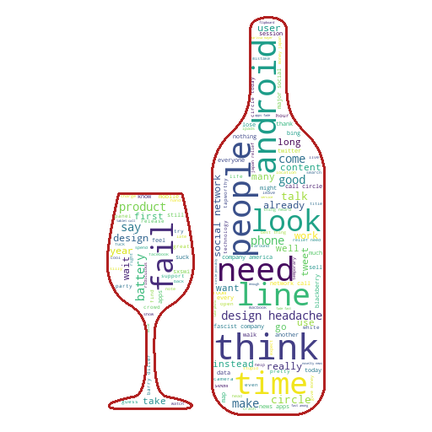
Negative Words

Slide 16
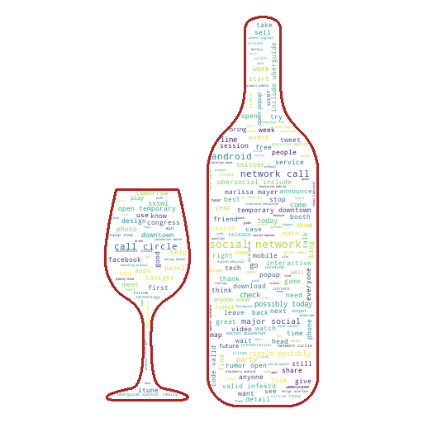
Neutral Words

Slide 17
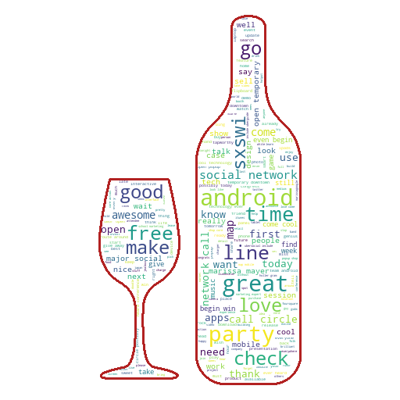
Positive Words

Slide 18
StakeHolders
Business analysts
Product managers
Customer support directors
Human resources
Event Organizers

Slide 19
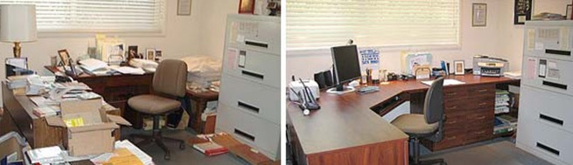
Data Preprocessing & Cleaning

Slide 20
Data Preprocessing:
Lowercase
HTML Parser
Removing punctuations,tags
Tokenization
Removing Stopwords
Common and Rare Words Removal
Spell Correction
Stemming/Lemmatization

Slide 21
Data Preprocessing:
Why data preprocessing?
Lot of noisy, irrelevant keywords in our dataset.
Convert the data to input format for our sentiment analysis tools.
Removed all the rare words where count = 1
Techniques for preprocessing:
Remove URLs, user handles
Language detection to discard tweets in english
Removing numbers, punctuations, emojis, etc.
Filter for tweets related to sentiment positive or negative

Slide 22
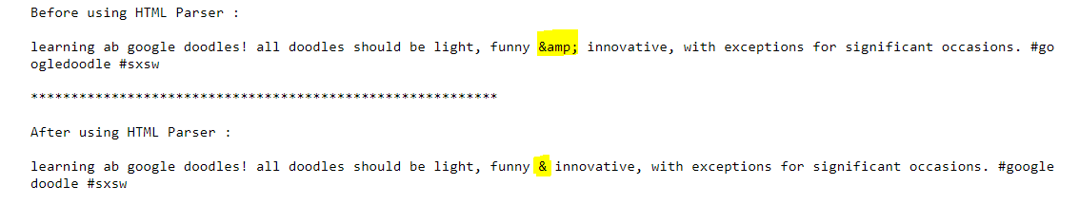
HTML Parser

Slide 23
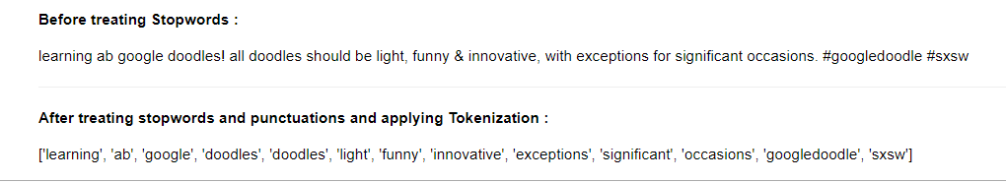
Tokenization & Stopwords

Slide 24
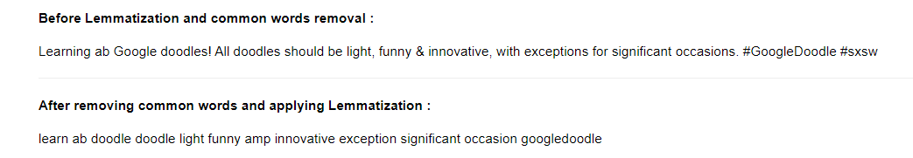
Lemmatization

Slide 25
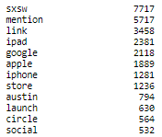
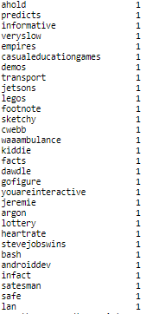
Common Words / Rare Words

Slide 26
Feature Extraction
Methods used for Vectorizing:
Bag of Words/ Count Vectorization
TF-IDF

Slide 27
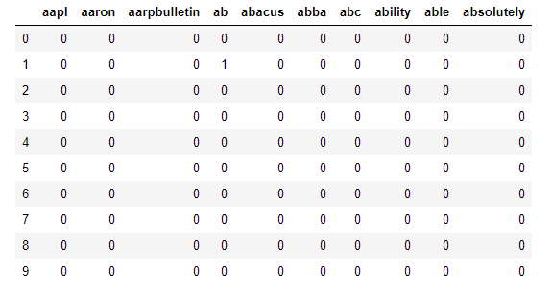
Count Vectorization

Slide 28
ML Models
Logistic Regression
We used Logistic Regression as our vanilla model to try out as it generally accepted as a good starter algorithm for text related classification
Naive Bayes Classifier
It belongs to family of simple ‘Probabilistic classifiers” algorithm based on applying Bayes Theorem. It is used for text classification having discrete features. It works well with integer feature counts.
Random Forest
It is an ensemble learning method for classification, regression tasks that operate by constructing a multitude of decision trees at training time and outputting the class that is the mode of the classes or mean prediction of the individual trees.

Slide 29
Models & Approaches
Steps | Logistic Regression | Naive Bayes Classifier | Random Forest
Bag of Words | 0.6420 | 0.6204 | 0.6345
TF-IDF | 0.6178 | 0.5589 | 0.6289
Remove Rare words | 0.6056 | 0.7430 | 0.6083
Models

Slide 30
Models Result on Test Data
Steps | Logistic Regression | Naive Bayes Classifier | Random Forest
Bag of Words | 0.58 | 0.65 | 0.61
Removing Rare words | 0.67 | 0.65 | 0.63
Models

Slide 31
Insights
Most of the tweets were:-
Neutral - 1266 - 70%
Positive - 506 - 27.45%
Negative - 46 - 2.5%
Can’t tell - 1 - 0.05%
69.59% have neutral views about the product
27% views are Positive with 2.5% Negative from which it’s clear that business is doing right.
Negative sentiments - Can be improved upon
Long queues
Battery life
Expensive mobile data plans
Design flaws
Missing apps

Slide 32
Things to Try
SMOTE (Imbalance)
CNN-LSTM model
Grid CV (Hyper Parameter tuning)

Slide 33





Team Machine

Slide 34

Thanks!
Team Machine

