Slide 1
Hangman
By:
Bharath V
Rishi Kumar S
Computer Science and Business System
Chennai Institute of Technology

Slide 2
Why this Project:
This programming project is designed to make use of linear recursive structures.
It also serves as an example of how to write Graphical User Interface (GUI) programs using the Model-View-Controller (MVC) pattern
At the highest level, the total Hangman game design uses a Model-View-Controller design pattern to decouple the internal workings of the game from the GUI

Slide 3
Introduction:
In this project, we have created a Hangman game with the help of the Pygame module in Python language. Basically, it is a guessing game. The player tries to guess it by suggesting letters within a certain number of guesses. If the guessed word is correct within the given limit then the player got wins. If the player selects the wrong letter then every time the wrong selection one of the body parts of the hangman will appear and thus when the guessed limit is over the player will lose the game.

Slide 4
Modules Used
pygame: It is a free and open-source cross-platform library for the development of multimedia applications like video games using Python.
sys: This module in Python provides various functions and variables that are used to manipulate different parts of the Python runtime environment.
random: Python Random module is an in-built module of Python which is used to generate random numbers.
time: The time module in python is an inbuilt module that needs to be imported when dealing with dates and times in python.

Slide 5
Importing and its uses:
Firstly, we have imported the necessary libraries. For this project, we have used “Pygame”, “random”, “time” and “sys” module.
After importing the Pygame module we initialized the module with the help of “.init()”
To set the frames per second for our window we have made use of “pygame.time.Clock()” of the “time” module.
To fulfill the most basic need to develop the game, we will use “pygame. the display.set_mode((width, height))” to create the game window

Slide 6
Working of the Game:
Initially, the value assigned to the variable is False. With the help of the “while” loop, we will process our game loop. With the help of “pygame.event.get()” we will run a loop for the events.
Since, we will need a font as well and with the help of “pygame.font.Sysfont(‘name’,’ size’)” will do so. In the game loop firstly we will render the font with the help of “.render()” and then we want the letter to be at the center of the box so for that we will use “.get_rect(center=(positions))” and after that, we will blit the font on the screen with the help of “.blit()” function.

Slide 7
Conditions:
To state the win and lose condition we will declare a winning variable initialized as true. For every letter that is not guessed, we want the win to be false and if the win is true then the message is to be displayed stating the win for the user and if it is false then the message of getting lost should be displayed.

Slide 8
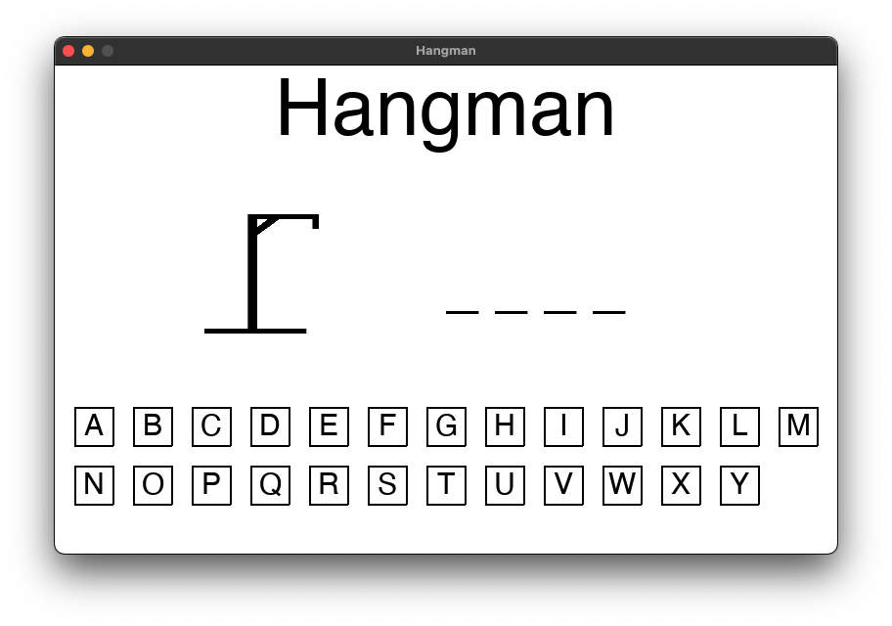
OUTPUT:

Slide 9
Conclusion:
Percentage of Times it worked without Error: 91%
No.of Day taken for Completion: approx. 3 days
Problems faced:
Setting Width and Height of the Pygame Window
Creating the images
Using the buttons

