Slide 1
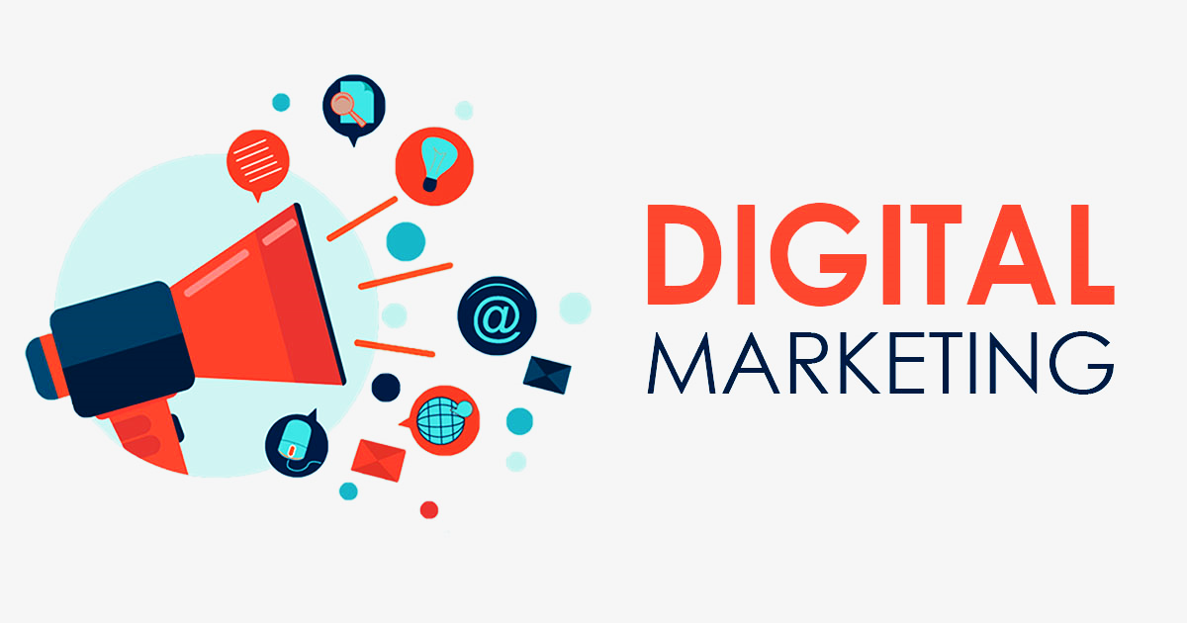
Digital Marketing Presented by Dev Sarswat (TYBCA-C-169) Faculty name: Akanksha Srivastav

Slide 2
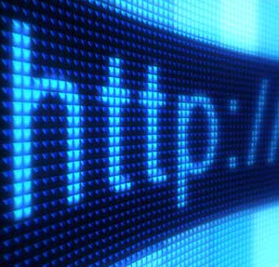
Digital Marketing Overview
Key points
What is digital marketing?
Why are people going online?
Benefits of digital marketing
What does digital marketing consist of?
Search engine optimization (SEO)
Social media Marketing (SMM)
Email Marketing
Display Advertising.
Digital marketing measurement
How digital marketing evolved
Conclusion

Slide 3
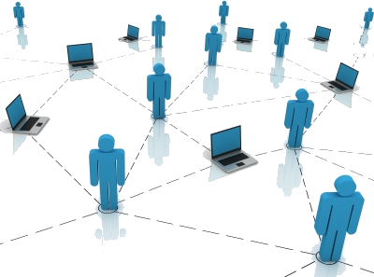
What is Digital Marketing?
Digital Marketing is the term used for the targeted, measurable, and interactive marketing of products or services using digital technologies to reach the viewers, turn them into customers, and retain them.
“Digital marketing” is the process of building and maintaining customer relationships through online activities to generate sales and/or capture customers that are searching on the Internet for answers.
Plain English: Getting found online

Slide 4

Why are people going online?

Slide 5
Why are people going online?
For information on a new product, service or location
With the constant growth of the web, and more people getting connected every day, digital marketing has become a necessity for many organizations. This also includes small businesses that want to trade online and make a name for themselves on the web.
The web is crowded with information. If you have a website, how can these people reach you? What are the benefits of digital marketing?

Slide 6
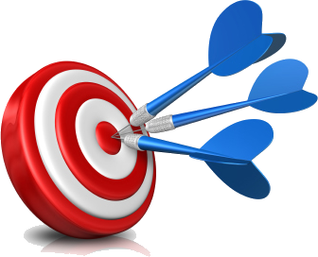
What are the benefits of Digital Marketing?
Over traditional marketing *
Puts the consumer in control
Provides convenience
Drives brand loyalty
Reduces the selling cycle
Builds your brand
It is measurable
It is cost effective

Slide 7

Digital Marketing Objectives:
One way to make sure you are found on the web is with an optimized digital marketing strategy. Most digital marketing strategies and campaigns have 5 objectives: (brainstorm)
Reach the right audience
Engage with your audience
Motivate your audience to take action
Ensure efficient spending on your campaign
Maximize return on investment (ROI)

Slide 8
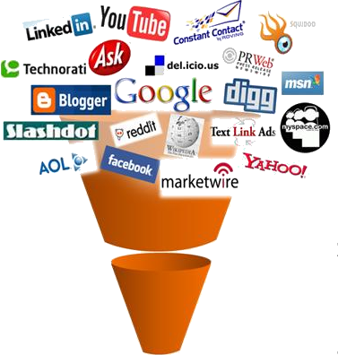
What does digital marketing consists of?
Key components
Website design (user experience)
Search engine optimization (SEO)
Pay per click (PPC)
Social media marketing (SMM)
Email marketing
Display advertising (banner ads)
Let’s look more closely at some of these key components.

Slide 9
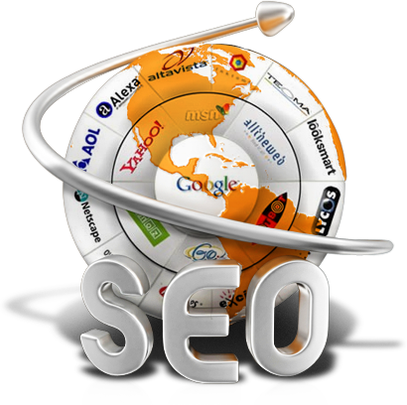
What is search engine optimization (SEO)?
SEO definition
Search engine optimization (SEO) is the process of getting traffic from the “free,” “organic,” or “natural” listings on search engines.
All major search engines such as Google, Yahoo and Bing have such results, where web pages and other content such as videos or local listings are shown and ranked based on what the search engine considers most relevant to users. Payment isn’t involved, as it is with paid search ads.

Slide 10
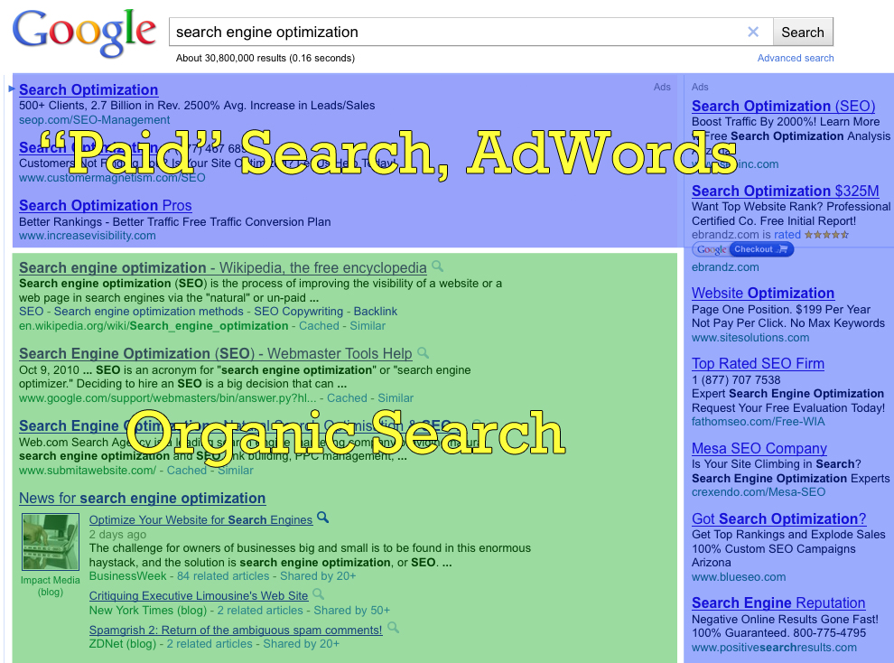

Slide 11
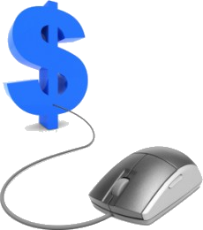
What is pay per click (PPC)?
PPC definition
Pay per click (PPC) is a type of sponsored online advertising that is used on a wide range of websites, including search engines, where the advertiser only pays if a web user clicks on their ad. Hence the title, 'pay per click'.
Advertisers place bids on keywords or phrases that they think their target audience would type in a search field when they are looking for specific goods or services.

Slide 12

Benefits of pay per click (PPC)?
Very fast
Get targeted visitors within hours (sometimes minutes)
Can yield highly profitable results
Great testing platform and can be highly targeted
Time of day
Geographic area
Keywords and phrases
Immediate feedback

Slide 13
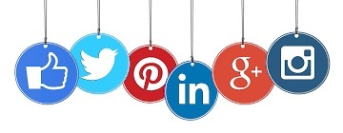
Social Media Marketing
Social Media Marketing is the manner of generating website traffic or attracting viewers and customers through social networking websites such as Facebook, Pinterest, LinkedIn, Twitter, and so on. Social media marketing is a subset of digital marketing.
All social networking websites support sharing of content, but all are not necessarily employed for digital marketing. While Facebook emphasizes on personal sharing, Twitter emphasizes on tweeting short messages about ones’ opinions or reactions, and LinkedIn goes for professional networking, Pinterest motivates to market one’s ideas and online businesses.

Slide 14
Benefits of social media marketing (SMM)?
Targeted traffic
High return on investment (ROI)
Does not require specialization or vast technical skills
Ability to go viral therefore high visibility
Cost effective (only time and effort)

Slide 15
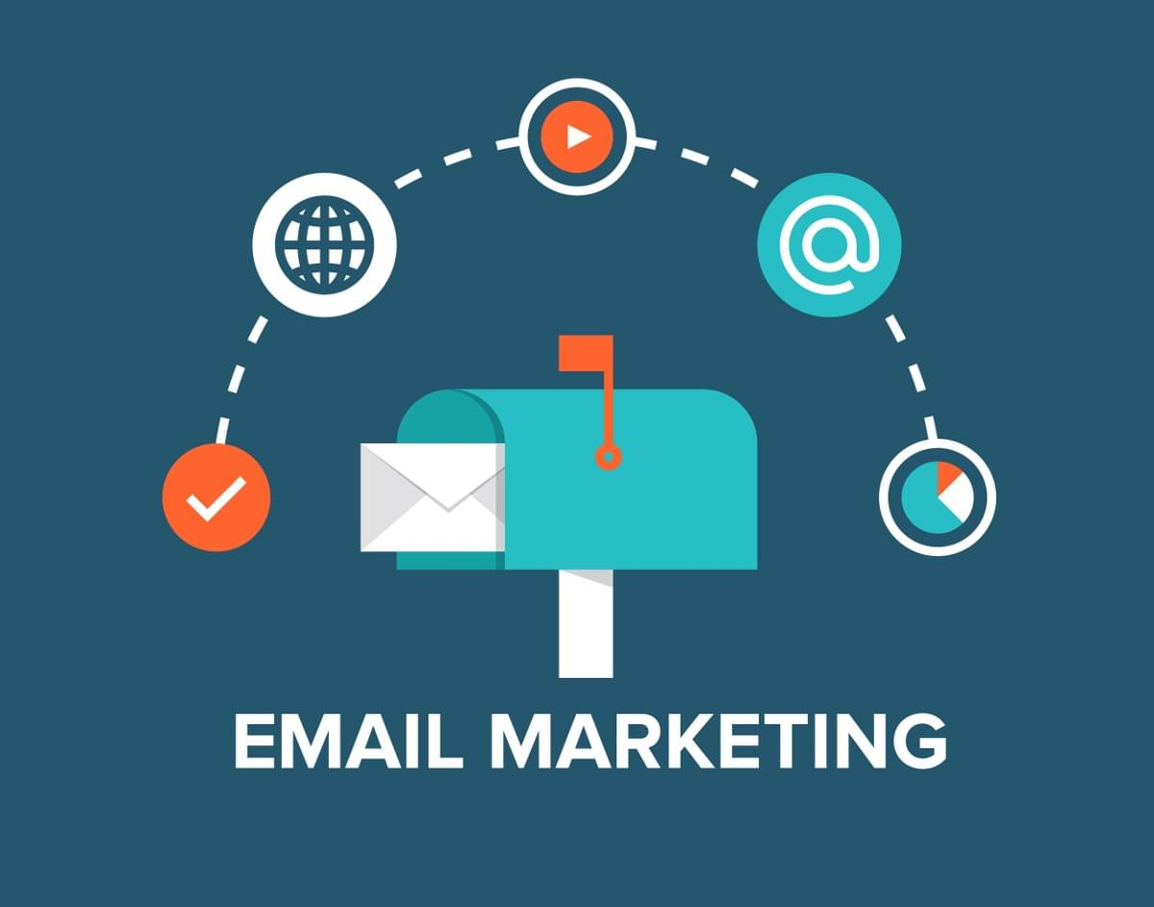
Email Marketing:
Email marketing is the act of sending a commercial message, typically to a group of people, using email.
In its broadest sense, every email sent to a potential or current customer could be considered email marketing.
It involves using email to send advertisements, request business, or solicit sales or donations.
A restaurant, for instance, might send an email to customers on their birthdays offering 50% off an entree.

Slide 16
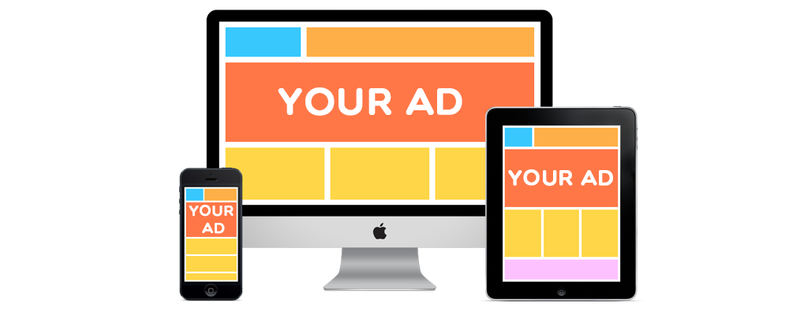
What is display advertising?
Display advertising refers to the process of advertising a product or service through visuals like images and videos on networks of publisher websites such as the Google Display Network and Facebook etc.
Display ads are placed on relevant third-party websites in the form of banner, image, and text ads.
The main purpose of display advertising is to deliver general advertisements and brand messages to site visitors

Slide 17
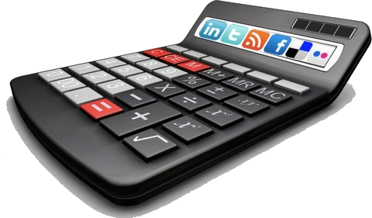
Digital marketing measurement
ROI (return on investment)
Many tools and systems are available to calculate your ROI and to measure the effectiveness of your digital marketing campaign.
ROI tools
Google analytics
Google webmasters tools
Basic google search
Google adwords
Social media monitoring tools
WHICH IS THE MOST EFFECTIVE? Find out and tell us!

Slide 18
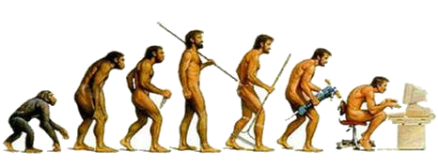
How has digital marketing evolved over the years?
Back in the day, it was all about …..
Build a website
Build links, build more links, and build even more backlinks
Hope it shows up in Google someday
Hope it displays on the results page with the right keywords (what people are typing in when they search)
It was like fishing and hoping you will get a catch.
With SEO, PPC was born – (pay per click)
Build ads around keywords and pay for everyone that clicks the ad and visits your site
Eg. Google’s Adwords (3 line ads that show up on the right/top of search engine results)
Microsoft’s Adcenter
Yahoo’s search marketing (Overture)

Slide 19
Conclusion:
Digital marketing is the future of marketing and will only keep progressing with time.
The innovations of digital marketing will stretch to both the online and offline world.
Social media is the latest way to connect with people.
It teaches us a new way of connecting to people and also helps us understand consumer behavior.
Within the short span of a lifetime, digital marketing will bring all your cherished dreams come reality. Digital marketing is a place where someone without much effort can make a career. Only patience is required to get your desired goals.

Slide 20
Reference:
YouTube.
Tutorials point.

Slide 21
Thank you.

